Slide 1

TEACHING DECK
Forces in action
Recreate the effect of balanced and unbalanced forces on an object’s motion using VR and AR.

Slide 2

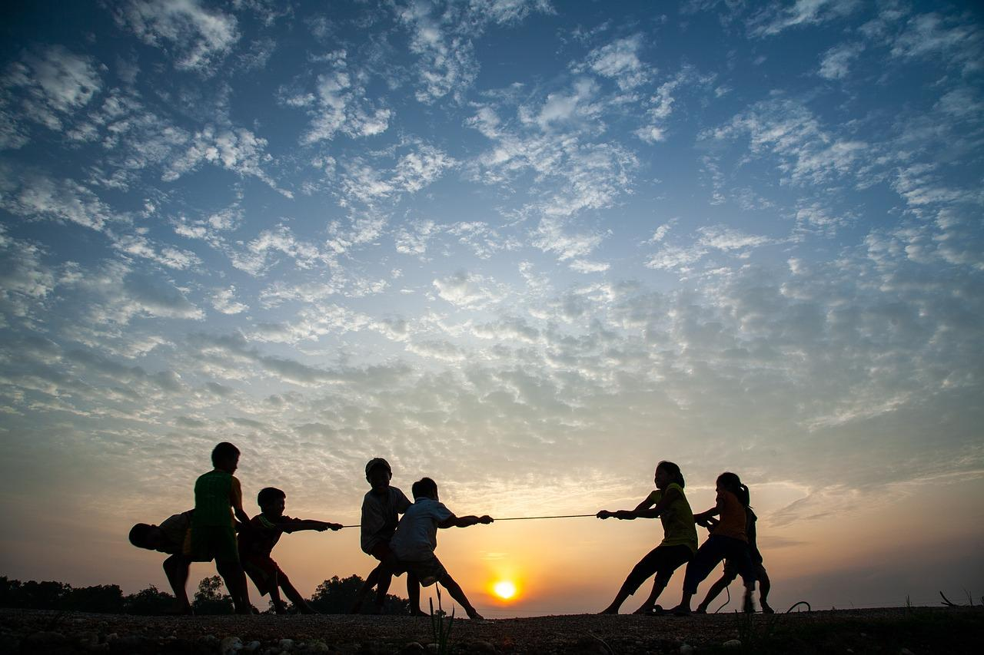
Tug-of-War
Did the rope move?
If so, in which direction?
Did one team consistently win, or did the rope stay in the middle?

Slide 3
Balanced and Unbalanced Forces
What’s the difference?
When the rope didn’t move, that is an example of a balanced force, where the forces coming from both sides of the rope were equal.
When the rope sways one way or another, it means there is an unbalanced force.

Slide 4
Think Puzzle Explore
What do you THINK you know about balanced and unbalanced forces?
What are the things that still PUZZLE you about forces?
How are you going to EXPLORE the topic of forces?

Slide 5

CoSpaces Physics
How does it Work?

Slide 6
Learning stations
Working in small groups
01
AR station
Use: Student Device / iPad / Tablet
View: AR on CoSpaces (Scan QR Codes)
Work on: Reflections template
02
HHVR station
Use: Student Device / HHVR headset
View: Plank World 360 (Scan QR Code)
Work on: Reflections template
03
Creation station: CoSpaces
Use: CoSpaces website on your laptop / iPad
Create: VR Experience showing balanced and unbalanced forces
Show: Record your finished CoSpaces experience

Slide 7
Groups
Which group are you in?
01
AR station
Write student names here
02
HHVR station
Write student names here
03
Creation station: CoSpaces
Write student names here

Slide 8
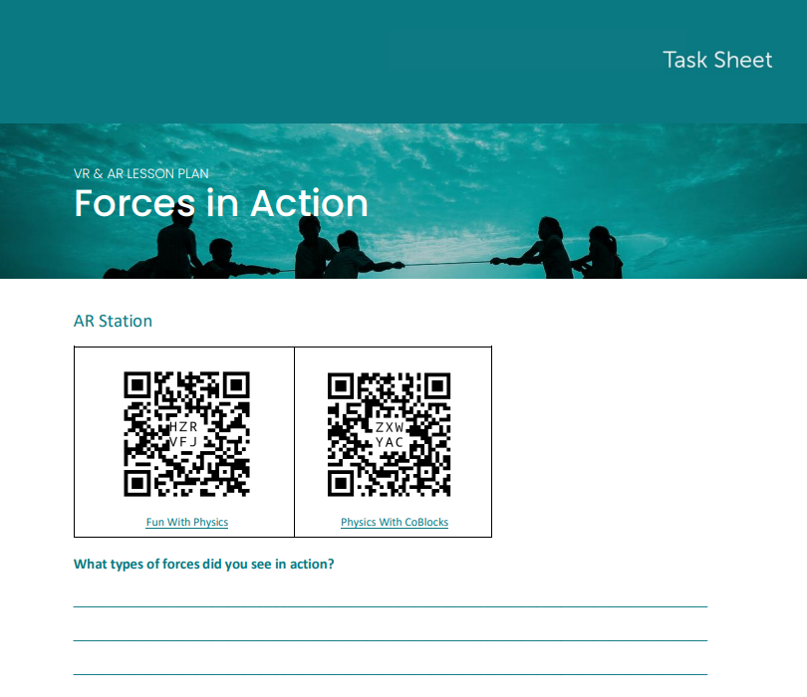
AR station
Scan the QR codes in the CoSpaces app.
View the AR experiences.
Answer the questions on your task sheet.

Slide 9
CoSpaces creation
Create a VR Experience that shows balanced and unbalanced forces.
Choose real world scenarios (moving cars, doors opening etc.)
Create 3 to 5 examples of balanced forces and 3 to 5 examples of unbalanced forces
Label your examples
Add interactive features when possible (e.g. pop-up text, quiz, etc)

Slide 10
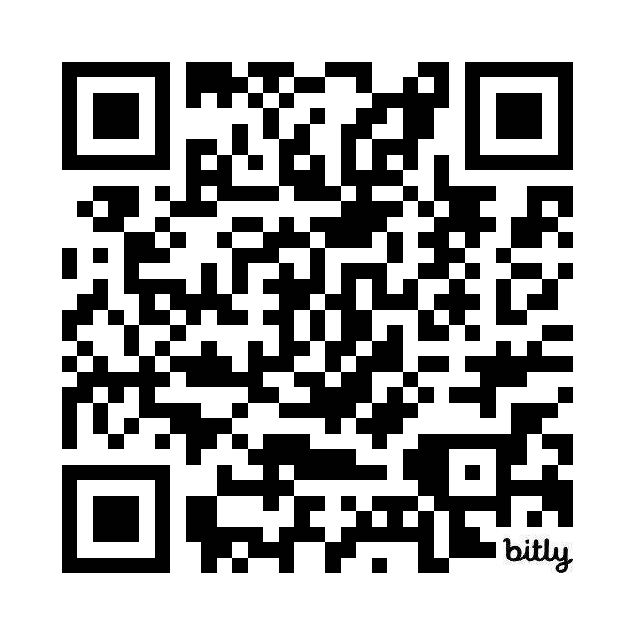
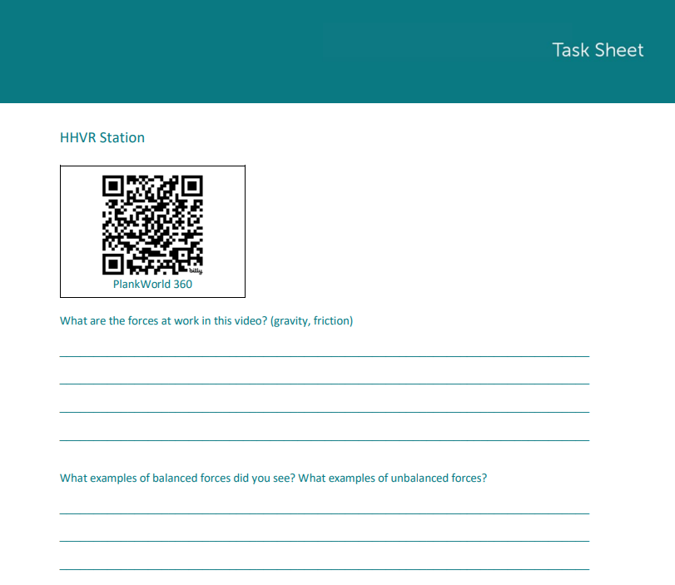
HHVR videos
Scan the QR code using your mobile device. Answer the questions after viewing.
Plank World 360’

