Slide 1

TEACHING DECK
Where in the World: Europe & North America
Learning about environments with VR

Slide 2

Your Travels
Name a place you’ve been to and share a memorable experience.
Share a place you’ve visited and a memorable experience. What made the experience memorable? Is it because you liked how it looked? How it made you feel? Or how it connected with your beliefs?
Add a photo from or drawing about that experience in this section.

Slide 3
What is environment?
Share what you know.
The environment is the total of all living and nonliving things in our surroundings that affect survival and development.
An environment can be built (cities, towns, etc) or natural (forests, beaches, rivers, etc).

Slide 4
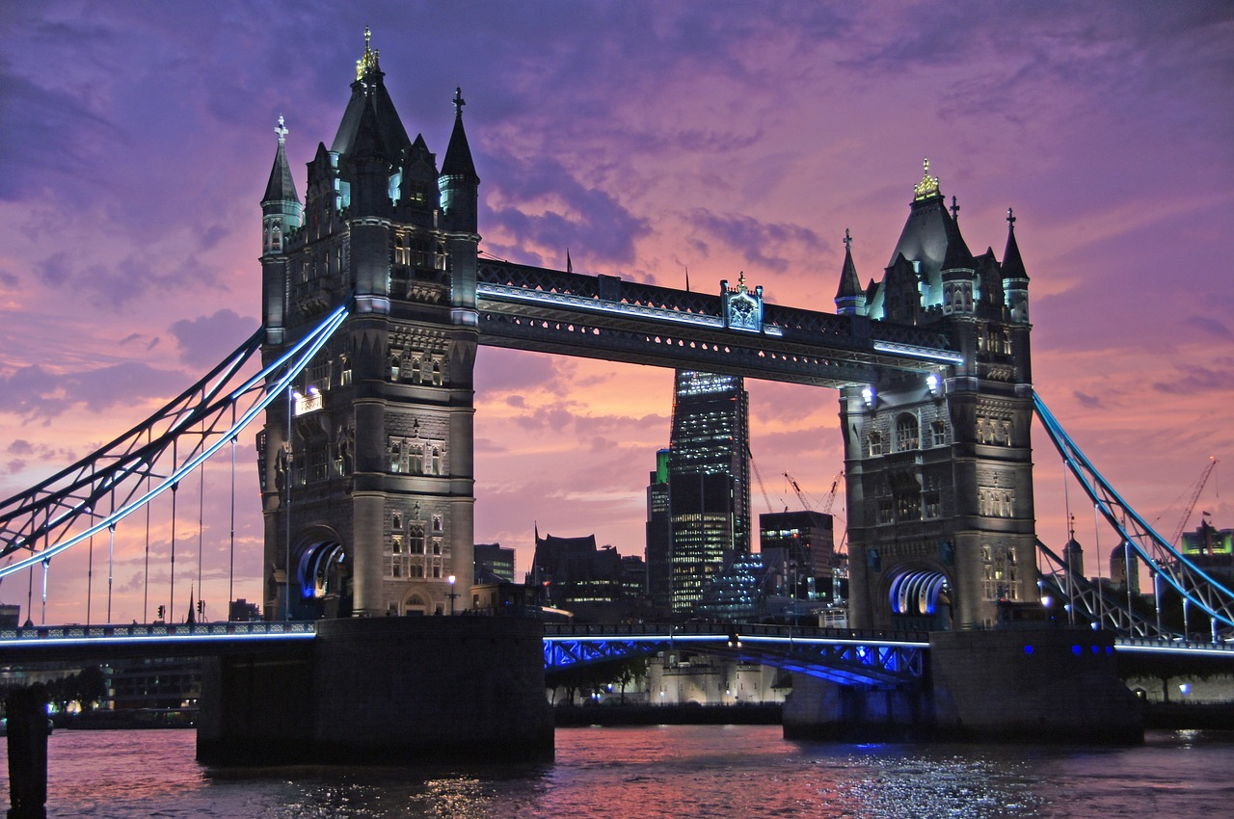
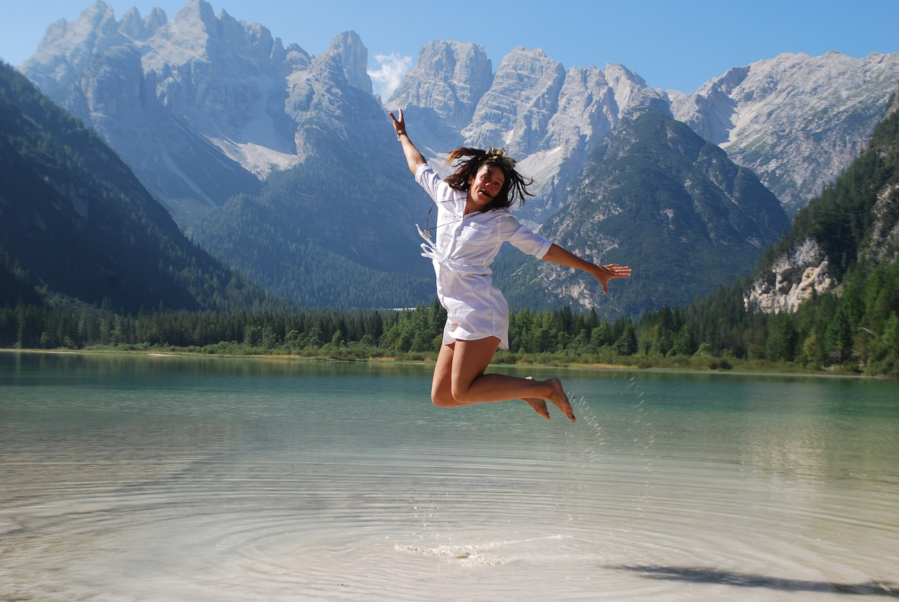
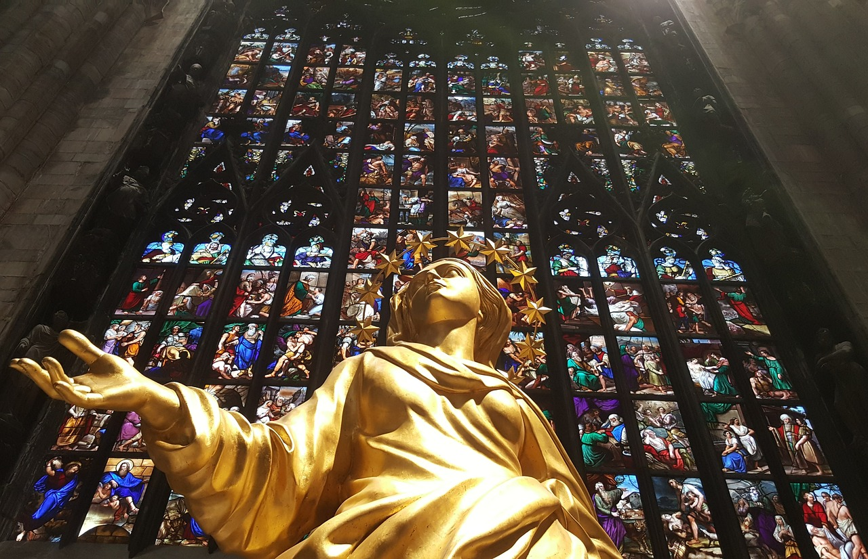
Your connection to the environment
What makes the place interesting or special to you?
Aesthetics
(How it looks)
Emotional
(How it makes you feel)
Spiritual
(How it aligns with your beliefs)
Notes:
Ask students what makes an environment important or special to them? Remind students that there are many ways an environment can be important. An environment can help humans live, play, work, and learn. However, environments and places can also be important through the way we connect with them - either through aesthetics, emotional, and spiritual.

Slide 5
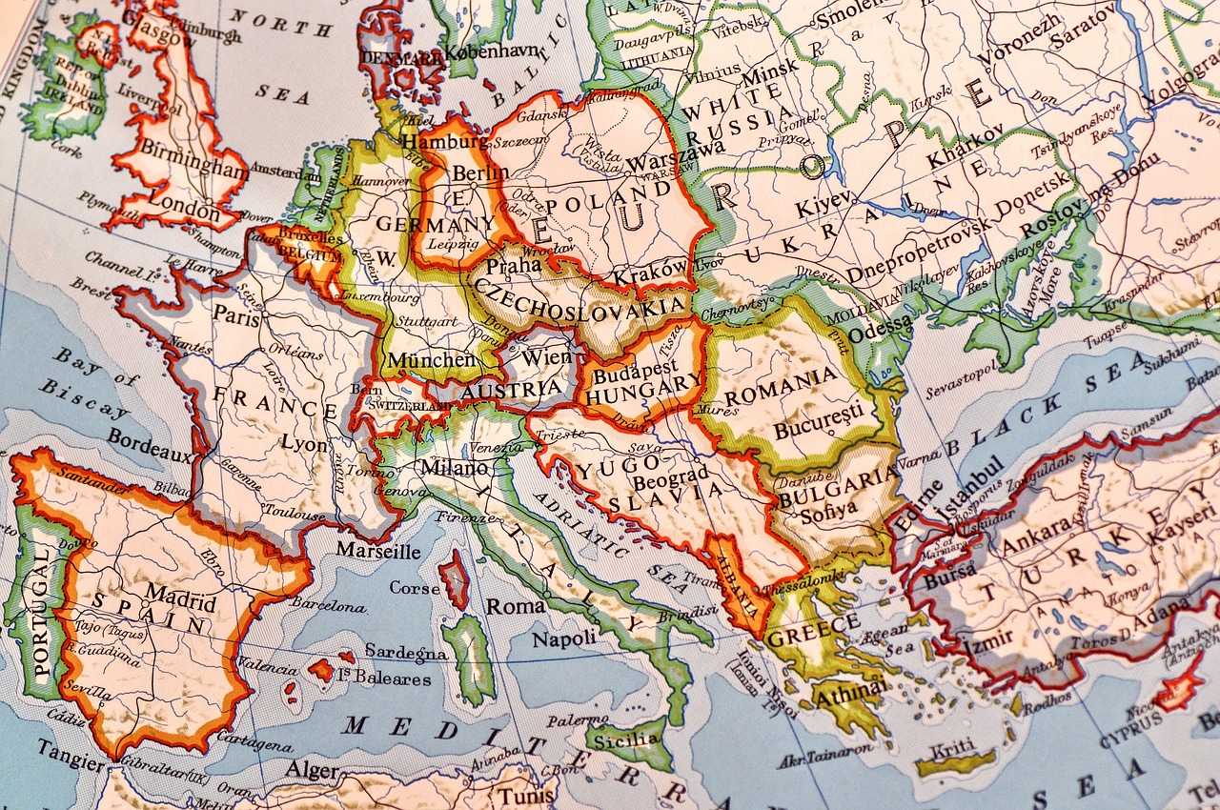
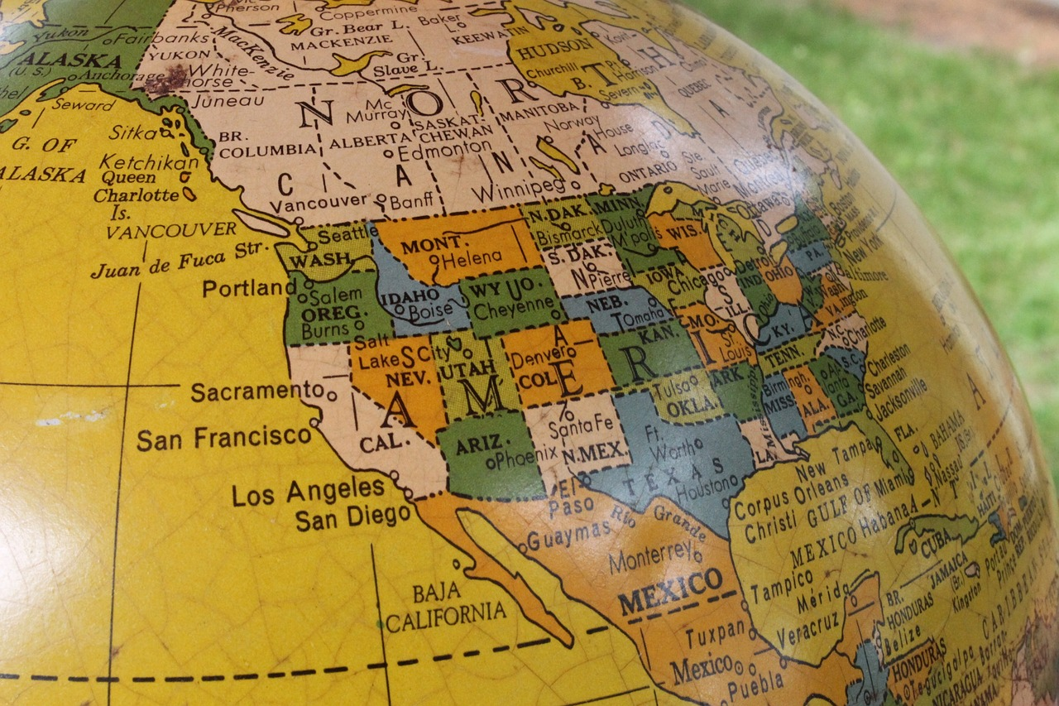
Let’s Travel the World
Which countries have you been to? What continents are they located in?
Europe
North America

Slide 6
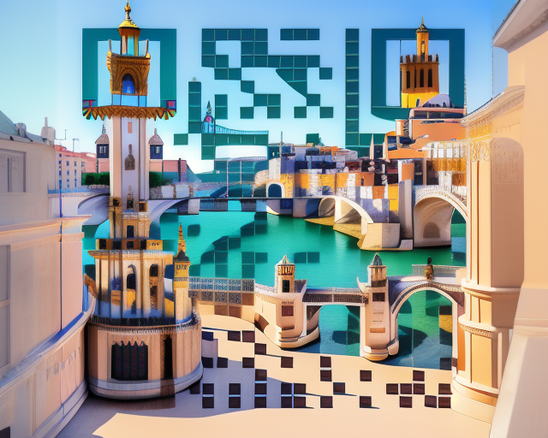
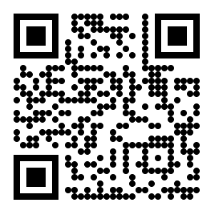
Visit Europe
Scan the QR codes using your devices.
Visit Europe https://bit.ly/4aaL1M6

Slide 7
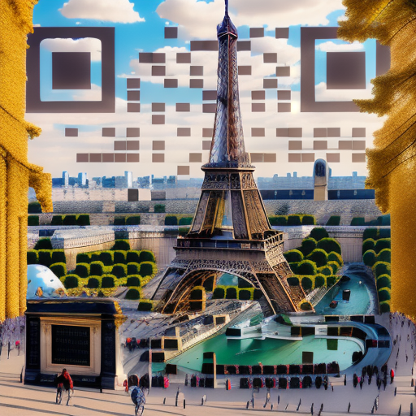
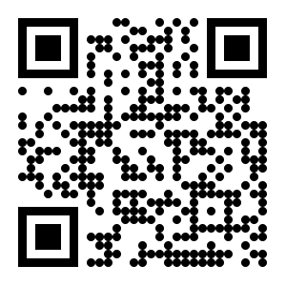
Visit Paris
Scan the QR codes using your devices.
Escape Now To Paris
https://bit.ly/47NpEyw

Slide 8
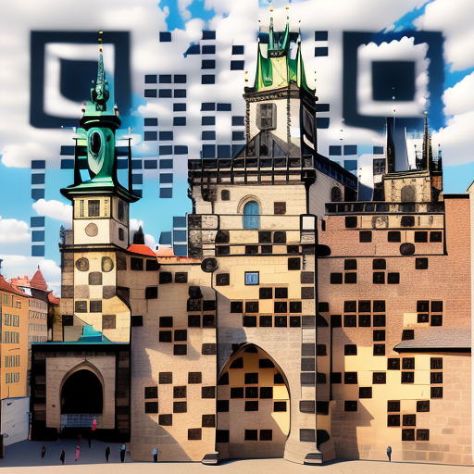
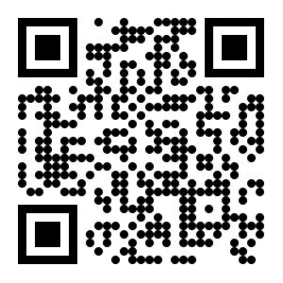
Visit Prague
Scan the QR codes using your devices.
Visit Prague
https://bit.ly/47E1irg

Slide 9
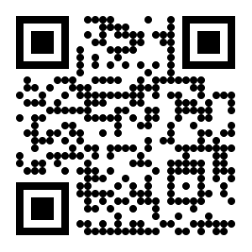
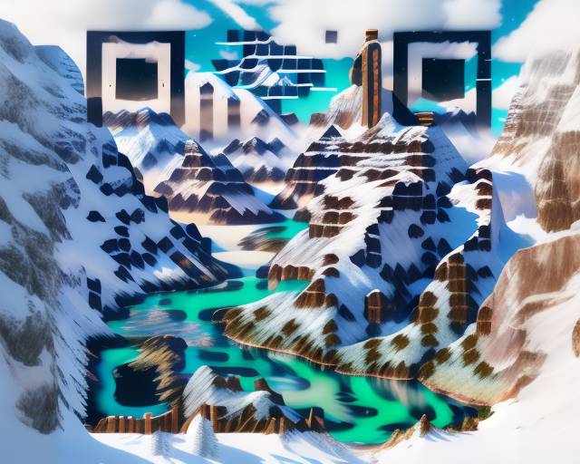
Visit North America
Scan the QR codes using your devices.
Visit North America
https://bit.ly/47Xy5qY

Slide 10
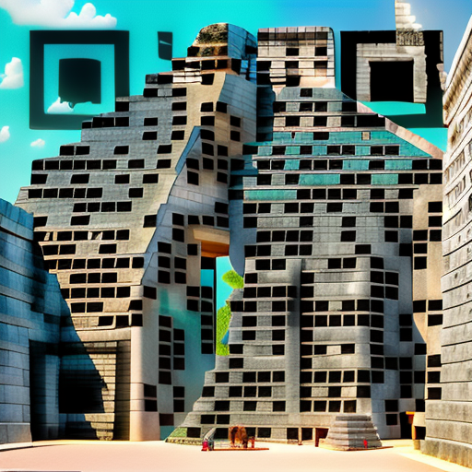
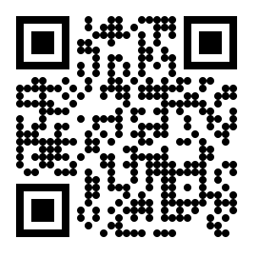
Visit Mexico
Scan the QR codes using your devices.
Visit Mexico
https://bit.ly/47NWQps

Slide 11

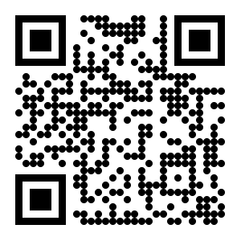
Visit New York
Scan the QR codes using your devices.
Visit New York
https://bit.ly/3Rmy4qT

