Slide 1

TEACHING DECK
Create a digital storyboard with Adobe Express
Create a digital storyboard to transform your narrative to a digital masterpiece with Adobe Express.

Slide 2


Why is storytelling important?
Stories are the fabric of human communication
They engage, inspire, and evoke emotions
From ancient myths to modern media, storytelling shapes our world
Discuss:
Do you have a favourite story?
What features make it a great story?

Slide 3
What is a digital storyboard?
Digital storytelling merges traditional narrative with multimedia elements. It's a dynamic way to captivate audiences in today's digital landscape
What is it?
Why do we use it?
How do we create it?
A digital storyboard is a visual blueprint for a story.
It organises images, text, audio, and video elements in a sequence.
Think of it as a roadmap for your storytelling journey.
They help visualise your story and organise content.
Easy collaboration: share and gather feedback effortlessly.
Enhance creativity: experiment with multimedia elements.
Translate script into a sequence of images or scenes.
Arrange multimedia elements for coherence and flow.
Experiment with animations, effects, and audio to enrich storytelling.

Slide 4
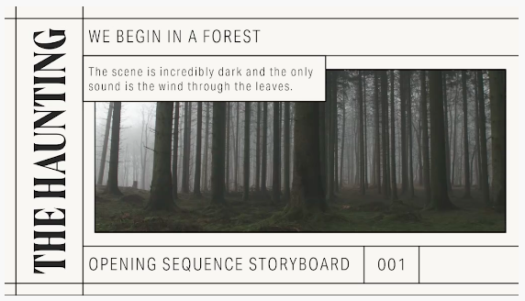
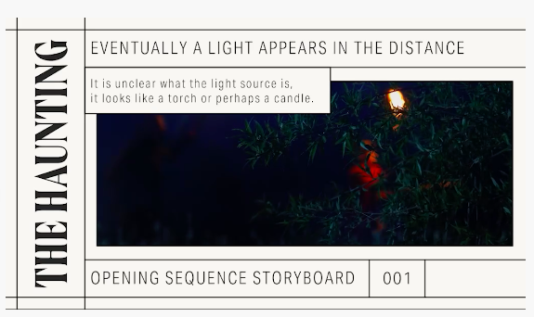
What is a digital storyboard?
Examples from Adobe Express
You can see from the screenshot of the storyboard that the heading, scene description, and image are clear and engaging.

Slide 5

Session 1 - Create your narrative
Using the planning template in your student digital notebook. You will then have time to write their short narrative in preparation for your digital storyboard. Remember the importance of including the following:
clear characters
a descriptive setting
a compelling plot
theme
Once complete share your short narratives with the class. Discuss how these stories could be enhanced with digital elements.

Slide 6
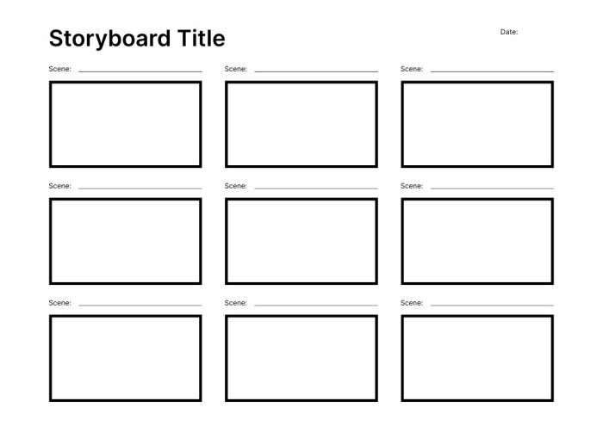
Session 1 - Convert your narrative to a storyboard template.
Convert your narrative to a storyboard to plan out how you would like to set up your digital story on Adobe Express.
You can use a template or create your own on a piece of paper.

Slide 7

Session 2 - Create your digital storyboard
Using Adobe Express - turn your narrative into a captivating digital story using the storyboard templates.
Students will now see using the teachers demonstration how to:
Add and edit text
Import pictures
Record voice overs
Apply transitions

Slide 8
Session 2 - Pair & share
Pair up and share your storyboards. Discuss the following questions:
What aspect of your partner's storyboard impressed you the most, and why? What tool from Adobe Express did they use to create this?
Can you identify any creative approaches or unique ideas in your partner's storyboard?
How does your partner's storyboard differ from yours in terms of visual style or storytelling technique?
What elements from your partner's storyboard do you think could be incorporated into your own, and how might they enhance it?
Were there any challenges or difficulties your partner faced in creating their storyboard? How did they overcome them?
What insights or new perspectives did you gain from viewing your partner's storyboard?

Slide 9
Reflection
Discuss and share :
What challenges did you encounter during the storyboard creation process, and how did you overcome them?
In what ways did the digital storyboard format enhance or influence your storytelling compared to traditional methods? Consider the advantages and limitations of using Adobe Express for creating multimedia-rich narratives and reflect on how it impacted the effectiveness of your storyboard.
Who would like to share their creations with the class?

