Slide 1


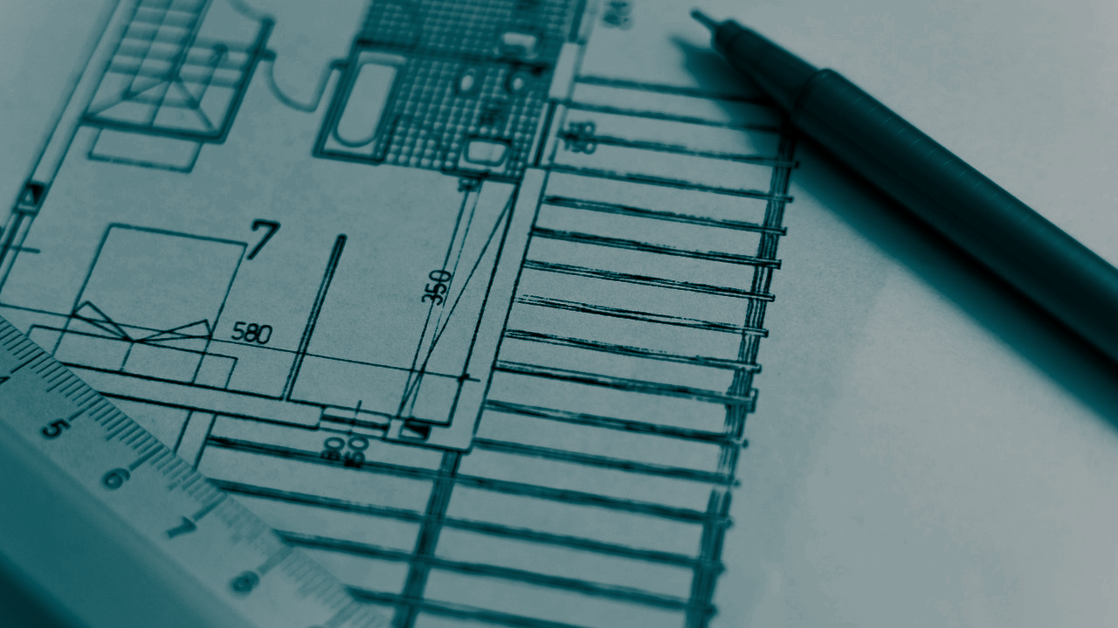
STUDENT DIGITAL NOTEBOOK
Designing for Future Impact
Student Name:

Slide 2

Community Needs Brainstorm
Identify as many community needs as you can.
Write your ideas here
Safety

Slide 3
Planning your Design
Your task is to design a solution to a chosen community need. Plan your design below before you begin.
Which community need have you decided to focus on?
Why have you chosen this?
Give a brief explanation of what you wish to design.
What materials will you use for your design?
Why have you chosen these materials?

Slide 4
Time to Sketch your Design
Make sure your design includes the following:
Detailed labels of each part
Identify the materials that are used
An appropriate scale (e.g. 1cm = 1m)
A written explanation of how your solution solves your chosen community need

Slide 5
My Final Design
Share a snapshot of your completed solution here.

Slide 6
My Final 3D Design
Share a snapshot of your completed 3D solution here.

Slide 7
Design Comparison
What are the advantages of using 3D modelling for design?
What are the disadvantages?
What are the advantages of using pencil and paper sketching for design?
What are the disadvantages?
What is your preferred method? _____________________

