Slide 1

TEACHING DECK
Urbanisation and the future
of cities
Analyse the effects of Urbanisation using VR

Slide 2

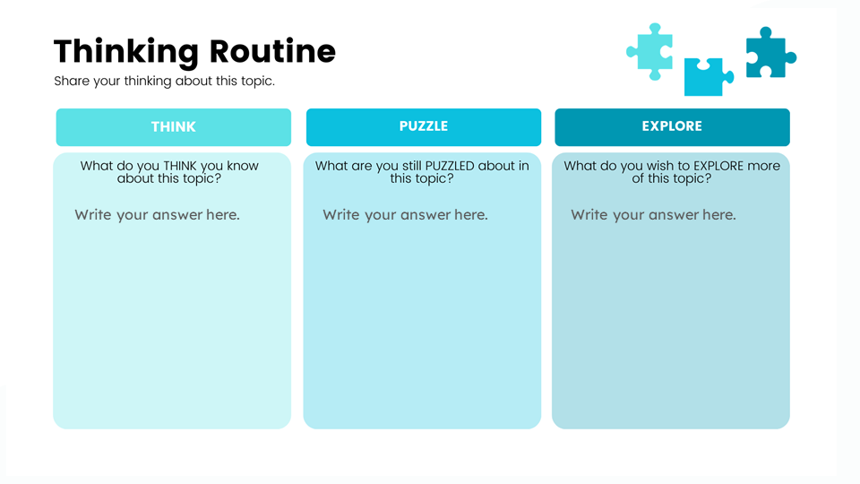
Prior Knowledge
Let’s see what you are thinking and wondering about urbanisation. Fill out the THINK, PUZZLE and EXPLORE sections of the Thinking Routine page in your student journal.

Slide 3
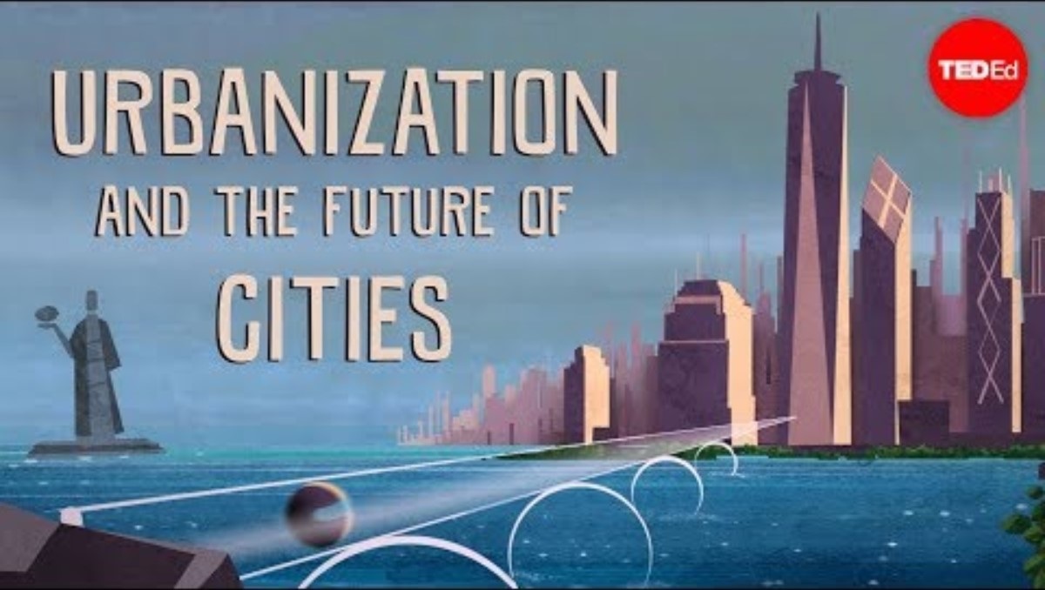
Urbanisation and the Future of Cities Video

Slide 4
Discuss
What did you learn about urbanisation?
Is urbanisation a new concept? What is its history?
Are there advantages to urbanisation? What about disadvantages?

Slide 5
Poll Time
Let’s see what the class thinks about urbanisation.
Teachers can add a link to their chosen poll website here

Slide 6
Poll Questions
What do you think of the results? Do you agree or disagree?
Why or why not?
Why do you think urbanisation is beneficial or not beneficial to society?
Do you think urbanisation is beneficial to society?

Slide 7
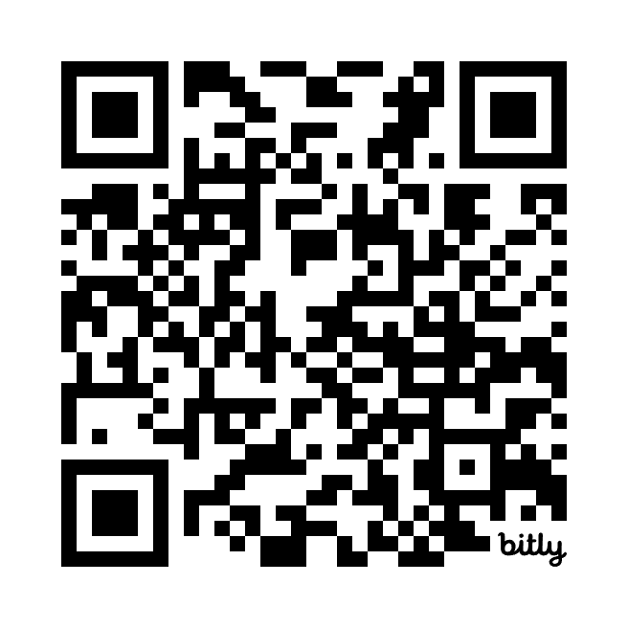

HHVR Video
Scan the QR codes using your mobile device. Complete pages 3 and 4 of your digital notebook after viewing.
How Will We Live In Tomorrow’s Cities
bit.ly/urbanisation23
Shanghai, China
bit.ly/chinavr360

