Slide 1
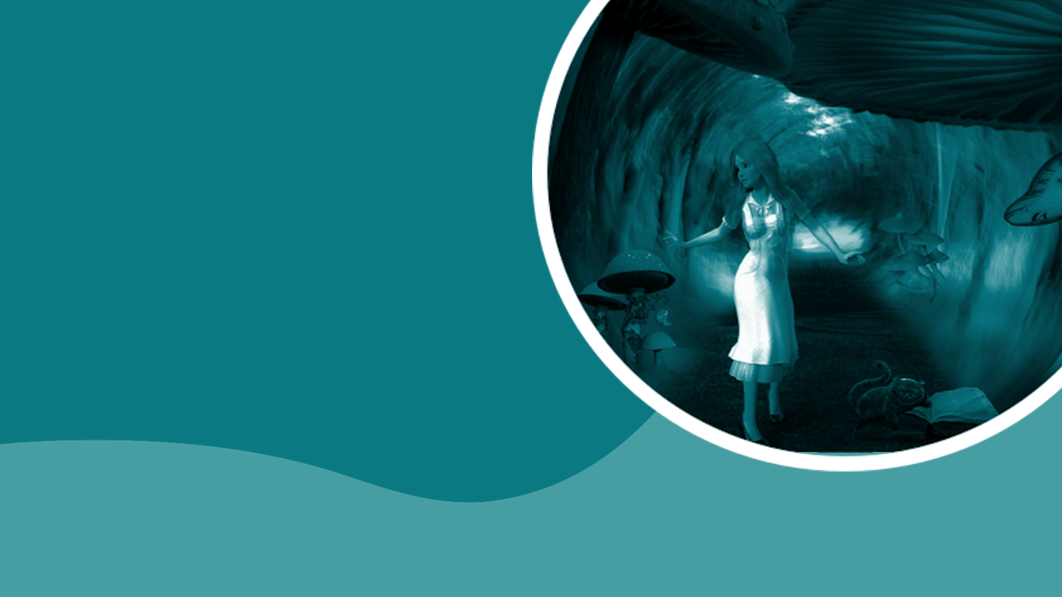
TEACHING DECK
Worlds of wonder with Alice
Exploring Alice in Wonderland in VR.

Slide 2

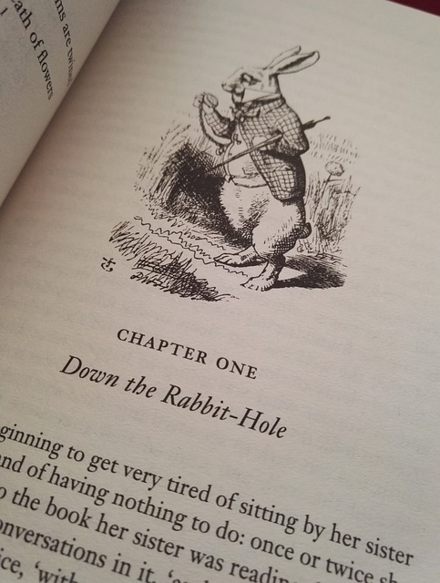
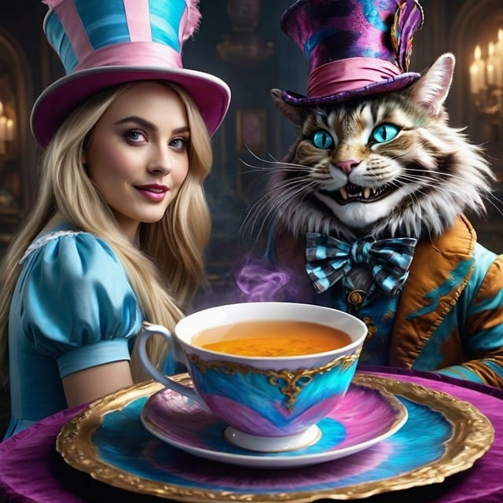
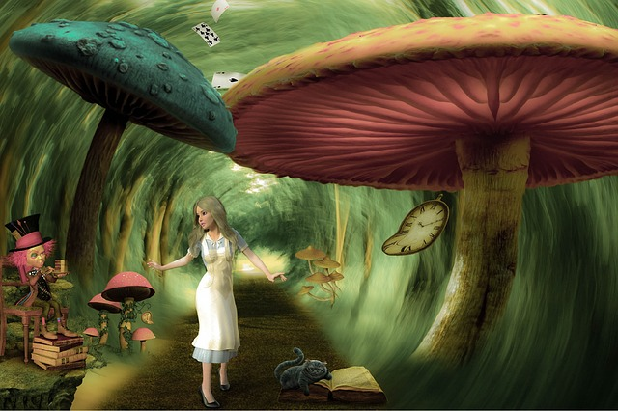
Alice in Wonderland
There’s more than one way to tell the same story.
The book
The movie
The VR experience

Slide 3
Metaphors
What are they? Give examples of metaphors related to Alice in Wonderland.
Metaphor: A figure of speech that describes something by comparing it to something else with similar qualities, without using the words "like" or "as". Metaphors create vivid imagery and draw connections that go beyond literal meanings.
Examples:
"Down the Rabbit Hole": This iconic phrase works as a metaphor for entering a strange, confusing, or disorienting situation. It doesn't mean literally falling down a hole, but venturing somewhere unpredictable.
The White Rabbit: The White Rabbit's constant rushing and fretting about being late symbolizes a hurried, anxiety-ridden lifestyle. He's always focused on time and being somewhere else, rather than enjoying the present moment.
Can you think of anything else?

Slide 4
The story
Choose a favourite scene and answer the questions below.
How did this scene make you feel? What metaphors did you find in this scene? How can you relate this to your life or another story you may have read?

Slide 5

Your Alice in Wonderland scene
Build it in VR.
Which scene did you choose?
Write your answer here.
Why did you choose it?
Write your answer here.
How are you going to build this scene in VR? What would you like to see and experience?
Write your answer here.
Consider the following when building your VR world:
animation and movement of your characters
the elements in the world (furniture, nature, etc)
showing the metaphors in the scene
any interactive elements you can add (when something is clicked, hovered, etc).
Instructions:
Complete your brainstorm on how you would like to build your Alice in Wonderland scene in VR.
Go to cospaces.io on your laptop or tablet and log in.
Log in to the class and work on the Alice in Wonderland assignment.
Build your VR world and test them with peers.
Take a short video screen recording of your scene and add it to your digital notebook (maximum 1 minute) on page 6.
Write your reflection and add the QR code and link to your creation on page 7.

Slide 6
Alice in CoSpaces
Add your video screen recording here.

Slide 7
Alice in CoSpaces
Add your reflection and QR code + link to your CoSpace here.
Write about what your VR creation is all about. Name at least three elements from Alice in Wonderland that you’ve added in this creation (character, text, etc). Were you inspired the most by the book, the movie, or the Curious Alice VR experience? What was your inspiration about?
QR code + Link to CoSpace

Slide 8
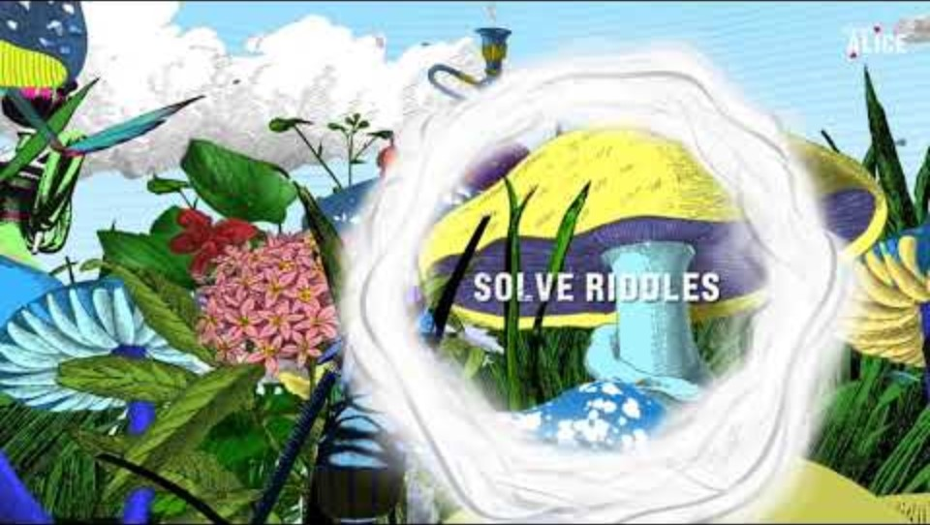
Curious Alice VR experience

Slide 9
Curious Alice VR experience
Share your reflections and ideas.
Share one activity that you’ve completed in Curious Alice. What was it about? Which part of the story do you think it was inspired by? How did your experience in VR enrich your understanding of the story?

Slide 10
Curious Alice VR experience
Group rotations on IMVR
Rotation (12 to 15 minutes per rotation) | Groups / Students
1 | Add names of students
2
3
4

