Slide 1
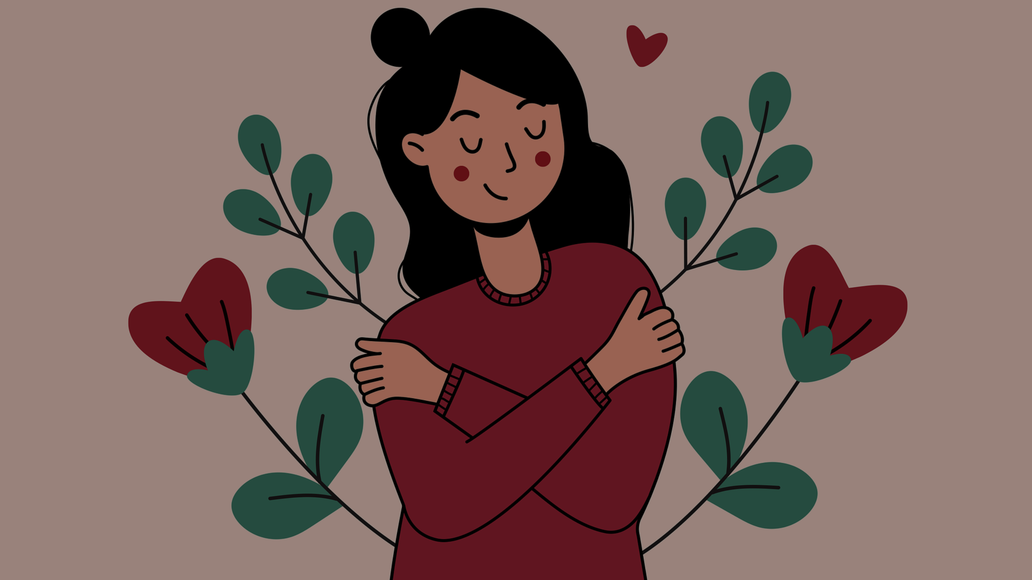

STUDENT DIGITAL NOTEBOOK
Digital Poster with Adobe Illustrator
Student Name:

Slide 2

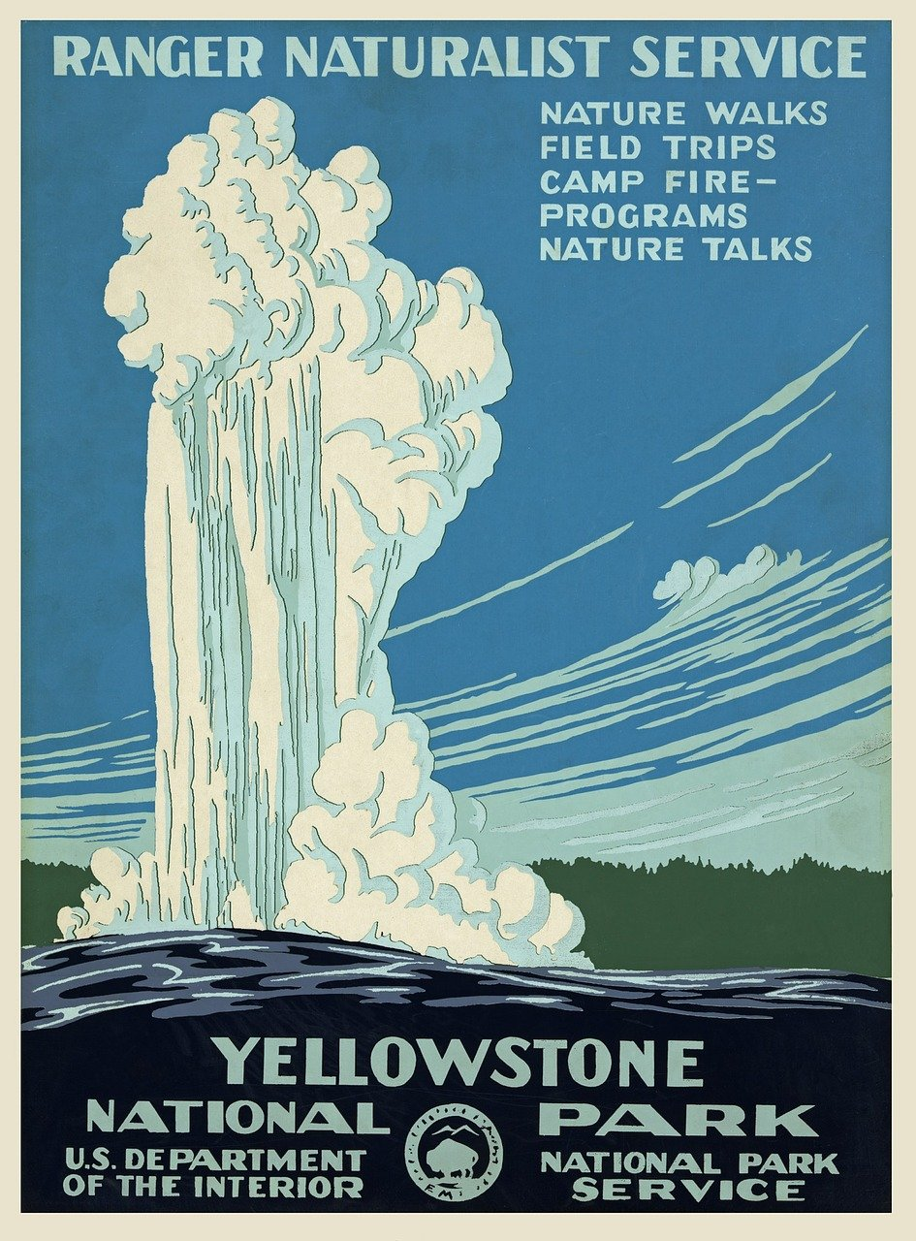

History of posters
Introduction to posters
Posters have been used for centuries to communicate information and promote events.
Early posters date back to the 19th century, used for advertisements and political messages.
The invention of lithography in 1796 revolutionised poster production, making it possible to print colorful and eye-catching designs.
Notes:
Images sourced from Pixabay

Slide 3

School Events
Finding inspiration
Discuss different school events (existing)
Discuss imagined school events (what you would like)
Notes:
Centrioles are organelles that help with cell division. They are not found in plant cells.
The image shows a labeled animal cell. The organelles that are labeled are:
Nucleus
Cytoplasm
Mitochondria
Golgi apparatus
Endoplasmic reticulum
Ribosomes
Vacuole
The nucleus is the largest organelle in the cell and it contains the cell's DNA. The cytoplasm is the jelly-like substance that fills the cell and contains the other organelles.
Mitochondria are organelles that produce energy for the cell. The Golgi apparatus is responsible for packaging and distributing proteins. The endoplasmic reticulum is responsible for synthesizing proteins. Ribosomes are organelles that produce proteins. The vacuole is a storage organelle.
Animal cells are found in all animals, from simple organisms like sponges to complex organisms like humans. They are essential for life and play a variety of roles in the body, such as providing energy, building tissues, and fighting infection.

Slide 4

Analogue poster
Create a written poster for your school event
Remember to include the following:
name of event
date
time (remember to include am/pm)
place (include the full address)
facts about the event (e.g. special activities)
Notes:
Centrioles are organelles that help with cell division. They are not found in plant cells.
The image shows a labeled animal cell. The organelles that are labeled are:
Nucleus
Cytoplasm
Mitochondria
Golgi apparatus
Endoplasmic reticulum
Ribosomes
Vacuole
The nucleus is the largest organelle in the cell and it contains the cell's DNA. The cytoplasm is the jelly-like substance that fills the cell and contains the other organelles.
Mitochondria are organelles that produce energy for the cell. The Golgi apparatus is responsible for packaging and distributing proteins. The endoplasmic reticulum is responsible for synthesizing proteins. Ribosomes are organelles that produce proteins. The vacuole is a storage organelle.
Animal cells are found in all animals, from simple organisms like sponges to complex organisms like humans. They are essential for life and play a variety of roles in the body, such as providing energy, building tissues, and fighting infection.

Slide 5

Adobe Illustrator
Creating a digital poster in Adobe Illustrator
Your task is to use Adobe Illustrator to create a digital poster based on an event you will be taking part in , or a new event you wish to create.
You will use various techniques to create your poster such as colours, layers, gradients and shapes.

Slide 6

Tutorials
There are many elements to creating your poster Watch the tutorials for more information. You can refer back to these at any time during the lesson.
How to use layers
How to create with drawing tools
Using colours and gradients
How to create and edit shapes
How to add text to designs

Slide 7

Reflecting on your event
Brainstorm how you would like advertise your event.
Think about the following:
colours
background
shapes
entice people to attend
think about the information you will
add e.g. (venue, cost, event, time etc.)

Slide 8

Brainstorm an event you would like to create your poster on
Reflecting on your event
Brainstorm in this space:
Some possible ideas may be:
sports day
swimming carnival
fundraiser
casual day

Slide 9
Creating your digital poster
Follow the steps below to create your poster on Adobe Illustrator:
5. Add Shading and Highlights: Use gradients, blends, or transparency to add shading and highlights to the poster, enhancing the three-dimensional effect. Pay attention to the direction of light in the reference image.
6. Refine and Adjust: Continuously refine the shapes, colours, and details of the poster until you are satisfied with the result. Don't hesitate to make adjustments as needed.
7. Final Touches: Add any final touches such as background elements or additional details to complete the composition.
8. Save Your Work: Once you're finished, save your vector portrait as an Adobe Illustrator (.ai) file so you can continue editing it later if needed.
Open Adobe Illustrator: Launch Adobe Illustrator on your computer.
Create New Document: Start a new document in Adobe Illustrator by selecting "File" > "New" and set the dimensions according to your preference.
Add Details: Add details such as borders, backgrounds, images, additional shapes, text boxes.
Apply Colour: Select each shape and choose a suitable fill colour from the color panel. You can sample colours directly from images using the Eyedropper Tool (I).
Note: Press the corresponding letter on the keyboard to quickly change to the desired tool.

Slide 10
Reflections
Reflect on your experience with Adobe Illustrator and answer the following:
How do you feel about the final result of your poster? Are there any aspects of it that you are particularly proud of?
What would you do differently if you were to create another poster for a different event in the future? What lessons did you learn from this experience?
How do you think creating a digital poster contributes to your understanding of digital art and design? In what ways might you apply these skills in the future?
Reflect on the importance of self-expression through art. How does creating a poster help you explore your creativity?
Place your poster here:

