Slide 1

TEACHING DECK
An Australian animals adventure in AR
Students explore and view Australian animals in Augmented Reality (AR).

Slide 2

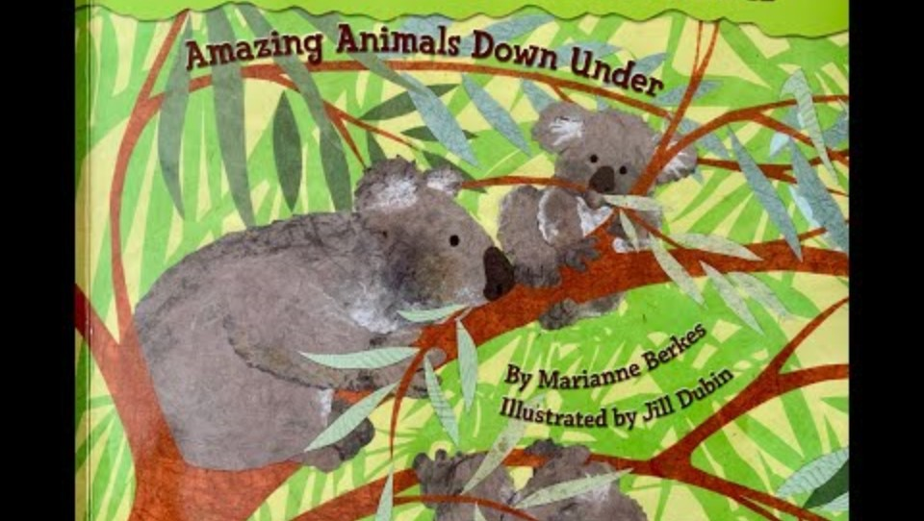
Over in Australia
Which Australian animals do you know?
What does the animal look like?
What are those features for?
Where do you think the animal lives?

Slide 3
Augmented Reality (AR)
What is it?
It is a special kind of technology that can put things that aren't really there into our world.
It uses special devices, like tablets, to show us things that look real but aren't actually there.

Slide 4

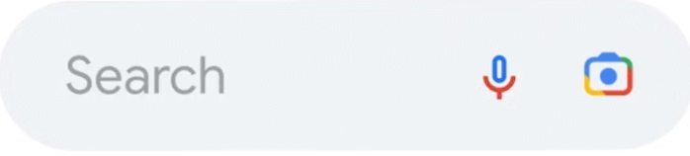
How to view in AR
1
2
3
Open Google.
Tap the search bar.
Type the animal.
Koala

Slide 5
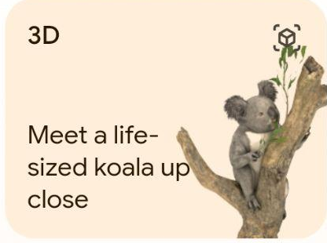
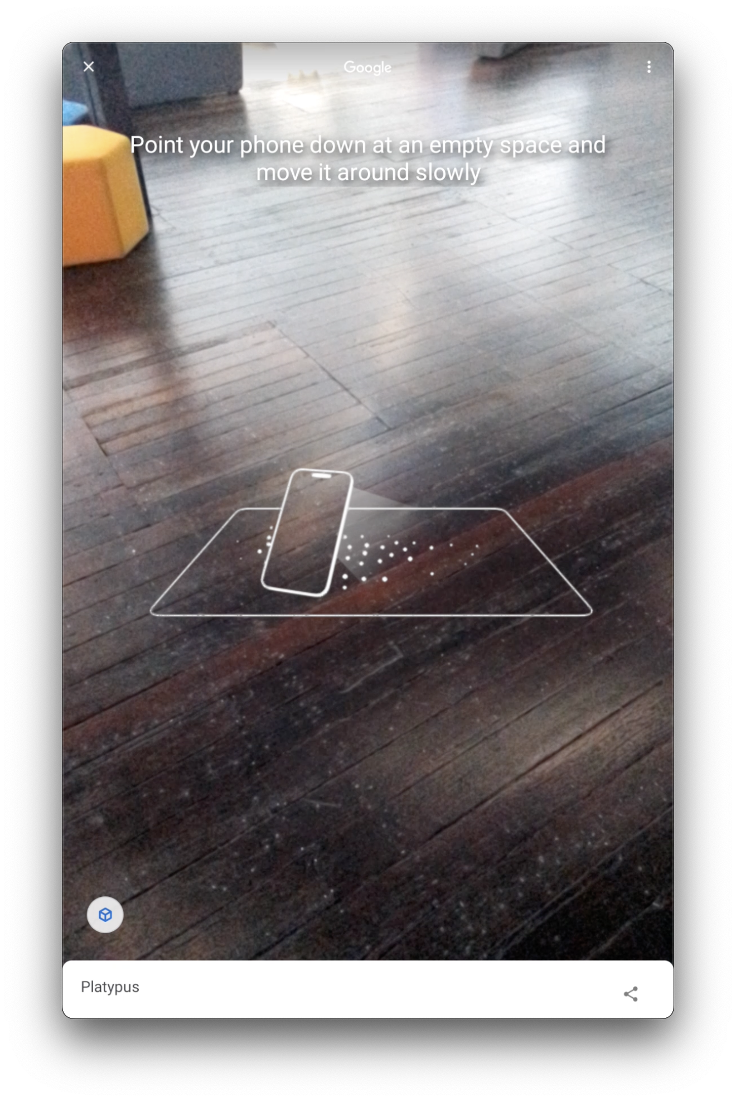
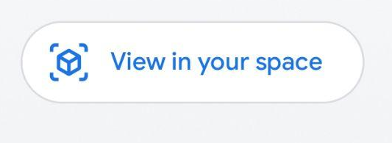
How to view in AR
4
5
6
Find the 3D button.
Tap ‘view in your space’.
Point the device at the floor and move it around.

Slide 6





Animal features
Word Mat
Ears
Nose
Claws
Feet
Tail

Slide 7
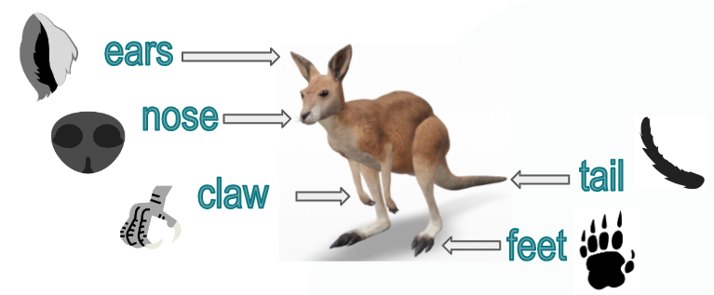
Animal features
What did you see?
Animal | Features | Purpose | Habitat
koala
kangaroo
wombat
emu

Slide 8
Animal features
What did you see?
Animal | Features | Purpose | Habitat
kookaburra
platypus
quokka
echidna

