Slide 1

TEACHING DECK
Capturing a 360° view
Using 360° cameras as a peripheral device.

Slide 2


Peripheral Devices
What are they?

Slide 3
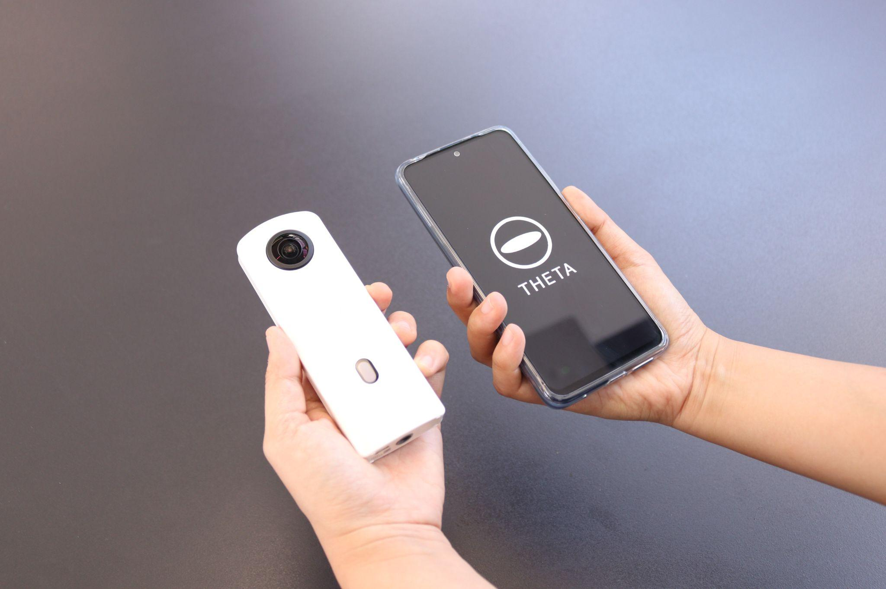
Peripheral Device Focus
The 360° Camera

Slide 4
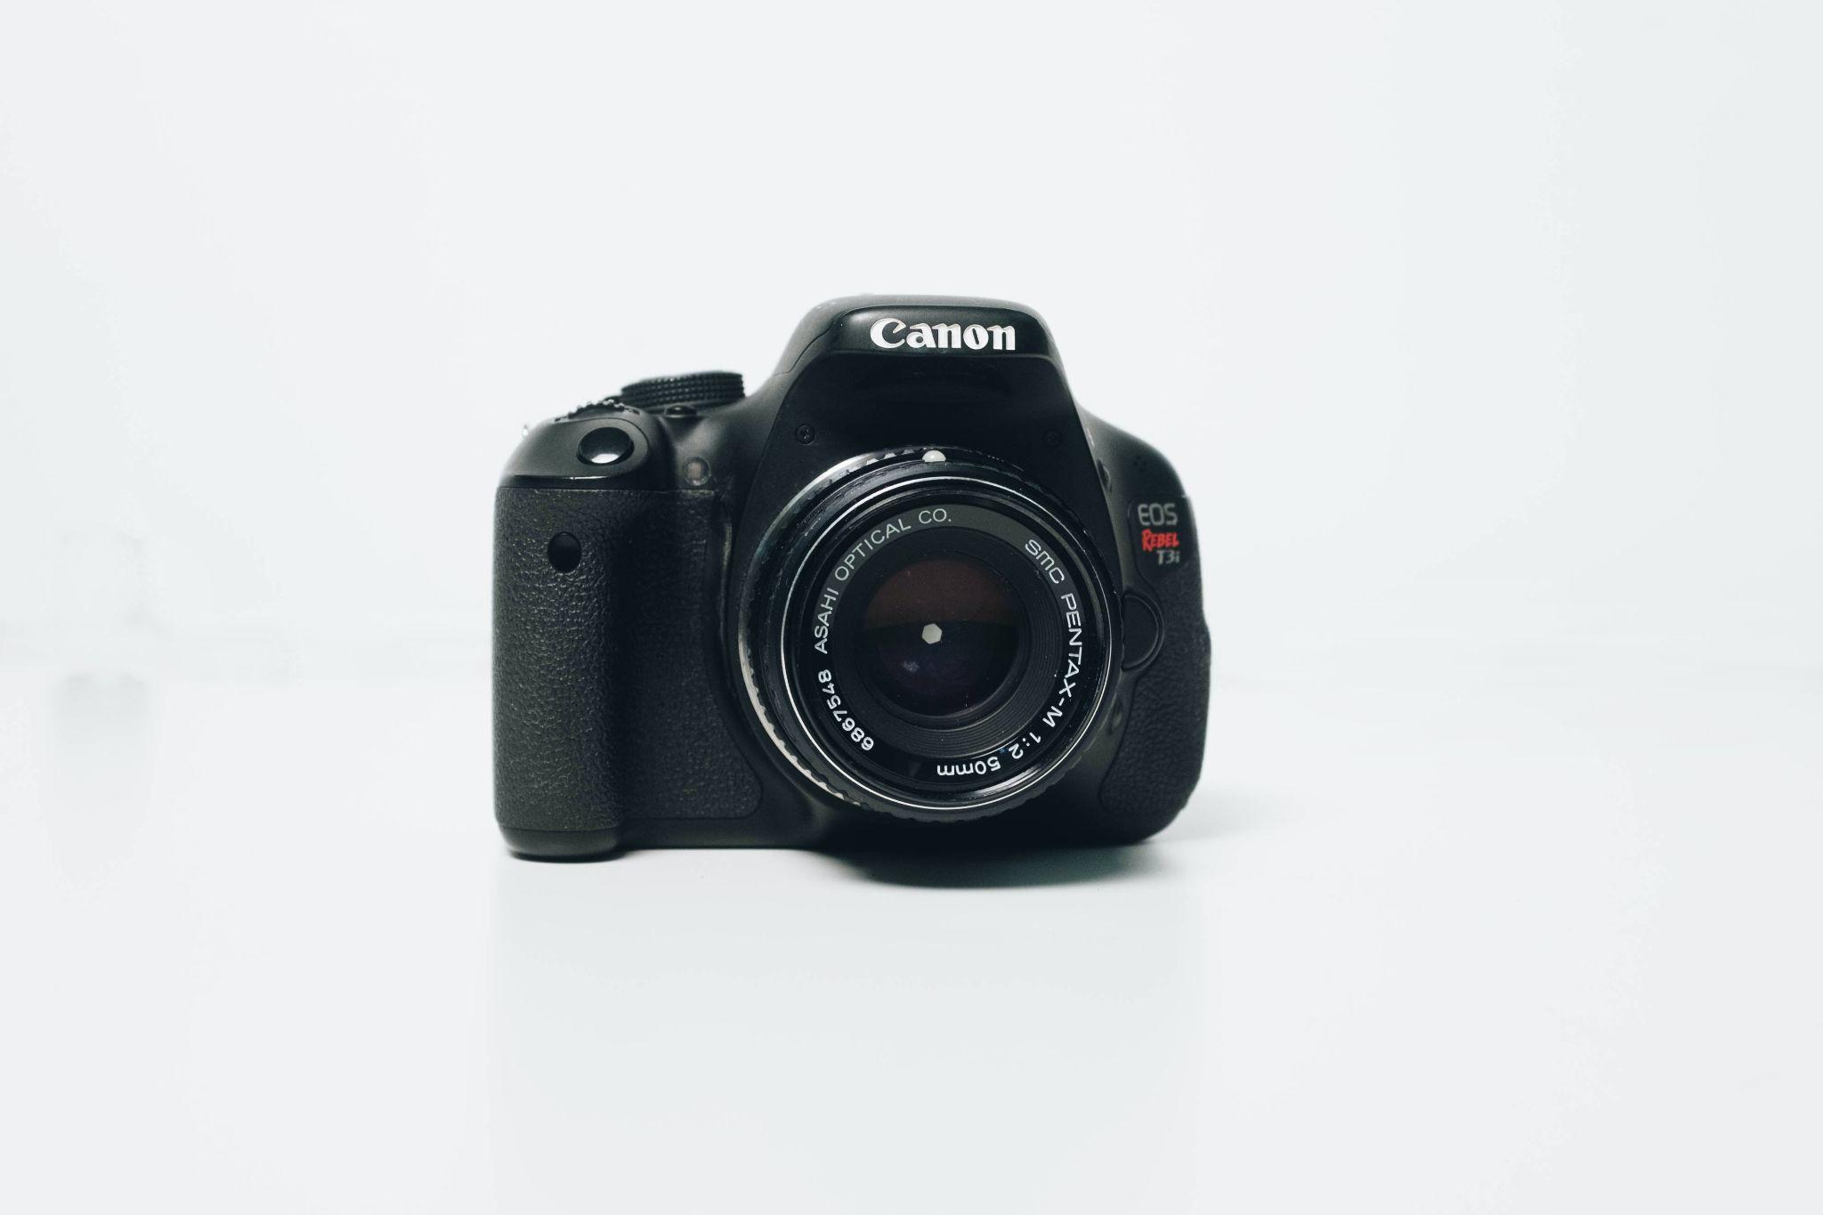
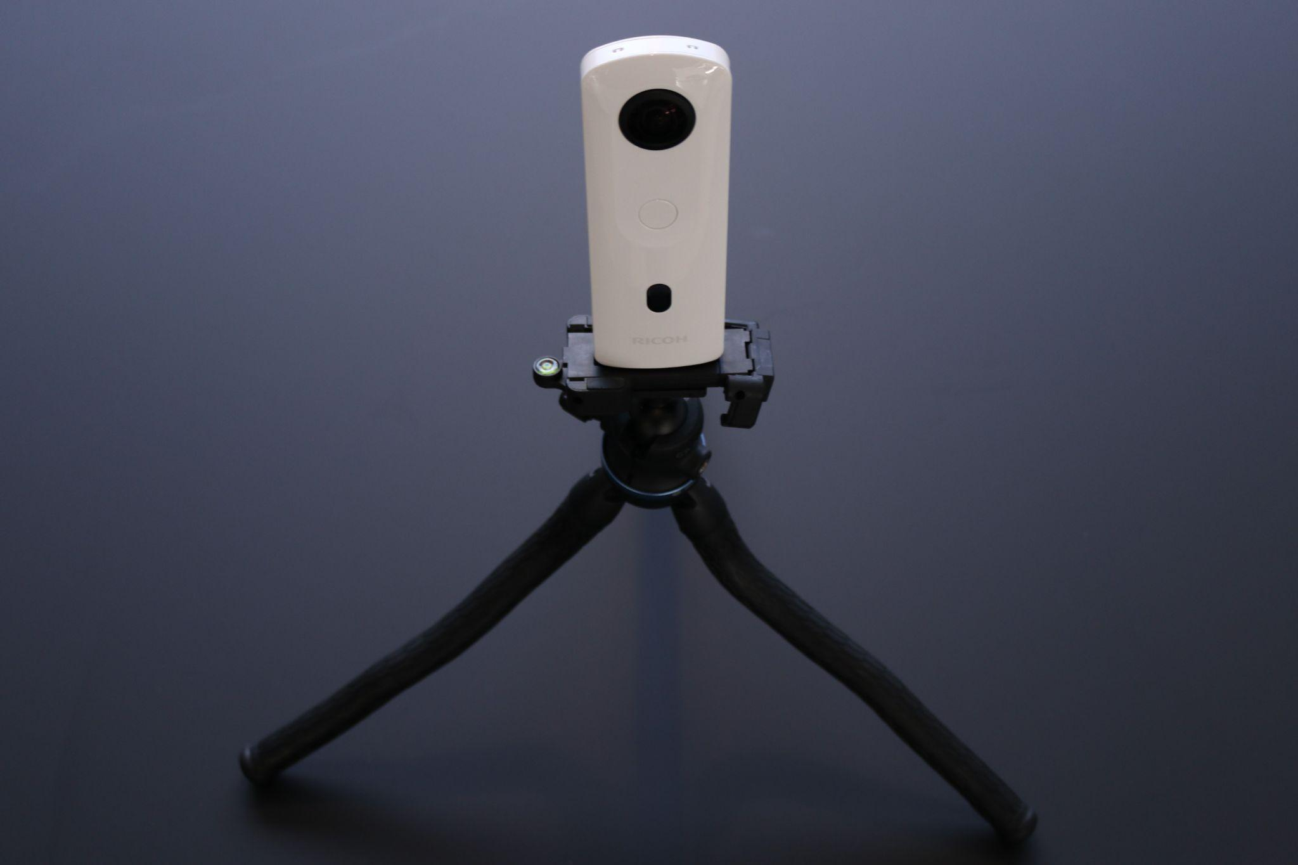
What can 360° cameras do?
Regular Camera
360 Camera
Takes single rectangular photos.
Only captures what is in front of the lens.
Can only view photos and videos after they are taken.
Takes 360 photos.
Captures the entire environment around the camera.
View of the camera can be seen using an app before photos and videos are taken.

Slide 5


What can 360° cameras do?
Regular Camera
360 Camera

Slide 6
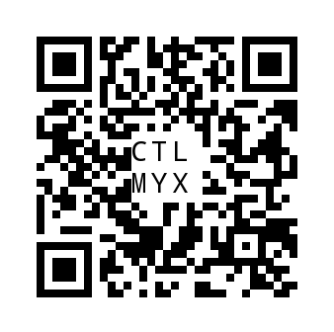
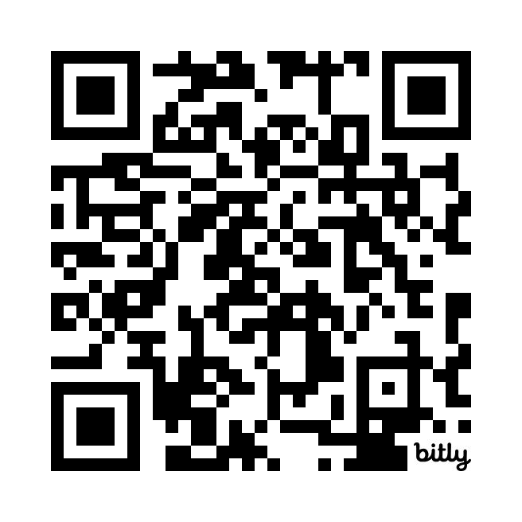
360° Tour Examples
Scan the QR Codes with a device to see what 360 tours look like.
ThingLink Tour Example:
Great Whales
CoSpaces Tour Example:
Morocco Tour
https://bit.ly/GreatWhales
https://edu.cospaces.io/CTL-MYX

Slide 7
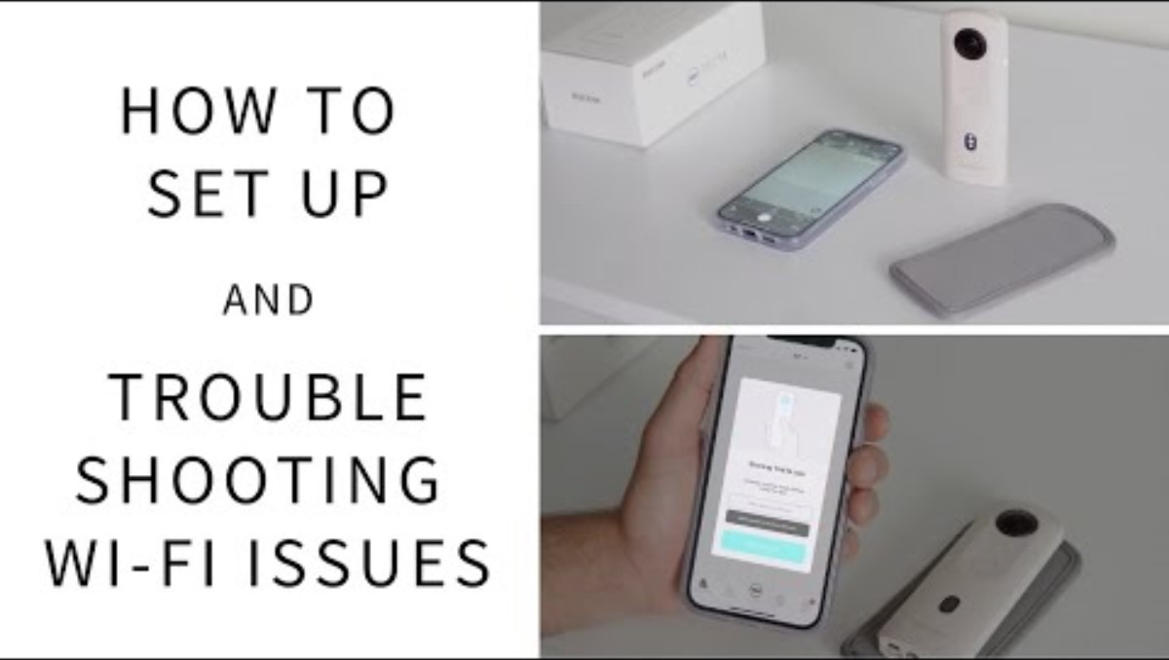
Setting up the camera

Slide 8
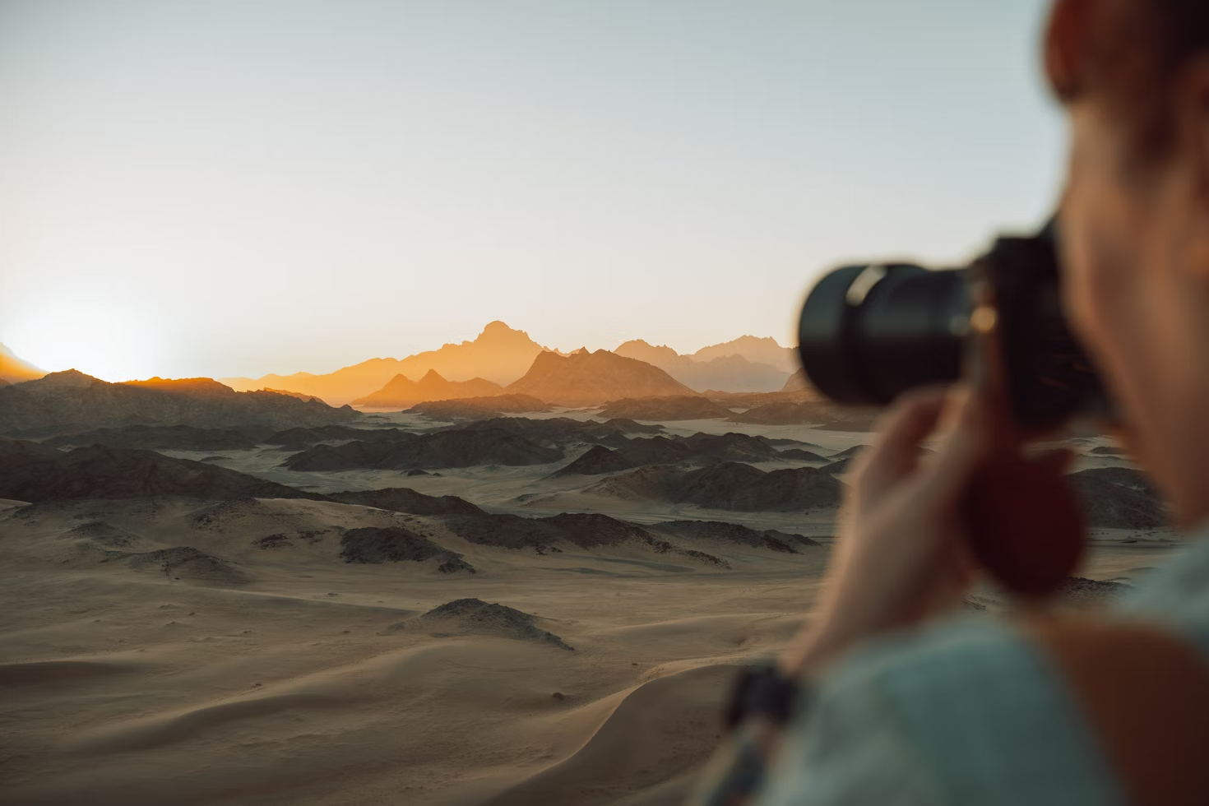

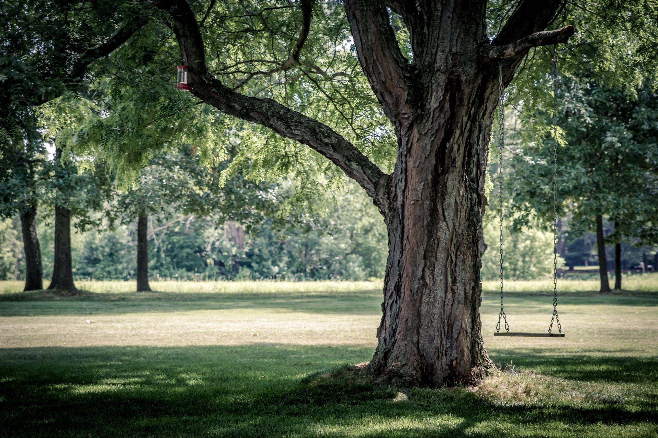
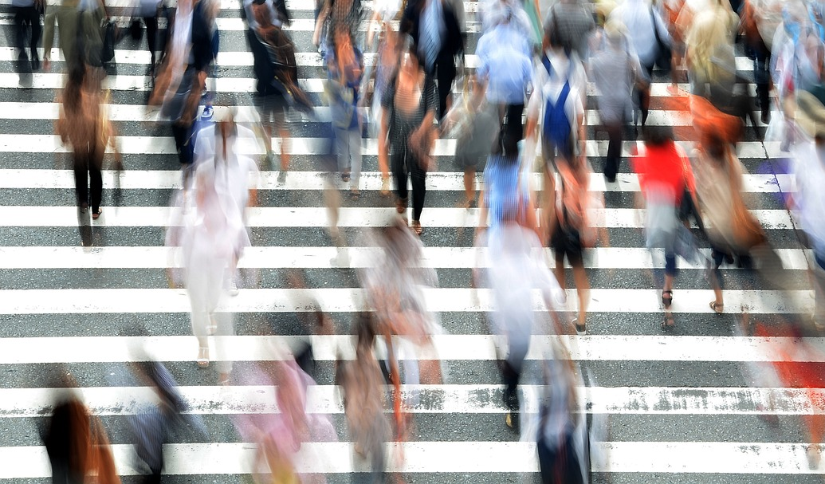
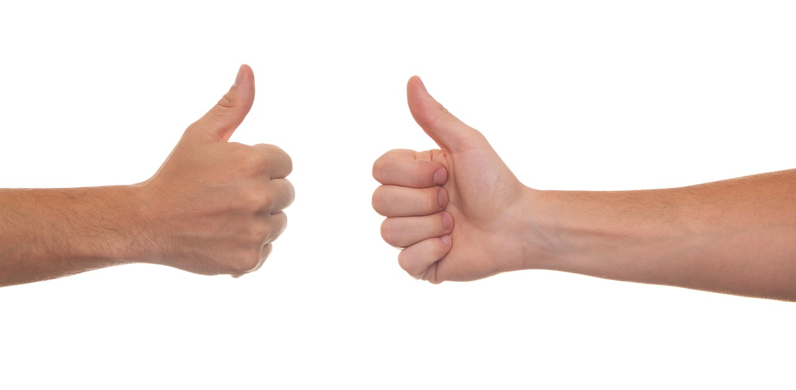
Tips and Tricks
How to get the best 360° images.
Hide if you don’t want to be in the picture.
Keep the camera in the shade to avoid shadows.
Take photos at eye level.
Don’t take photos of people without their permission.
Avoid moving objects as they look blurry in the final image.

Slide 9
Safe Handling Tips
Handle with care: Treat the camera gently to avoid damage.
Be aware of surroundings: Pay attention to your surroundings during camera use.
Use tripods safely: Set up and use tripods securely to prevent accidents.
Charge responsibly: Charge the camera safely, avoiding overcharging.
Respect privacy: Obtain permission before featuring others in your content.
Store equipment safely: Store the camera and accessories securely after use.
Supervise and collaborate: Work together responsibly and seek guidance from teachers.
Consider weather conditions: Avoid using the camera in extreme weather to prevent damage.

Slide 10
Task Steps
Get into your groups.
Take a 360° camera and a device (if using).
Connect your 360° camera to your device.
Take a tripod.
Take your 360° images.
Download your images and upload to another device for sharing.

Slide 11
360° Photo Ideas
A room/classroom using the tripod (make sure no people are in the shot)
A selfie with a friend/s using a selfie stick
An outdoor photo of your choice
A photo taken at a low angle
A photo taken at a medium height (attach the flexible tripod on something that is not too high and use the timer); and/or
A view of the playground.

Slide 12
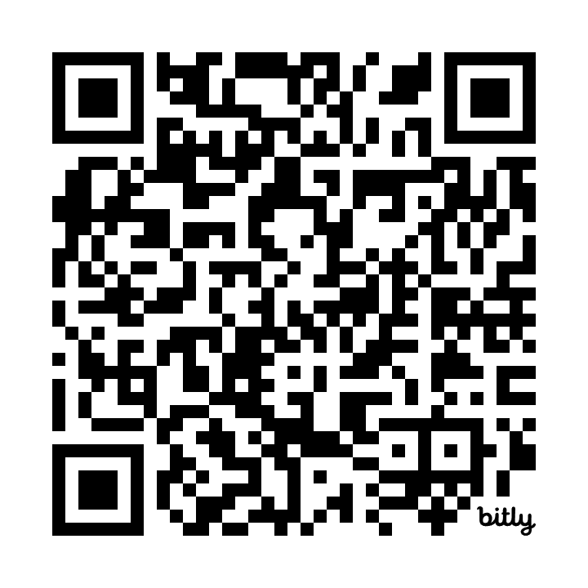
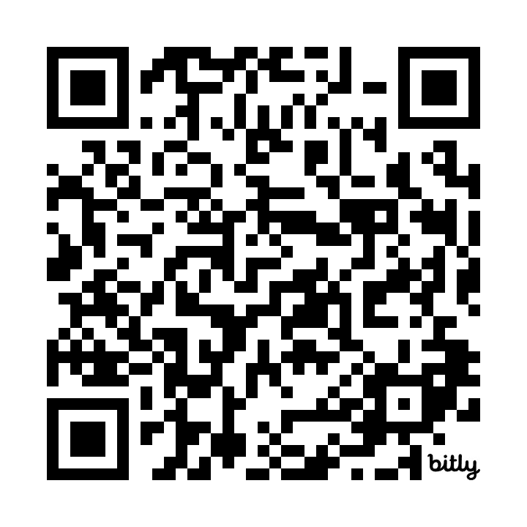
Google Arts and Culture
360° tours to inspire you.
A Journey Along The Great Barrier Reef
Fantastic Beasts™: The Wonder of Nature exhibition

Slide 13
Quick Quiz
Give a thumbs up for ‘true’ and a thumbs down for ‘false’.
360° images can be taken on a normal camera.
A mouse is a peripheral device.
The 360° camera can capture both photos and videos in 360 degrees.
If you don’t want to be seen in the 360 photo, you must hide.
You can take 360° photos without using the Theta app.
Notes:
Answers:
360° images can be taken on a normal camera. (Thumbs Down)
A mouse is a peripheral device. (Thumbs Up)
The 360° camera can capture both photos and videos in 360 degrees. (Thumbs Up)
If you don’t want to be seen in the 360 photo, you must hide. (Thumbs Up)
You can take 360° photos without using the Theta app. (Thumbs Up)

