Slide 1

TEACHING DECK
Designing for future impact
Creating designed solutions to community needs

Slide 2



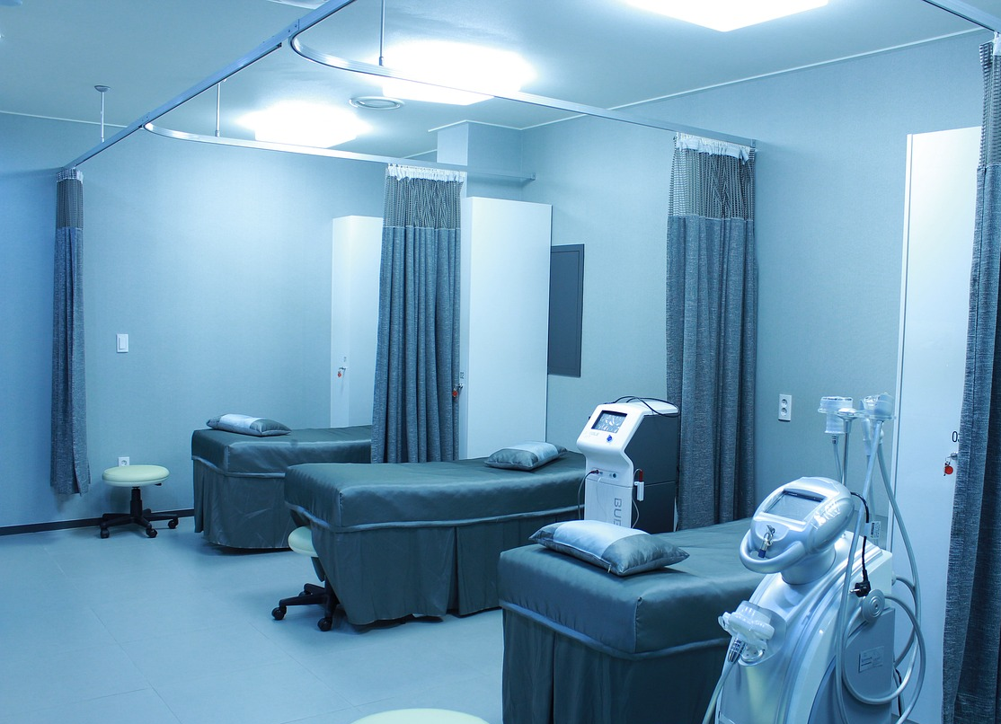
Community Needs Brainstorm
Students: See page 2 of your digital notebook.
Identify as many community needs as you can.

Slide 3
Share your ideas
What parts of your community could be improved?
How could you improve your community?
If you could invent anything to make your community better, what would it be?
During this lesson, you’ll be creating a designed solution to a community need of your choice.

Slide 4

Plan your design
Students: Use page 3 of your digital notebook to plan your solution.
Ensure you complete your plan before beginning your design.

Slide 5
Plan your design
Now that you have your plan, it’s time to sketch your solution. Your sketch should include:
detailed labels of each part
the materials that are used
an appropriate scale (e.g. 1cm = 1m)
a written explanation of how your solution solves your chosen community need.

Slide 6
Discussion
Work with a partner or a small group.
What are the advantages of designing solutions using this traditional method?
What are the disadvantages?

Slide 7
TEACHING DECK
Designing for Future Impact
Session 2:
Creating designed solutions to community needs

Slide 8

Gallery Walk
Display your design from last lesson on your desk.
Walk around the room to view other people’s designs.

Slide 9
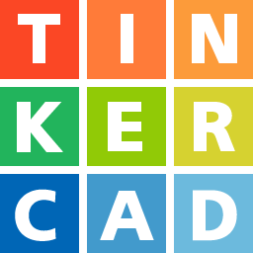

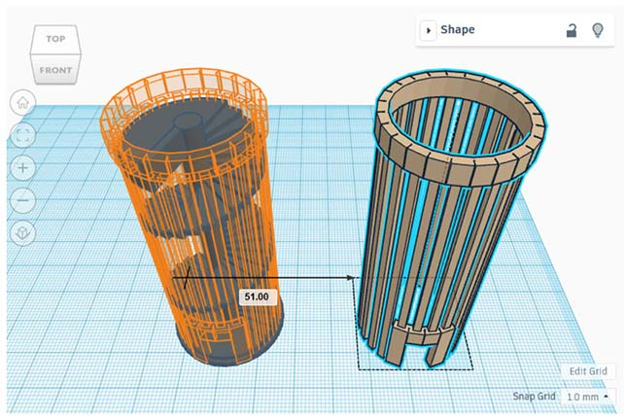
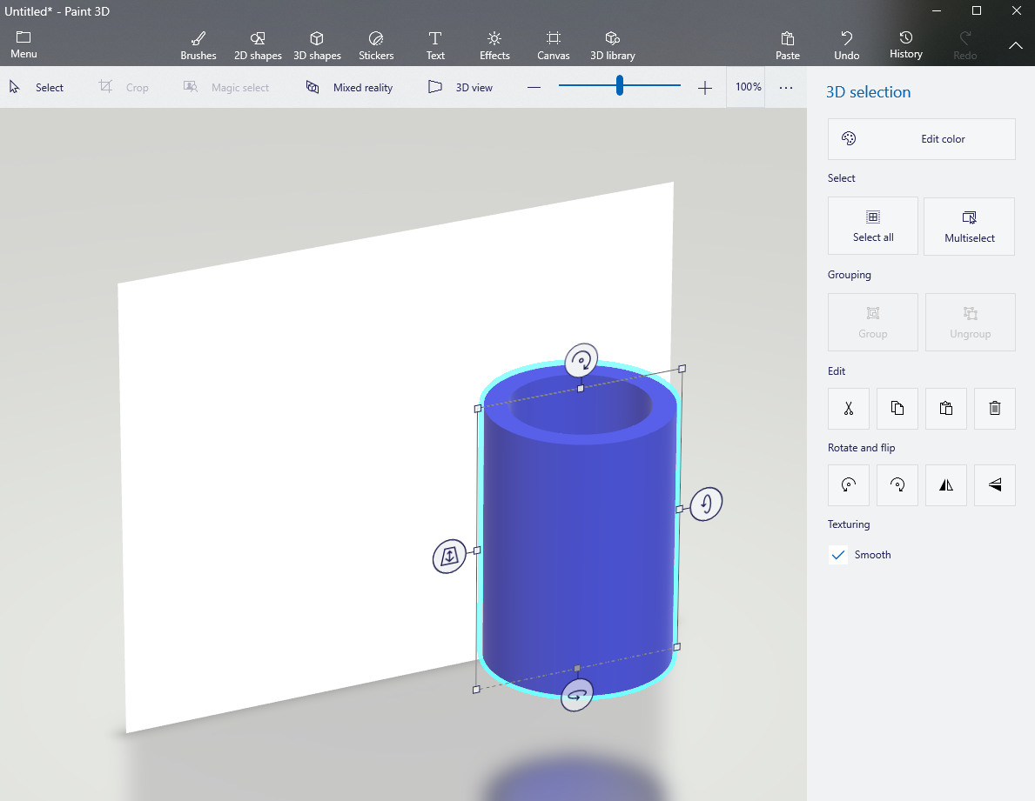
Tinkercad Design
Recreate your design as a 3D model using Tinkercad or Paint 3D.

Slide 10
Reflections
Students: See page 7 of your digital notebook to reflect on the advantages and disadvantages of using 3D modelling and traditional methods for design.
Do you have a preferred method? If yes, which one? Why?
What are the advantages of using 3D modelling for design?
What are the disadvantages?
What are the advantages of using pencil and paper sketching for design?
What are the disadvantages?

