Slide 1

TEACHING DECK
Learning the Periodic Table in AR
Examine how elements are organised in the periodic table.

Slide 2


Watch: The genius of Mendeleev’s periodic table

Slide 3
Discuss
What did you learn about the periodic table from this video?
How was the first periodic table different from the current periodic table?
How did Mendeleev know about the properties of an element just based on its location on the periodic table? (eg, Eka Aluminium example, later known as Gallum)

Slide 4
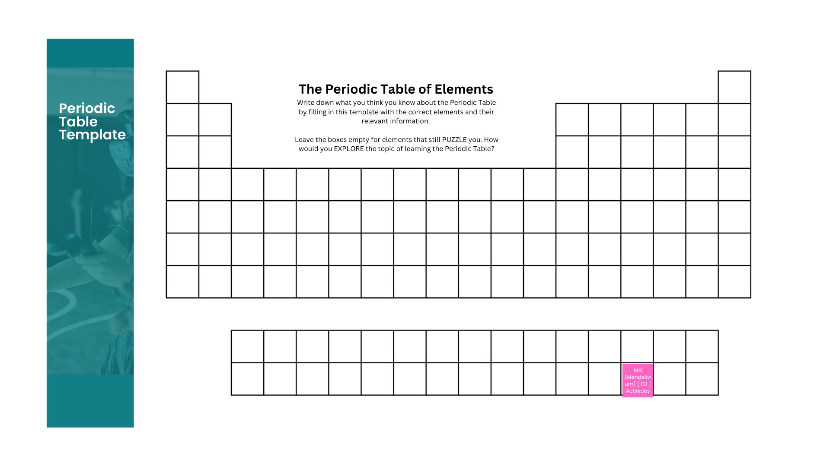
Prior knowledge check
What do you already know?
Visit the following link and make a copy of The Periodic Table of Elements template.
Periodic Table of Elements Template

Slide 5
Task list
Add any information for the elements you think they KNOW about using the blank Periodic Table template.
Leave the boxes of the elements that you are still PUZZLED about.
How are you going to EXPLORE the elements that you are puzzled about?

Slide 6
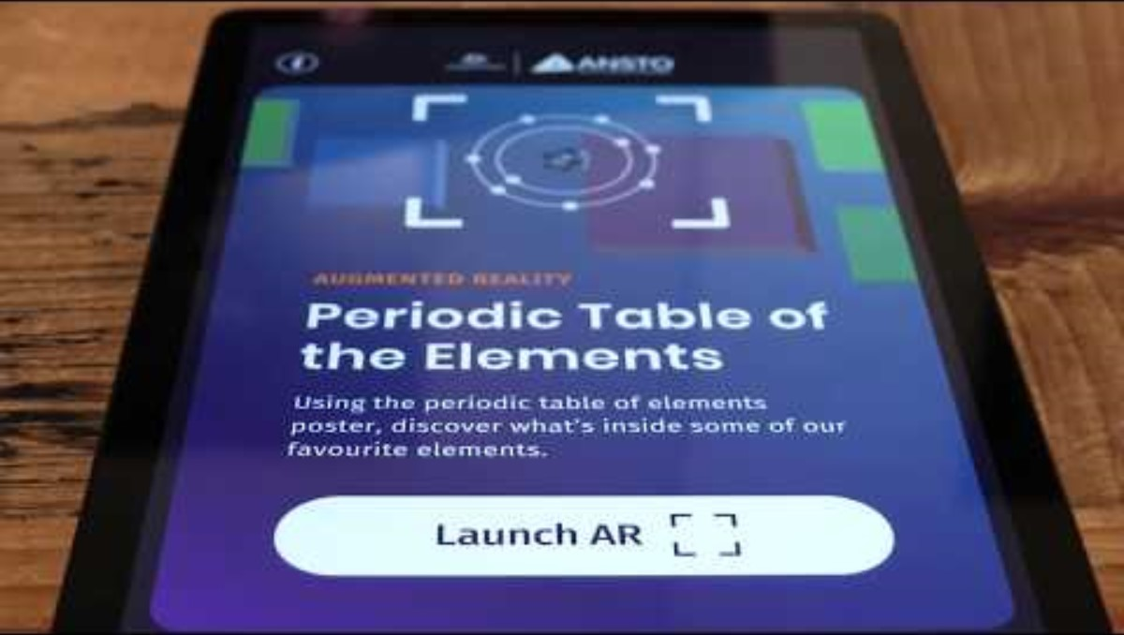
Get to know: ANSTO XR app

Slide 7
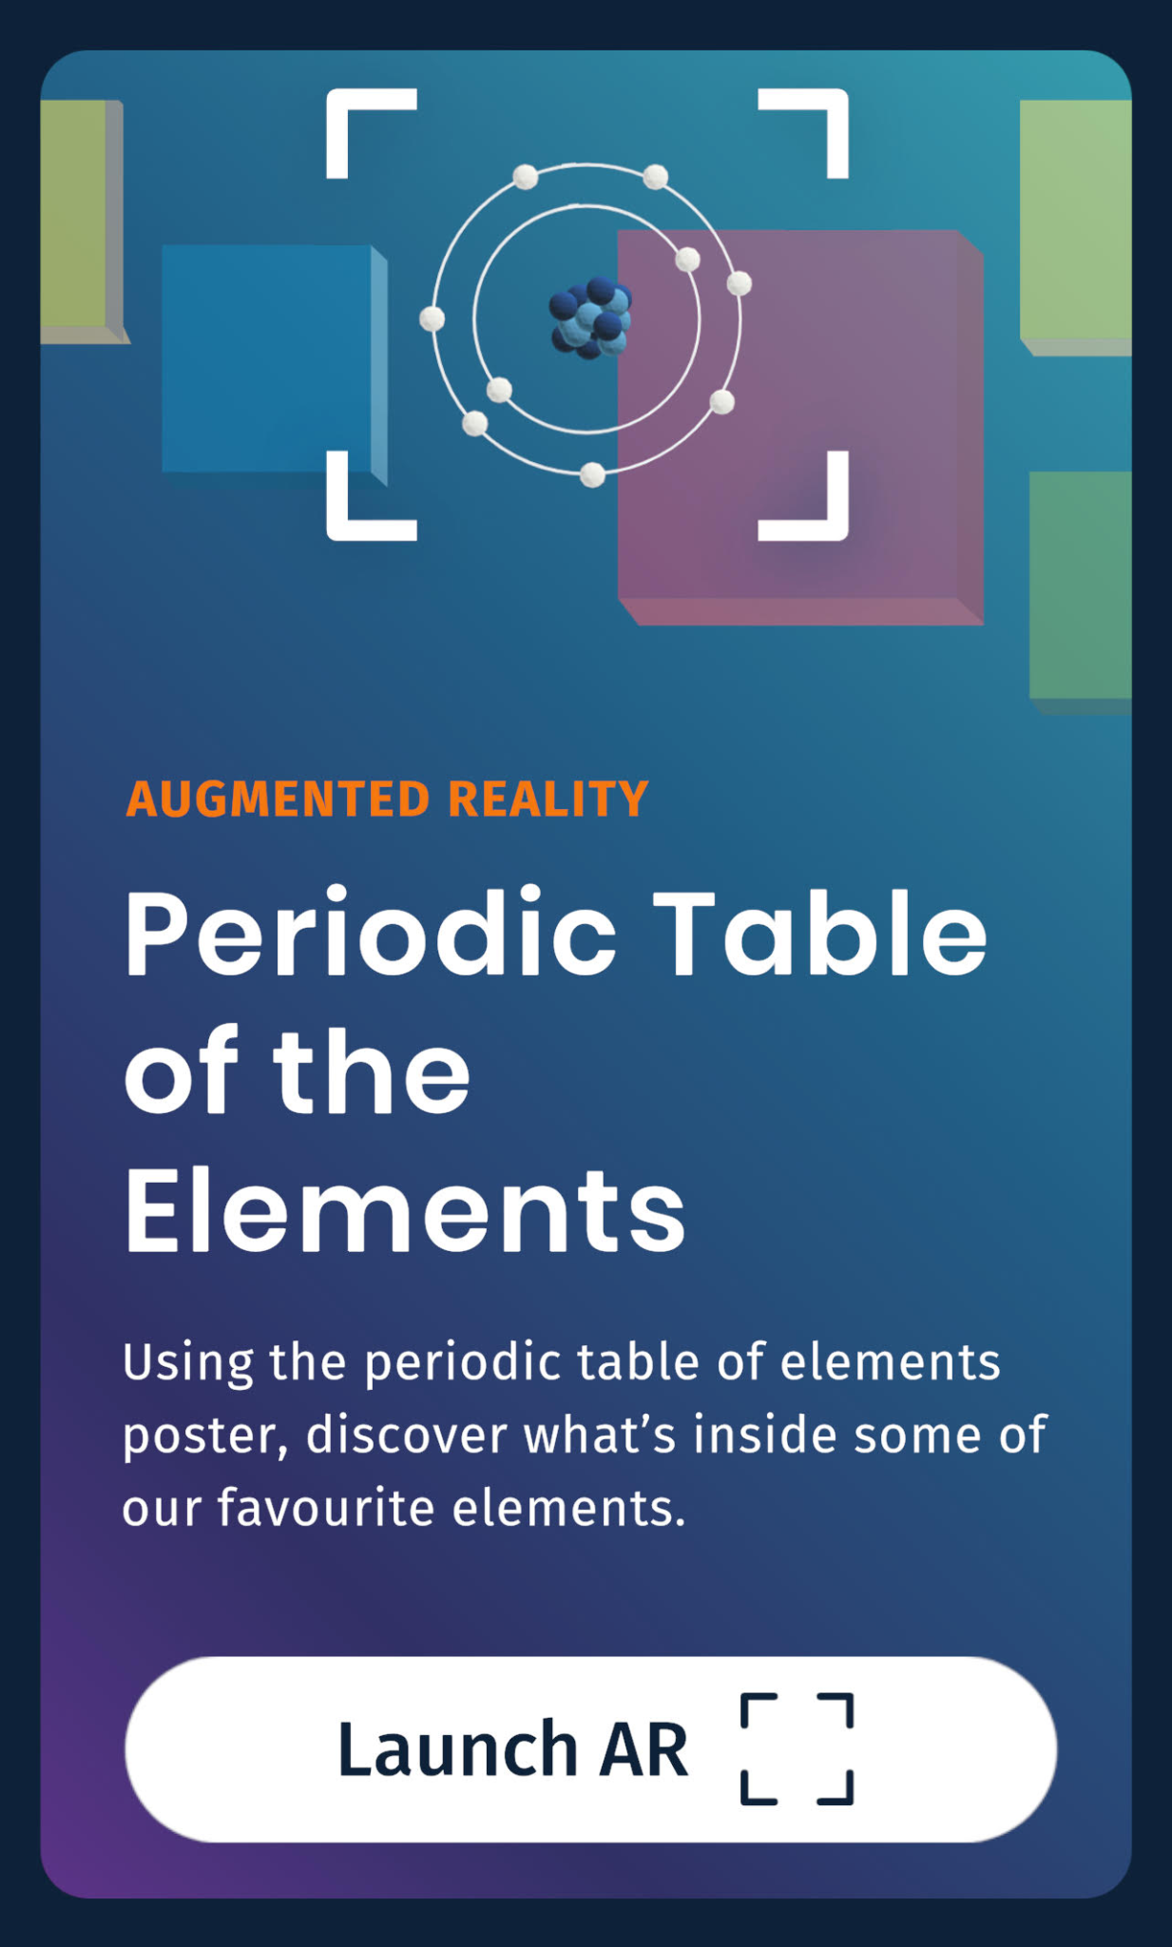
Time to explore
Scan the Periodic Table of Elements poster with the ANSTO XR App.
Tap on the element you wish to learn more about.
Add / change your information to your Periodic Table of Elements template.

Slide 8
Group sharing
Get into groups of 3 or 4.
Compare your information with your group members:
Did your fellow group members focus on the same elements?
Did anybody in your group find information that was different from yours?
What questions do you still have?

