Slide 1

TEACHING DECK
Planets of our Solar System
Identifying and comparing planets with XR

Slide 2

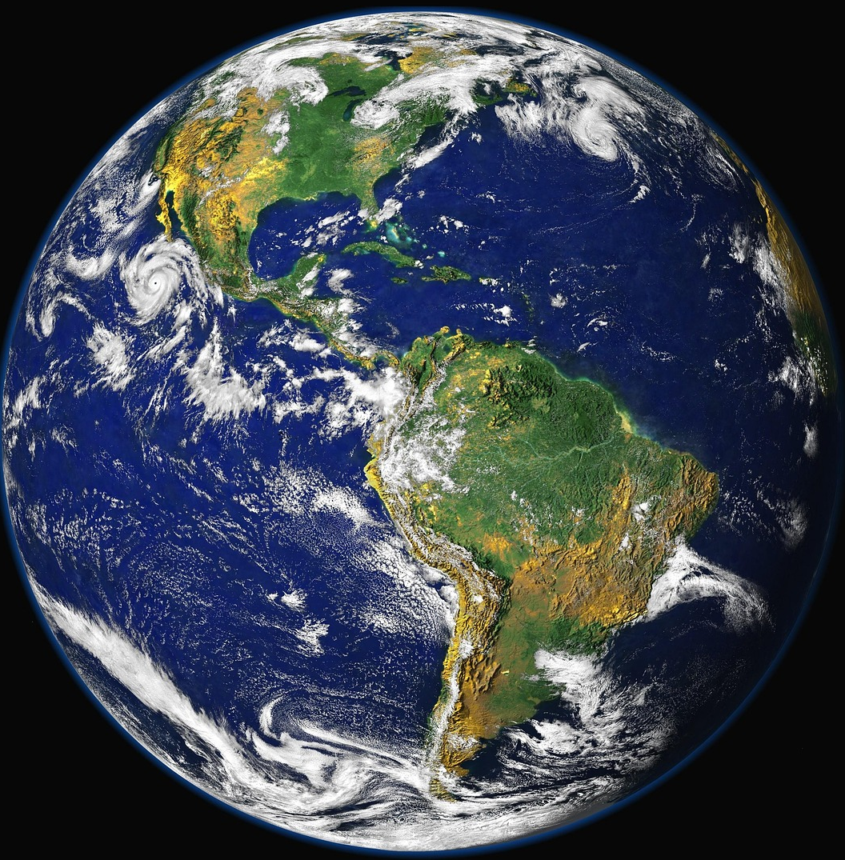
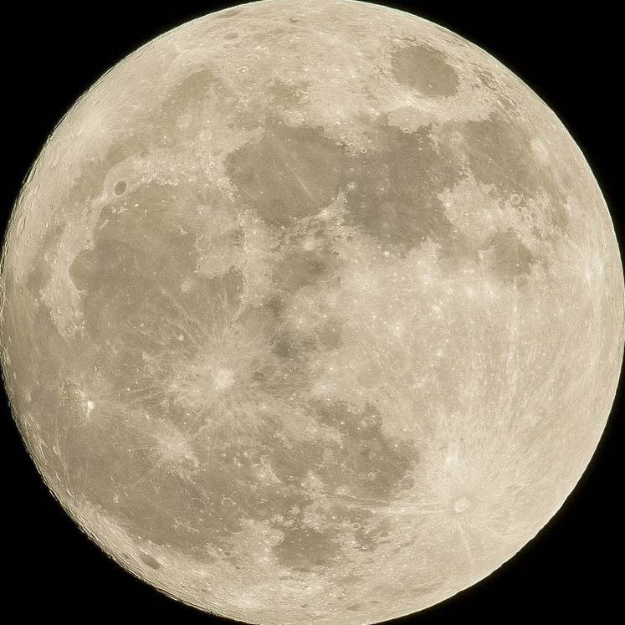
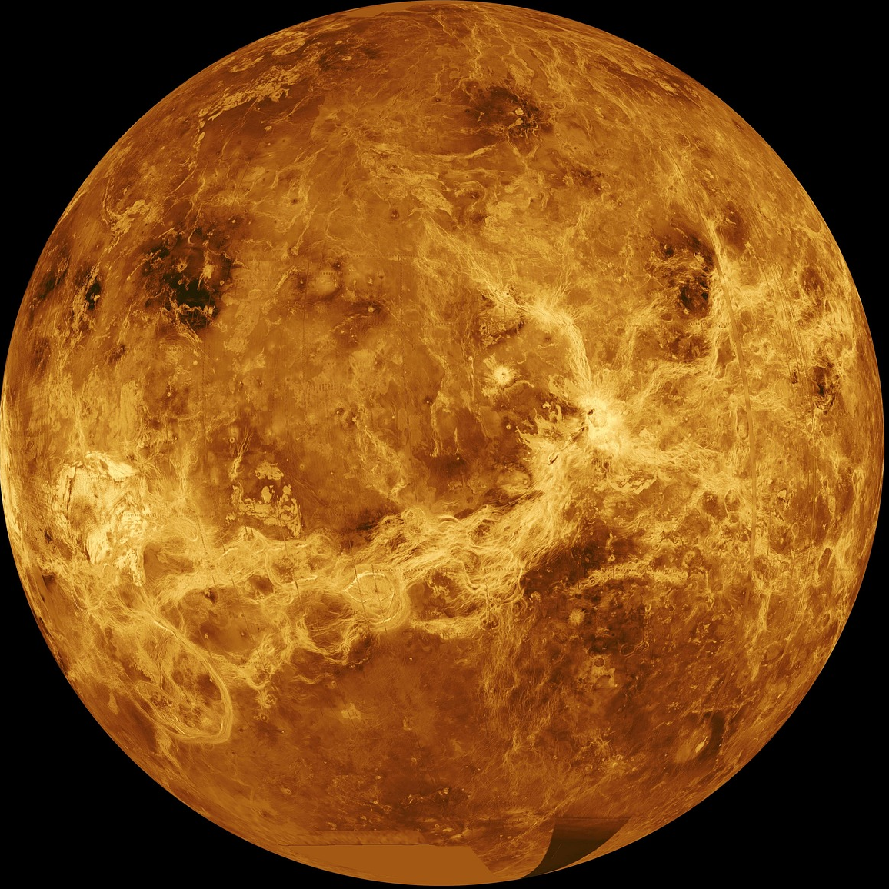
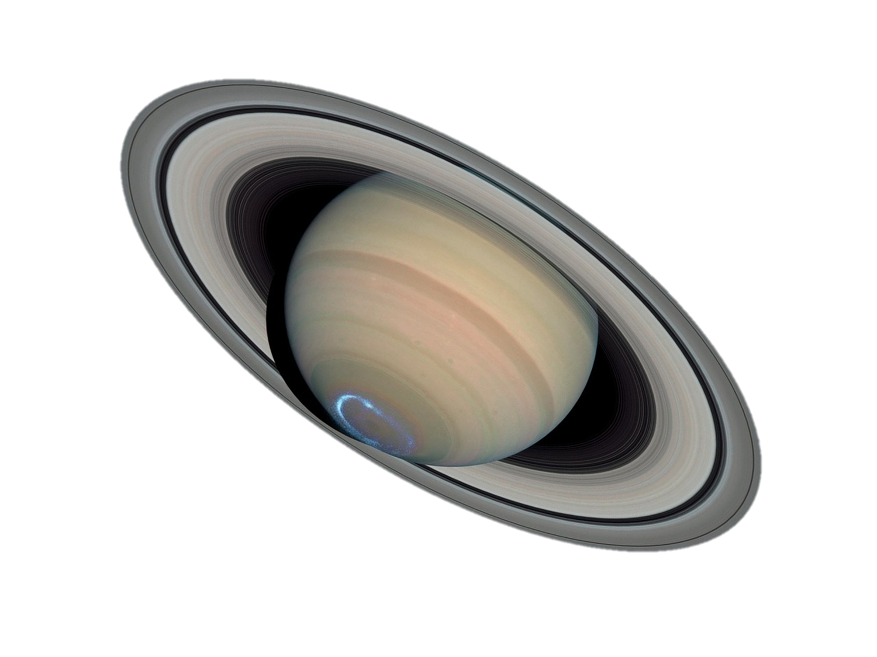
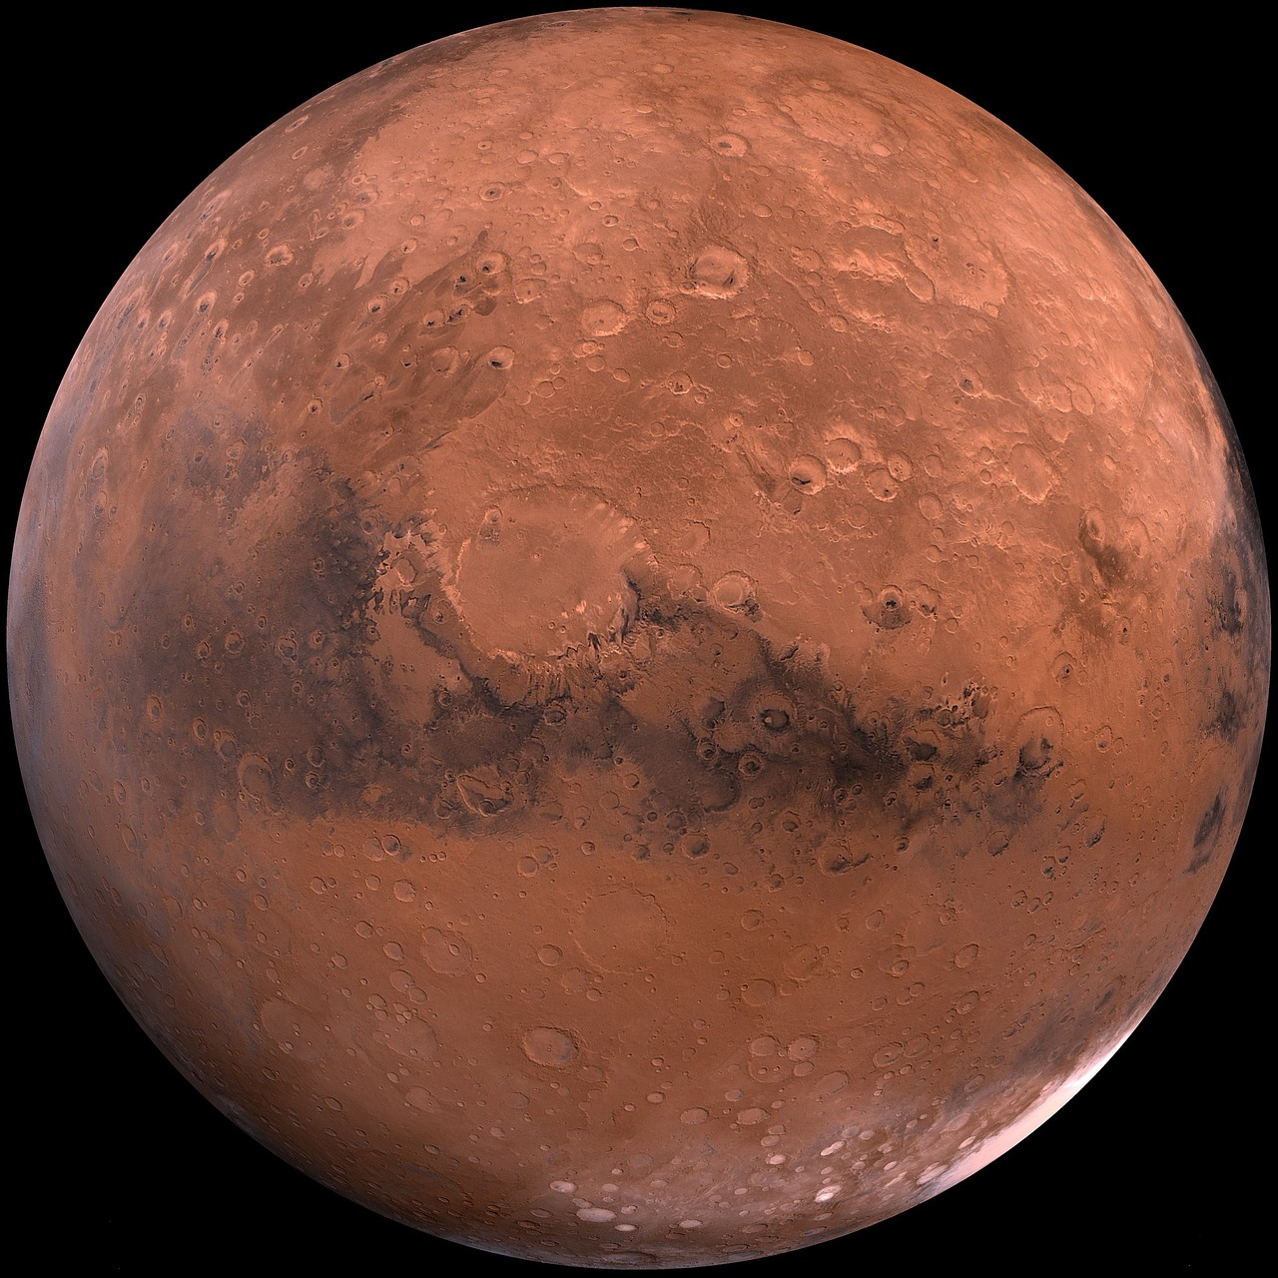
What do we know about these?
Notes:
What are these objects called?
Where can we find them?
Do you know the name of any of these planets?

Slide 3
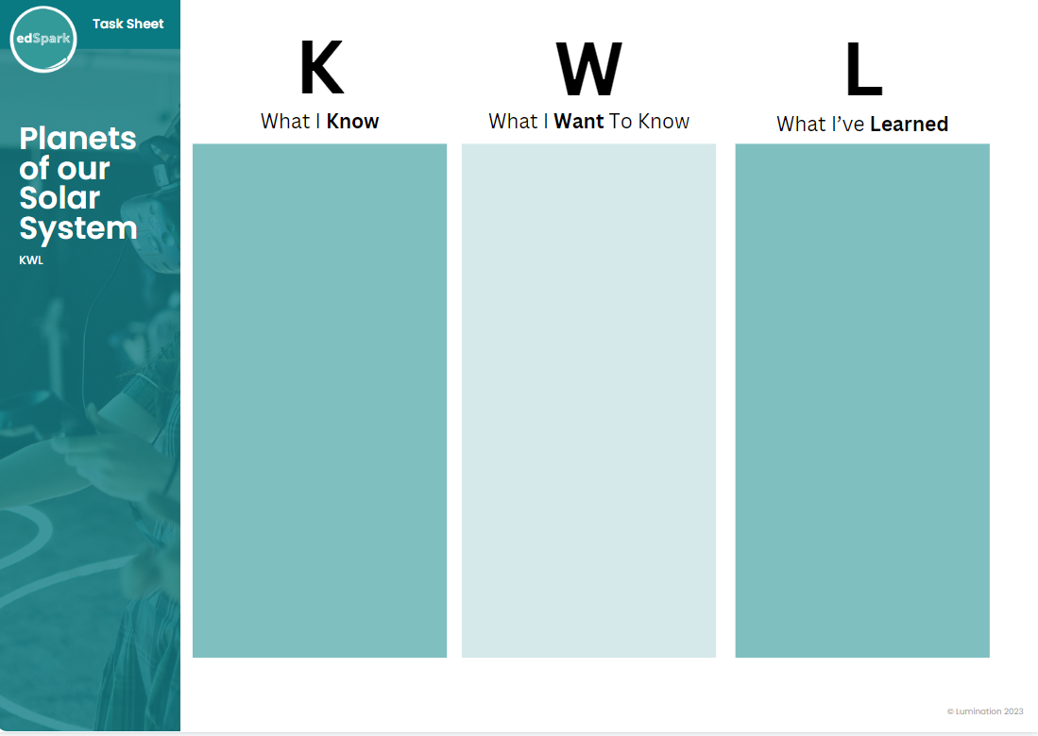
KWL Chart
Let’s find out what we know and what we want to learn. You will complete the first two columns with a partner, and share back your thoughts to the class.
Download: KWL Chart

Slide 4
Whole Class KWL Chart
What we KNOW | What we WANT to know | What we’ve LEARNT

Slide 5
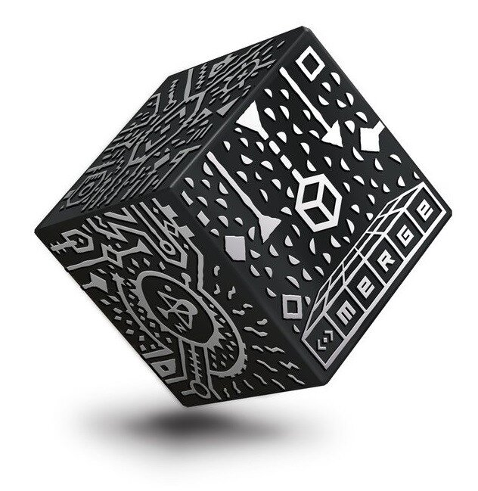
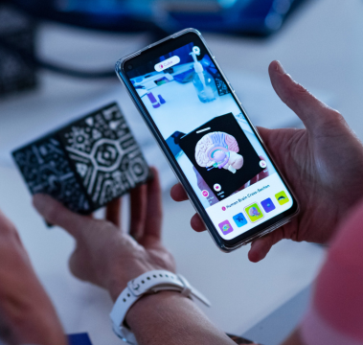
Merge Cubes
Notes:
Discuss Augmented Reality (AR) with students, making sure they understand what merge cubes are and how they work.

Slide 6
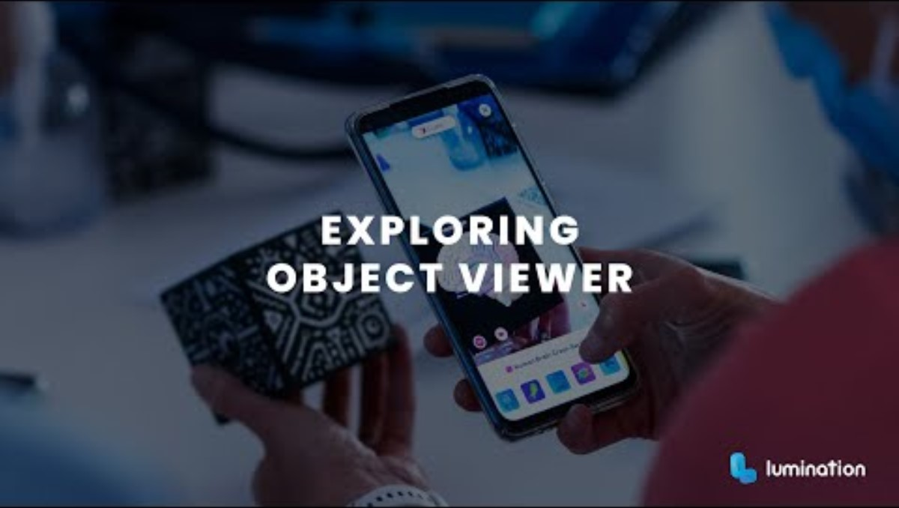
How to use Object Viewer

Slide 7

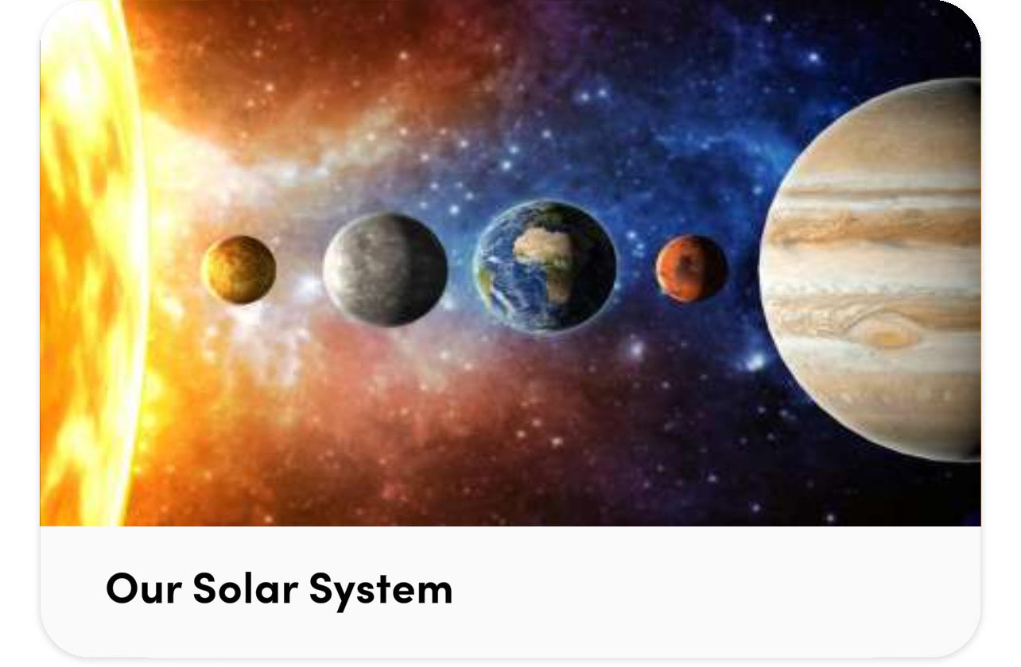
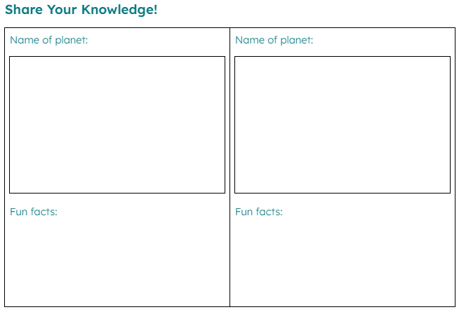
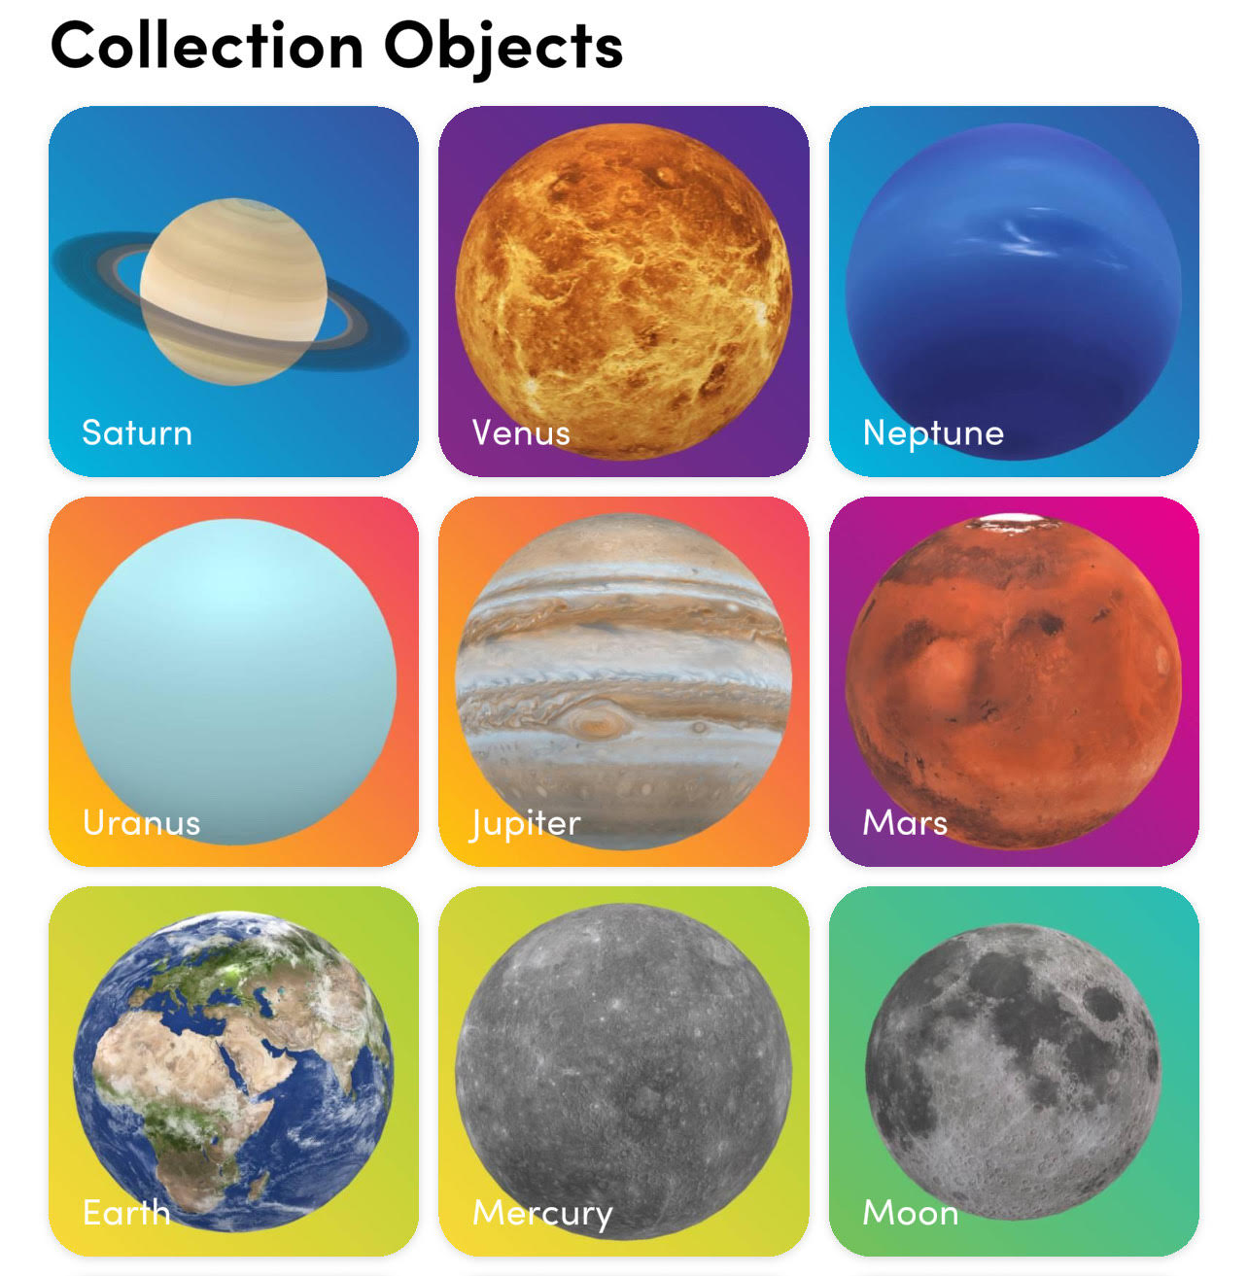
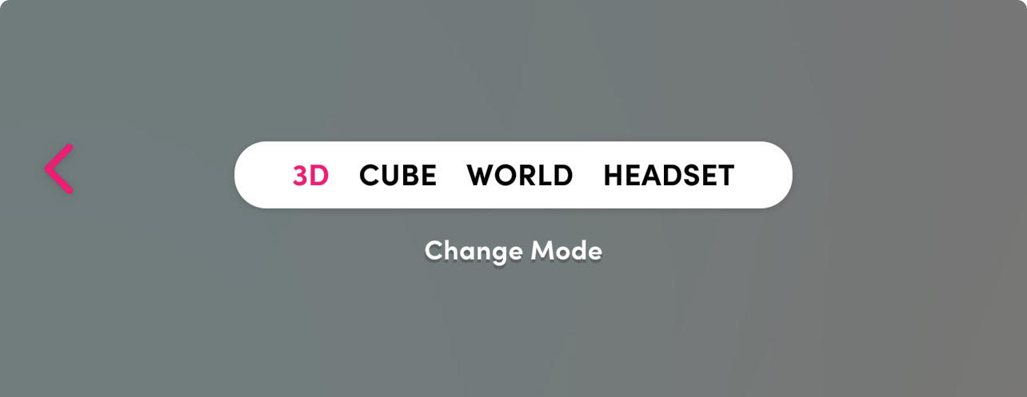


Let’s Explore
For each planet, write down its name, draw a picture, and record at least one fun fact.
Follow these 4 steps to view planets.
1. Open Object Viewer.
2. Find ‘Our Solar System’.
3. Tap on a planet.
4. Tap ‘Cube’.

Slide 8
What did we Learn?
It’s now time to go back to your KWL charts and record what you’ve learnt, with a partner. Be ready to share back with the class.

