Slide 1

TEACHING DECK
Wondrous Ancient Worlds
Exploring ancient history in Augmented Reality (AR)

Slide 2

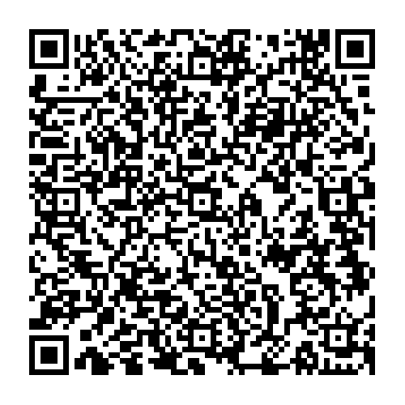
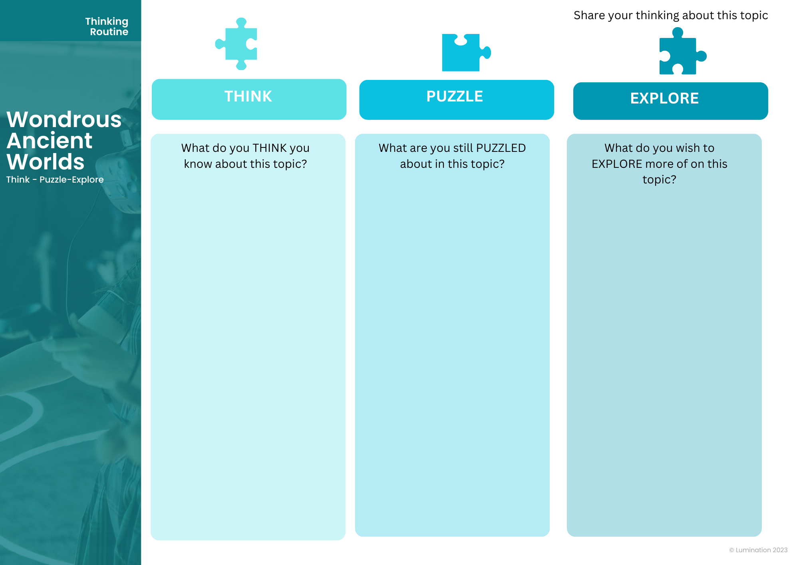
Brainstorming Session
Thinking Routine Topic: Ancient artefacts and ancient historical figures
Download the Template – Wondrous Ancienct Worlds Canva Template

Slide 3
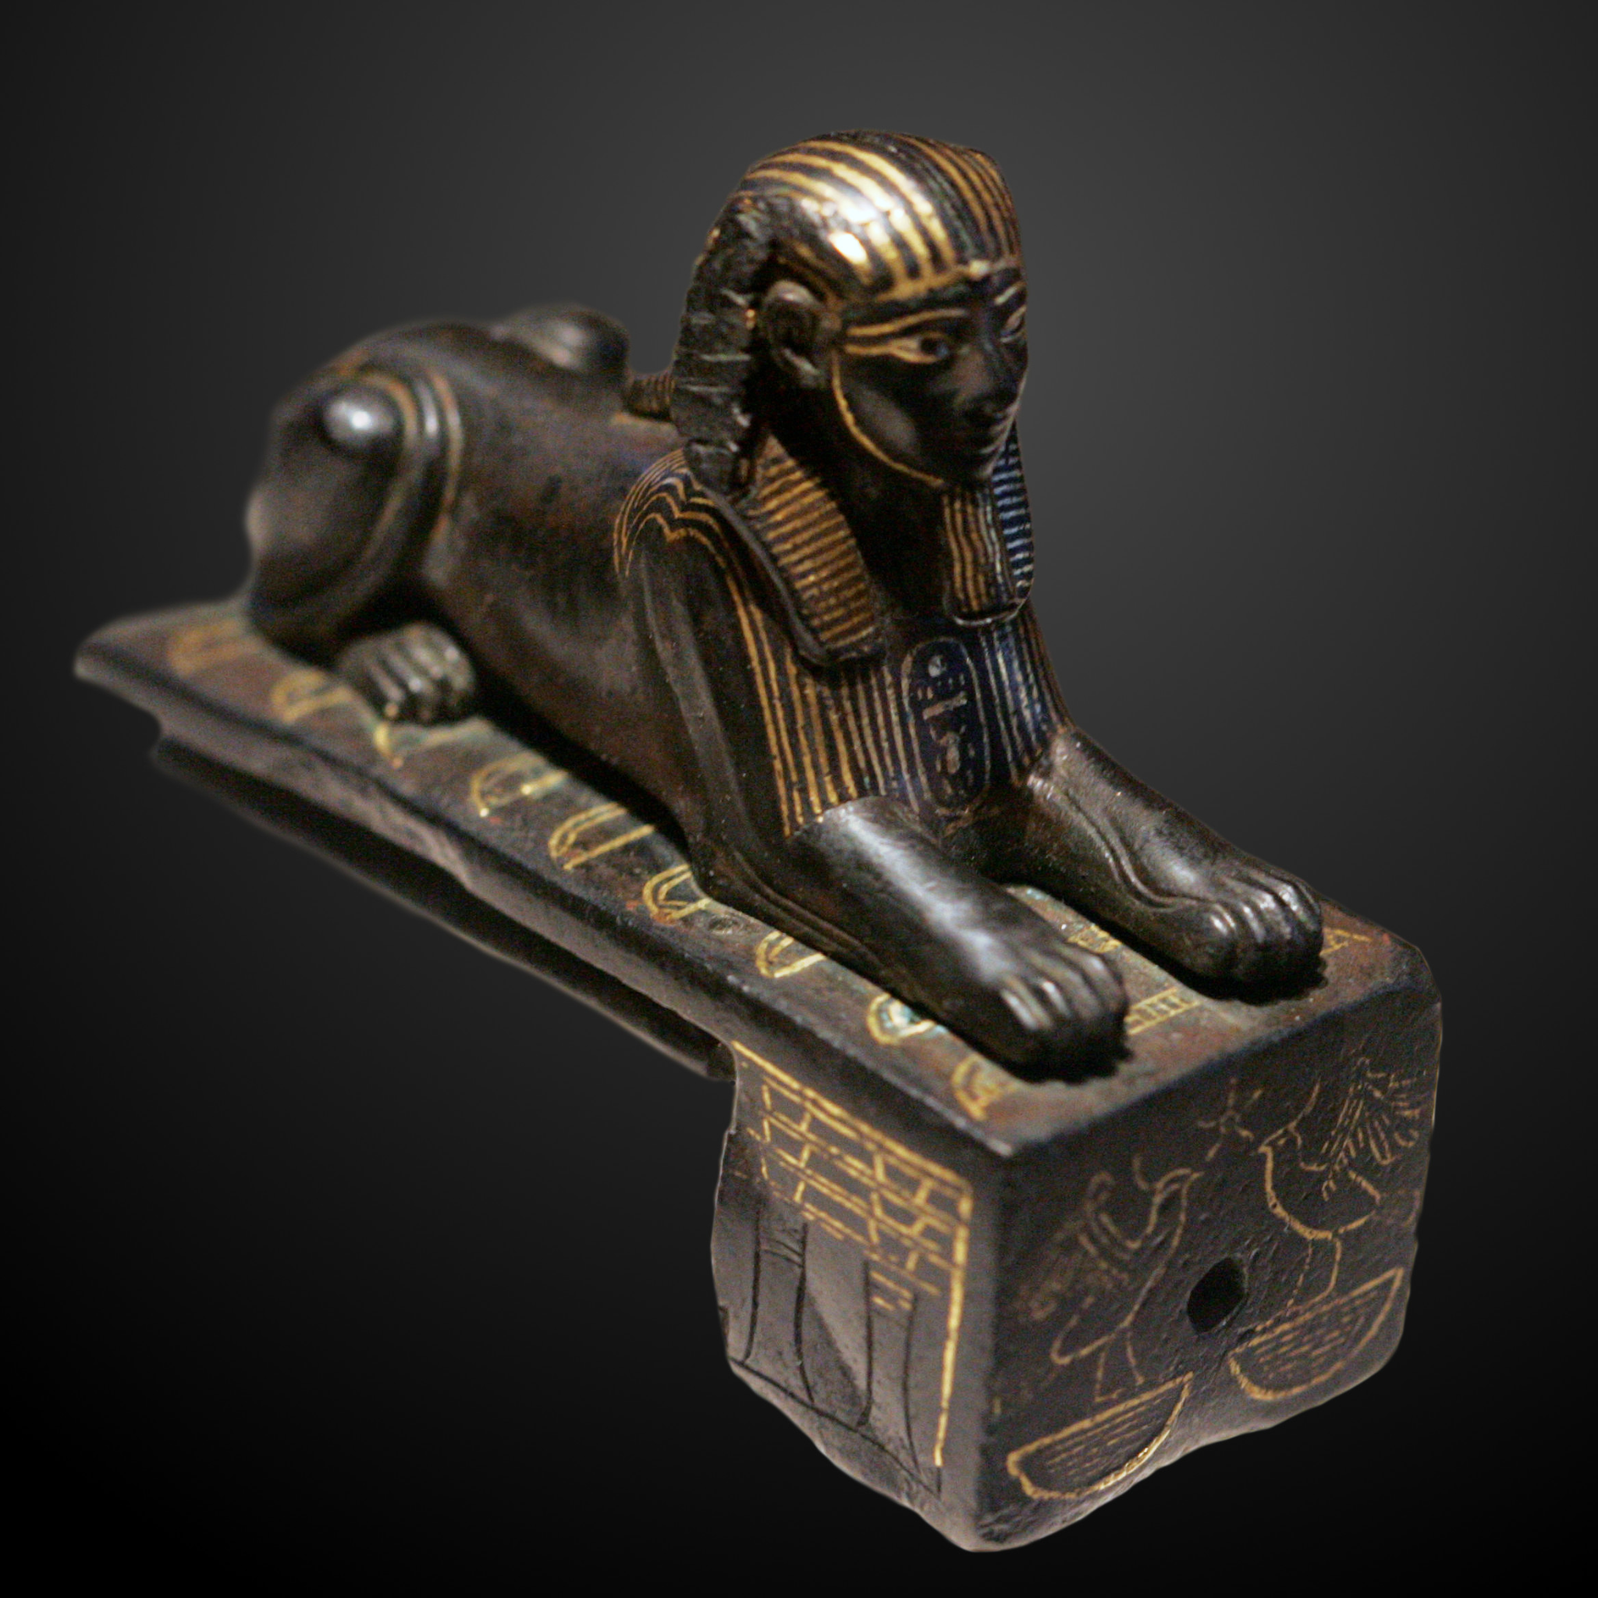
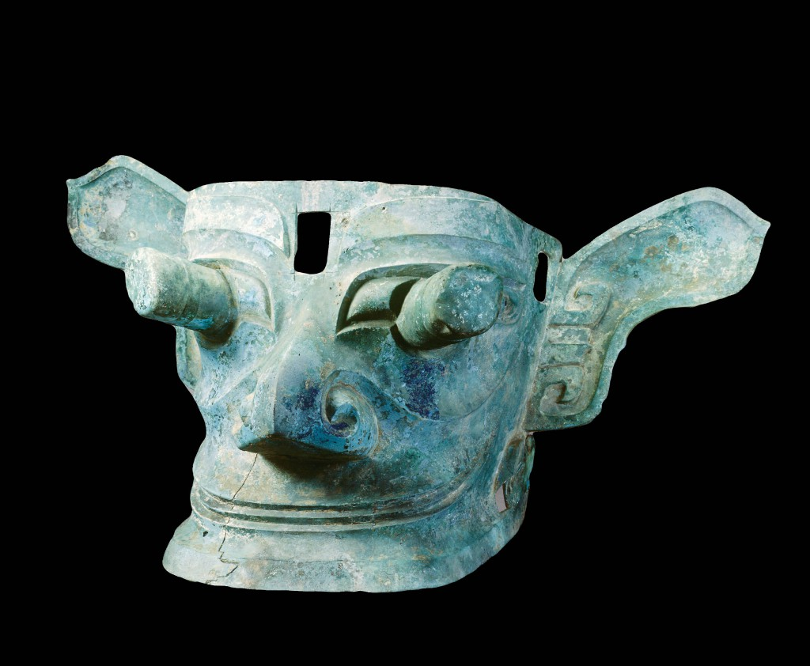
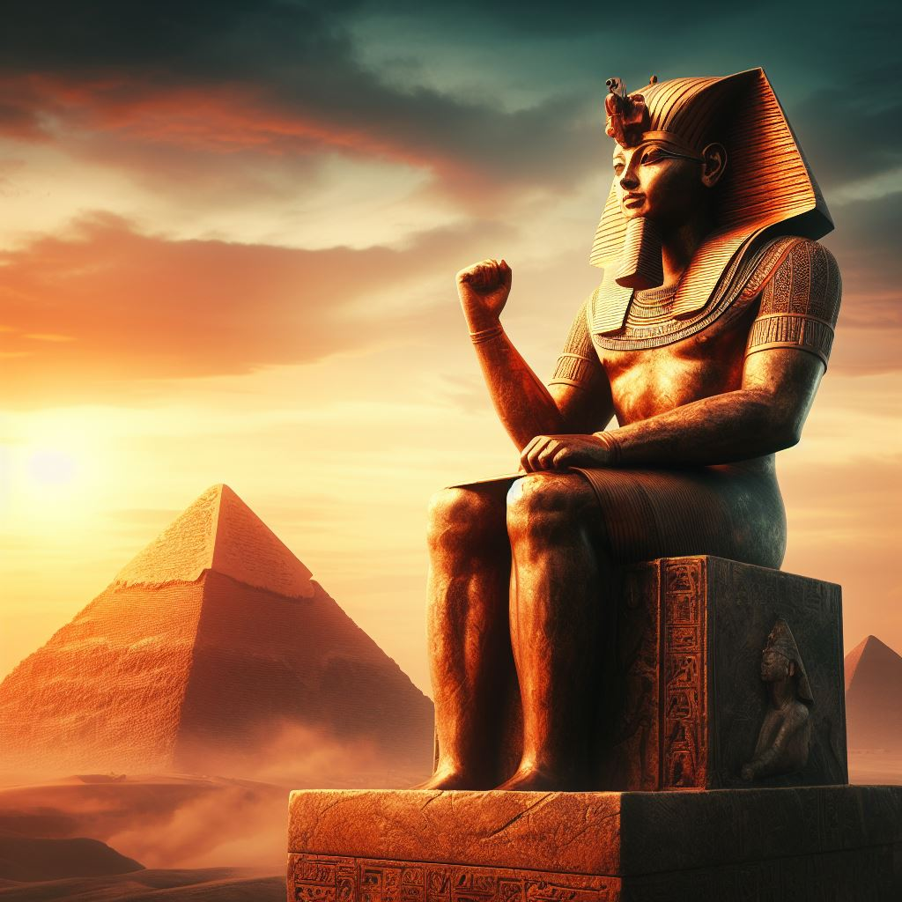
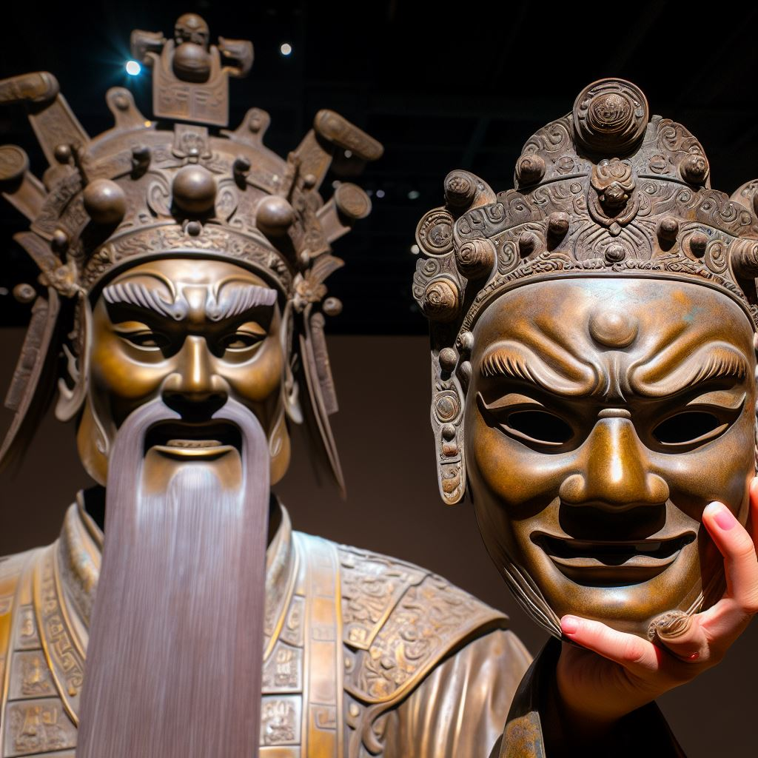
Ancient Artefacts and Historical Figures
What do you know? Who do you know?
Examples of ancient artefacts
Examples of historical figures
Bronze Sphinx of Thutmose III
circa 1479 to 1425 BCE
Bronze Age Mask of Ancient Civilisation of China, Sanxingdui, circa 1800 BC
Thutmose III, the sixth pharaoh of the eighteenth dynasty in Egypt
Cancong, founder of the Shu kingdom in China during Sanxingdui civilisation
Notes:
Give students the opportunity to share what they know first before sharing these examples. Talk about how some of these ancient artefacts link to historical figures.
The Bronze Sphinx is representation of the ruling pharoah of the eighteenth dynasty, Thutmose III.
The bronze age mask from Sanxingdui is believed to be created in likeness of Cancong who is the founder of the Shu kingdom, who was described to have protruding eyes.

Slide 4
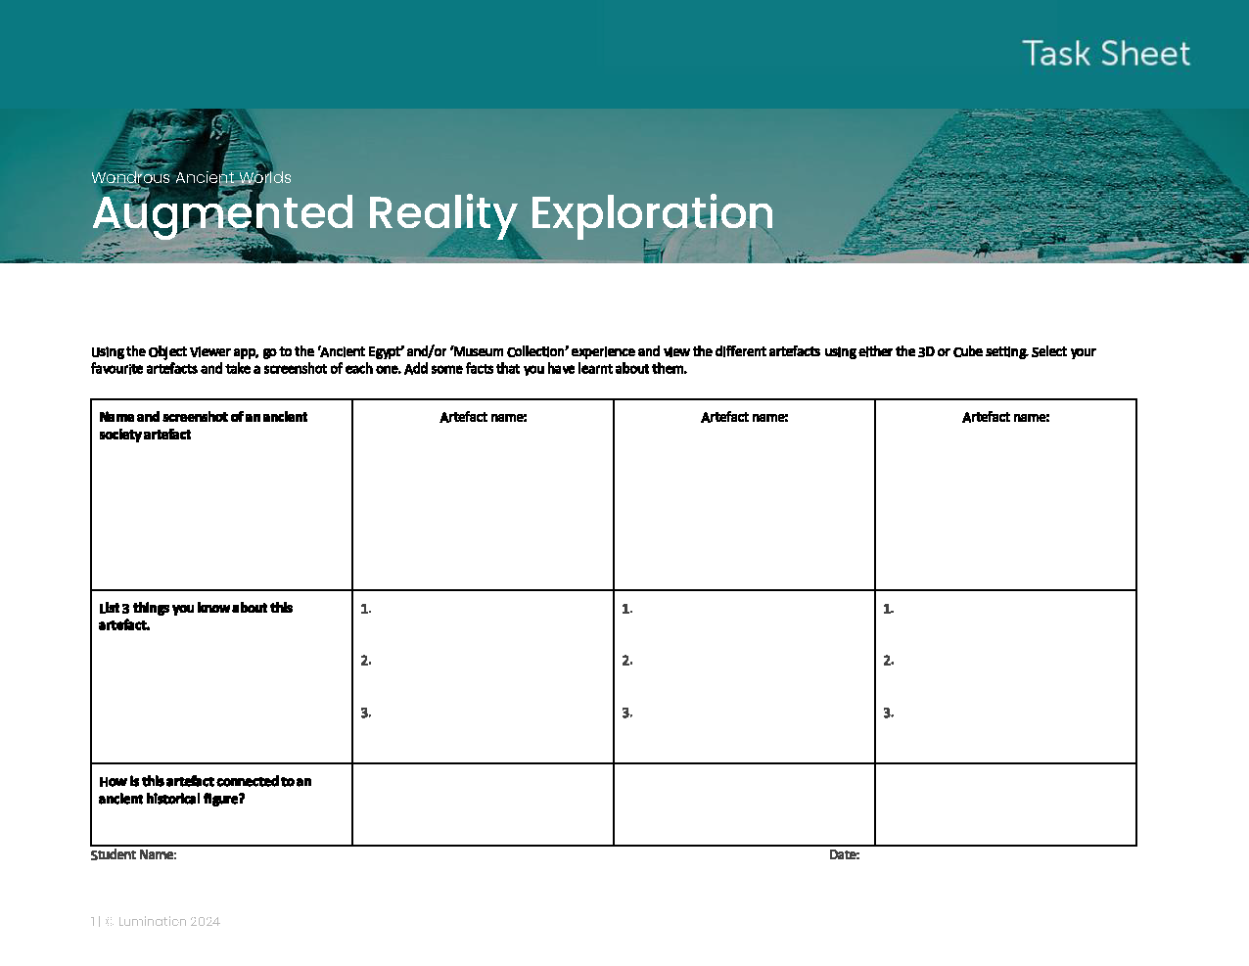

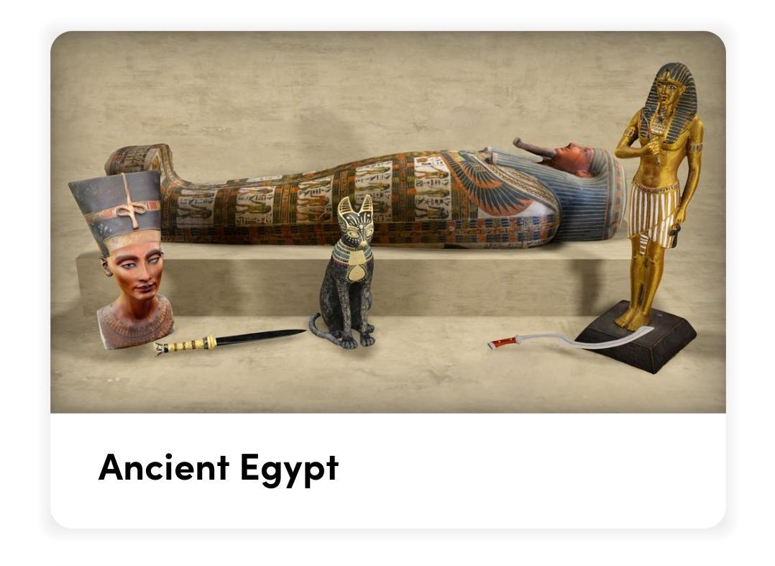
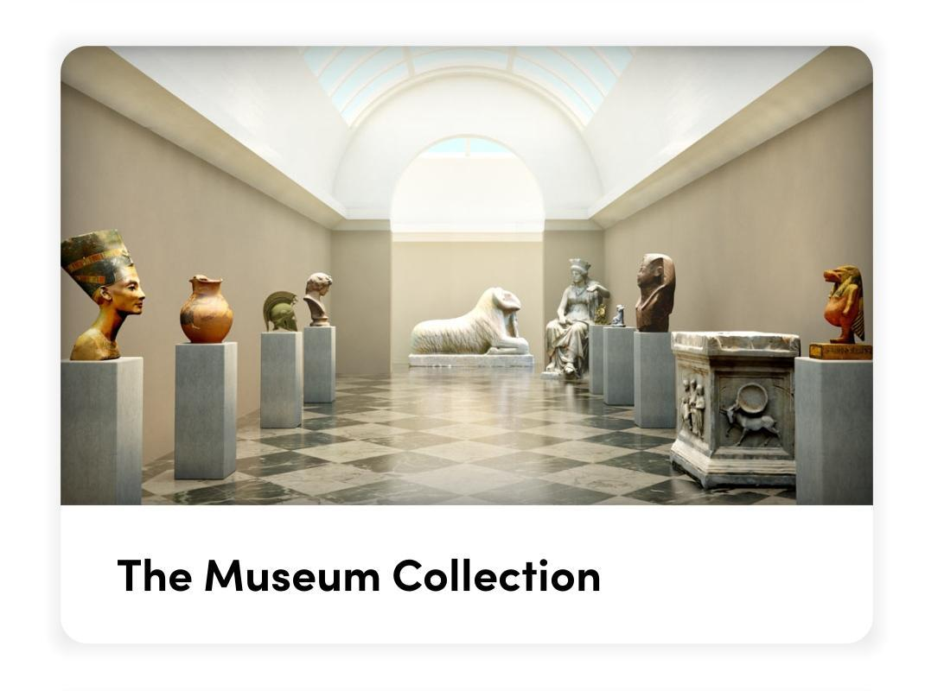
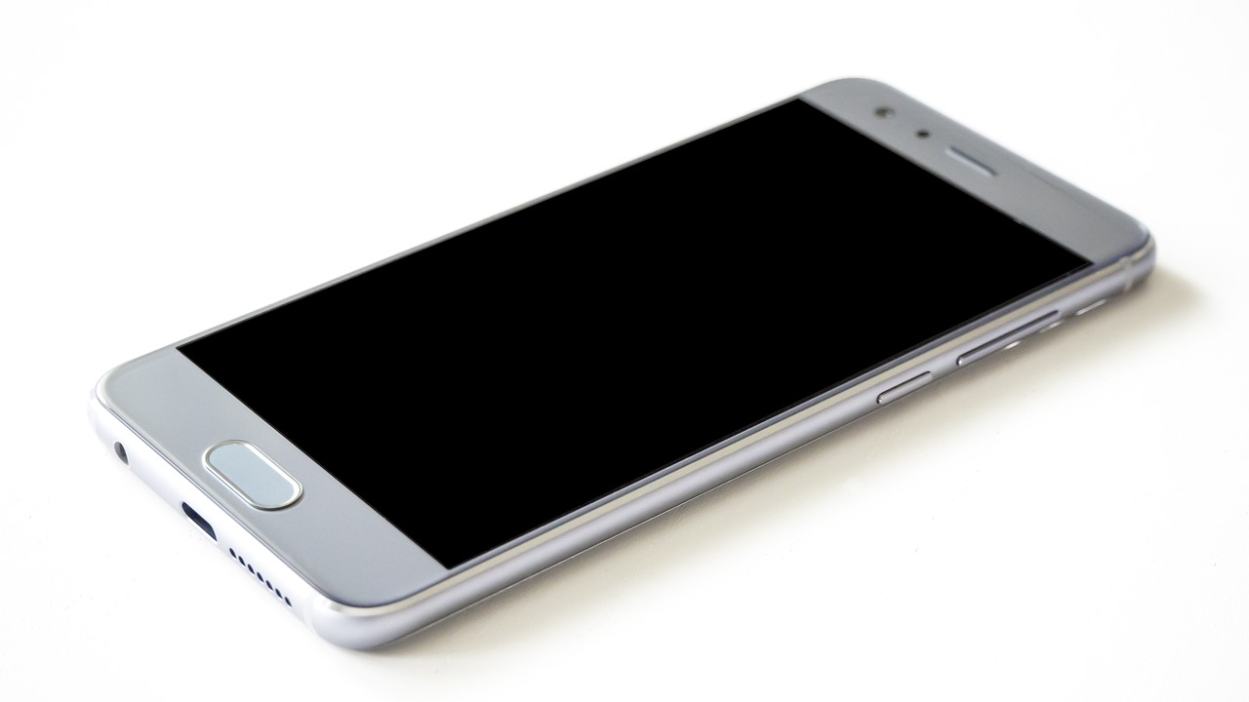

Ancient Artefacts in AR
Linking artefacts to historical figures
Notes:
Make sure students have their own copy of the task sheet, either printed or digitally.

Slide 5
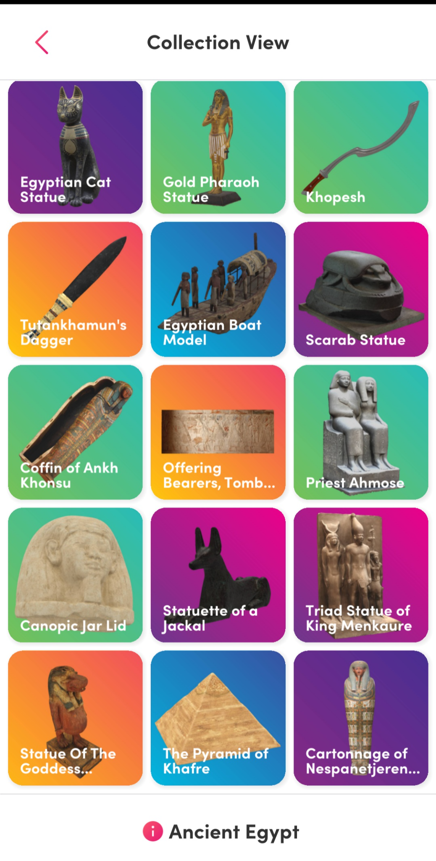
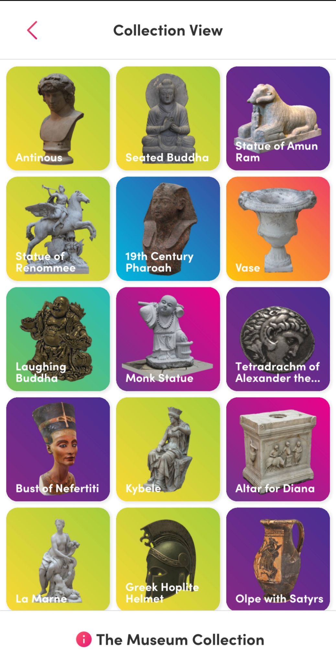
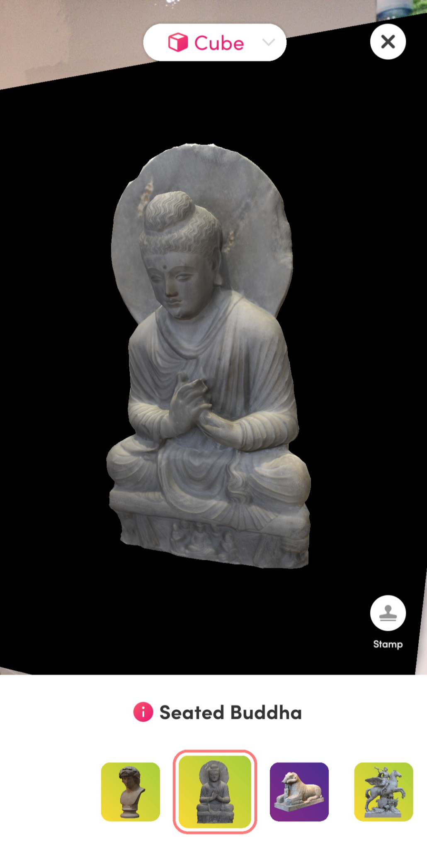
Ancient Artefacts in AR
Linking artefacts to historical figures
View in Cube (if using Merge Cubes) or 3D (if there are no Merge Cubes available)
Look at different artefacts in AR.
Take a screenshot of selected artefacts (up to four).
Add the screenshots to your Task Sheet.
Write facts about each artefact. Use the ‘i’ icon on the app and/or do your own research online.
Link the artefact to an ancient historical figure.

Slide 6


AR Experience: Cleopatra
Scan the QR codes using your mobile devices. You can view the first one using a Merge Cube if you have one. The second option is the non-Merge Cube version in AR.
Ancient Egypt - Cleopatra Profile (Merge Cube AR): https://edu.cospaces.io/KLK-YKD
Ancient Egypt - Cleopatra Profile (AR): https://edu.cospaces.io/GUB-URQ

Slide 7
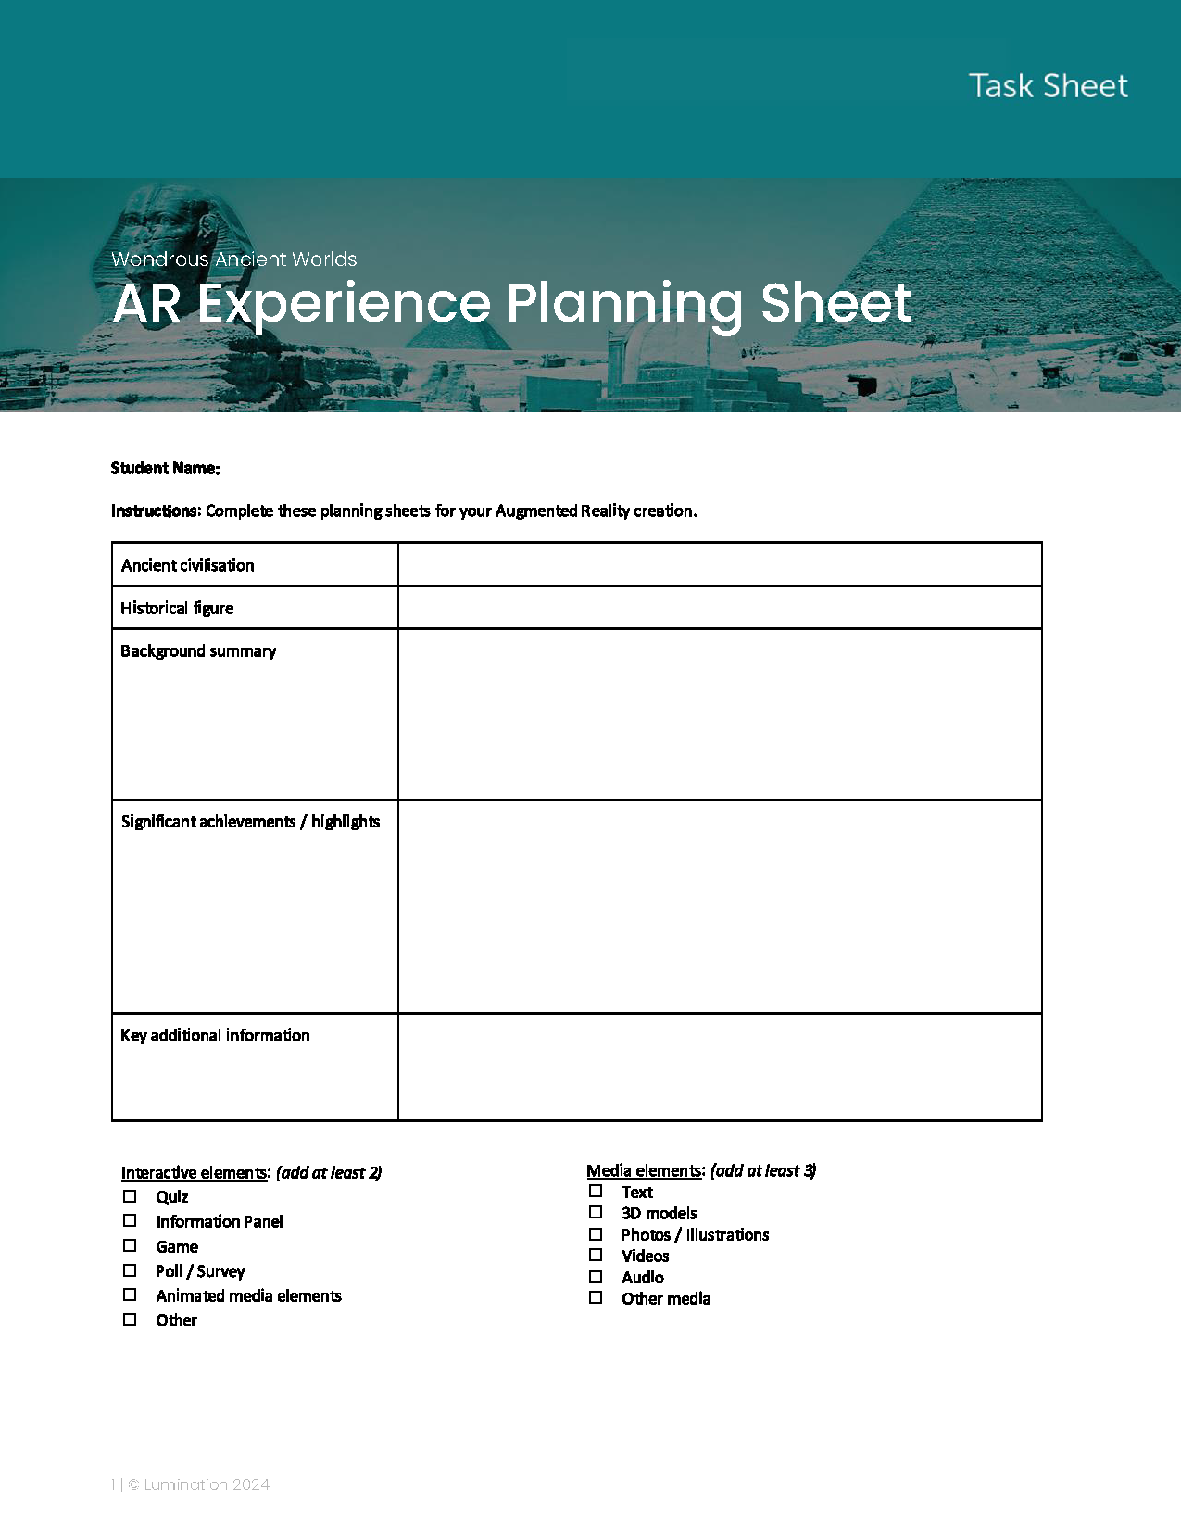
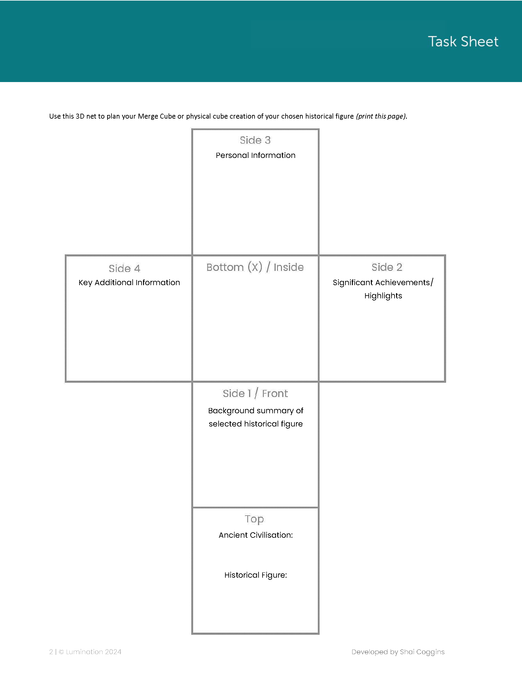
AR Creation Planning Sheet
Fill out your planning sheet before building your AR creation.

