Slide 1

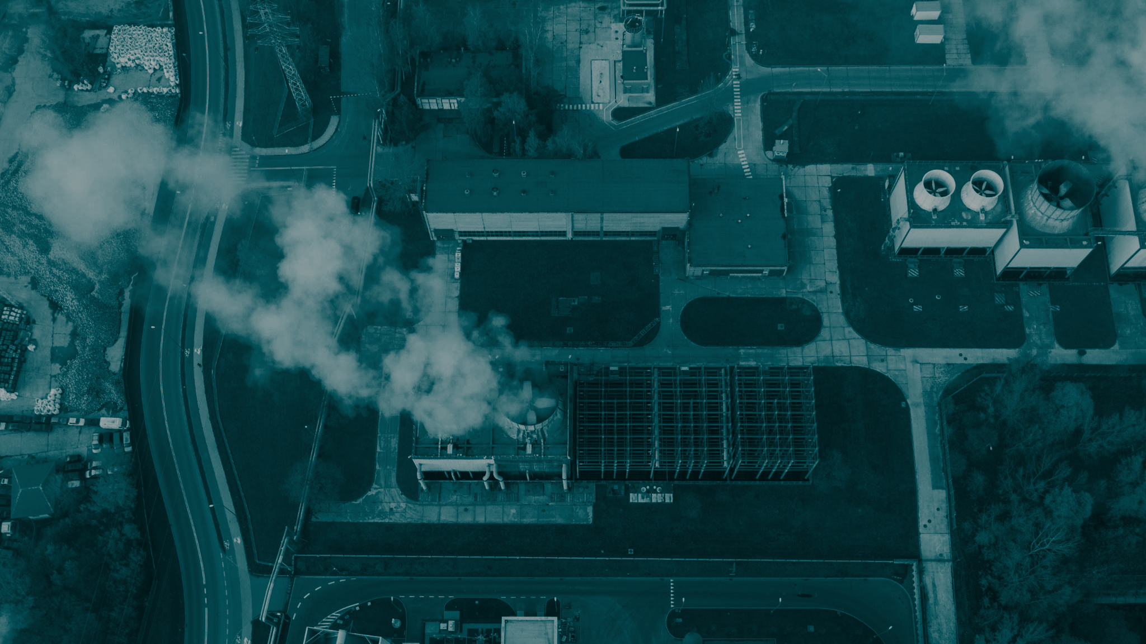
DIGITAL NOTEBOOK
Get to know your Carbon Footprint
Student Name:

Slide 2

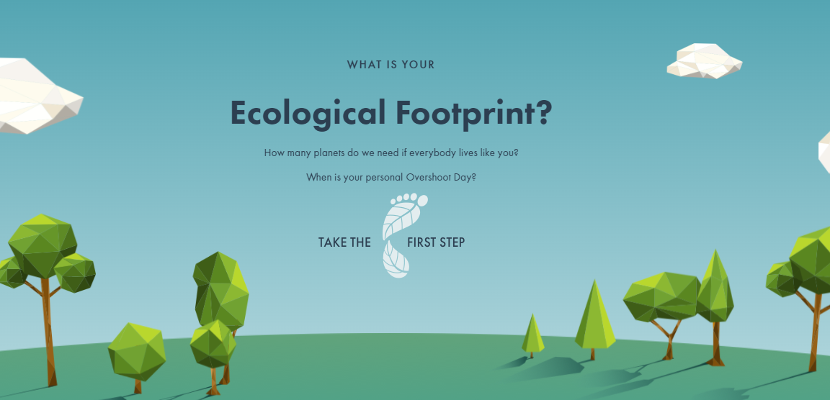
Ecological / Carbon footprint
Let’s check your carbon footprint.
Ecological Footprint Calculator

Slide 3
My ecological footprint
Below are my results.
Also post your data to our whole class board and our <placeholder link for whole class spreadsheet>.

Slide 4
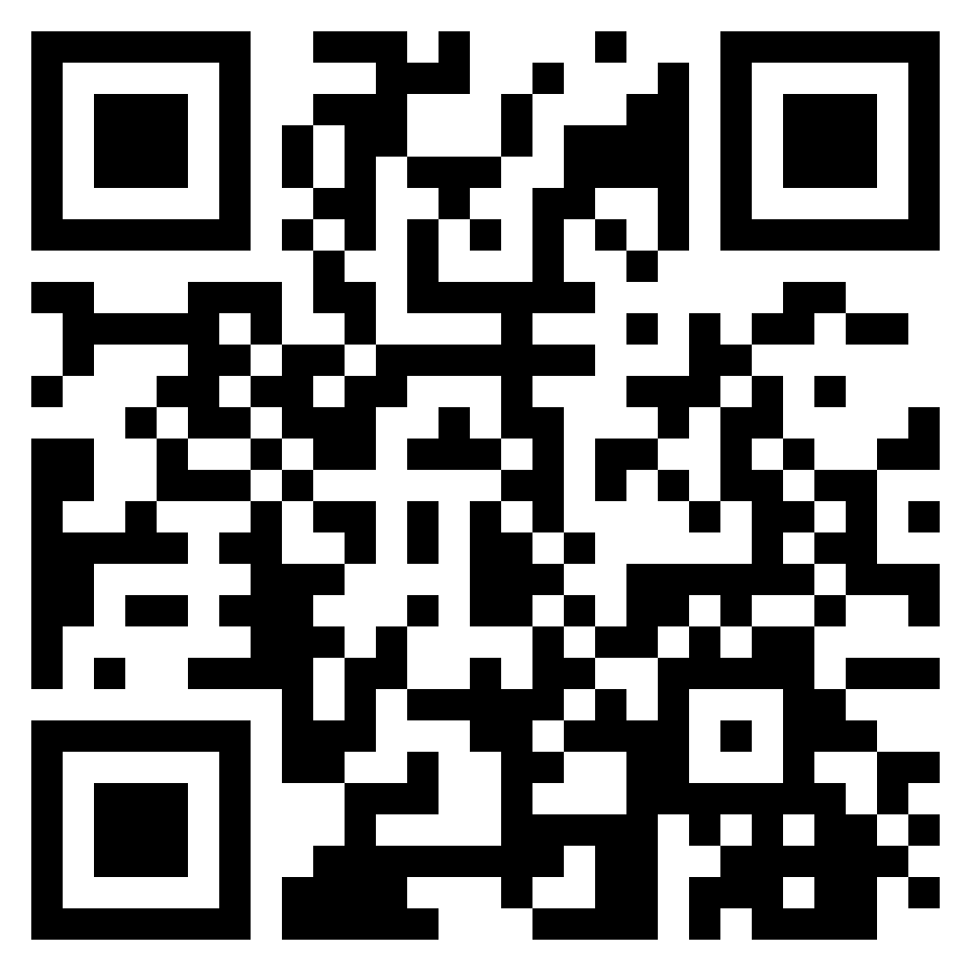
Meet your carbon footprint in VR
Scan the QR code using your mobile device and answer the following questions.
What everyday choices did you see in the video that impacts our environment? (e.g. buying imported foods, excessive driving)
How did you feel when viewing these scenes? Why?
What were some strategies to reduce your carbon footprint?
Meet your carbon footprint (4.46)

Slide 5
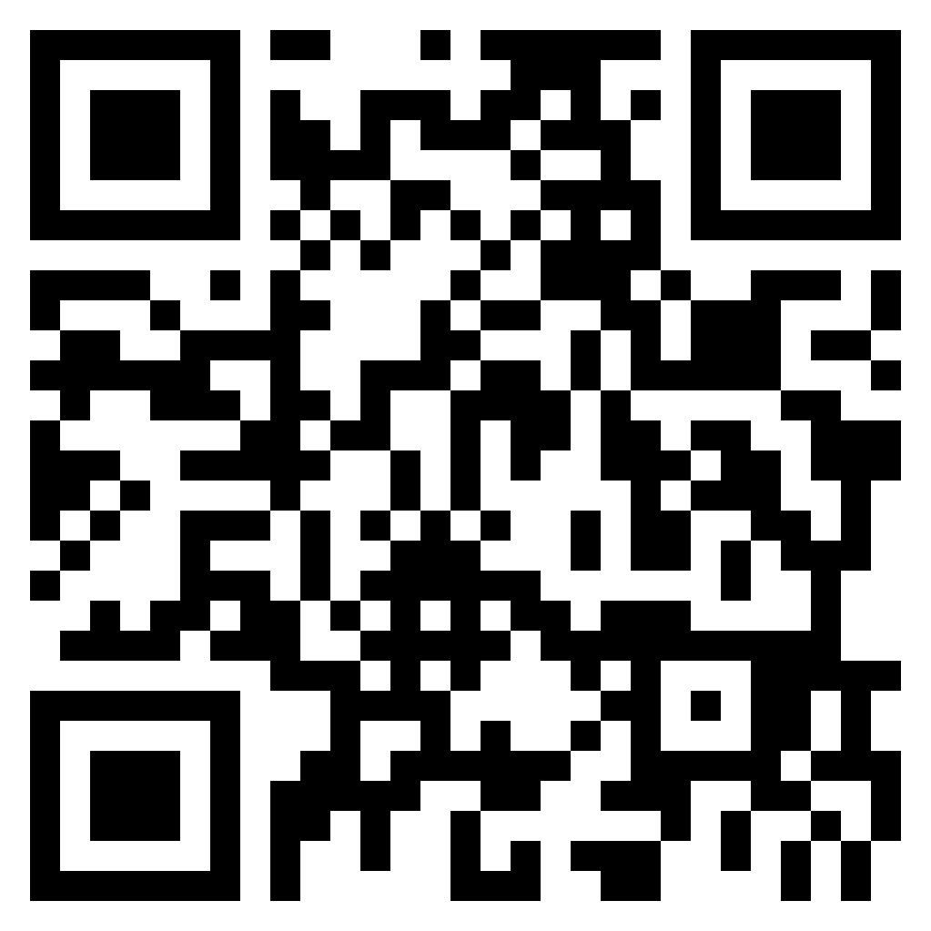
What impact do you have on the planet?
Scan the QR code using your mobile device and answer the following questions.
What was an interesting fact that you learnt?
What countries use the most amount of materials/resources? Why do you think this is?
When it came to transport, who had the biggest carbon impact?
What’s one thing you now hope to do differently to lower your carbon footprint?
What impact do you have on the planet?
(6.14)

