Slide 1

TEACHING DECK
How machines learn
Design, implement and evaluate data using machine learning

Slide 2

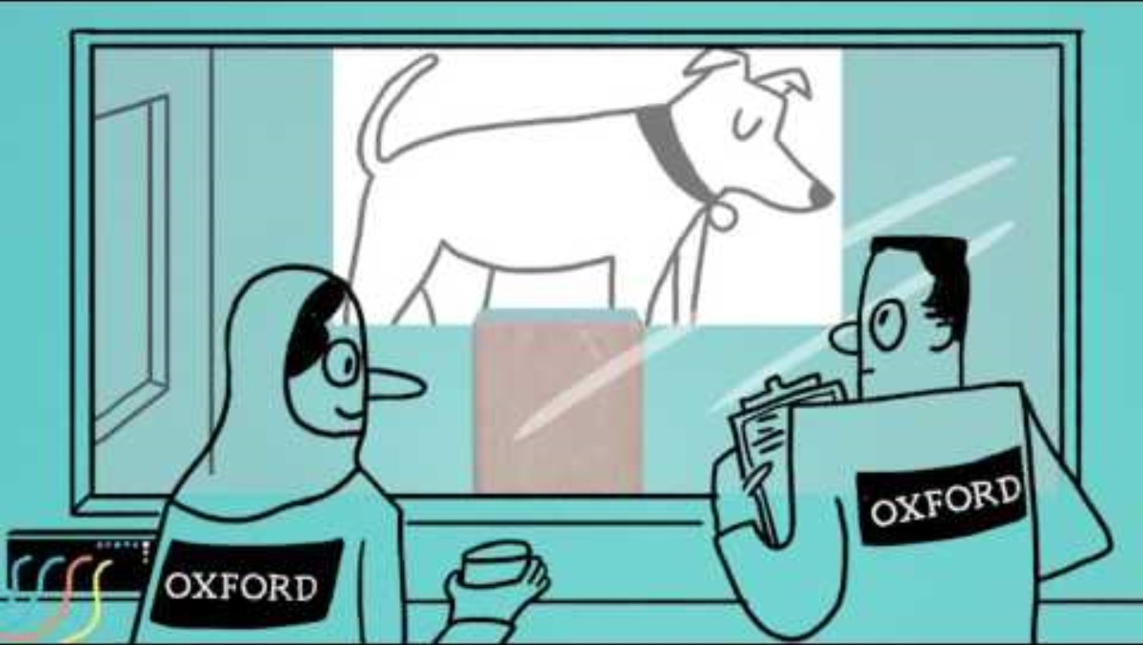
What is Machine Learning?
Introduction to Machine Learning
Notes:
Video length: 2:19

Slide 3
Let’s talk about it
Discussing Machine Learning
What do you understand about Machine Learning?
Can you think of real life examples of how Machine Learning is currently being used?
What other possible ways can Machine Learning be used?

Slide 4
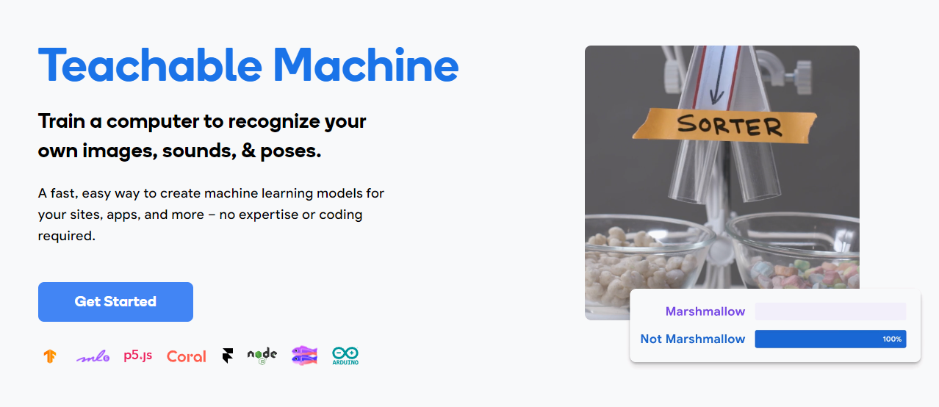
Teachable Machine

Slide 5
How to Teach a Machine
Go to teachablemachine.withgoogle.com
and click on ‘Get Started’.
Scroll down to see tutorials and sample projects.

Slide 6

Machine Learning: What it can do
How is Machine Learning is used to solve real world problems.
Notes:
Video length: 5:19

Slide 7
Let’s talk about it
What do you know now about Machine Learning?
How does the Machine Learning tool work?
What do you understand about the input and output process?
What do you understand about the ‘Classes’?
Can you think of other ideas on how to use this Machine Learning tool?

Slide 8
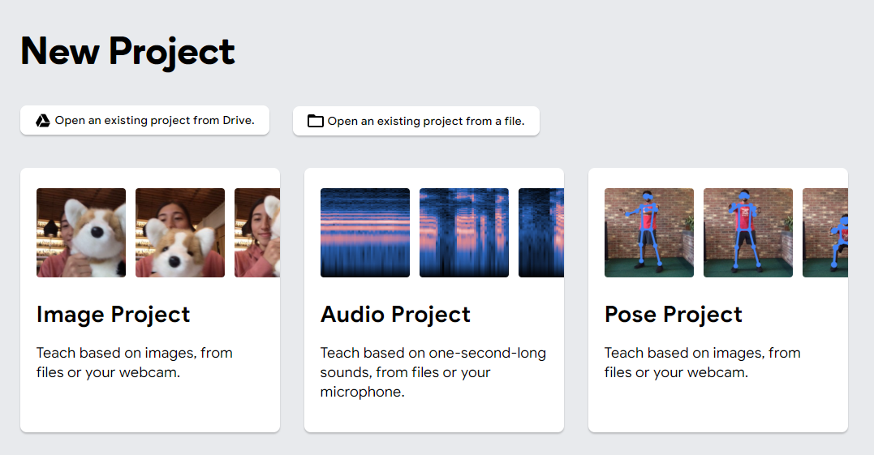
Teachable Machine Instructions
Decide what you want your machine to do. See sample project ideas on the next page.
Start a new project.
Choose an Image, Audio, or Pose Project.
Train the machine using your webcam or pre-downloaded images.
Test your machine. Record responses on page 7. Identify class, label, and number of samples. Add other notes.
Add sample images and screenshots on page 8.
Write your reflections on page 9.
If there’s time, test other students’ projects and share feedback.

Slide 9
Mini Project Ideas
What will you design today?
Feelings Identifier
Get the machine to identify basic feelings based on images/webcam input (e.g., Sad, Happy, Angry).
Sound Level Identifier
Get the machine to identify sound levels (e.g., Loud, Regular, Soft).
Posture Identifier
Get the machine to identify the correct posture for a particular pose or stance.

Slide 10
Machine Learning Task
Topic:
Model Type:
Class | Label | Number of Samples | Trials |  |  |  |  |  |  |  |  |  | NOTES
 |  |  | 1 | 2 | 3 | 4 | 5 | 6 | 7 | 8 | 9 | 10
1
2

Slide 11
Your Samples
Add some of your samples here.
Add images, text, etc.

Slide 12
Reflection
Write about your machine learning project here.
Some guiding questions:
What did you design? Why did you choose to design this for your machine learning project?
What real world problem does this design solve?
What worked and what didn’t work in your design?
What would you change or do differently with this design? Why?

Slide 13
Machine Learning Task Rubric Pt 1
Criteria | Excellent (4) | Proficient (3) | Basic (2) | Limited (1)
Project understanding | Demonstrates a deep understanding of the machine learning project, including the problem being addressed and its relevance. Clearly defines the project's scope and purpose. | Shows a good understanding of the machine learning project, including the problem being addressed. Defines the project's scope and purpose adequately. | Shows some understanding of the machine learning project, but the problem being addressed and its relevance may not be clearly defined. The scope and purpose are somewhat vague. | Demonstrates a limited understanding of the machine learning project, and the problem being addressed is unclear. The scope and purpose are poorly defined.
Data acquisition | Effectively acquires and uses a diverse range of data from multiple sources, demonstrating a high level of creativity and resourcefulness. Data is relevant and well-prepared. | Acquires and uses data from multiple sources, demonstrating creativity and resourcefulness. Data is mostly relevant and adequately prepared. | Acquires data from limited sources, with some creativity. Data relevance and preparation may be inconsistent. | Acquires limited data from few sources, with minimal creativity. Data relevance and preparation are lacking.
Data storage and validation | Skillfully uses stores, records, and validate data. Demonstrates a high level of proficiency in organising and validating data using a spreadsheet. | Effectively stores, records, and validate data. Demonstrates proficiency in organising and validating data. | Stores, records, and validates data, but with some inconsistencies. Organisation and validation may need improvement. | Attempts to store, record, and validate data, but with significant errors. Organisation and validation are lacking.
Teachable Machine implementation | Successfully utilises Google's Teachable Machine tool to train a machine learning model. Demonstrates a clear understanding of the tool's features and functionality. | Effectively uses Google's Teachable Machine tool to train a machine learning model. Shows competence in understanding the tool's features and functionality. | Attempts to use Google's Teachable Machine tool, but with some difficulties. Understanding of features and functionality may be limited. | Struggles to use Google's Teachable Machine tool, resulting in a poorly trained machine learning model. Limited understanding of features and functionality.

Slide 14
Machine Learning Task Rubric Pt 2
Criteria | Excellent (4) | Proficient (3) | Basic (2) | Limited (1)
Project presentation | Delivers a well-organised and engaging presentation that effectively communicates the project's objectives, process, and outcomes. Utilises multimedia elements effectively. | Presents the project in a organised manner, effectively communicating the objectives, process, and outcomes. Uses some multimedia elements. | Presents the project with some organisation, but communication of objectives, process, and outcomes may be unclear. Limited use of multimedia elements. | Presents the project in a disorganised manner, with unclear communication of objectives, process, and outcomes. Minimal use of multimedia elements.
Creativity and innovation | Demonstrates exceptional creativity and innovation in approaching the machine learning project. Introduces unique elements or approaches that enhance the project. | Displays creativity and innovation in approaching the machine learning project. Introduces some unique elements or approaches. | Shows some creativity and innovation in the machine learning project, but with limited unique elements or approaches. | Lacks creativity and innovation in approaching the machine learning project.
Collaboration and communication skills | Collaborates effectively with team members, actively participates in discussions, and communicates ideas clearly. | Collaborates well with team members and communicates ideas effectively. | Participates in collaboration with team members, but communication may lack clarity at times. | Struggles to collaborate with team members and communicate ideas effectively.
Documentation and reflection | Provides thorough documentation of the project, including data sources, code, and a reflective analysis of the process. Reflection demonstrates a deep understanding of the project's challenges and successes. | Provides adequate documentation of the project, including data sources and code. Reflection demonstrates a good understanding of the project's challenges and successes. | Provides basic documentation of the project, but some elements may be incomplete. Reflection shows a limited understanding of the project's challenges and successes. | Provides minimal documentation of the project, with significant gaps in data sources and code. Reflection lacks depth and understanding of the project.

