Slide 1

TEACHING DECK
Cells in Focus
Zooming in on plant and animal cells in VR

Slide 2

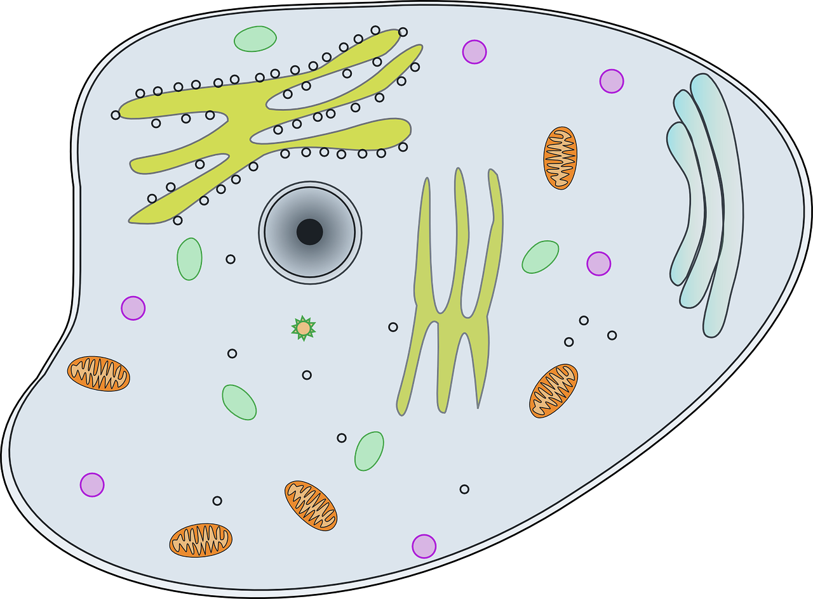
Name this Cell
What type of cell is this?
Notes:
The cell in the image is an animal cell. Animal cells are a type of eukaryotic cell, meaning that they have a nucleus and other membrane-bound organelles. Animal cells are characterized by their lack of a cell wall and their presence of centrioles.
Centrioles are organelles that help with cell division. They are not found in plant cells.
The image shows a labeled animal cell. The organelles that are labeled are:
Nucleus
Cytoplasm
Mitochondria
Golgi apparatus
Endoplasmic reticulum
Ribosomes
Vacuole
The nucleus is the largest organelle in the cell and it contains the cell's DNA. The cytoplasm is the jelly-like substance that fills the cell and contains the other organelles.
Mitochondria are organelles that produce energy for the cell. The Golgi apparatus is responsible for packaging and distributing proteins. The endoplasmic reticulum is responsible for synthesizing proteins. Ribosomes are organelles that produce proteins. The vacuole is a storage organelle.
Animal cells are found in all animals, from simple organisms like sponges to complex organisms like humans. They are essential for life and play a variety of roles in the body, such as providing energy, building tissues, and fighting infection.

Slide 3
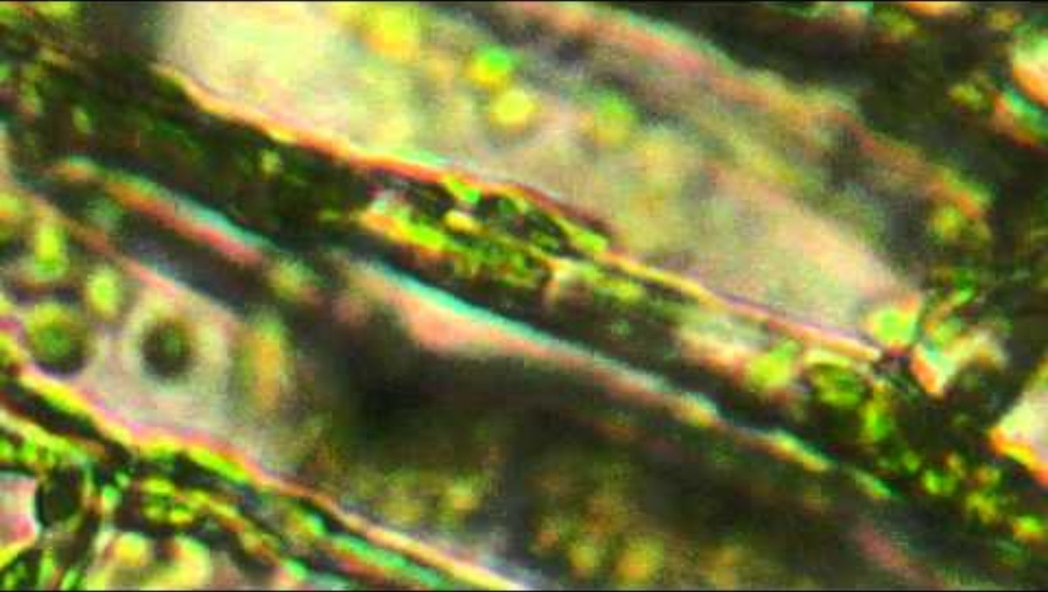
Plant Cell
Under the microscope

Slide 4
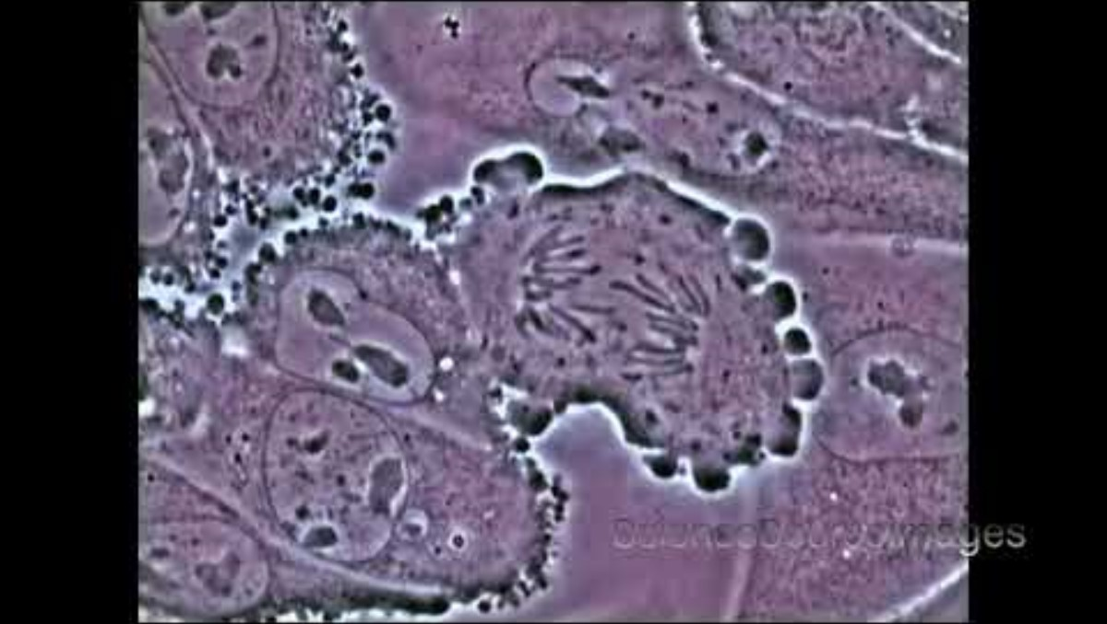
Animal Cell
Under the microscope

Slide 5
Cells Discussion
Illustration vs under the microscope
Guiding questions:
What was it like viewing plant and animal cells using a microscope?
Are you able to visualise and understand the different parts and functions of cells better than seeing a photo or illustration?

Slide 6
Learning Stations
Working in small groups
01
Brainstorming Session: Think + Puzzle + Explore
Use: Student Digital Notebook
Work On: Thinking Routine
02
HHVR Station: View Plant & Animal Cells In VR
Check: Student Digital Notebook
View: HHVR Videos (Scan QR Codes)
Respond to Questions
03
Creation Station: Draw A Cell
Use an app like MS Paint for digital illustrations
You can also use traditional media (pen, pencils, paper, etc)
Share illustration in your Student Digital Notebook

Slide 7
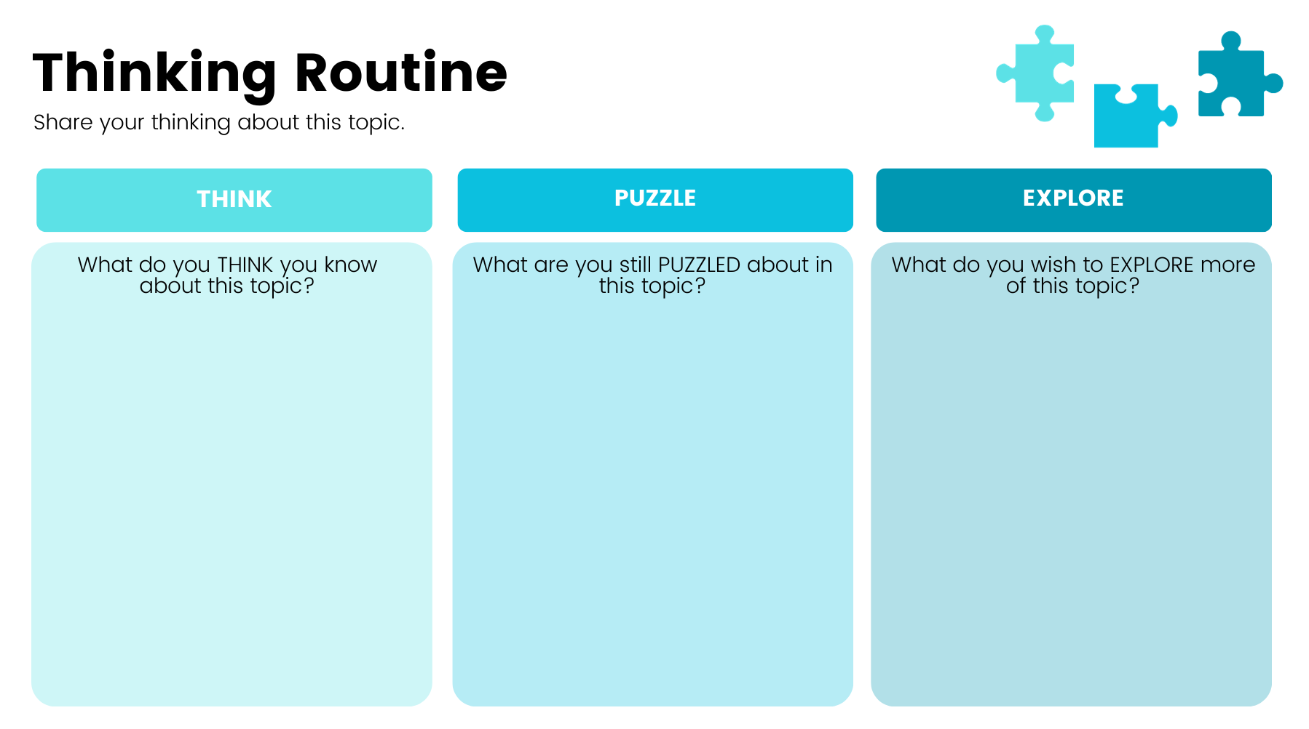
Brainstorming Session
Student digital notebook

Slide 8


HHVR Videos
Scan the QR codes using your mobile devices.
View a Plant Cell In VR
https://bit.ly/PlantCellVR
View an Animal Cell In VR
https://bit.ly/AnimalCellVR

Slide 9
Plant and Animal Cells Mind Map
Create a mind map of plant and animal cells’ form and function, starting with the organelle. See example below.
Used For
Mitochondria
Oxidative Phosphorylation
Respiration
Organelles
Animal Cell
Non-Living Granules
Food and Materials Storage
Ribosomes
Translation of the Genetic Code

Slide 10
Plant and Animal Cells in VR
Task questions
Based on this activity, can you name at least three things that are the same between animal cells and plant cells?
Can you name at least one thing that’s different in a plant cell? What is its function?
Can you name at least one thing that’s different in an animal cell? What is its function?

Slide 11
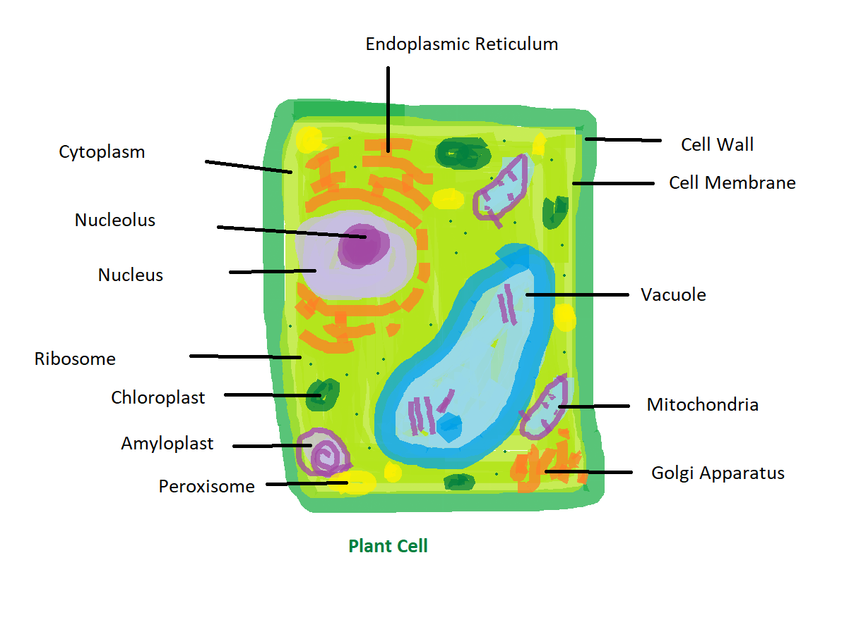
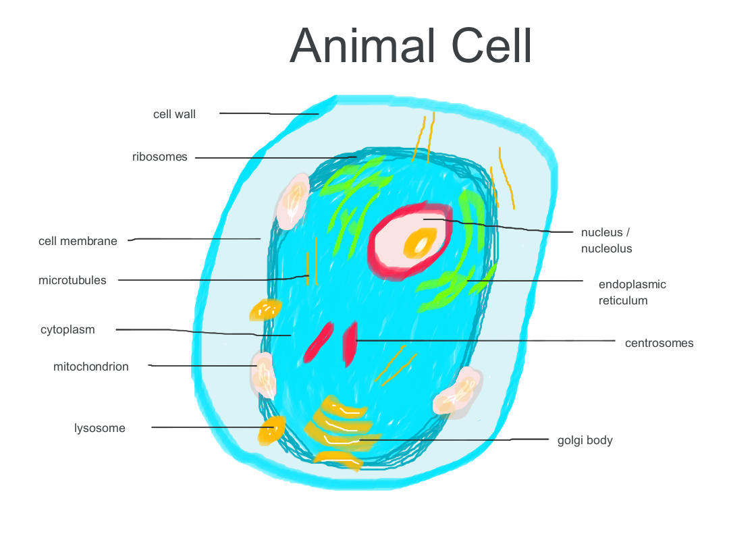
Draw a Cell

Slide 12
Plant and Animal Cells
What was one thing that PUZZLED you about cells that had been answered through this activity? What did you learn?

Slide 13
Quick Quiz
Answer the following questions in your digital notebooks or online form.
Which of these cell structures is present in both plant and animal cells?
  Cell wall
  Chloroplast
  Cytoplasm
  Vacuole
  Which cell component controls the substances that enter and exit a cell?
  Cell membrane
  Cell wall
  Chloroplast
  Cytoplasm
In which component of a plant cell does photosynthesis occur?
  Cell membrane
  Cell wall
  Chloroplast
  Cytoplasm
What does the cell nucleus do?
  Provides support
  Keeps the cell firm
  Absorbs sunlight
  Controls cell activity
What makes raw vegetables crunchy?
  Their cytoplasm
  Their mitochondria
  Rigid cell walls
  Their chloroplasts
Notes:
You can get students to answer these questions using their digital notebooks or you can transfer the questions to an online form like MS Form or Google Form, or to a learning management system for automatic marking.

Slide 14
Quick Quiz: Answers
Answer the following questions in your digital notebooks or online form.
Which of these cell structures is present in both plant and animal cells?
  Cell wall
  Chloroplast
  Cytoplasm
  Vacuole
  Which cell component controls the substances that enter and exit a cell?
  Cell membrane
  Cell wall
  Chloroplast
  Cytoplasm
In which component of a plant cell does photosynthesis occur?
  Cell membrane
  Cell wall
  Chloroplast
  Cytoplasm
What does the cell nucleus do?
  Provides support
  Keeps the cell firm
  Absorbs sunlight
  Controls cell activity
What makes raw vegetables crunchy?
  Their cytoplasm
  Their mitochondria
  Rigid cell walls
  Their chloroplasts
Notes:
You can get students to answer these questions using their digital notebooks or you can transfer the questions to an online form like MS Form or Google Form, or to a learning management system for automatic marking.

