Slide 1
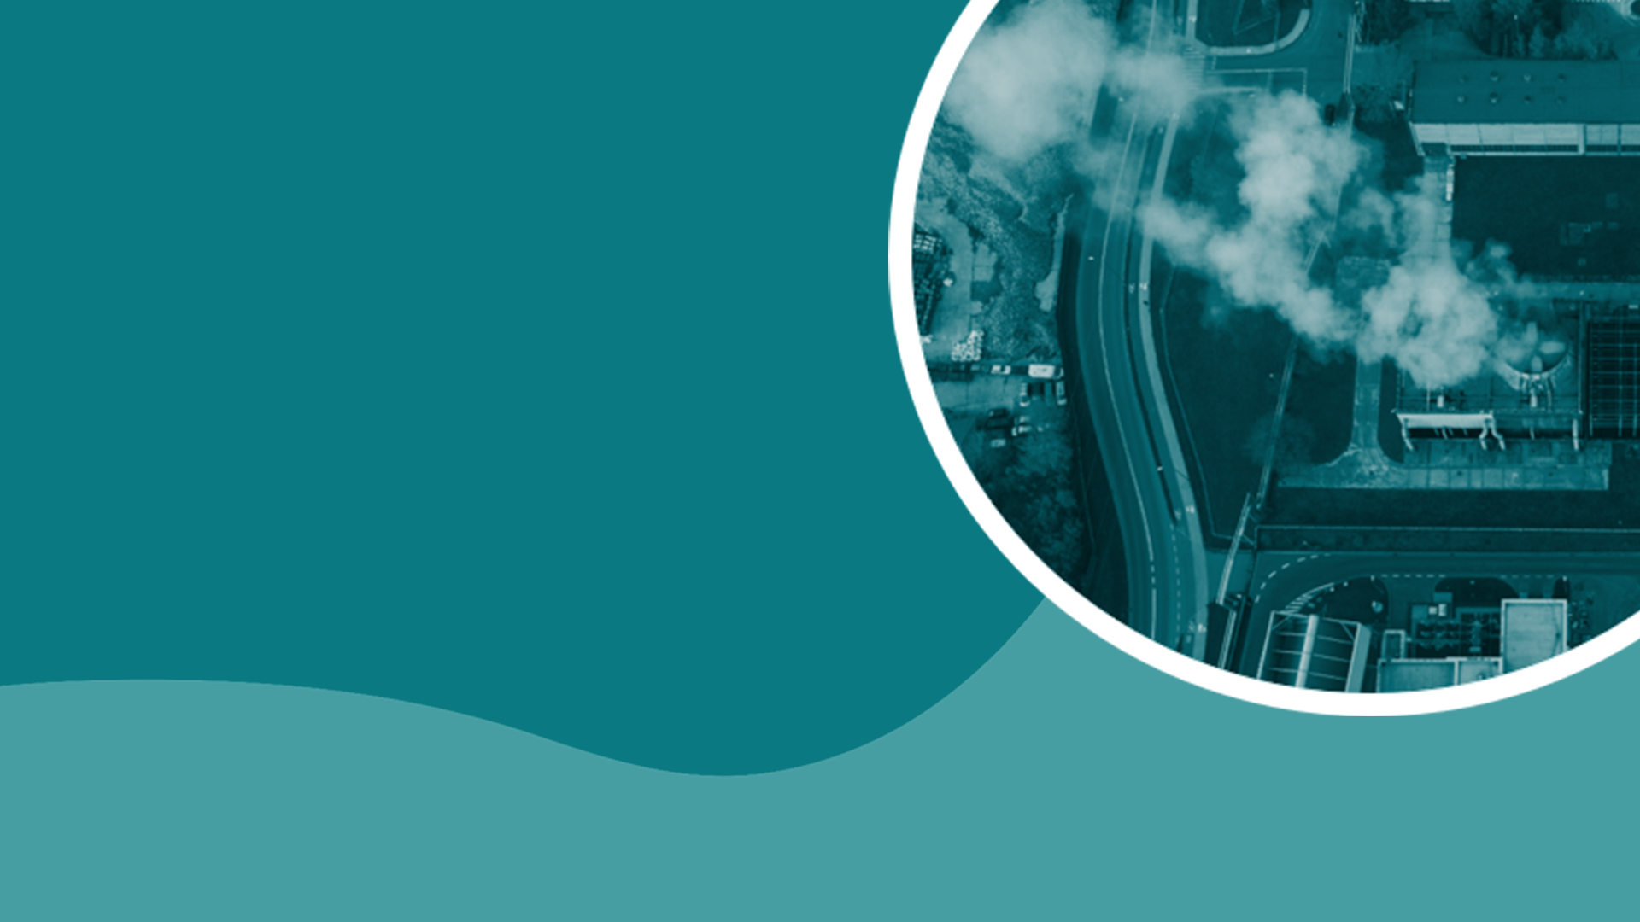
TEACHING DECK
Get to know your Carbon Footprint
Explore your carbon footprint and learn how it affects climate change.

Slide 2

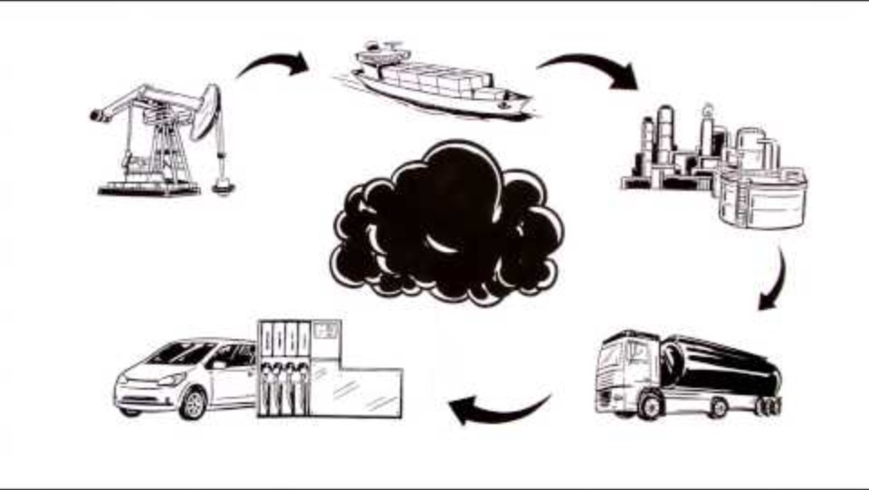
Carbon footprint
What is it? What do you know?

Slide 3
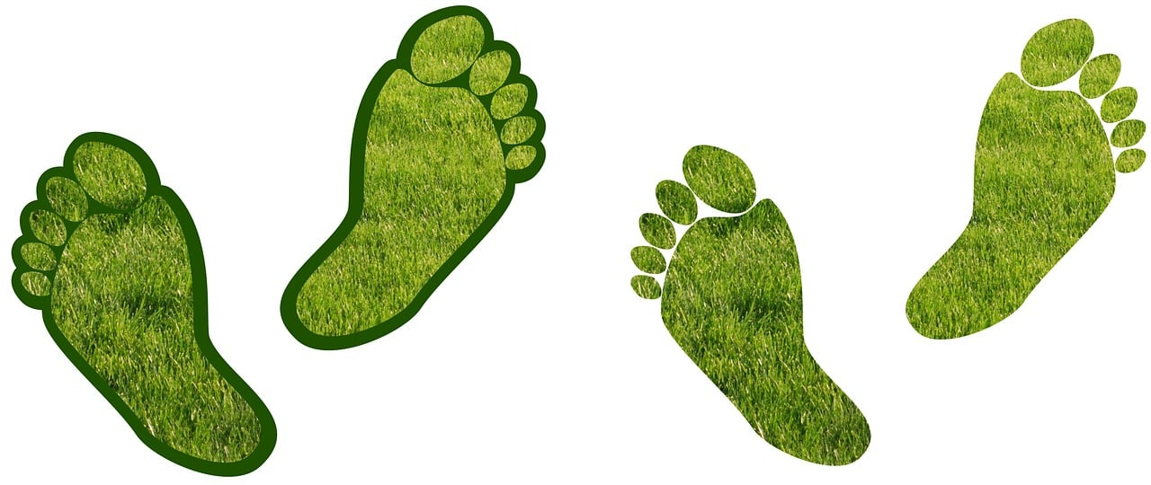
Ecological / Carbon footprint
What did you know? What did you learn?
What did you find most surprising from the video?
Have you ever looked into your personal carbon footprint?
Have you heard of “Earth Overshoot Day”?

Slide 4
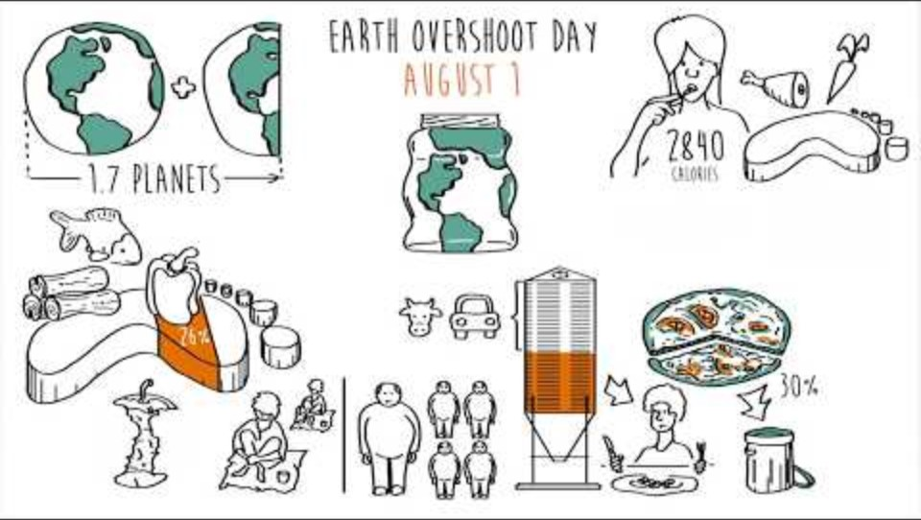
Earth Overshoot Day
Let’s learn what it is.

Slide 5
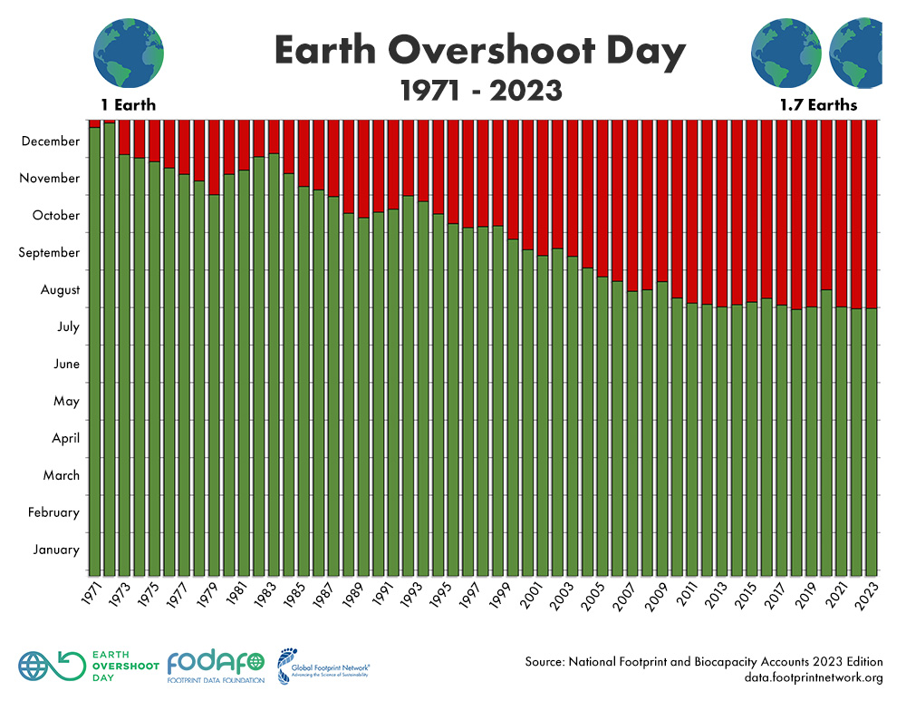
Earth Overshoot Day marks the date when humanity’s demand for ecological resources and services in a given year exceeds what Earth can regenerate in that year.

Slide 6
Earth Overshoot Day
Let’s discuss.
What is one of your food consumption practices that negatively affect the environment?
Do they have any food consumption practices that positively affect the environment? What are they?
What other consumption practices do you know that may affect the environment? (driving to school/work, using the air conditioning/heater regularly, etc).

Slide 7
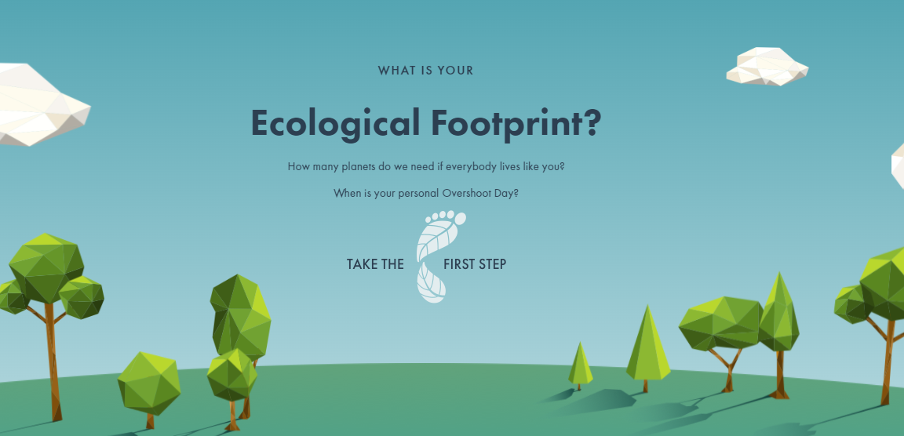
Ecological / Carbon Footprint
Time to check your footprint.
Ecological Footprint Calculator

Slide 8
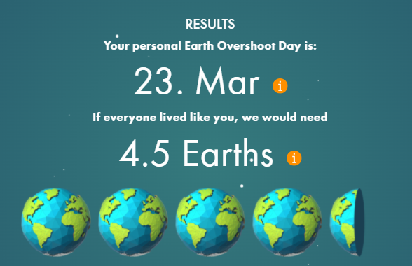
Ecological / Carbon footprint
Post your results.
Post a screenshot of your results on slide 3 of your student notebook.
Post your results to our whole class board: Class Eco Footprint.
Add your name and data to our class spreadsheet.
Example of results.

Slide 9
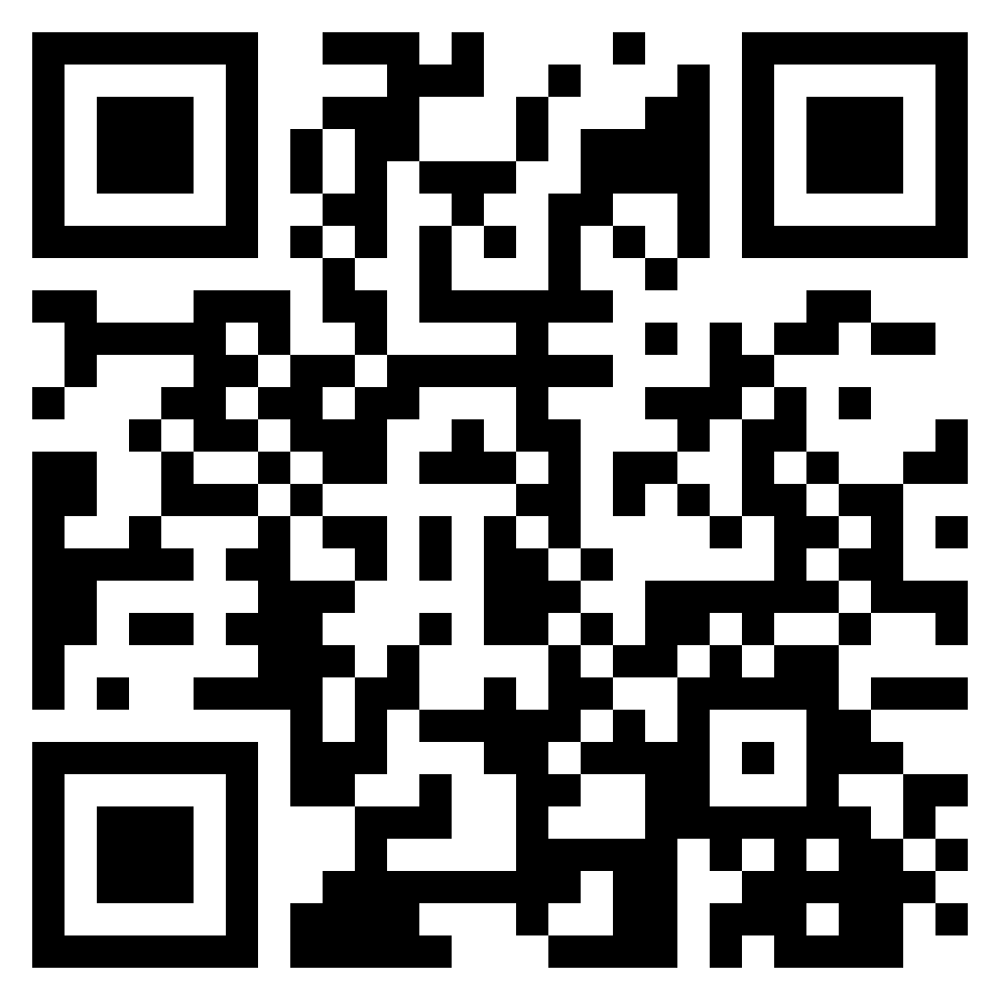
Meet your carbon footprint in VR
Scan the QR code using your mobile device and answer the following questions.
What everyday choices did you see in the video that impacts our environment? (e.g. buying imported foods, excessive driving)
How did you feel when viewing these scenes? Why?
What were some strategies to reduce your carbon footprint?
Meet your carbon footprint (4:46)

Slide 10
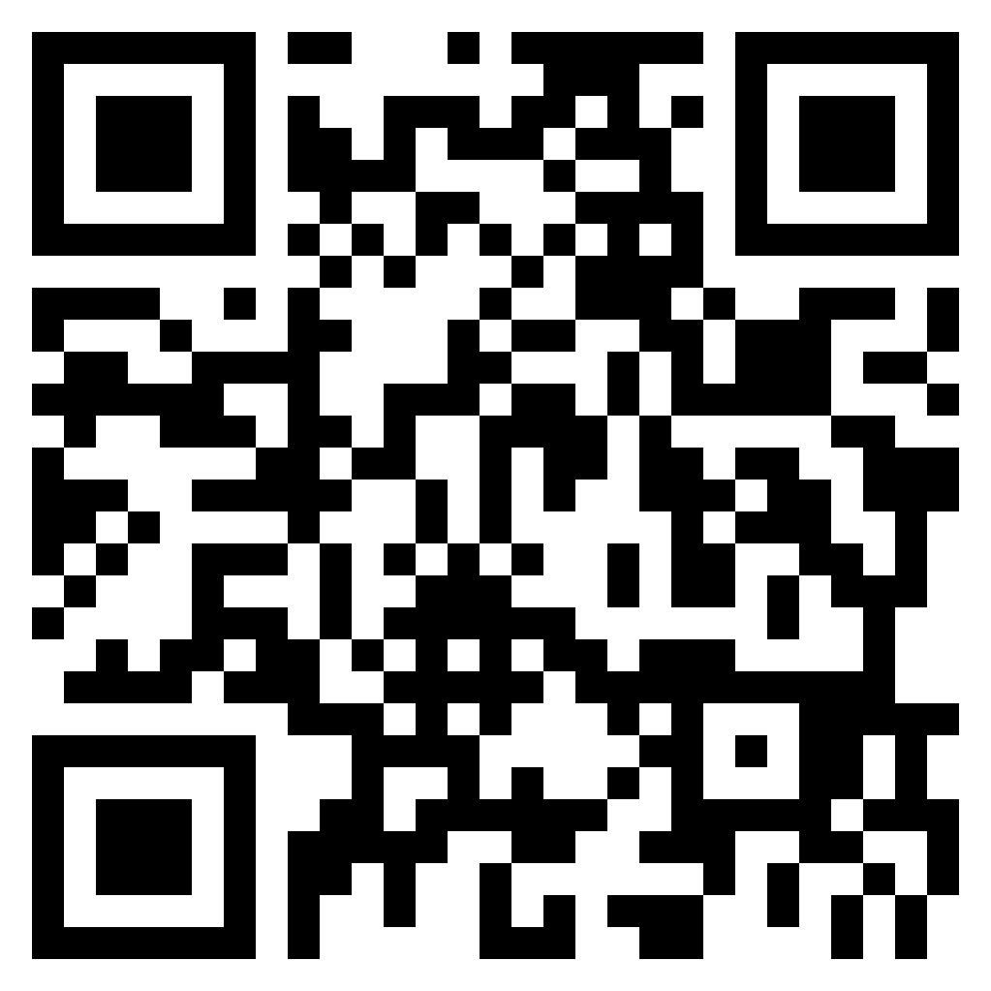
What impact do you have on the planet?
Scan the QR code using your mobile device and answer the following questions.
What was an interesting fact that you learnt?
What countries use the most amount of materials/resources? Why do you think this is?
When it came to transport, who had the biggest carbon impact?
What’s one thing you now hope to do differently to lower your carbon footprint?
What impact do you have on the planet?
(6:14)

Slide 11
Reflection
Let’s look at our class data around carbon footprint.
What was the earliest Overshoot Day we had? What was the latest? What does this mean?
What was the least number of Earths needed? What was the most number of Earths?
Let’s look at our class average for how many Earths we need to survive.
What’s one thing that you are hoping to change in your
lifestyle to reduce your carbon footprint?

