Slide 1

TEACHING DECK
Painting with music
Explore the connection between art and music.

Slide 2

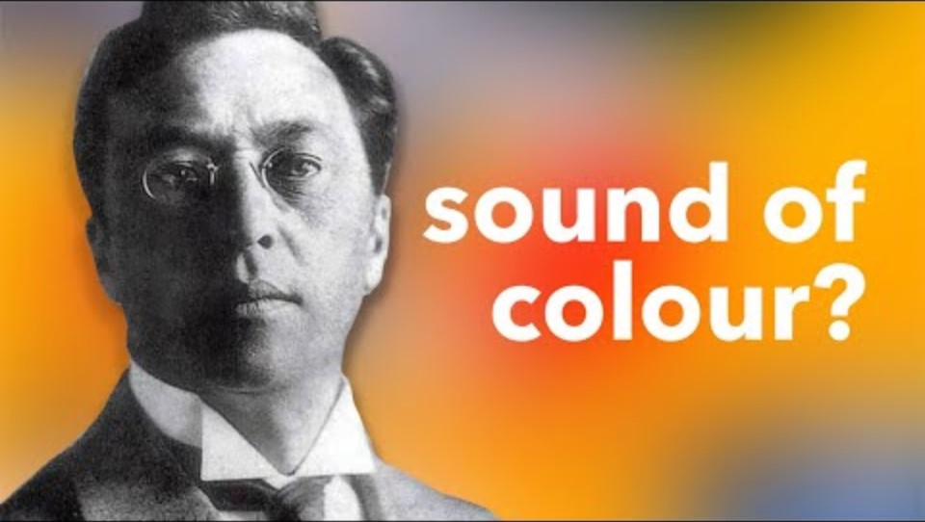
What's the sound of colour?
Kandinsky and music

Slide 3
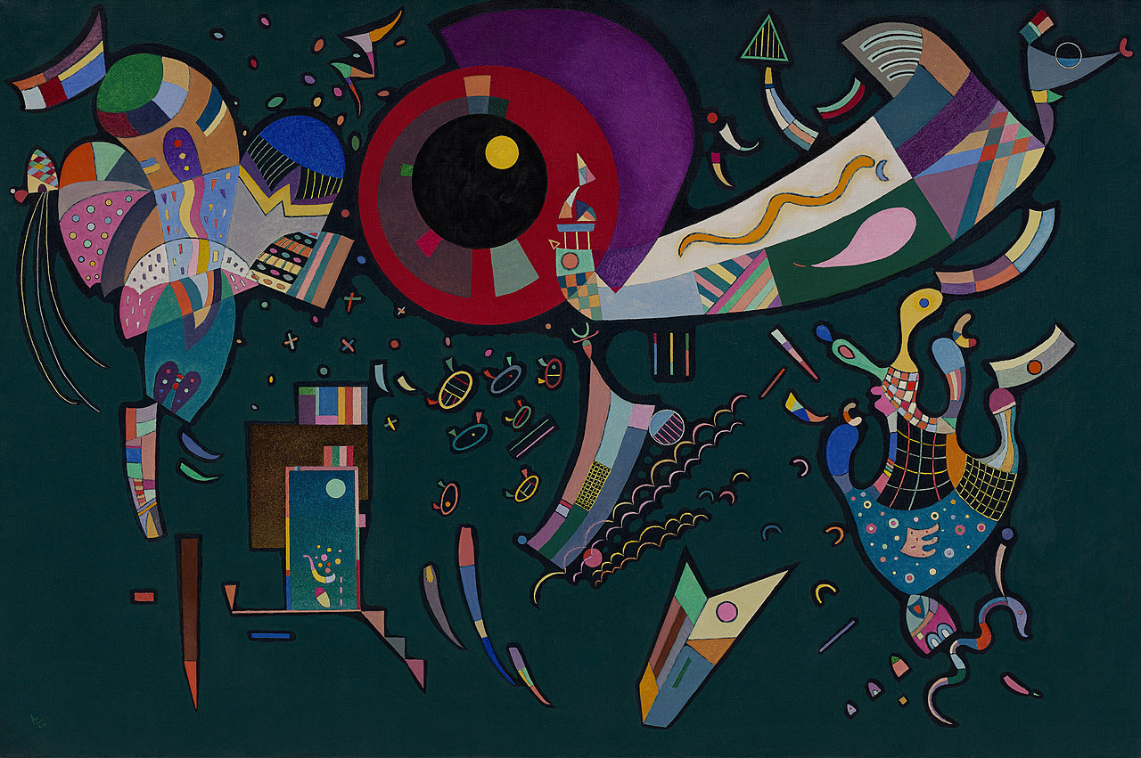

Discussion
Talking about Kandinsky and music
What have you learnt about Kandinsky?
What do you know about the condition, ‘synesthesia’?
Can you imagine being able to paint with music? How do you think you could do it?
Around The Circle; 1940

Slide 4
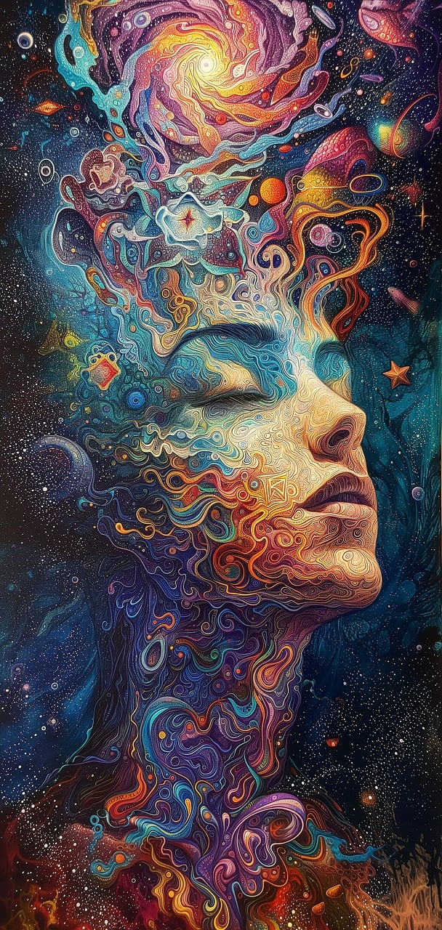
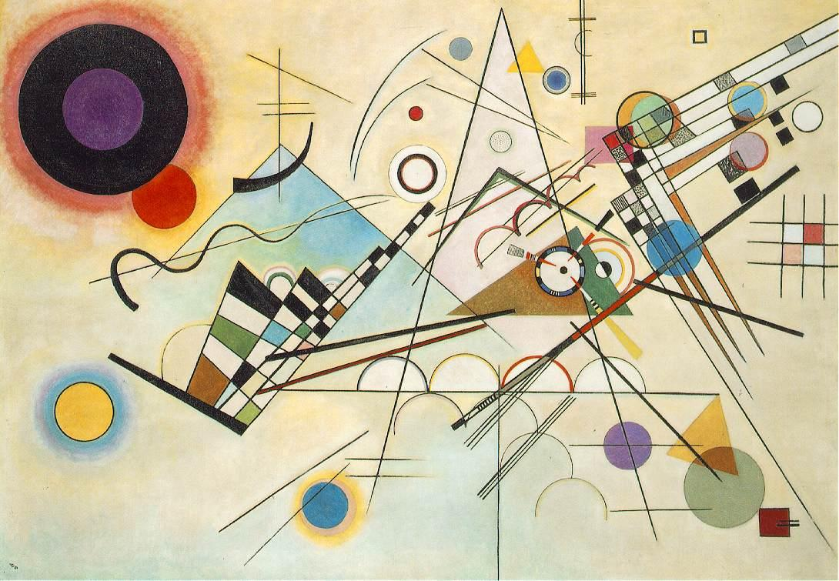
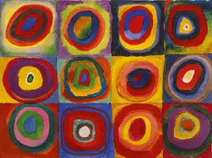
Discussion
Talking about Kandinsky and music
What else do you know about Wassily Kandinsky, music, synesthesia, and making art using music?
Composition 8; 1923; Kandinsky
Colour Study, Squares with Concentric Circles; 1913; Kandinsky

Slide 5
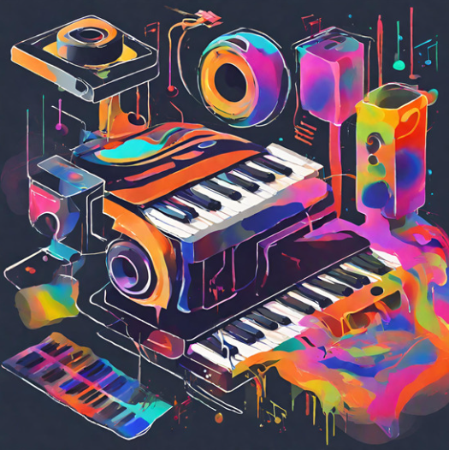
Paint with music
Art, music, and machine learning
Machine learning is a way of teaching computers to learn and make decisions on their own.
In this app we’re going to use today, Google engineers have used something called Magenta’s DDSP (Differentiable Digital Signal Processing) to code the computer to be able to turn drawings and brush strokes on the screen into various musical instruments all on its own.

Slide 6
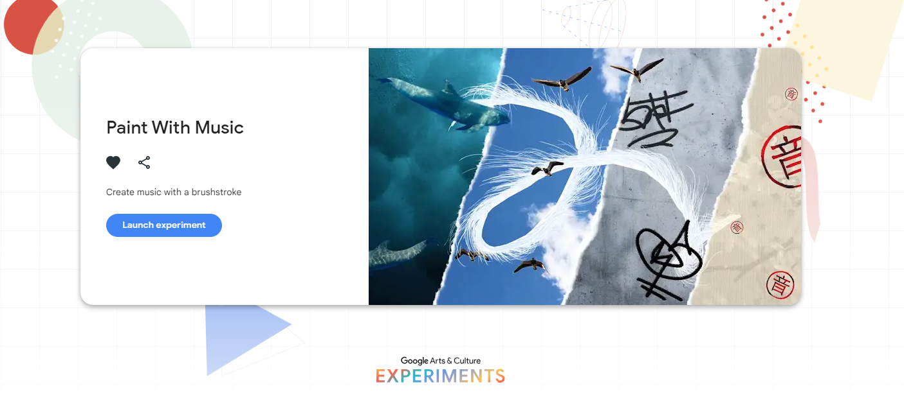
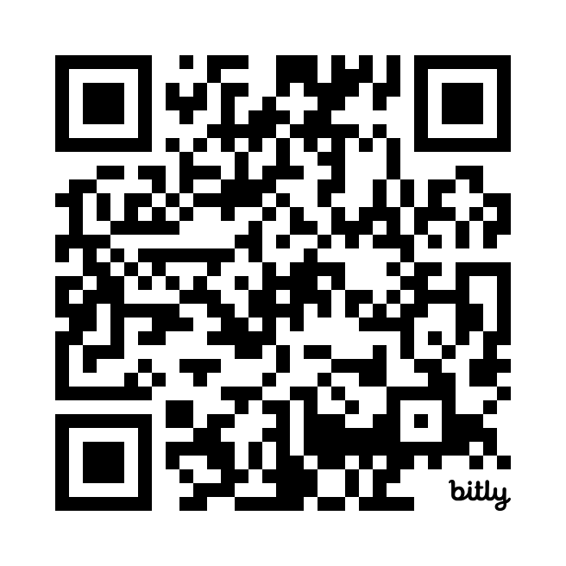
Paint with music
Art, music, and machine learning
Go to Google Arts & Culture app and go to Google Experiments and find ‘Paint With Music’ activity using the search function.
Alternatively, go to this link https://bit.ly/MusicPainting, or scan the QR code.
This experience has four theme options:
  In the Sky
  Underwater
  On the Street
  On Paper.
Each theme would come with its own set of ‘brushes’, sounds, colours, and other effects.

Slide 7
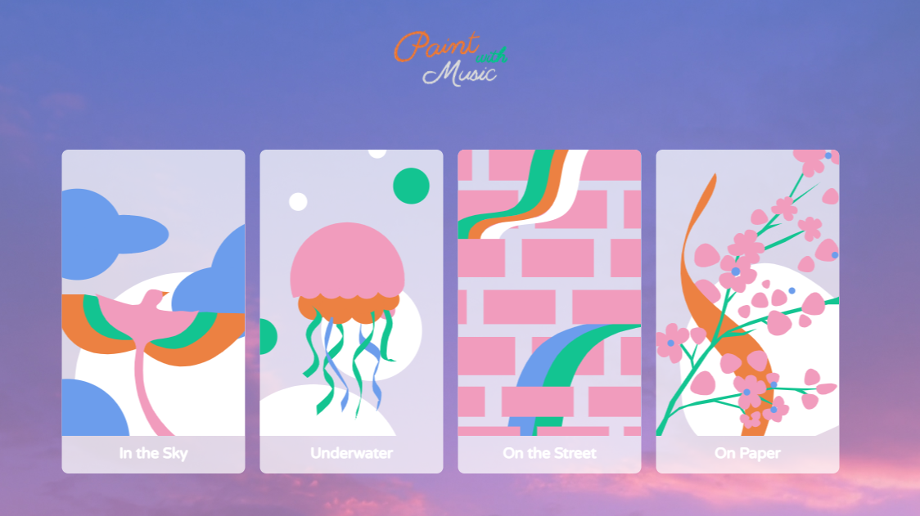
Paint with music
Art, music, and machine learning
These are the different themes. Test them out. Choose a theme you like best and complete a painting and composition using that theme.

Slide 8
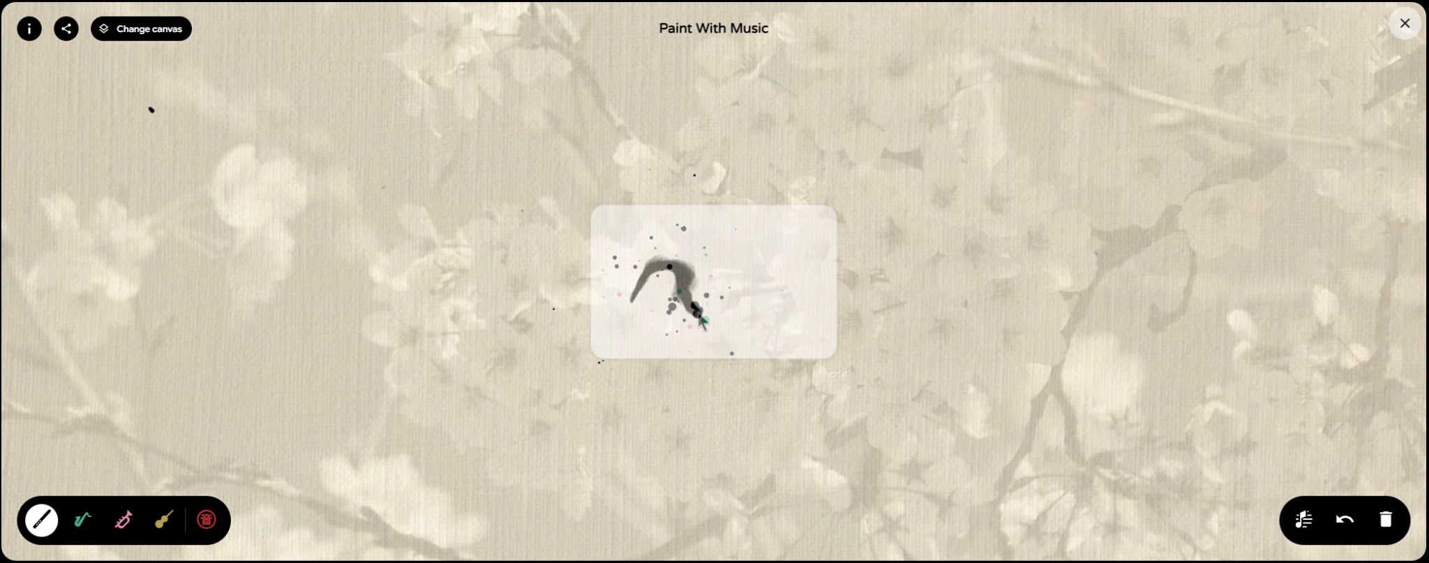
Paint with music
Art, music, and machine learning
The top left shows some information about the experiment, a share icon, and a way to change canvas.
Information, Share, Change Canvas
The bottom right is a toggle notes guide, undo, and delete button that enables the user to erase their existing work and begin again.
The bottom left shows various ‘musical brushes’ using different instruments that are used as notations, including some organic options
Canvas
Musical Brushes and Stamp
The middle part is the canvas. It’s where you will see your creation unfold.
Toggle Notes Guide, Undo, and Delete

Slide 9
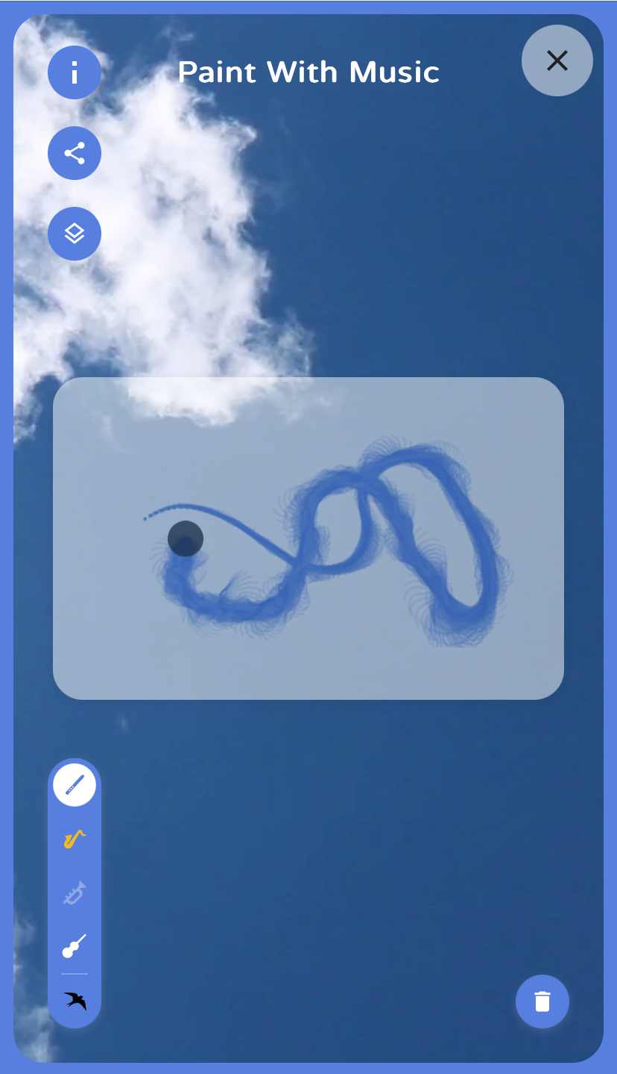

Sample creation
Scan the QR code using your devices.
Choose ‘In The Sky’ once it’s loaded on your device.

Slide 10
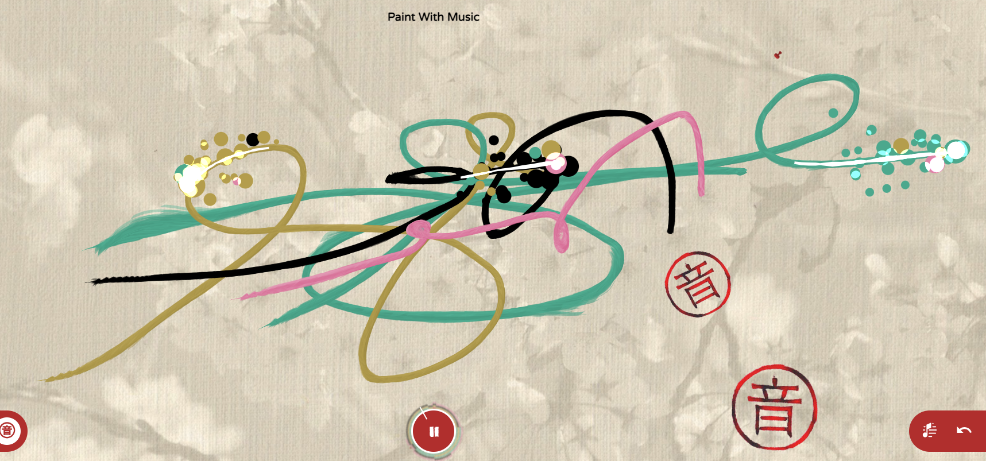
Talk about your creation
Sharing inspiration
Move into small groups (2-3) and share your ‘paint with music’ creation. Discuss the following:
What inspired you to create this work?
What did you think about being able to hear their paintings?
How did the music affect the way you painted your creations?

