Slide 1
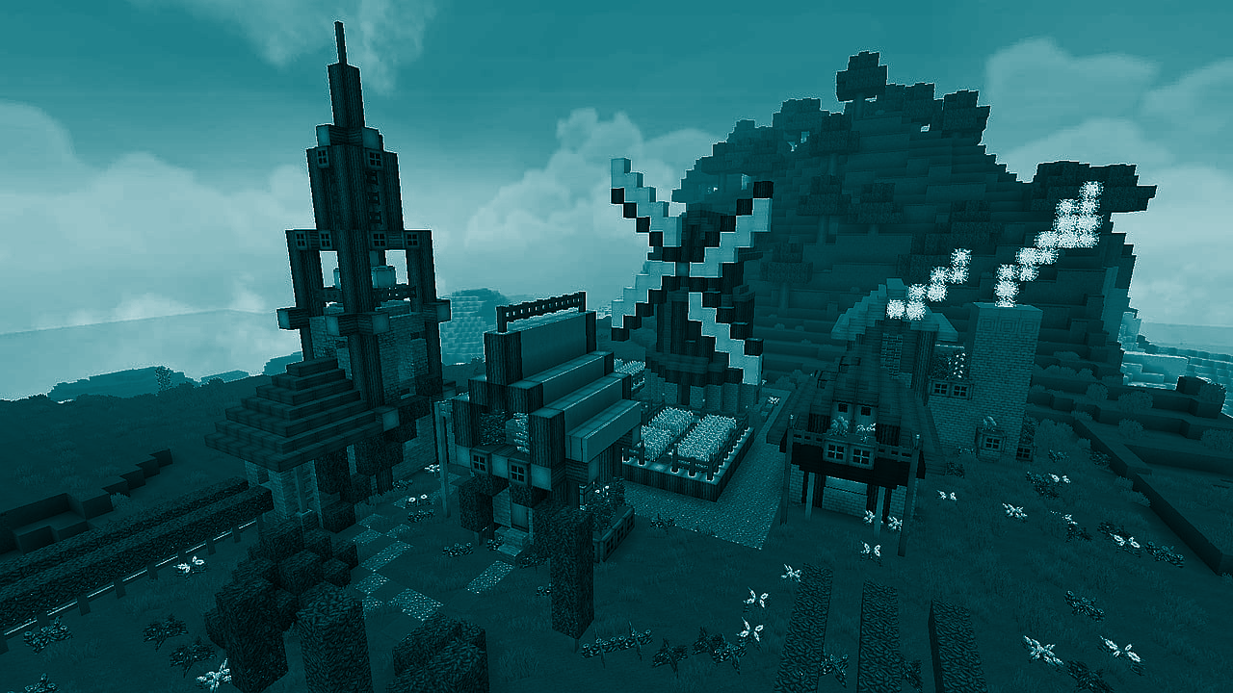

STUDENT DIGITAL NOTEBOOK
Exploring ecosystems in Minecraft Education
Student Name:

Slide 2

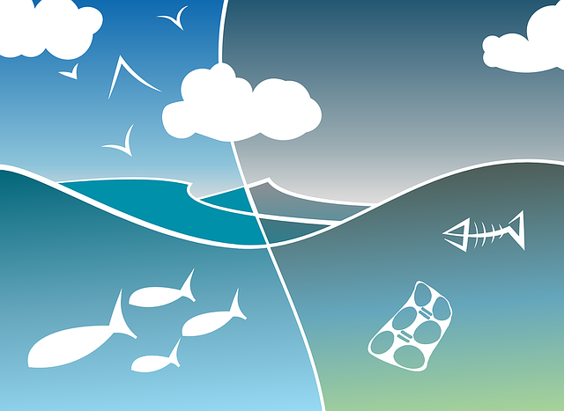
What is an ecosystem?
An ecosystem is a system that environments and their organisms form through their interaction.
The biotic and abiotic components are linked together through nutrient cycles and energy flows.
Ecosystems are controlled by external and internal factors.

Slide 3
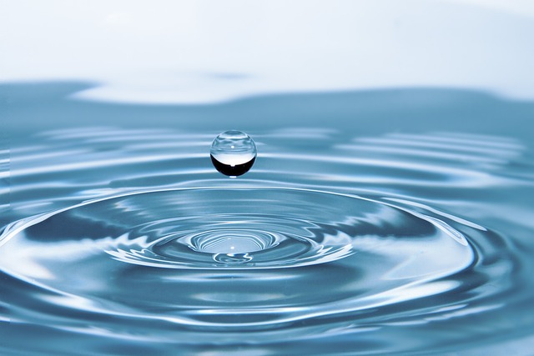
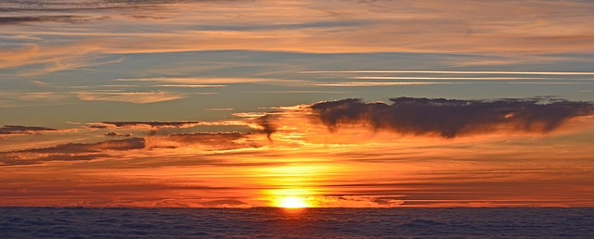
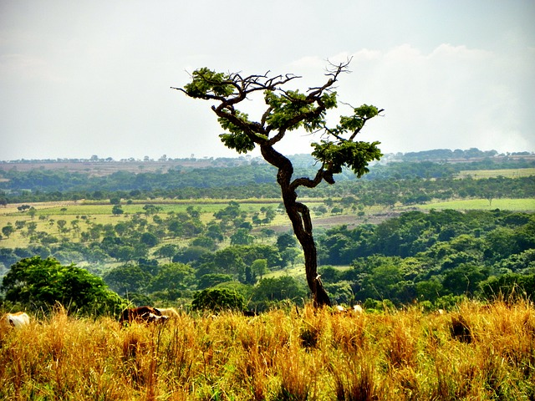
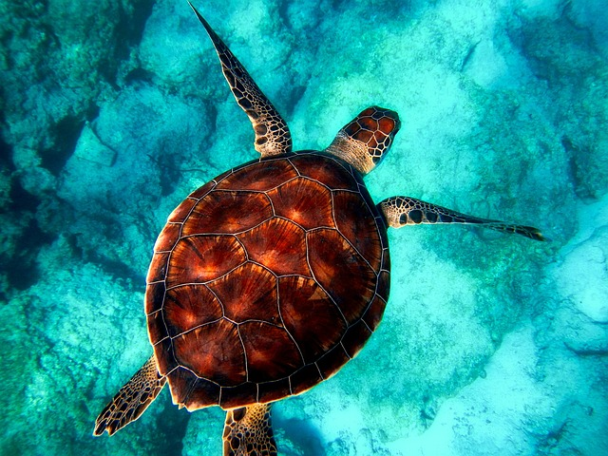
Biotic and abiotic factors
Biotic and abiotic factors are what make up ecosystems.
Biotic factors are living things within an ecosystem; such as plants, animals, and bacteria.
Abiotic factors are non-living components; such as water, soil and atmosphere.
The way these components interact is critical in an ecosystem.
Abiotic factor
Abiotic factor
Biotic factor
Biotic factor

Slide 4
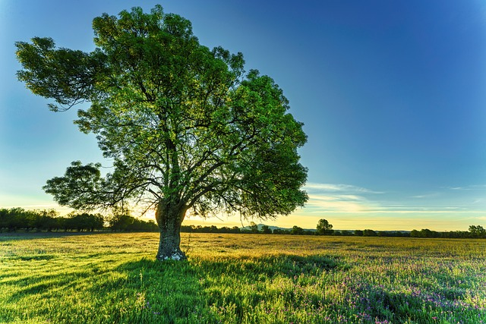
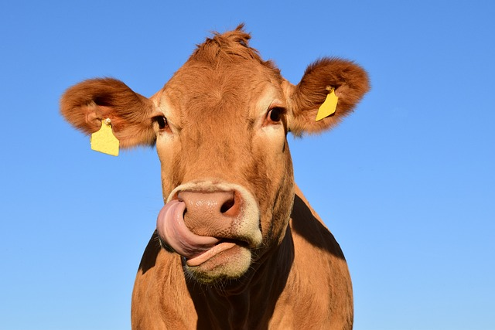
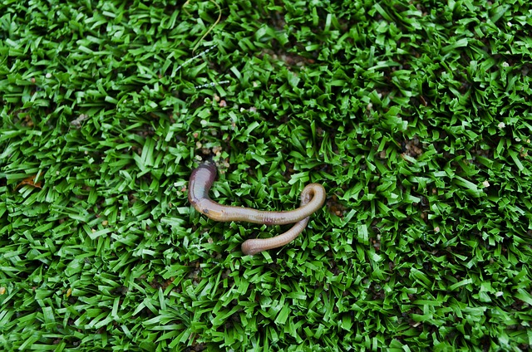
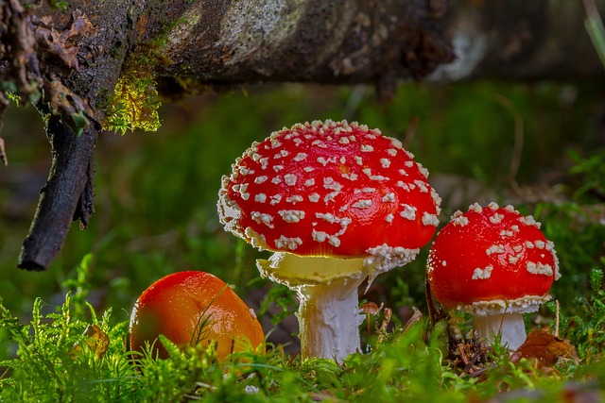
Producers, consumers and decomposers
Producers | Consumers | Decomposers
Make their own food | Eat other organisms for food | Break down dead material

Slide 5
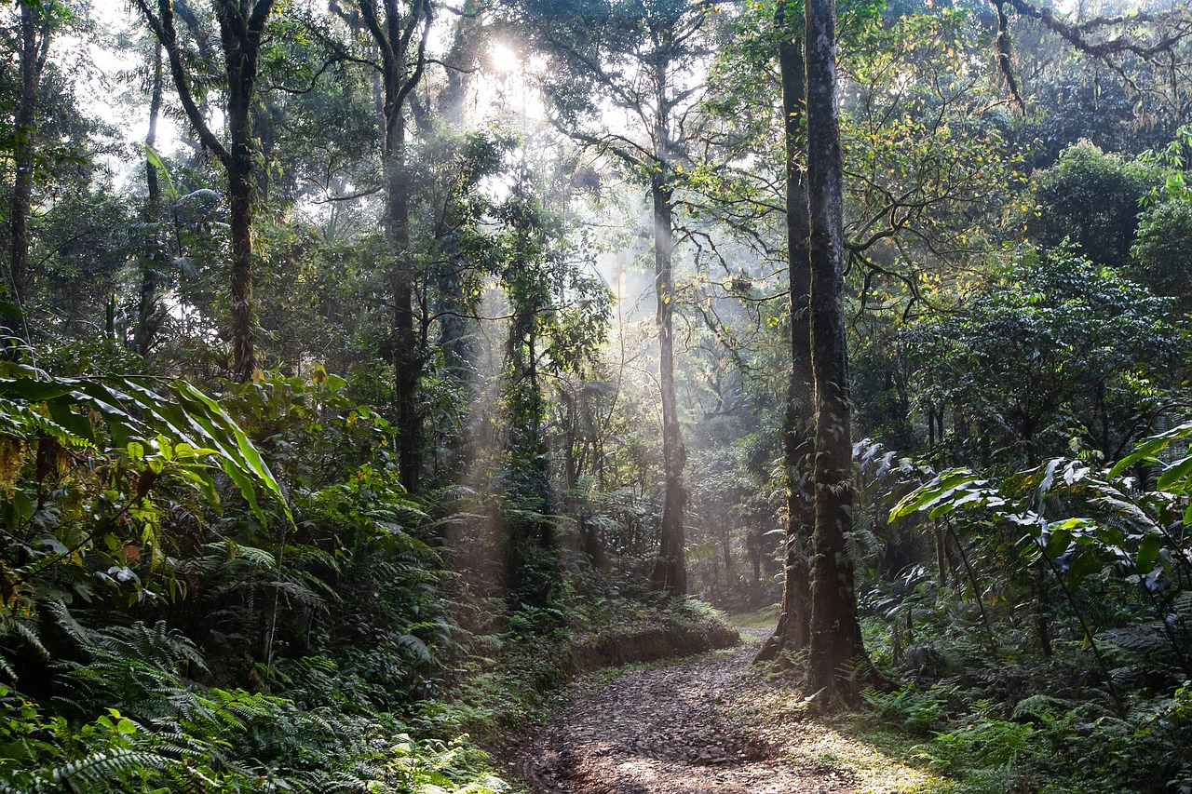
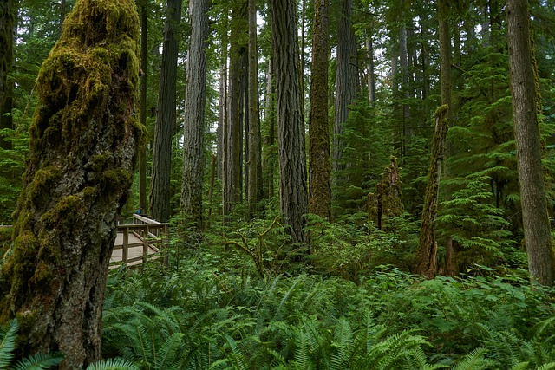
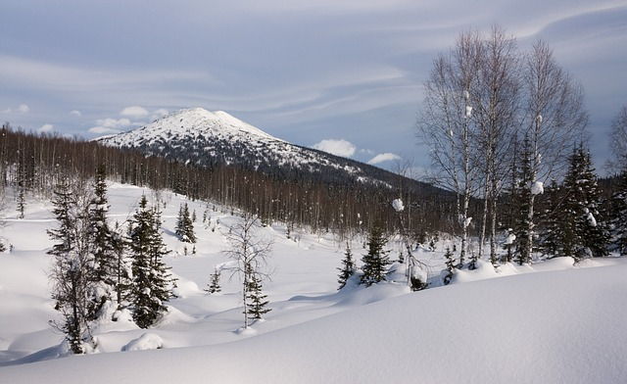
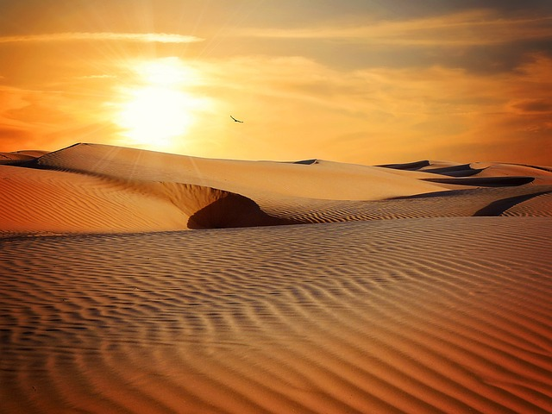
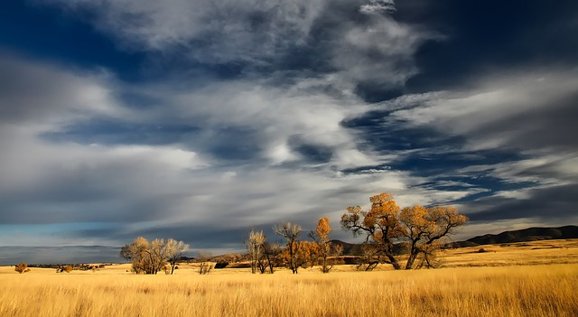
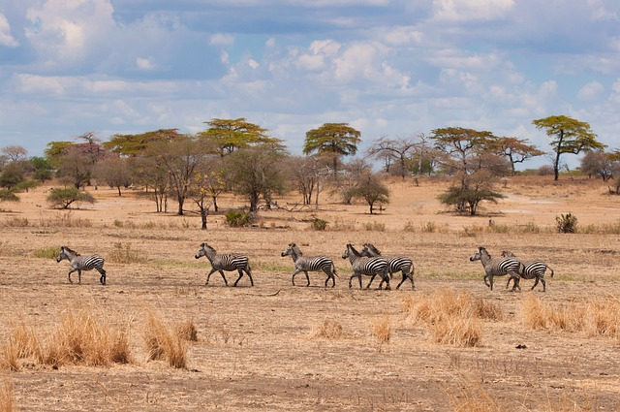
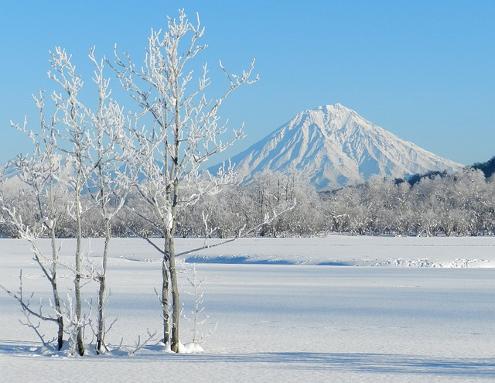
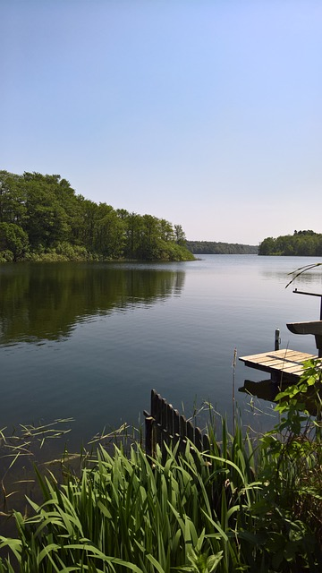
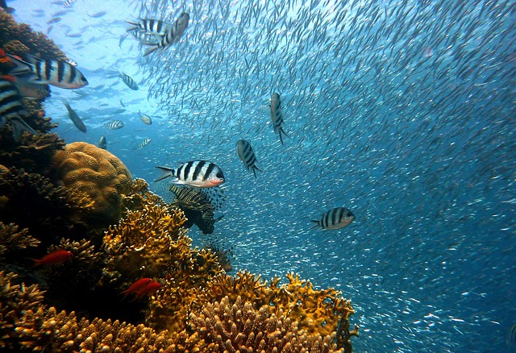
Biomes
A biome is a distinct geographical region with specific climate, vegetation, and animal life.
It consists of a biological community that has formed in response to its physical environment and regional climate. Biomes may span more than one continent. A biome encompasses multiple ecosystems within its boundaries.
Rainforest | Temperate Forest | Taiga
Desert | Grassland | Savanna
Tundra | Freshwater | Marine

Slide 6
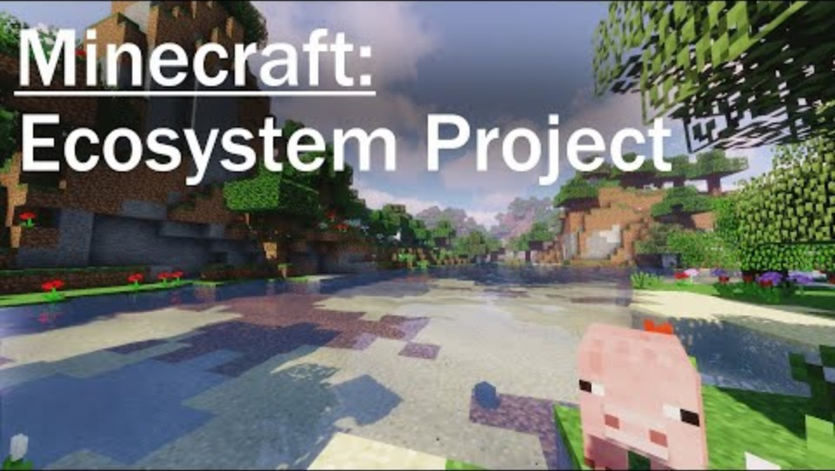
Minecraft Education - Virtual ecosystem
Watch and discuss
Watch the video to explore one of the pre-built ecosystems in Minecraft Education:
What did you notice about the different components of the ecosystems you explored in Minecraft?
Can you describe any interesting interactions between the plants and animals within the virtual ecosystems?
How did the climate or geography of the virtual ecosystems affect the organisms living there?
Were there any unexpected features or patterns you observed while exploring the virtual ecosystems?

Slide 7
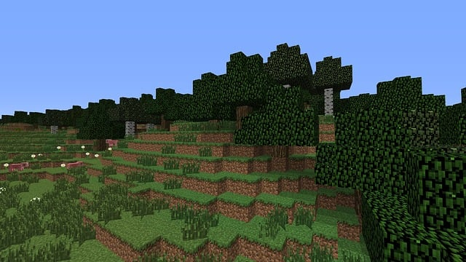
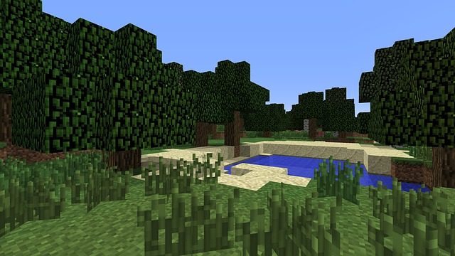
Virtual ecosystem
Your task is to create a virtual ecosystem using Minecraft Education.
Using Minecraft Education explore the different components of each ecosystem, such as plants, animals, soil, water, and climate.
Create your virtual ecosystem including:
biome
biotic and abiotic factors
producers, consumers and decomposers

Slide 8
Virtual ecosystem- brainstorm
Brainstorm features of your virtual ecosystem using Minecraft Education.
Biome:
Biotic and abiotic factors:
Producers, consumers and decomposers:

Slide 9
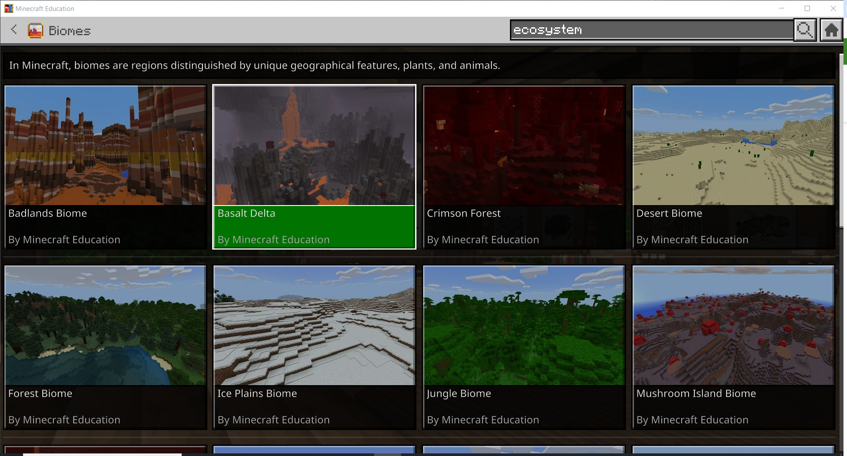
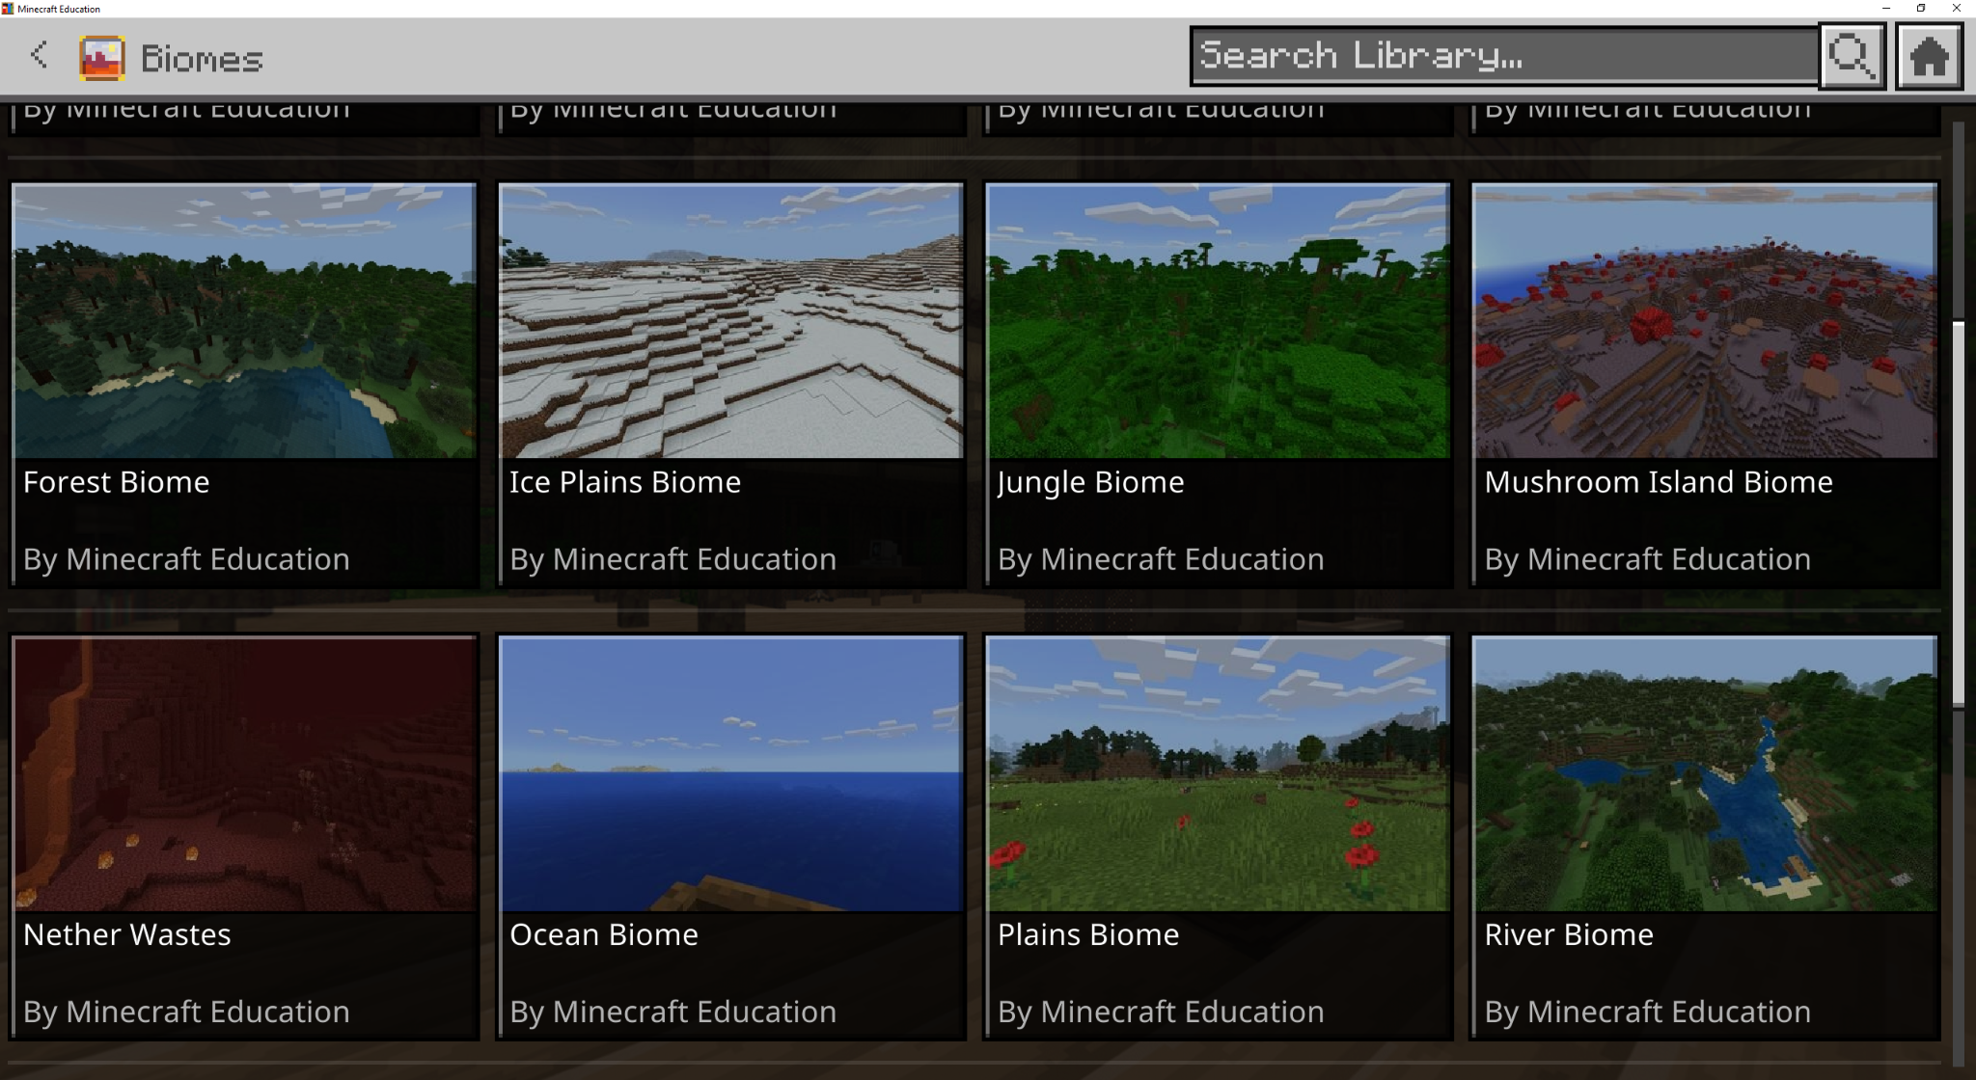
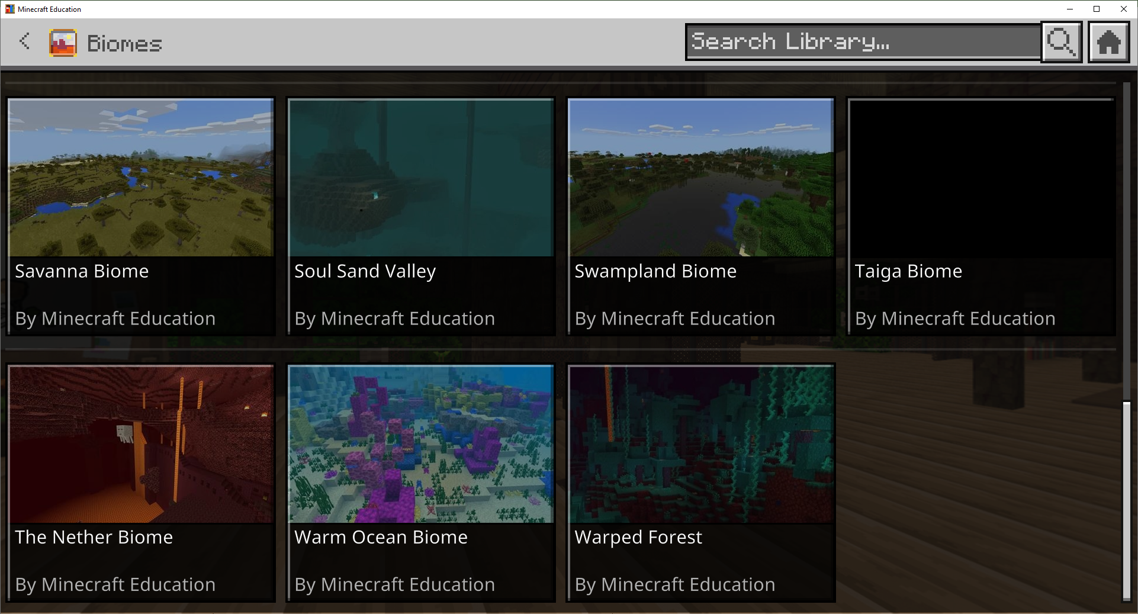
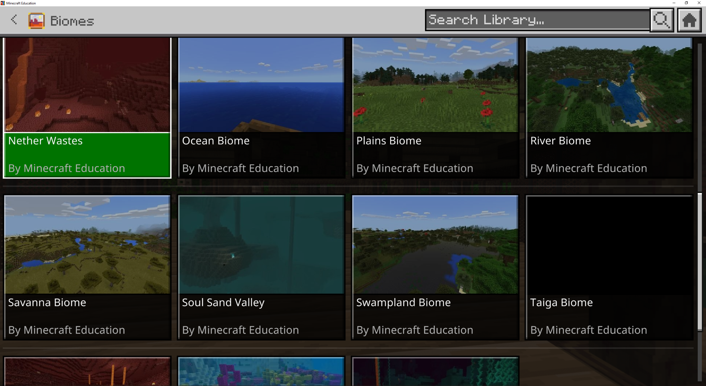
Biomes in Minecraft Education
Minecraft Education has various Biomes which you can choose from to begin your virtual ecosystem.
(Source: Minecraft Education)

Slide 10
Reflection
Reflect on the importance of each ecosystem component and how they contribute to the overall balance of the ecosystem.
Did you encounter any challenges or obstacles while building your own virtual ecosystems? How did you overcome them?
What similarities did you notice between the virtual ecosystems and real-world ecosystems?
How do you think the virtual ecosystems we explored in Minecraft compare to ecosystems you've seen or learned about in the real world?

Slide 11
Reflection
Reflect on the importance of each ecosystem component and how they contribute to the overall balance of the ecosystem.
What are some important lessons about ecosystem balance and sustainability that you learned from this activity?
If you could make any changes or additions to the virtual ecosystems, what would you do differently and why?
How do you think the skills and knowledge gained from exploring ecosystems in Minecraft could be applied to real-world environmental conservation efforts?

