Slide 1

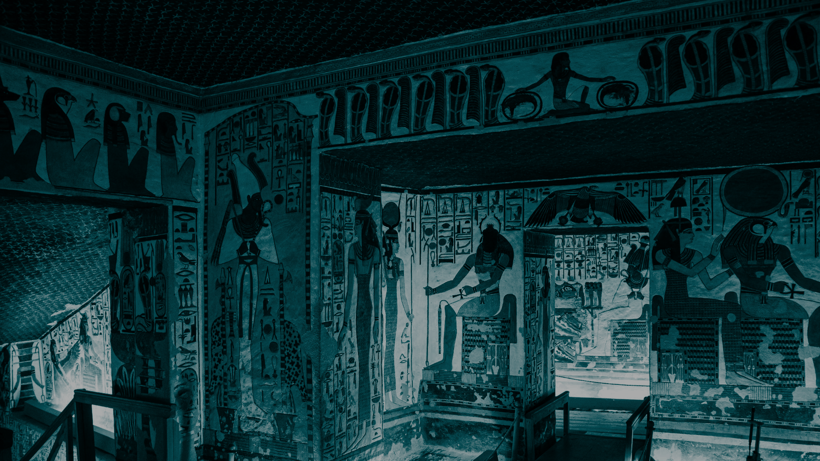
STUDENT DIGITAL NOTEBOOK
Exploring Ancient Egypt: Queen Nefertari’s Tomb
Student Name:

Slide 2

Learning stations
Working in pairs within your groups
01
IMVR:
Nefertari - Journey to Eternity
Work in pairs to explore the IMVR experience
Switch over after 5 minutes
Help each other navigate through the space and learn facts about what you see in the space
02
HHVR:
Egyptian Escape Room
Launch escape room on CoSpaces with code EAY-YKB
Problem solve your way around this experience
03
HHVR / Research:
360° video of Nefertari’s tomb
Use your laptop or HHVR to view the 360 video of the Nefertari experience
Answer the questions in your student notebook

Slide 3

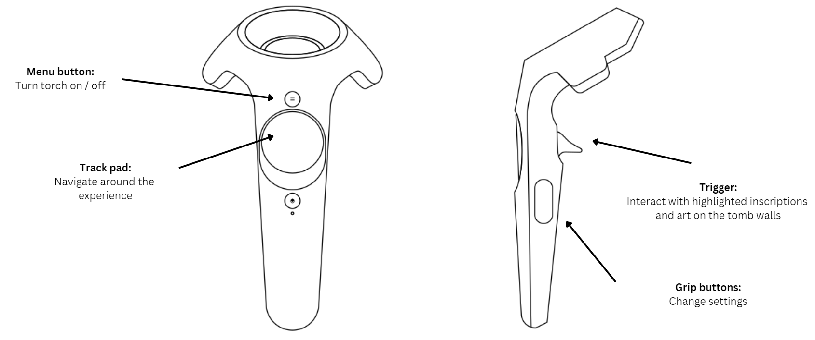
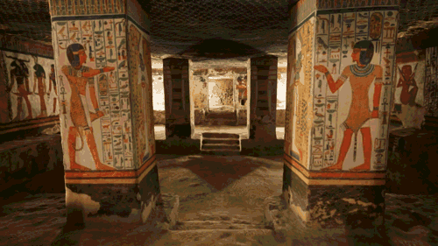
IMVR: Nefertari - Journey to Eternity
Take turns with your partner to explore Nefertari’s tomb.
Download the experience here.

Slide 4
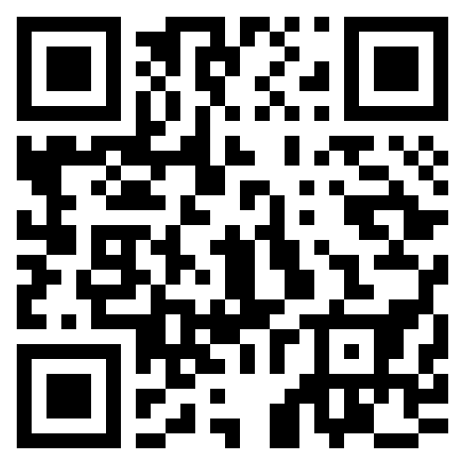
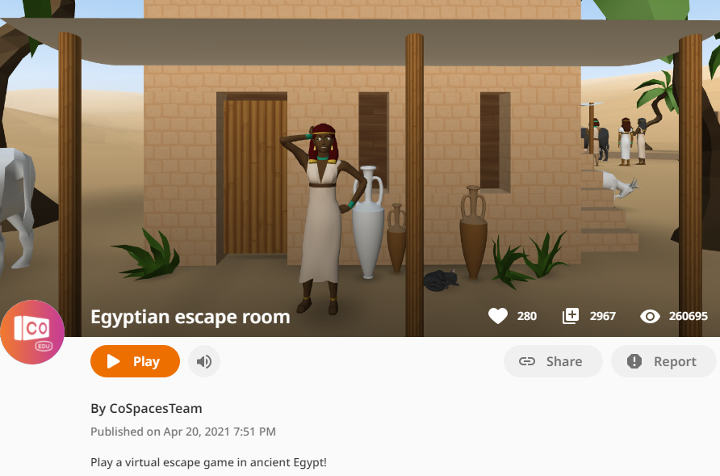
HHVR: Egyptian escape room
Problem solve your way out of this virtual escape room in ancient Egypt!
Scan the QR code or click on the image to the left to begin.
Press ‘Play’.
Use the button on the HHVR to walk forward / or the arrows on your laptop if viewing on a device.
Follow the clues to escape this Egyptian puzzle.

Slide 5
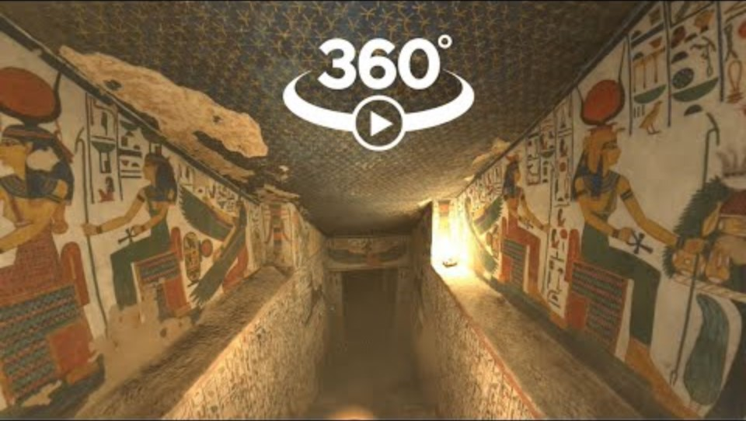
HHVR: Research
Watch the video below to answer the questions on the next few pages. Be sure to work collaboratively with your partner. You can research any information you may not find in the video.

Slide 6
HHVR: Research
Questions | Response
What is the other name for Queen Nefertari’s tomb?
What does the name ‘Nefertari’ mean?
Who is Nefertari’s husband?
What were Queen Nefertari’s significant skills?

Slide 7
HHVR: Research
Questions | Response
How many chambers does Queen Nefertari’s tomb have?
What can you see on the ceilings of the tomb and what do they represent?
Why were scriptures from Ancient Egypt’s Book of the Dead painted on the walls of the tomb?
What were stolen from the tomb?

Slide 8
HHVR: Research
There are many paintings on the walls of Queen Nefertari’s tomb. A number of them were gods and goddesses of Ancient Egypt. Name at least 6 gods or goddesses and their significance or representations.
God / Goddess | Their significance / representation

Slide 9
HHVR: Research
There are many paintings on the walls of Queen Nefertari’s tomb. A number of them were gods and goddesses of Ancient Egypt. Name at least 6 gods or goddesses and their significance or representations.
God / Goddess | Their significance / representation

