Slide 1

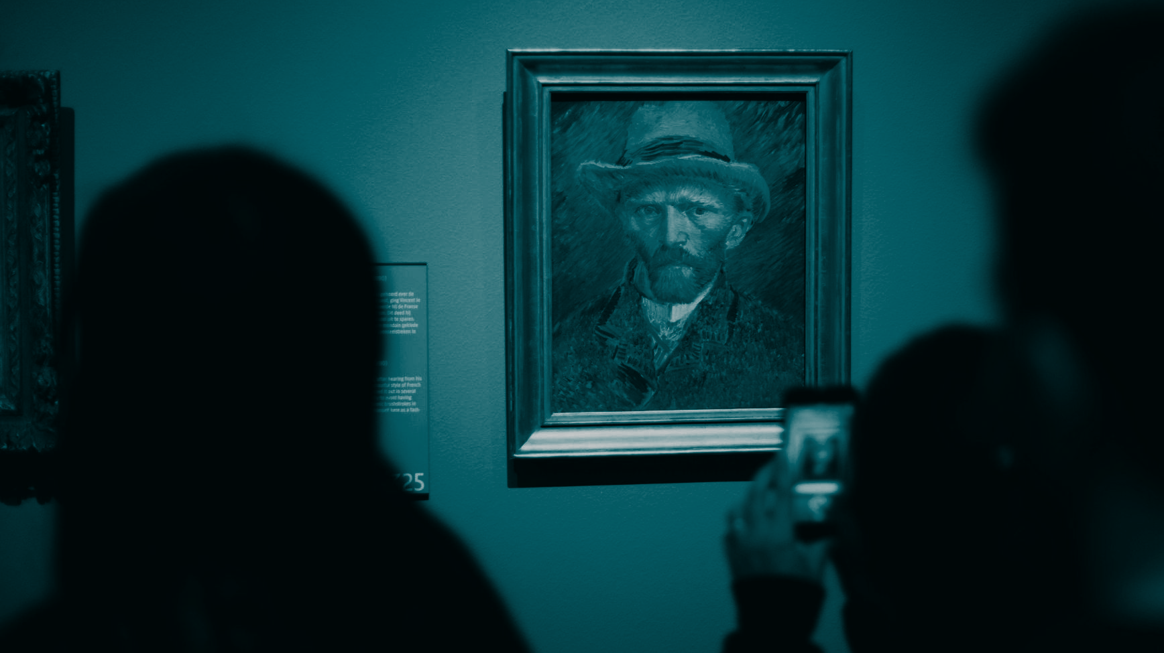
DIGITAL NOTEBOOK
Art Styles Exploration with Emerging Technologies
Student Name:

Slide 2

Art Filter Instructions
Choose an art artefact.
Apply a filter.
Take a photo or video and post it on the next page.
Write about the inspiration for this image:
  Which artwork is it based on?
  Do you know the style or movement and artist?
  Why did you choose it?

Slide 3
Art Filter
Your photo or video
Write about the image inspiration.

Slide 4
Art Transfer
Take a photo (self portrait, scene, or object) and choose an art piece and apply the filter. Click on ‘Share’ to save the photo to the gallery and upload to this document. Then, write about the inspiration for this image. Which artwork is it based on? Do you know the style or movement and artist? Why did you choose it?
Your photo or video
Write about the image inspiration.

Slide 5
Art Selfie
Take a photo of yourself and see which artwork looks most like you. Take a screenshot of the image you like best, then upload the image to this document. Which artwork looks most like you? Do you know the style or movement and artist? Do you think the artwork looks like you? Why or why not?
Your photo or video
Write about the image inspiration.

Slide 6
Art Projector
Follow the instructions on how to place the Augmented Reality (AR) view in the room. Choose an artwork to view it in AR. Take a photo or video of your favourite piece, then upload to this document. Write about the artwork you selected. Do you know the style or movement and artist? Why did you choose it?
Your photo or video
Write about the image inspiration.

