Slide 1


STUDENT DIGITAL NOTEBOOK
Design a Future Gadget
Student Name:

Slide 2

Learning Tasks
These are the tasks you will need to complete for this lesson.
01
Tinkercad Design
Go on app “’Tinkercad”
Brainstorm a design for your future gadget
Reflect in your Design Thinking Digital Notebook
02
Immersive Virtual Reality (IMVR)
Go on IMVR app “Blocks by Google”
Create and trial your gadget in VR
03
Reflection
Complete your digital notebook
Share some of your experiences
What makes your gadget unique?

Slide 3
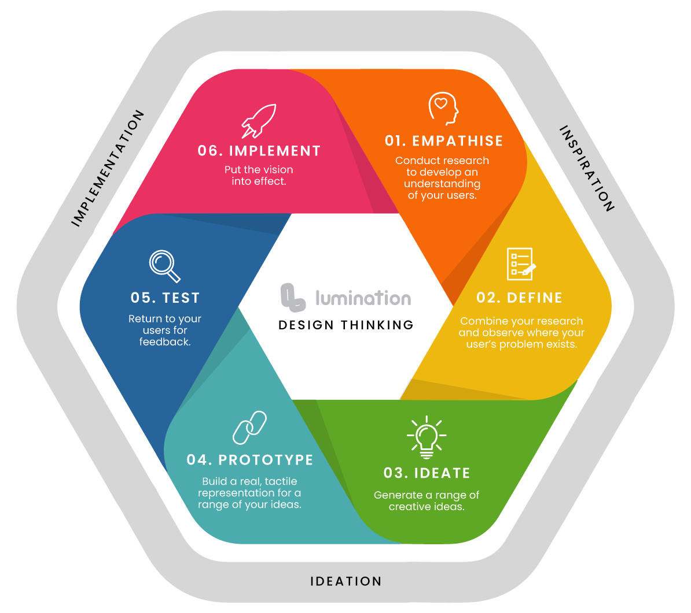
Design Thinking Framework

Slide 4

Learning Stations
Complete the stations in order. Station two to be done in small groups.
01
Think/Design/Reflect
Complete tasks on slides 5-8 of your student digital notebook
02
Go on app “’Tinkercad”
Brainstorm a design for your future gadget
Reflect in your student digital notebook
Tinkercad Design
03
Immersive Virtual Reality (IMVR)
Go on app “Blocks by Google”
Create and trial your gadget in VR
Each student has five minutes on the app

Slide 5
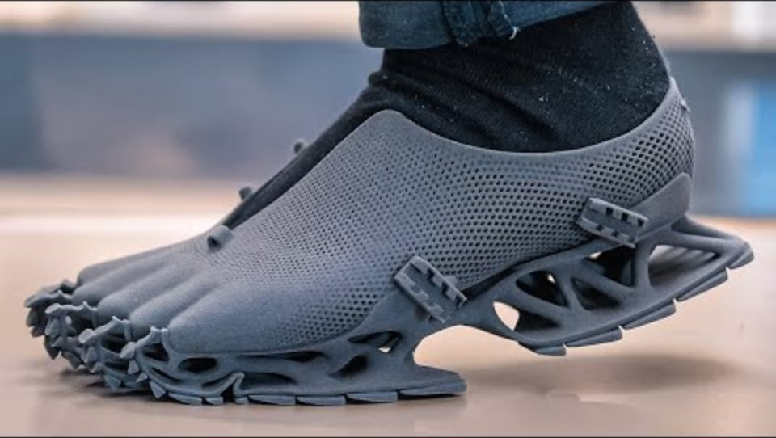
Inventions of the future
Watch the video “Inventions of the future”.

Slide 6
Design Thinking: Empathise
After watching “The Inventions of the Future” , consider the following:
Which invention excited you the most?
What problems or issues do these inventions solve?
Who would benefit from those inventions? Why?

Slide 7
Design Thinking: Define
After watching “The Inventions of the Future” , consider what gadget would be useful in the future?
Brainstorm some future issues that could be solved with a new gadget.

Slide 8
Design Thinking: Ideate
Brainstorm the design of your future gadget, how will it solve the problem?

Slide 9
Design Thinking: Prototype
Share screenshots or images of your creation using Tinkercad

Slide 10
Design Thinking: Feedback
Get feedback after creating your gadget in Tinkercad and Blocks by Google.
I like…
I wish…
What if…?

Slide 11
Design Thinking: Implement
Based on the feedback on your gadget, what would you like to improve upon if you were able to implement this solution?
Name at least one improvement and why?

Slide 12
Design Thinking: Additional notes
Use this space to add any other information, images and/or resources.

