Slide 1
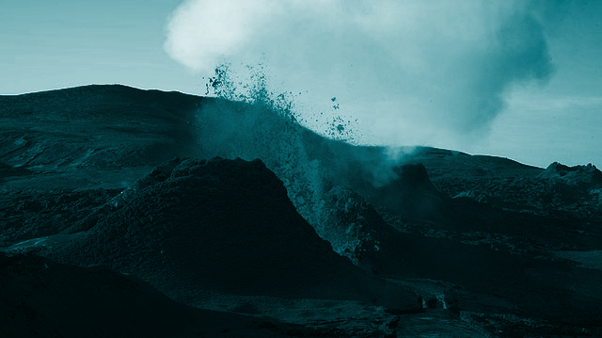

DIGITAL NOTEBOOK
Volcanoes in VR
Student Name:

Slide 2

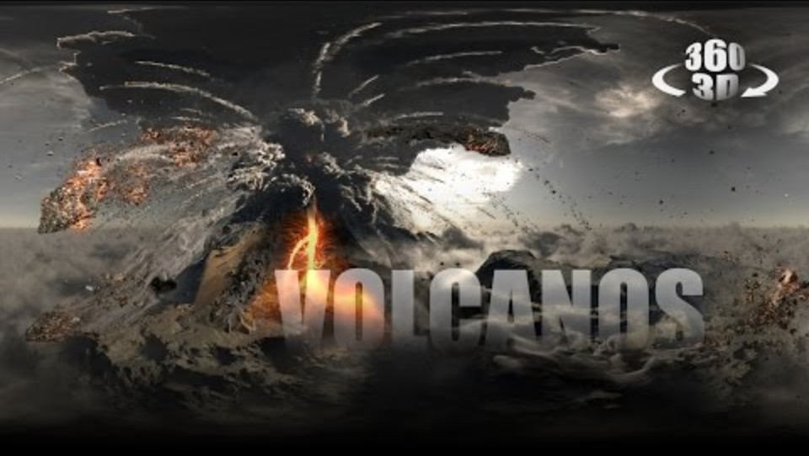
Volcanoes: An Immersive Experience 360’
HHVR class viewing
Using the HHVR devices watch Volcanoes: An Immersive Experience 360’ then fill out the Y chart using sticky notes.
Think about :
What did you SEE on the video?
What did you THINK while watching the video?
What did you FEEL while watching the video?

Slide 3
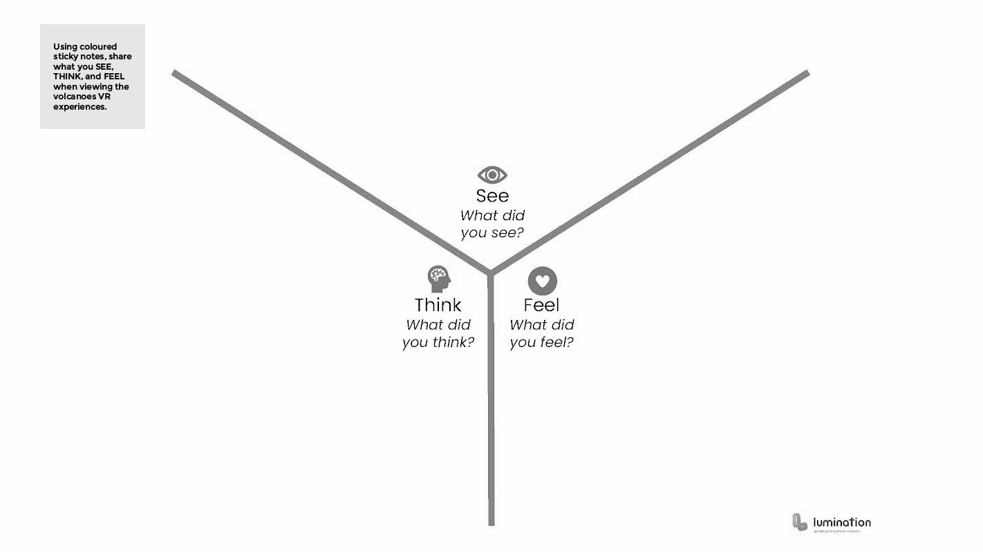
Volcanoes: An Immersive Experience 360°
Fill in the Y chart using Canva
Canva Whiteboard - Y chart

Slide 4


Explicit Knowledge
Copy and paste symbols into your table
Watch the video and complete the table.
Boundary Type | Movement | Volcanoes? | Earthquakes? | Other geological formation

Slide 5
Learning Stations
Working in small groups
01
Check: Student Digital Notebook
View: HHVR Videos (Scan QR Codes)
Reflect on your experiences
HHVR Station
02
Explore Volcanoes in Google Earth VR
In pairs take turns, 3-5 minutes each
Reflect on your experiences
IMVR Station
03
In groups use Stop Motion (or similar) to demonstrate the result of plate tectonics.
Extension : Demonstrate the movement of plate boundaries and use a voice over to describe how convection currents cause plates to move and consequently collide.
Animation Creation Station

Slide 6
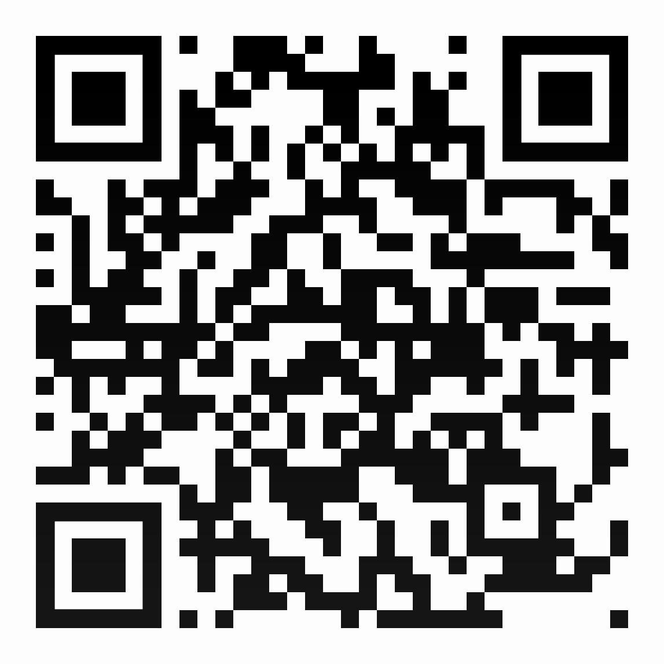
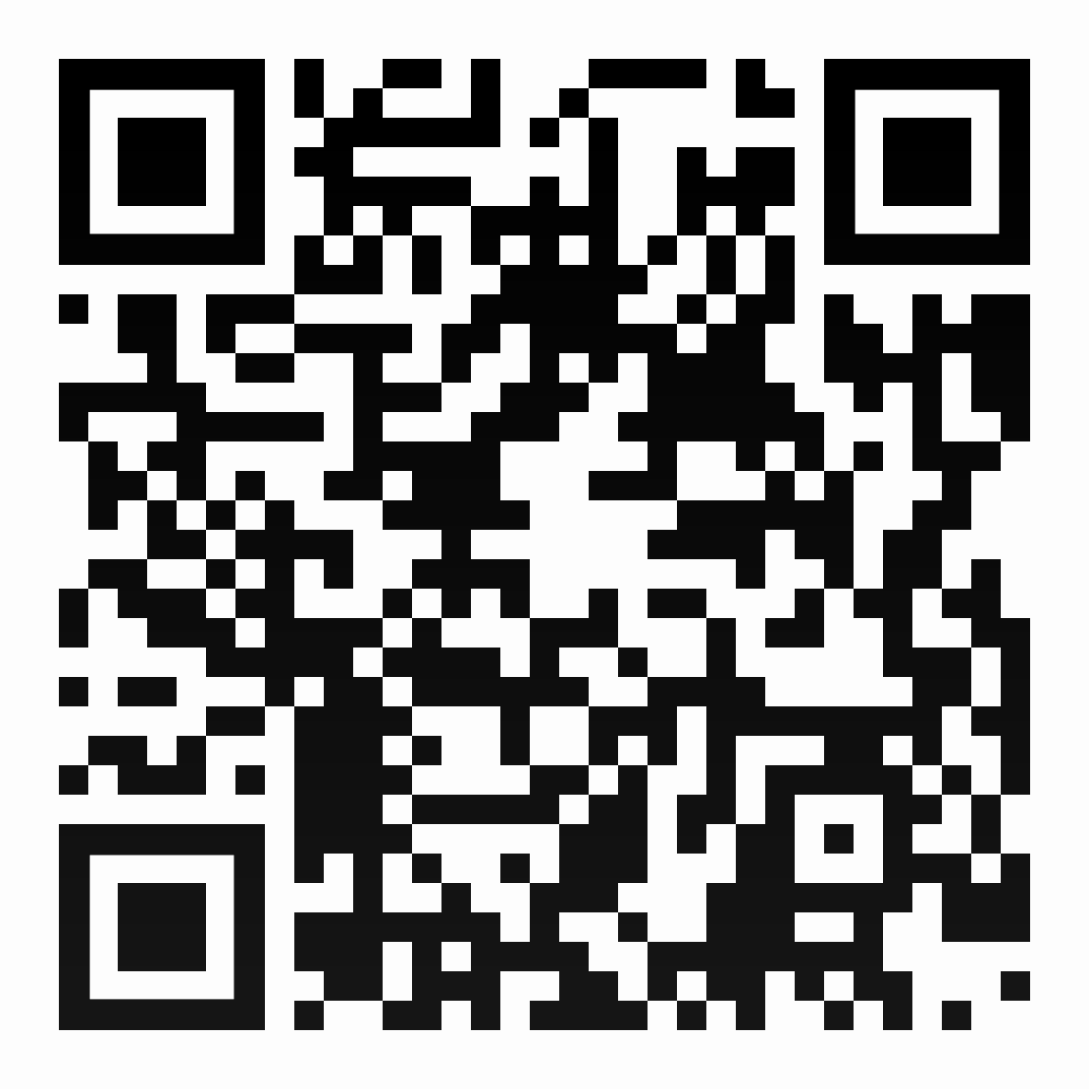
QR Codes
Scan the QR codes using your devices.
How Volcanoes Affect Earth's Climate Over Millions of Years (2:06)
Lassen Volcanic National Park in 360° Virtual Reality
(3:27)

Slide 7
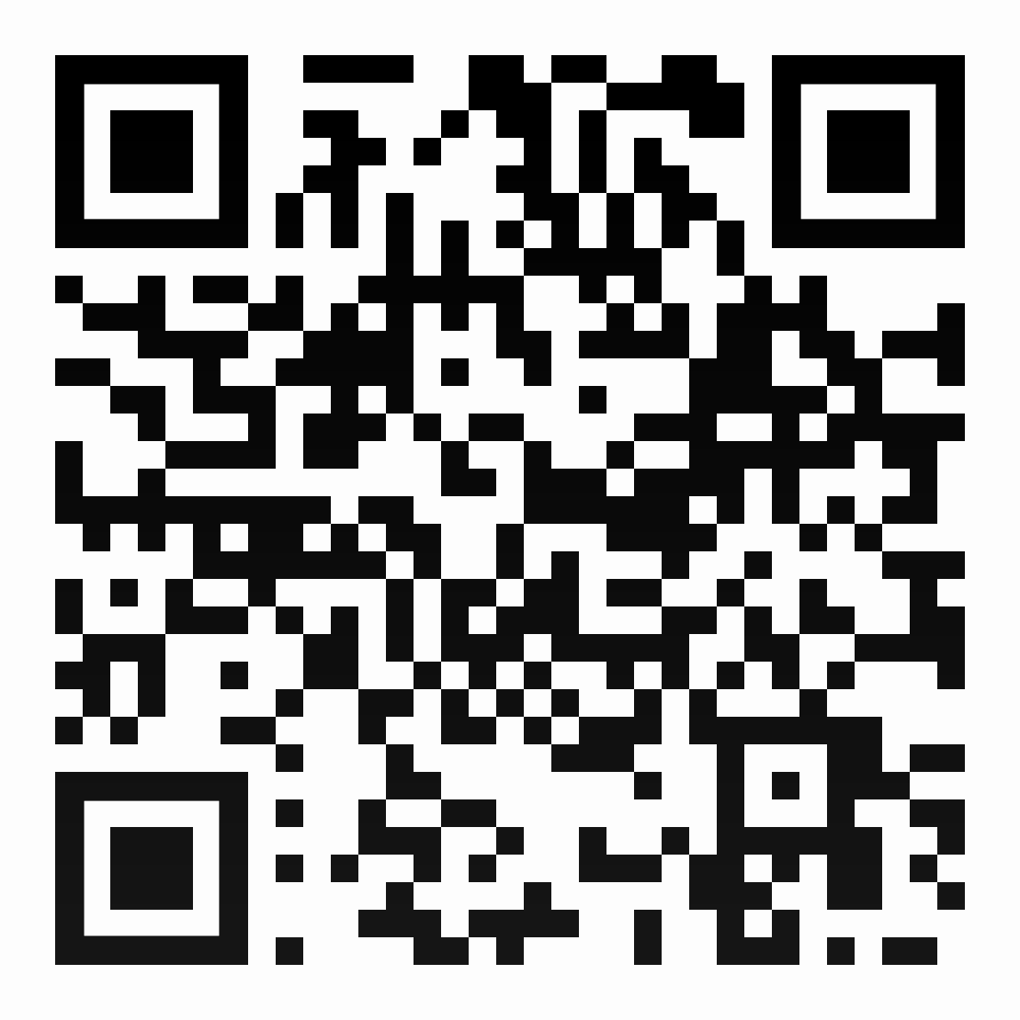
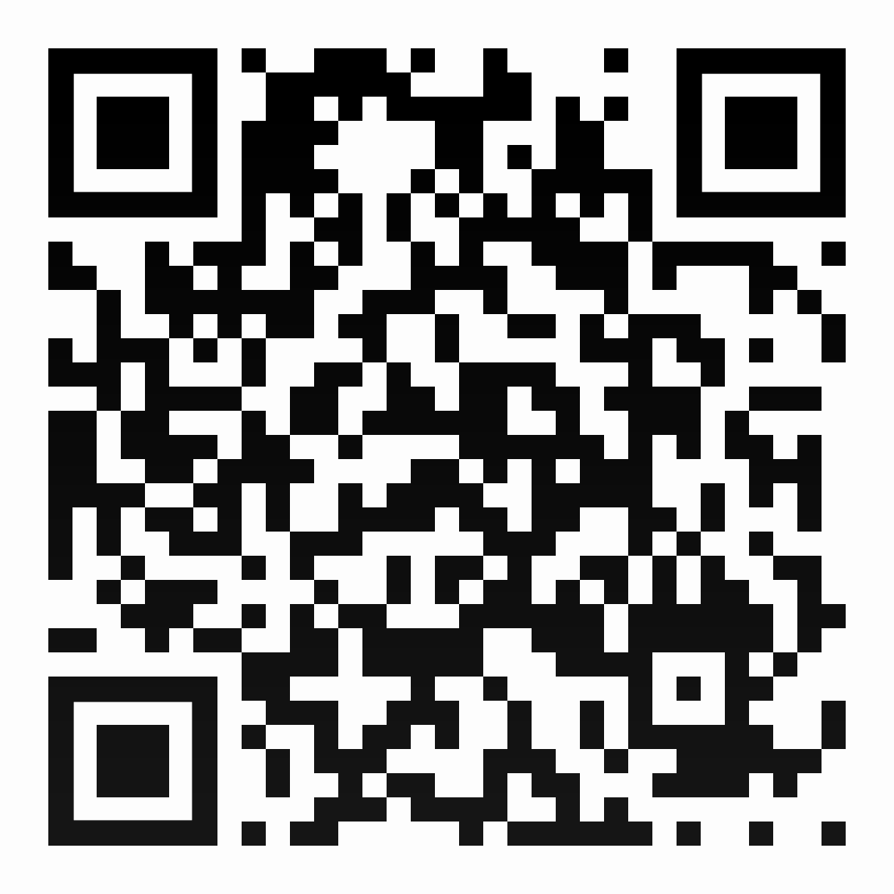
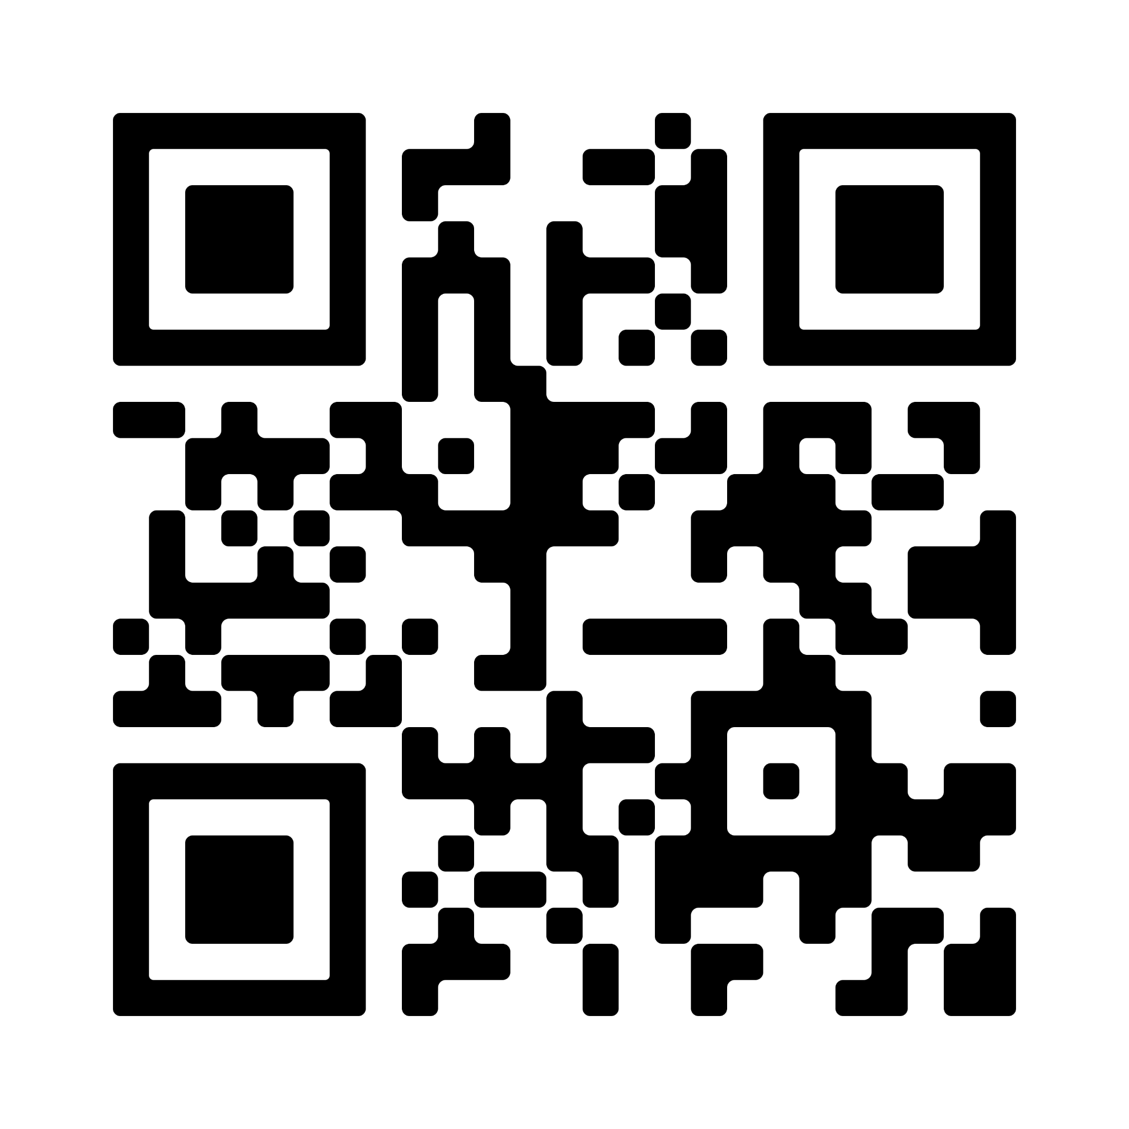
QR Codes
Scan the QR codes using your devices.
Insta360 VR: Flying Over Iceland Volcano - A Virtual Reality Experience (1:38)
Volcano Eruption 360/VR Video - Minecraft Animation(4:55)
TO THE EARTH'S CORE 360° - VR Video (3:08)

Slide 8
Reflection - Discussion
Reflecting on VR experiences
What's one new thing you learned about volcanoes from watching the videos?
After seeing volcanoes in VR, can you explain how the movement of tectonic plates helps form volcanoes? Give one example of where this happens.
Why do you think early warning systems are necessary for people living in volcanic regions? Why do you think people still choose to live near these zones?

Slide 9
Reflection - Discussion
Reflecting on VR experiences
Describe how an early warning system would work by using your understanding of plate tectonics?

Slide 10
Animation Creation
Share your animations

