Slide 1

TEACHING DECK
Forces in motion
Learn all about balanced and unbalanced forces using XR.

Slide 2

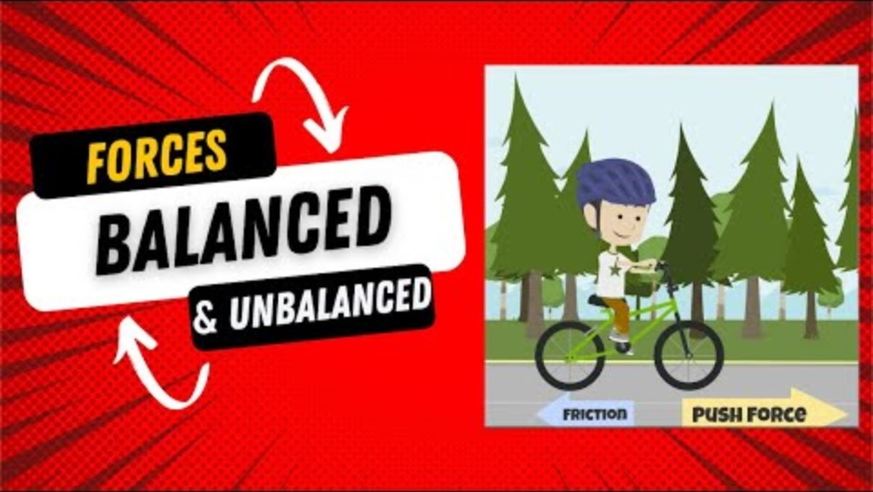
Balanced and unbalanced forces
What is it? What do you know?

Slide 3

Balanced and unbalanced forces
What did you know? What did you learn?
What did you find most surprising from the video?
What does balanced forces mean? What are unbalanced forces?
What are some examples of this around the room?
What are simple machines?
How can you demonstrate balanced and unbalanced forces with simple machines?

Slide 4
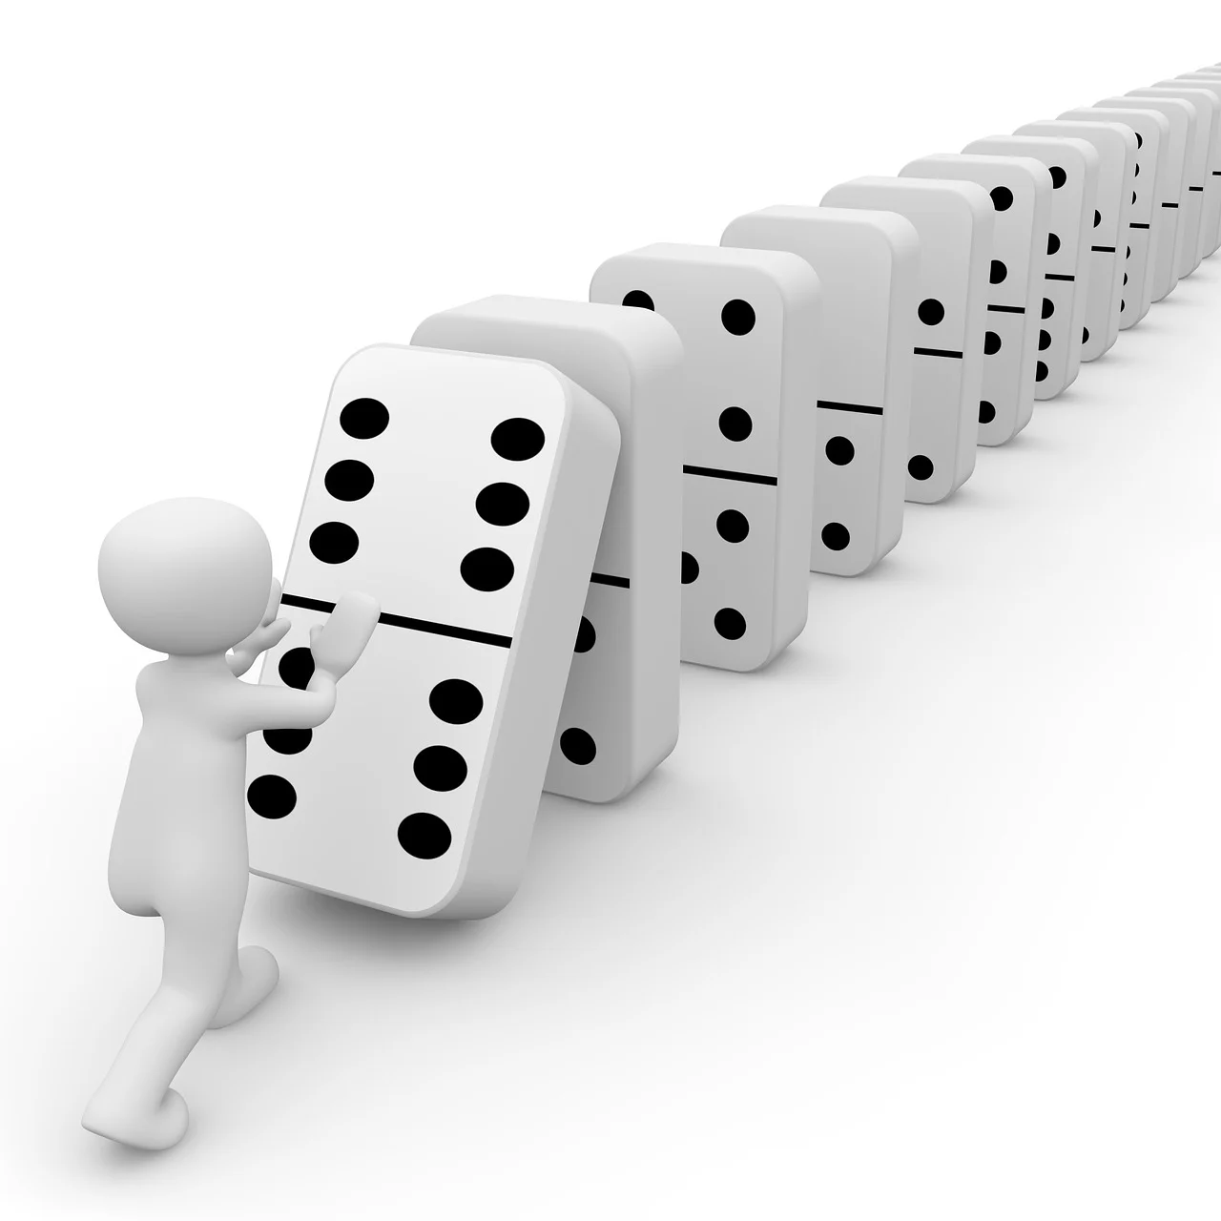
Your three stations
We will be rotating stations every 20 minutes.
 | Station 1 IMVR - Gadgeteer | Station 2 HHVR/Reflection | Station 3 CoSpaces/ Makerspace/ Tinkercad Creation
Round 1 (20 minutes) | Group 1 | Group 2 | Group 3
Round 2 (20 minutes) | Group 3 | Group 1 | Group 2
Round 3 (20 minutes) | Group 2 | Group 3 | Group 1

Slide 5
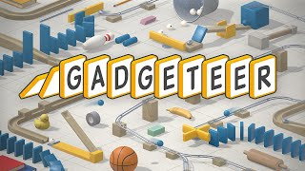
Station 1: IMVR - Gadgeteer
Use your problem solving skills as you experiment with unbalanced forces.
Working in pairs, strategically place everyday objects to create a chain reaction.
Show your understanding of balanced and unbalanced forces to complete the task.
Consider what objects will exert the appropriate amount of force for what you need.

Slide 6
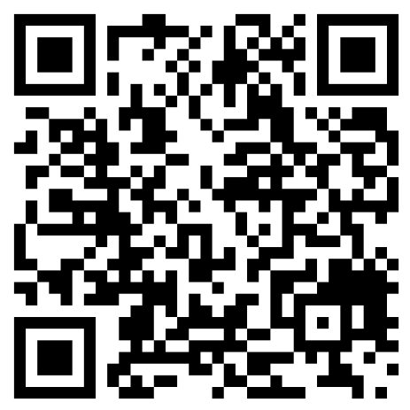
Station 2: HHVR - Forces in motion
Scan the QR code using your mobile device and answer the following questions.
The green ball was balanced at the beginning of the video. What type of force unbalanced the ball and caused it to move?
What types of forces can you see in the video that sped up or slowed down the objects in action?
Choose one or two simple system in this video, and recommend an alternative way to complete the same action.
360° Rube Goldberg Machine
(0:55)
You can rewatch the video as needed to answer the questions.

Slide 7
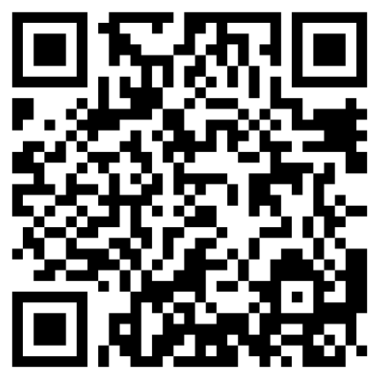
Station 2: HHVR - Forces in motion
Scan the QR code using your mobile device and answer the following questions.
What balanced objects do you see at the start of this video?
Why do you think the dominos get larger as they go on?
What additional step would you have added to this chain reaction?
DO NOT Push The Red Button!
(1:40)

Slide 8
Station 2: HHVR - Forces in motion
Time to get creative and unbalanced your world!
Looking around this room, what object would you use to unbalance a balanced object to make it move? Draw and label a simple design below.

Slide 9
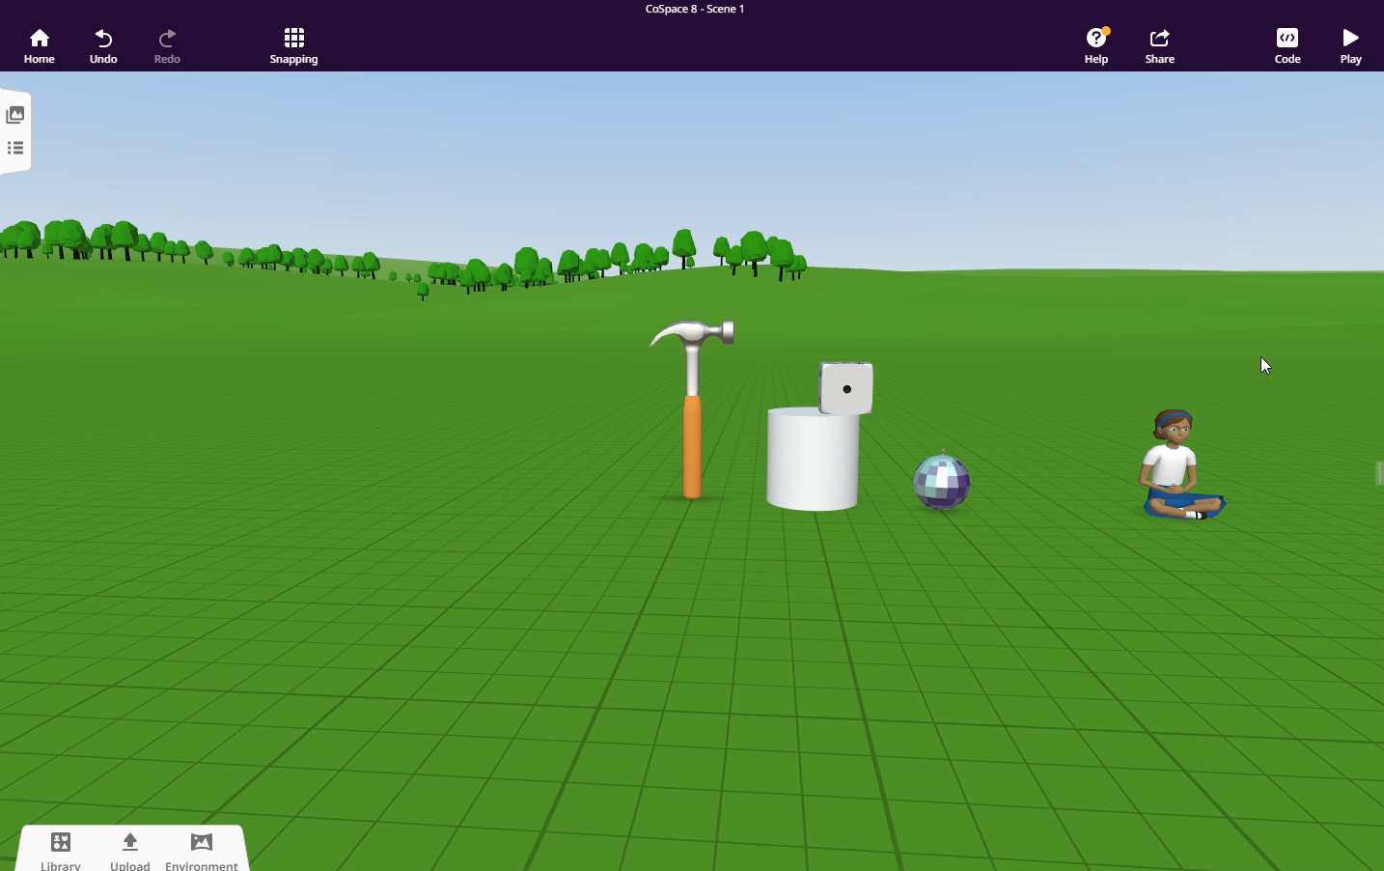
Station 3: Creation - CoSpaces
Time for some trial and error!
Experiment with the physics feature on CoSpaces to create a chain reaction.
Drag items in your space from the ‘Library’.
Right click on objects and turn on ‘physics’.
Adjust the mass, bounciness, and friction of each object.
Press play to test your product.
Continue adjusting each object’s physics until you have reached your desired outcome.
Add some code block to make your objects react when collided with one another.

Slide 10
Reflection
Let’s discuss what we’ve learnt.
What did you learn about balanced and unbalanced forces?
What types of forces did you use today to unbalance your object?
When experimenting with the physics feature on CoSpaces, what did you notice the mass, bounciness and friction does to an object when unbalanced?
What is a question you still have about balanced and
unbalanced forces?

