Slide 1

TEACHING DECK
Exploring Ancient Egypt: Queen Nefertari’s Tomb
Go on a virtual excursion to one of Egypt’s most famous tombs.

Slide 2

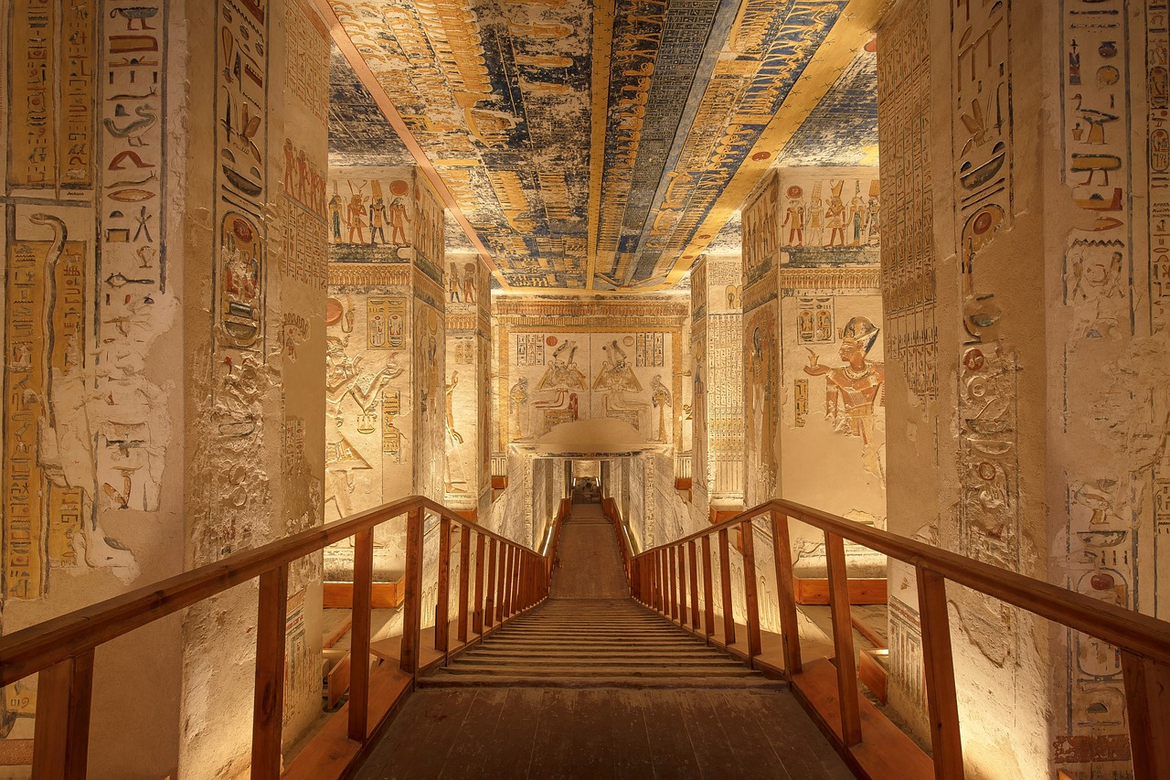
What do you notice?
What do you know about this image? What wonderings come to mind?

Slide 3
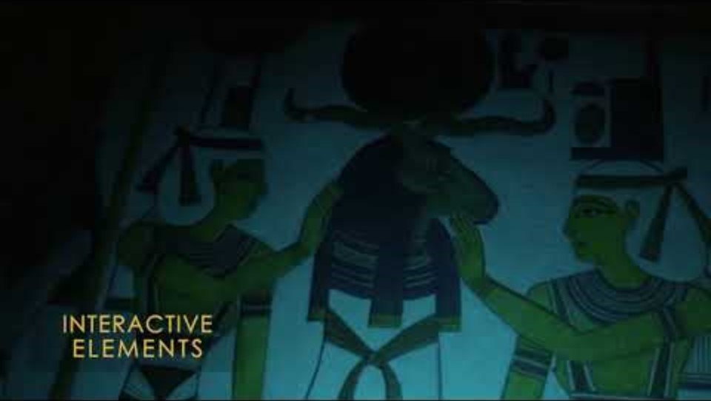
Nefertari: Journey to Eternity
What do you know about Queen Nefertari?
What do you know about tombs, or in particular, Egyptian tombs?
Do you know of any ancient Egyptian customs/traditions?

Slide 4
Learning stations
Working in pairs within your groups
01
IMVR:
Nefertari - Journey to Eternity
Work in pairs to explore the IMVR experience
Switch over after 5 minutes
Help each other navigate through the space and learn facts about what you see in the space
02
HHVR:
Egyptian Escape Room
Launch escape room on CoSpaces with code EAY-YKB
Problem solve your way around this experience
03
HHVR / Research:
360° video of Nefertari’s tomb
Use your laptop or HHVR to view the 360° video of the Nefertari experience
Answer the questions in your student notebook

Slide 5
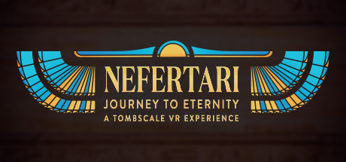
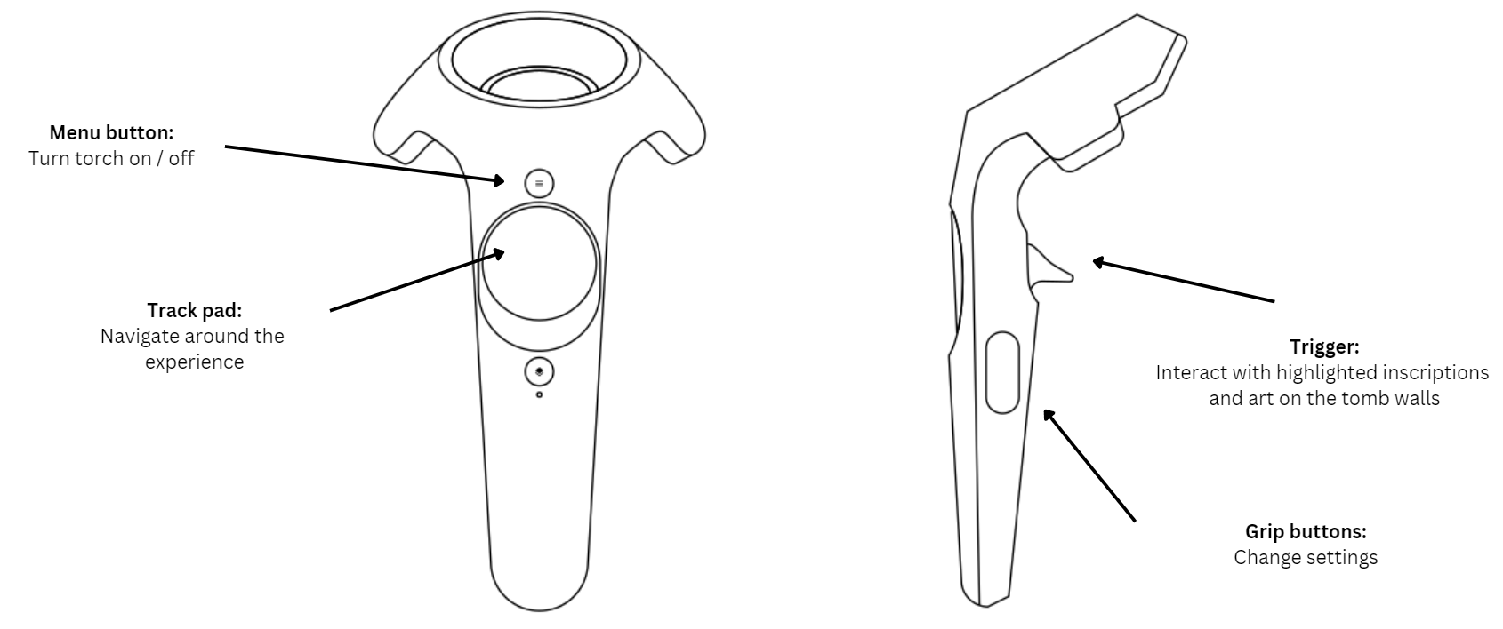
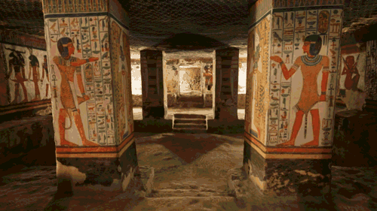
IMVR: Nefertari - Journey to Eternity
Take turns with your partner to explore Nefertari’s tomb.

Slide 6
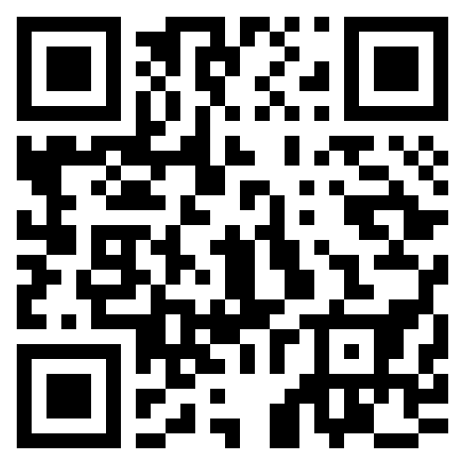
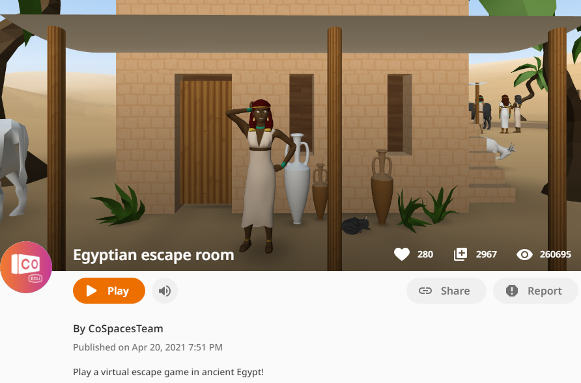
HHVR: Egyptian escape room
Problem solve your way out of this virtual escape room in ancient Egypt!
Scan the QR code or click on the image to the left to begin.
Press ‘Play’.
Use the button on the HHVR to walk forward / or the arrows on your laptop if viewing on a device.
Follow the clues to escape this Egyptian puzzle.

Slide 7
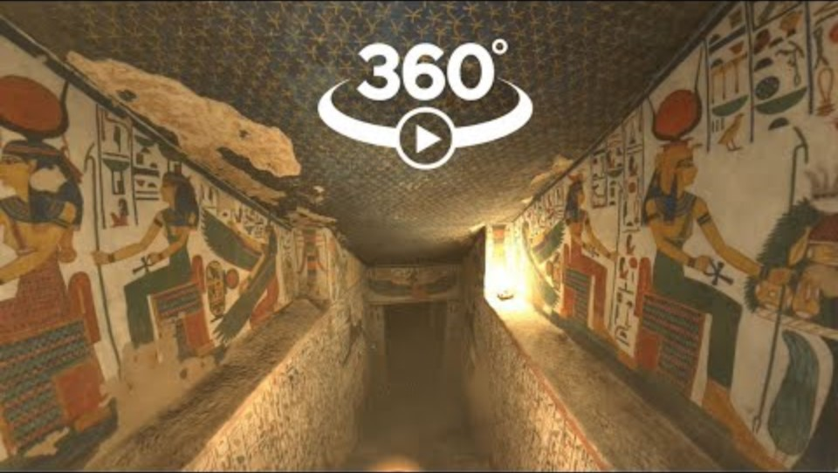
HHVR: Research
Watch the video below to answer the questions on the next few pages. Be sure to work collaboratively with your partner.

Slide 8
HHVR: Research
Questions | Response
What is the other name for Queen Nefertari’s tomb?
What does the name ‘Nefertari’ mean?
Who is Nefertari’s husband?
What were Queen Nefertari’s significant skills?

Slide 9
HHVR: Research
Questions | Response
How many chambers does Queen Nefertari’s tomb have?
What can you see on the ceilings of the tomb and what do they represent?
Why were scriptures from Ancient Egypt’s Book of the Dead painted on the walls of the tomb?
What were stolen from the tomb?

Slide 10
HHVR: Research
There are many paintings on the walls of Queen Nefertari’s tomb. A number of them were gods and goddesses of Ancient Egypt. Name at least 6 gods or goddesses and their significance or representations.
God / Goddess | Their significance / representation

Slide 11
HHVR: Research
There are many paintings on the walls of Queen Nefertari’s tomb. A number of them were gods and goddesses of Ancient Egypt. Name at least 6 gods or goddesses and their significance or representations.
God / Goddess | Their significance / representation

Slide 12
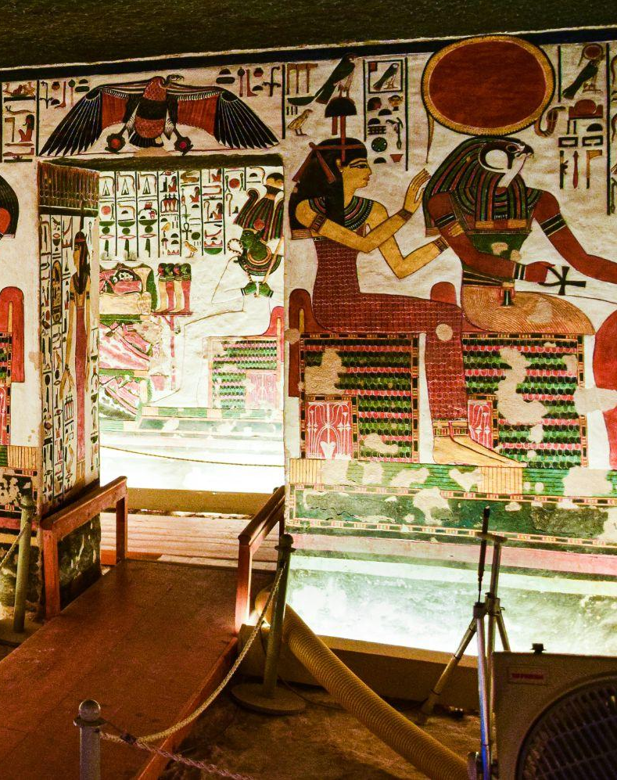
Let’s reflect
What did you think of Nefertari’s tomb?
What was the most interesting fact that you learnt?
What is something that you’re still wondering?

Slide 13
God/Goddess possible responses
Below are the 12 Gods and Goddesses that are mentioned in the IMVR experience that students could write about.
God / Goddess | Their significance / representation
Anubis | God of the dead; represented by the head of a jackal; associated with funerary practice
Isis | Motherhood and magical ability
Nekhbet | Represented upper/southern Egypt; wears a ring that symbolises Eternity.
Notes:
For teacher referral only.

Slide 14
God/Goddess possible responses
Below are the 12 Gods and Goddesses that are mentioned in the IMVR experience that students could write about.
God / Goddess | Their significance / representation
Horus | Represented as a falcon or as a man with a falcon's head. Horus was a sky god associated with war and hunting.
Ptah | God of creation, crafts, and arts
Thoth | God of writing and wisdom
Notes:
For teacher referral only.

Slide 15
God/Goddess possible responses
Below are the 12 Gods and Goddesses that are mentioned in the IMVR experience that students could write about.
God / Goddess | Their significance / representation
Osiris | God of the Underworld; symbolised death, fertility, and rebirth
Ra | Sun god; creator god; represented with human body and head of a hawk
Hathor | Represented as a cow, a goddess with a cow head or cow’s ears; symbolises motherhood, love, joy; protected women in childbirth
Notes:
For teacher referral only.

Slide 16
God/Goddess possible responses
Below are the 12 Gods and Goddesses that are mentioned in the IMVR experience that students could write about.
God / Goddess | Their significance / representation
Neith / Neit | First and primary creator goddess; patron goddess of lower Egypt and known as goddess of war and weaving
Ma’at / Mayet | Goddess representing truth, justice, and the cosmic order. The daughter of the sun god Re.
Nephthys | Goddess of the air; symbolises the death experience
Notes:
For teacher referral only.

