Slide 1
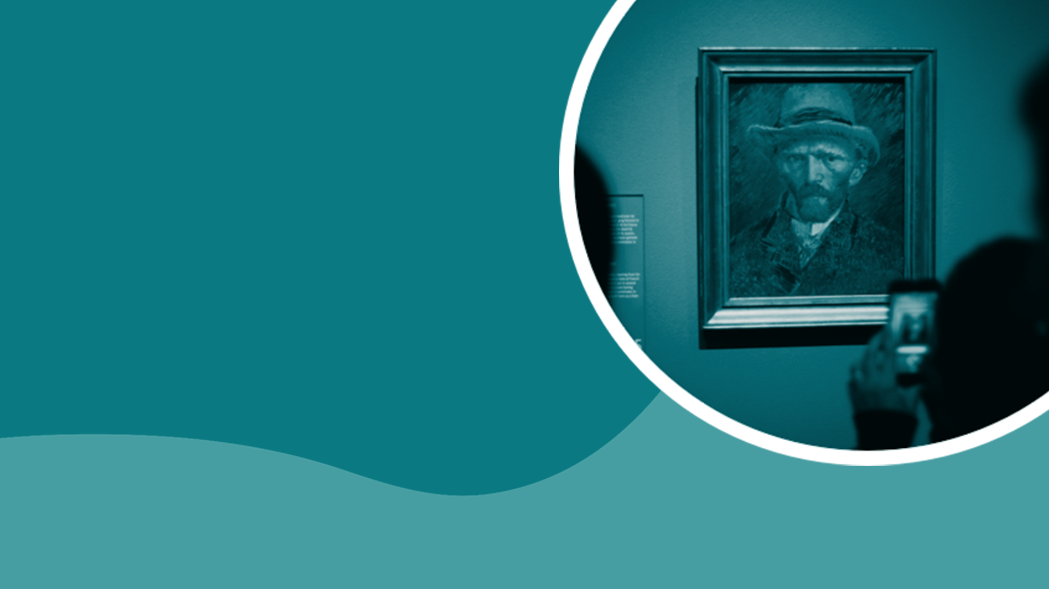
TEACHING DECK
Art styles exploration with emerging technologies
Learn about art styles and movements using AR and AI technologies.

Slide 2

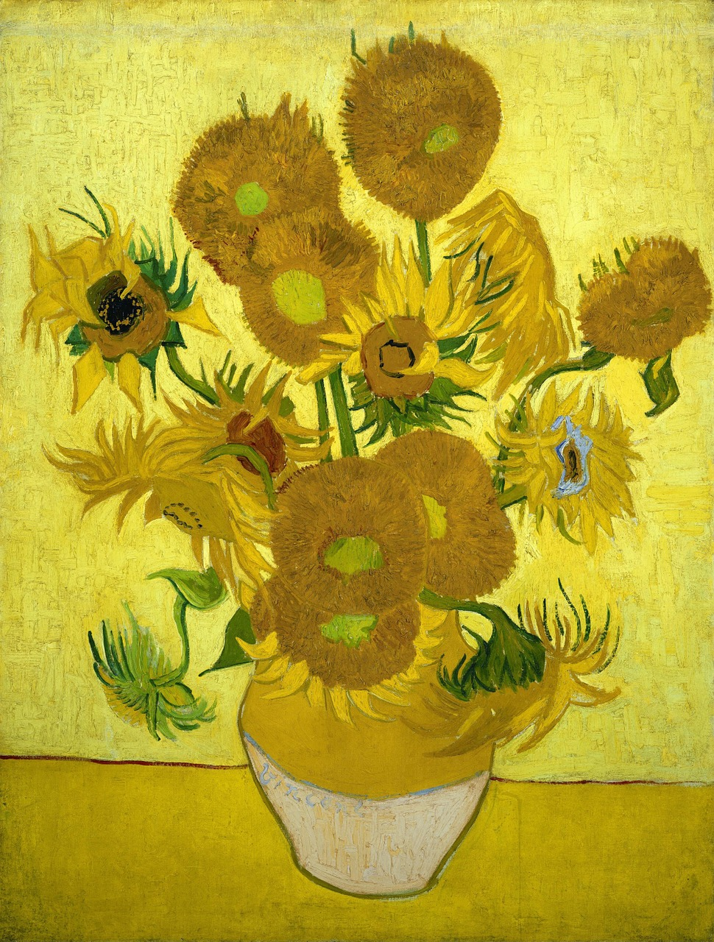
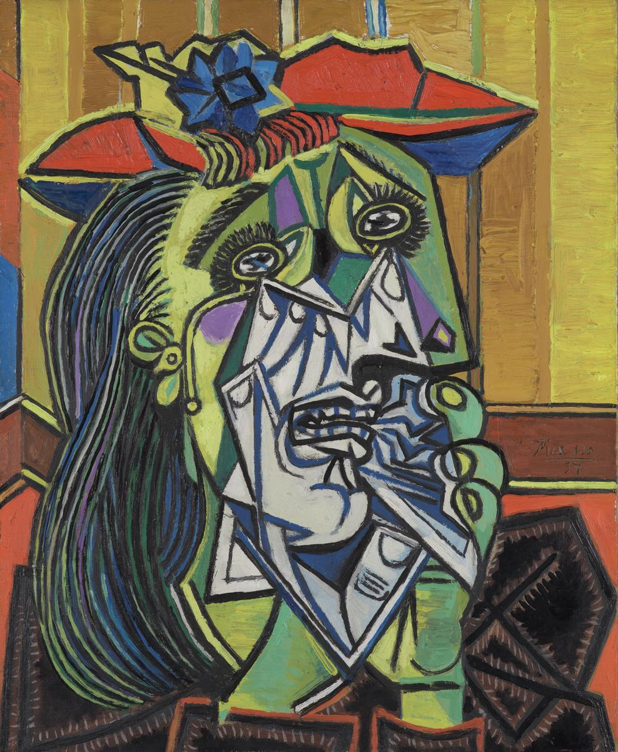
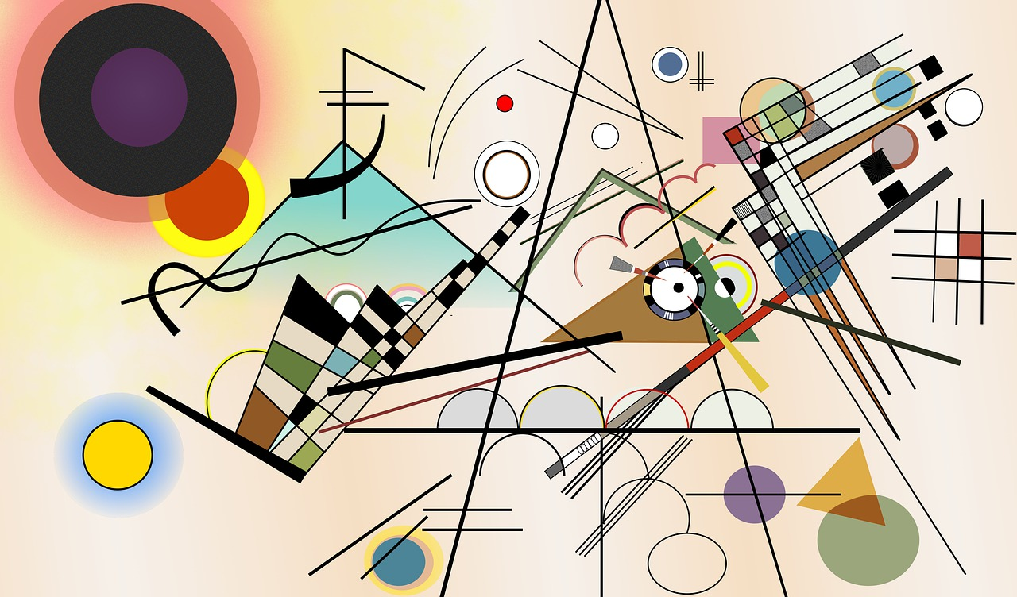
Art Styles / Art Movements
Which art styles/art movements do you know?
Post-Impressionism
Abstract Modern Art
Cubism
Notes:
Painting 1: Sunflowers by Vincent Van Gogh - Post-Impressionism
Painting 2: Composition 8 by Wassily Kandinsky - Abstract Modern Art
Painting 3: Weeping Woman by Pablo Picasso - Cubism

Slide 3
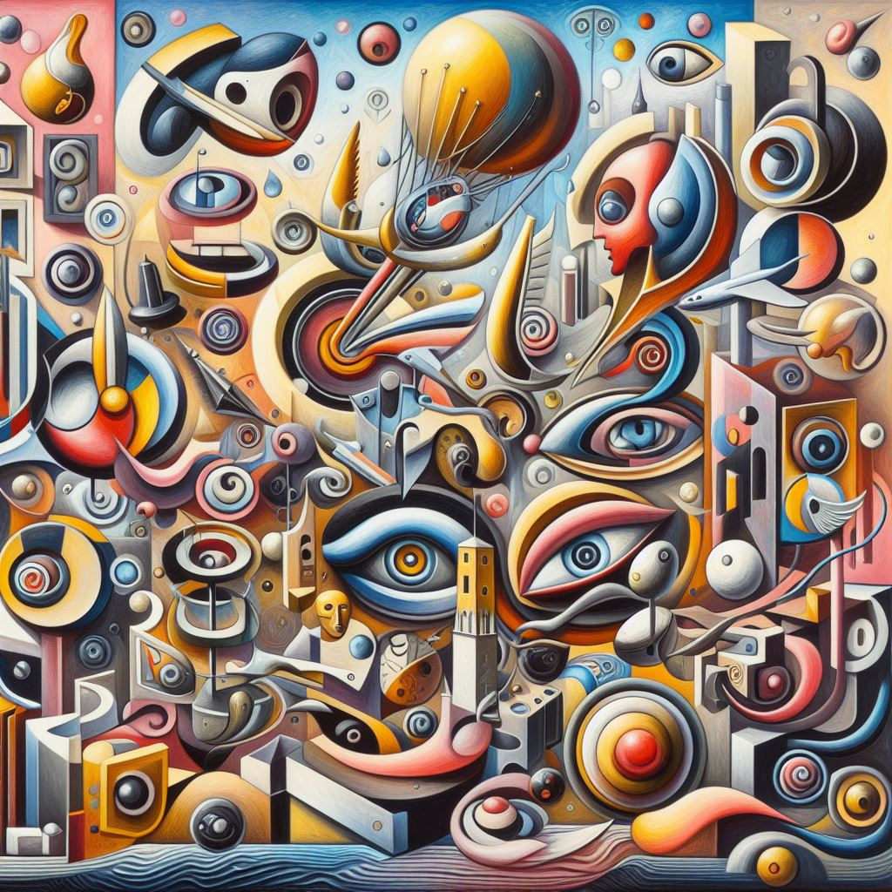
Art Styles and Art Movements
What are art styles and art movements?
An art movement is a tendency or style in art with a specific common philosophy or goal, followed by a group of artists during a specific period of time.
Some popular art movements or styles include:
Abstract Expressionism
Cubism
Impressionism & Post Impressionism
Digital Art
Street At
Pop Art.

Slide 4
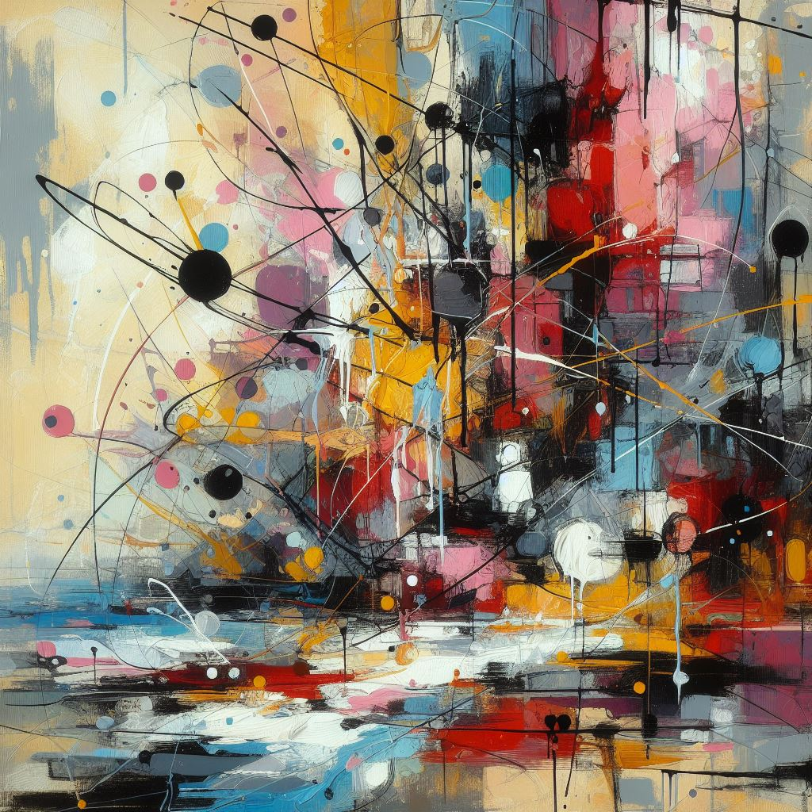
Which 20th century art movement are you?
Class personality quiz:
Questions:
Do you refuse to play the rules (in art)?
  Dadaism
Do you see the world in a different way?
  Surrealism
Do you like to keep things simple and efficient?
  Minimalism
Are you ruled by your conscience?
  Social Realism
Do you like to see things as they really are?
  Photorealism
Notes:
Teachers - Go to: https://bit.ly/ArtMoveQuiz

Slide 5
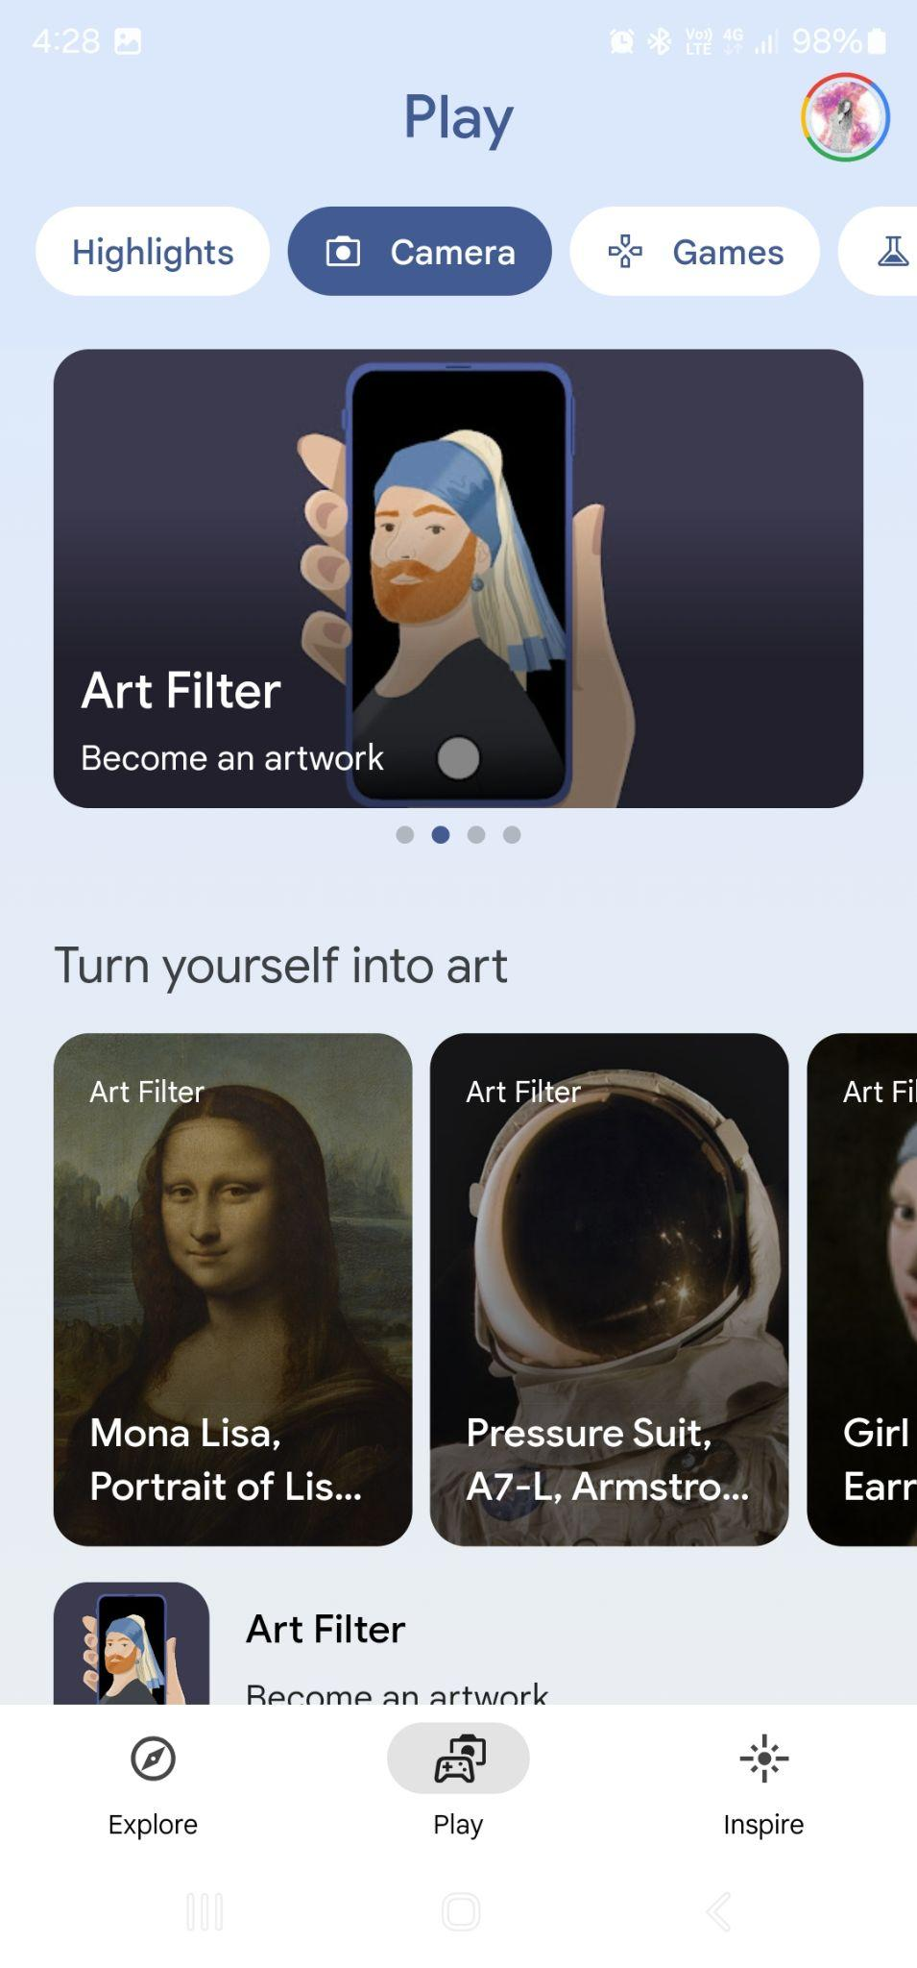
Launching the AR experiences
On Google Arts & Culture
Find Google Arts & Culture on the mobile device and launch it.
Click on the ‘Play’ icon, then go to the ‘Camera’ button.
Choose the specific AR experiences you need to complete for your digital notebook:
  Art Filter
  Art Transfer
  Art Selfie
  Art Projector

Slide 6
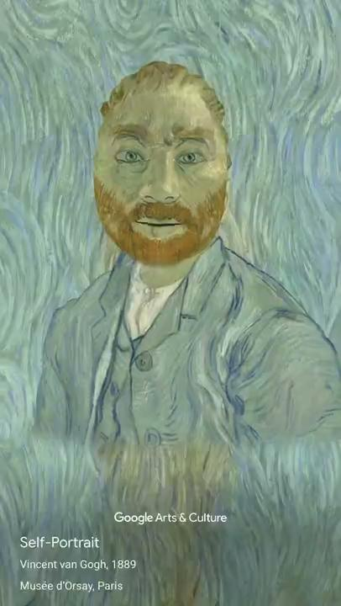
Art Filter
Choose an art artefact and apply the filter. Take a photo or video and post it here. Then, write about the inspiration for this image. Which artwork is it based on? Do you know the style or movement and artist? Why did you choose it?
This is a video based on Vincent Van Gogh’s self-portrait painting. It is from the Post-Impressionism movement.
I chose it because…
Notes:
Teachers: Please feel free to change the sample creations.

Slide 7
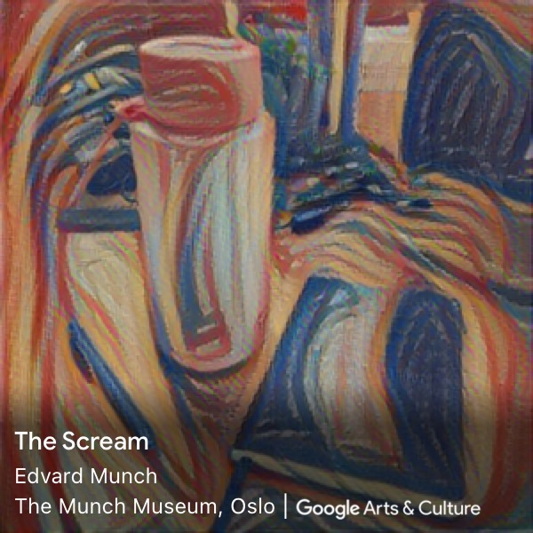
Art Transfer
Take a photo (self portrait, scene, or object) and choose an art piece and apply the filter. Click on ‘Share’ to save the photo to the gallery and upload to this document. Then, write about the inspiration for this image. Which artwork is it based on? Do you know the style or movement and artist? Why did you choose it?
This is a photo of a VR headset. It applied a filter inspired by ‘The Starry Night’ painting by Vincent Van Gogh from the Post-Impressionism movement.
I chose to take a photo of this because…
I selected the filter because…

Slide 8
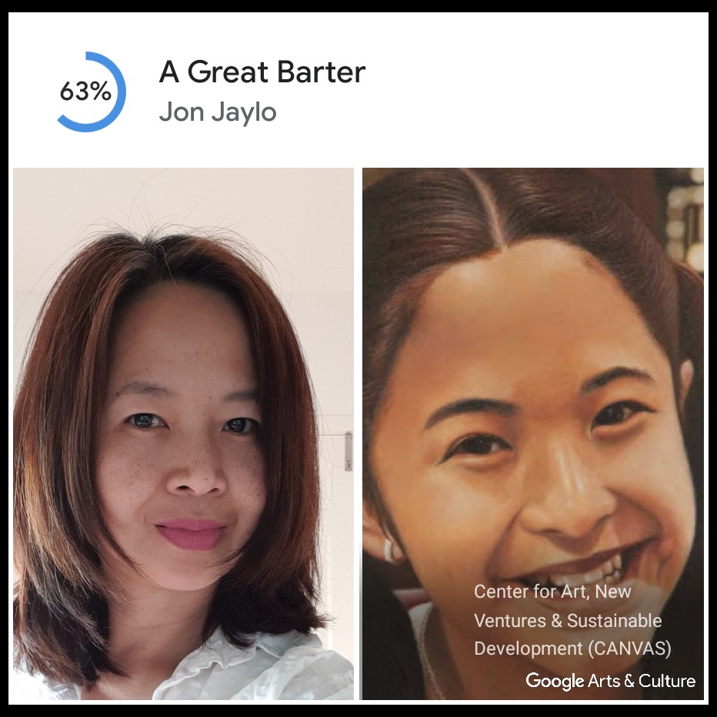
Art Selfie
Take a photo of yourself and see which artwork looks most like you. Take a screenshot of the image you like best, then upload the image to this document. Which artwork looks most like you? Do you know the style or movement and artist? Do you think the artwork looks like you? Why or why not?
The painting that looks most like me is ‘A Great Barter’ by Jon Jaylo. It was painted in 2013-2015 by a Filipino artist and is inspired by the photorealism movement.
I think the painting looks like…

Slide 9
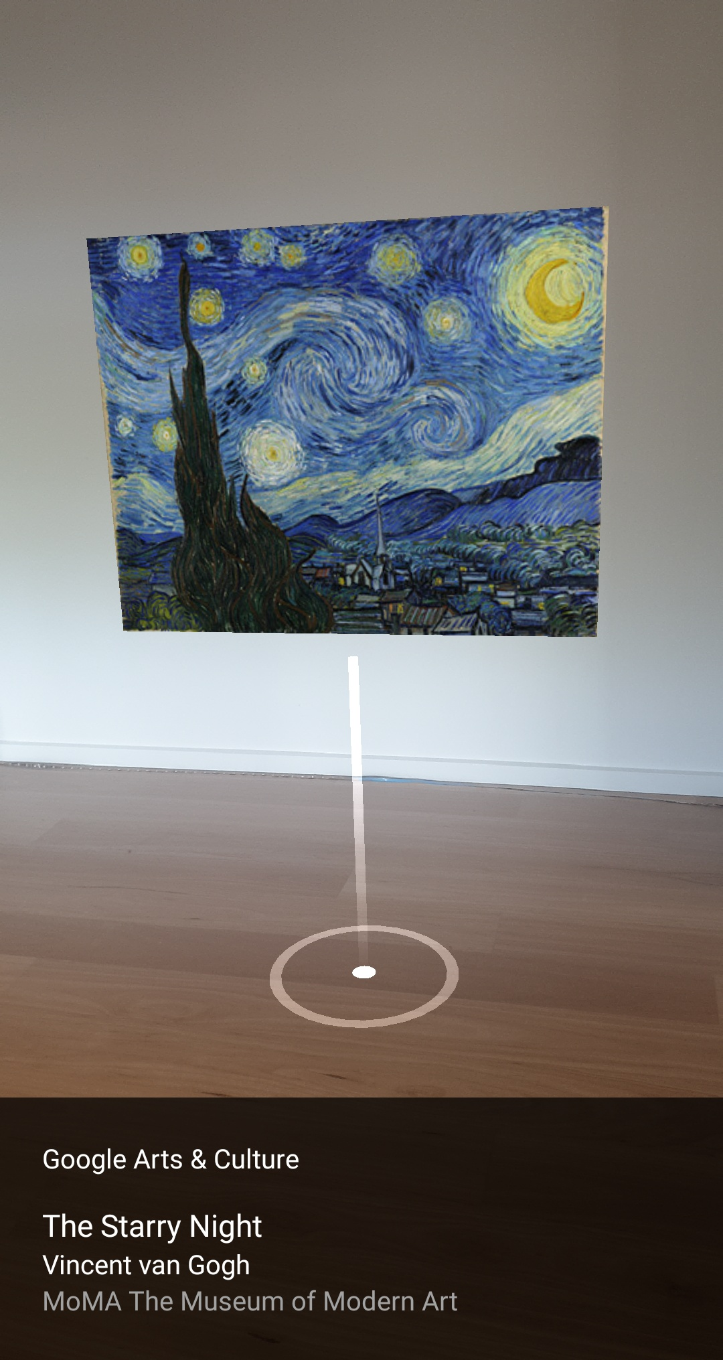
Art Projector
Follow the instructions on how to place the Augmented Reality (AR) view in the room. Choose an artwork to view it in AR. Take a photo or video of your favourite piece, then upload to this document. Write about the artwork you selected. Do you know the style or movement and artist? Why did you choose it?
This is The Starry Night by Vincent Van Gogh. It is from the Post-Impressionism movement.
I chose this artwork because…

