Slide 1

TEACHING DECK
Design a future gadget
Creating a future gadget in 3D and exploring in VR

Slide 2

Learning Tasks
These are the tasks you will need to complete for this lesson.
01
Tinkercad Design
Go on app “’Tinkercad”
Brainstorm a design for your future gadget
Reflect in your student digital notebook
02
Immersive Virtual Reality (IMVR)
Go on IMVR app “Blocks by Google”
Create and trial your gadget in VR
03
Reflection
Complete your student digital notebook
Share some of your experiences
What makes your gadget unique?

Slide 3
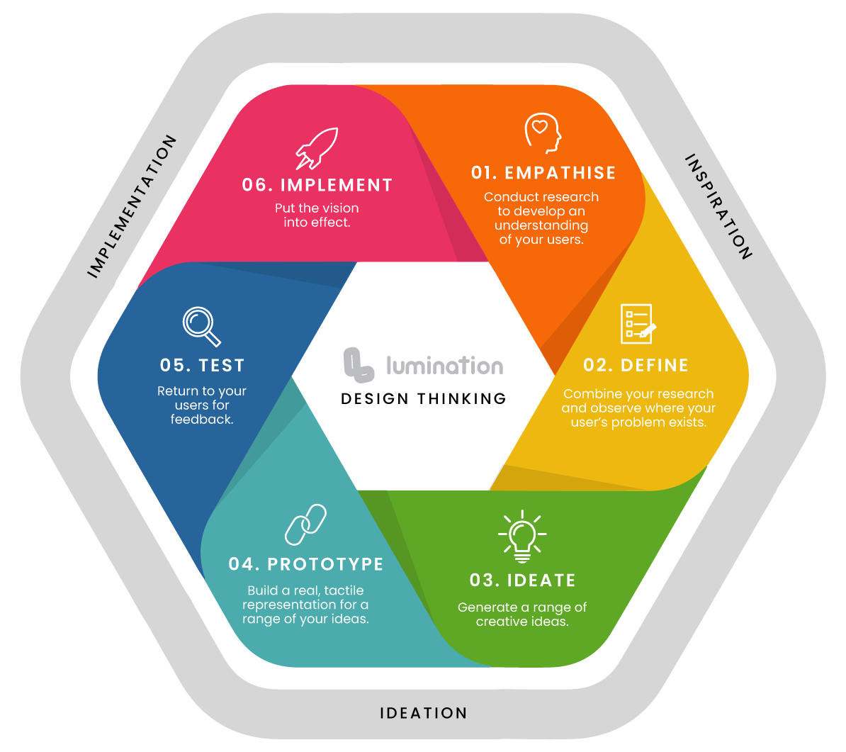
Design Thinking Framework

Slide 4
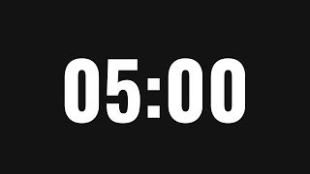
Learning Stations
Complete the stations in order. Station two to be done in small groups.
01
Think/Design/Reflect
Complete tasks on slides 5-8 of your student digital notebook
02
Go on app “’Tinkercad”
Brainstorm a design for your future gadget
Reflect in your student digital notebook
Tinkercad Design
03
Immersive Virtual Reality (IMVR)
Go on app “Blocks by Google”
Create and trial your gadget in VR
Each student has five minutes on the app

Slide 5
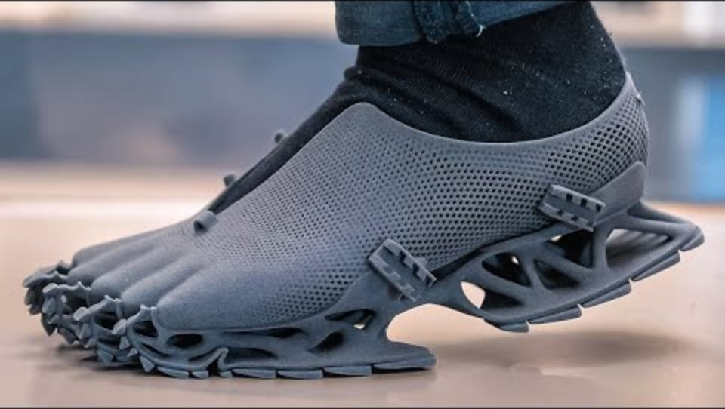
Inventions of the future
Watch the video “Inventions of the future”.

Slide 6
Discuss and record
Record your thoughts and observations from watching “The Inventions of the Future” on slide 5 of your student digital notebook
Which invention excited you the most?
What problems or issues do these inventions solve?
Who would benefit from those inventions? Why?

Slide 7

Tinkercad
Design the gadget to help solve the issue you have identified.
01
Tinkercad Design
Go on app “’Tinkercad”
Design your future gadget
Reflect in your Design Thinking Digital Notebook
Tinkercad - Login

Slide 8
Blocks by Google
Create your gadget on Blocks by Google to experience it in VR.
In small groups, go on Blocks by Google on the IMVR stations to trial your future gadget design in Virtual Reality. The student who is not wearing the IMVR headset can assist the student who is wearing it, and then switch after 5 minutes.
02
Google Blocks
Go on app “Blocks by Google”
Create and trial your gadget in VR

Slide 9
Reflection
Discuss your ideas as a class.
Share some of your experiences and designs you created.
What problem does your gadget solve? What makes your gadget unique?
Based on your feedback, what would you improve upon if you were able to implement this solution?

