Slide 1

TEACHING DECK
Volcanoes in VR
Understand and explore volcanic eruptions and how the landscape changes due to this extreme weather event using VR

Slide 2

Prior knowledge
Discussion
What types of extreme geological events do you remember? (e.g. earthquakes, volcanic eruptions, landslides, etc)
Using the theory of plate tectonics, explain how a volcano is formed? How do you know?
Can you identify where an active volcano currently is on the planet?
What type of plate boundary interaction results in a volcano?

Slide 3
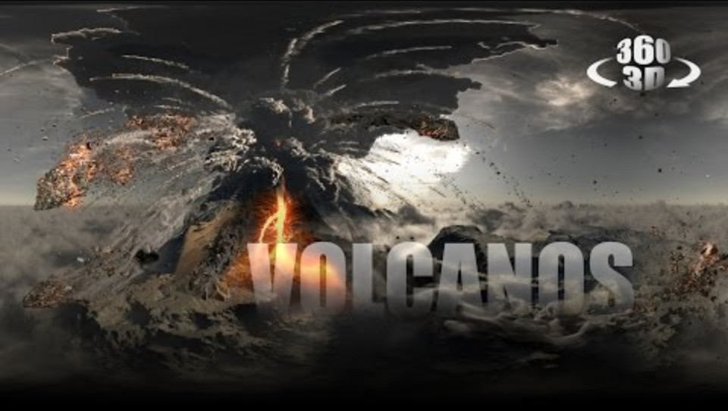
Volcanoes: An Immersive Experience 360°
HHVR class viewing

Slide 4
Explicit Knowledge
Watch the video and complete the table.
Boundary Type | Movement | Volcanoes? | Earthquakes? | Other geological formation

Slide 5


Explicit Knowledge
Boundary Type | Movement | Volcanoes? | Earthquakes? | Other geological formation
Constructive/ divergent | Away from each other |  |  | Trench/valley
Destructive/ convergent (with one continental plate and one oceanic plate) | Towards each other, and the oceanic subducts under the continental plate
Destructive/ convergent (with two continental plates i.e. collision) | Towards each other, creating fold mountains |  |  | Fold mountains
Conservative/ transform | Side

Slide 6
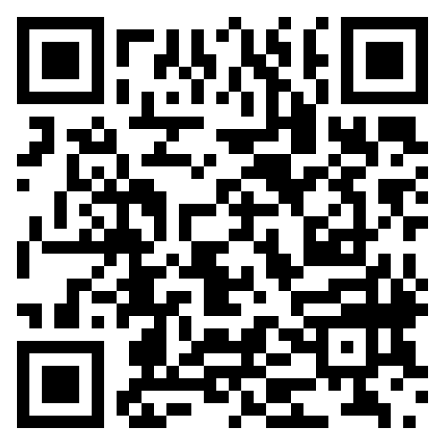
Volcanoes: An Immersive Experience 360°
HHVR video
Using the HHVR headsets watch Volcanoes: An Immersive Experience 360° then fill out the Y chart using sticky notes.
Think about :
What did you SEE on the video?
What did you THINK while watching the video?
What did you FEEL while watching the video?
Volcanoes: An Immersive Experience 360° (4:52)

Slide 7
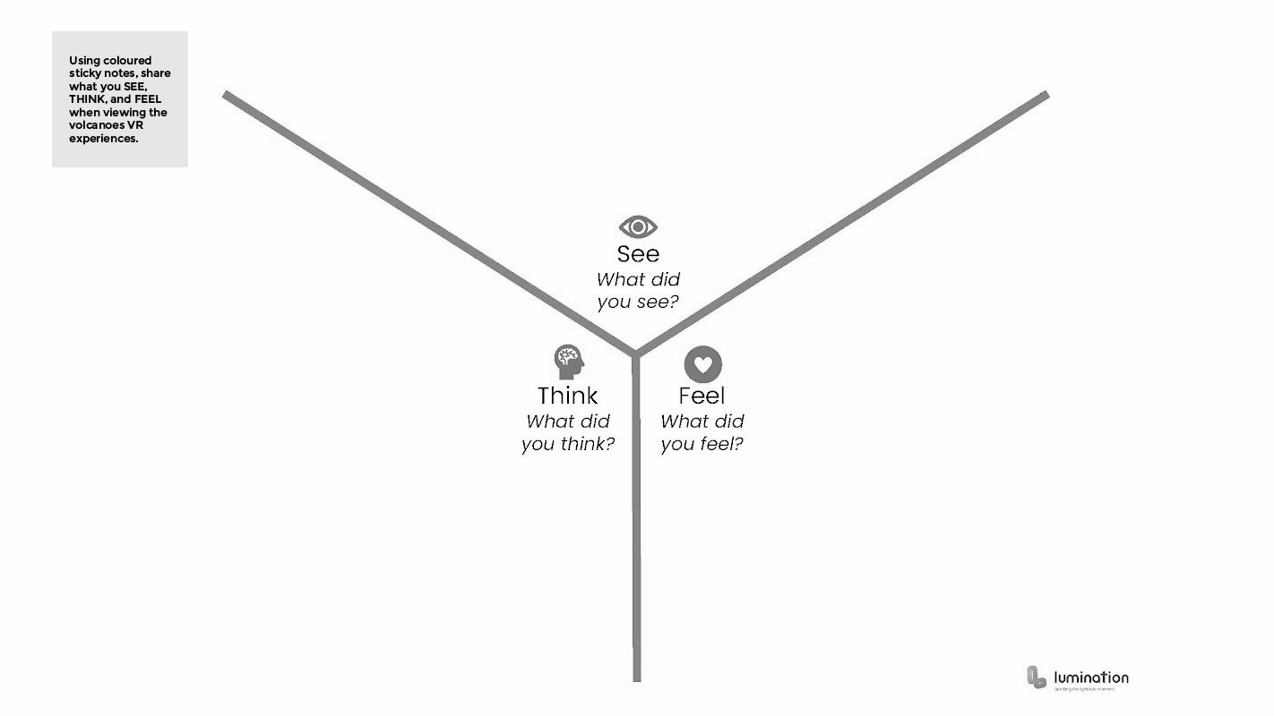
Volcanoes: An Immersive Experience 360°
Get students to click the link and fill in the Y chart using Canva
Canva Whiteboard - Y chart

Slide 8
Learning Stations
Working in small groups
01
Check: Student Digital Notebook
View: HHVR Videos (Scan QR Codes)
Reflect on your experiences
HHVR Station
02
Explore Volcanoes in Google Earth VR
In pairs take turns, 3-5 minutes each
Reflect on your experiences
IMVR Station
03
In groups use Stop Motion (or similar) to demonstrate the result of plate tectonics.
Extension : Demonstrate the movement of plate boundaries and use a voice over to describe how convection currents cause plates to move and consequently collide.
Animation Creation Station

Slide 9


QR Codes
Scan the QR codes using your devices.
How Volcanoes Affect Earth's Climate Over Millions of Years (2:06)
Lassen Volcanic National Park in 360° Virtual Reality
(3:27)

Slide 10



QR Codes
Scan the QR codes using your devices.
Insta360 VR: Flying Over Iceland Volcano - A Virtual Reality Experience (1:38)
Volcano Eruption 360/VR Video - Minecraft Animation(4:55)
TO THE EARTH'S CORE 360° - VR Video (3:08)

Slide 11
Reflection - Discussion
Reflecting on VR experiences
What's one new thing you learned about volcanoes from watching the videos?
After seeing volcanoes in VR, can you explain how the movement of tectonic plates helps form volcanoes? Give one example of where this happens.
Why do you think early warning systems are necessary for people living in volcanic regions? Why do you think people still choose to live near these zones?

Slide 12
Reflection - Discussion
Reflecting on VR experiences
Describe how an early warning system would work by using your understanding of plate tectonics?

Slide 13
Animation Creation
Share your animations

