Slide 1
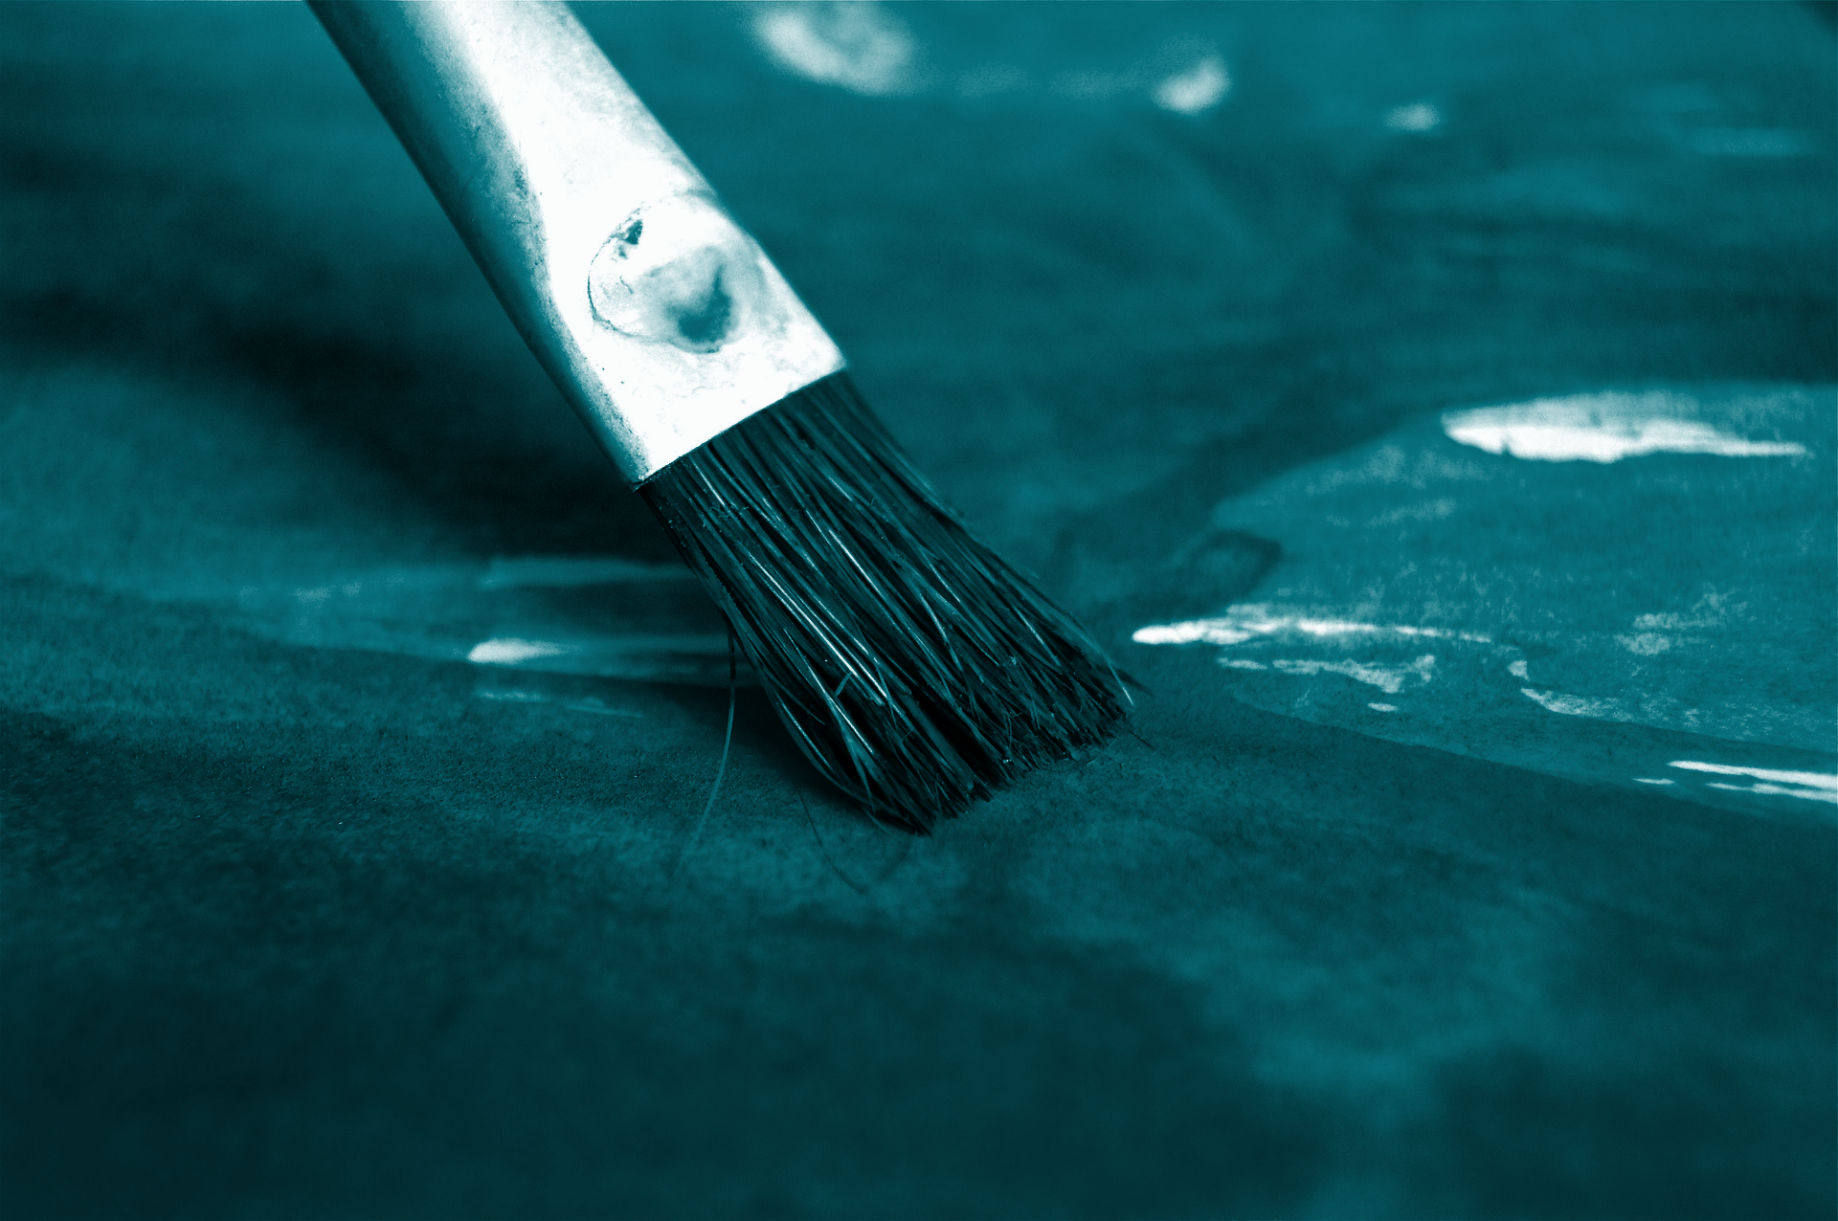

STUDENT DIGITAL NOTEBOOK
Art Portfolio
in Canva
Student Name:

Slide 2

What is a digital portfolio?
A digital portfolio ….

Slide 3
What’s the difference?
What differences do you think exist between displaying art physically (in galleries, on walls) versus digitally (online galleries, digital portfolios)?
Physical
Digital

Slide 4
Brainstorm
Discussion
Can you remember the first piece of art you were truly proud of creating? What made it special to you?
Have you ever looked at an artist’s portfolio online? What did you notice about how they presented their work?
Are there any digital tools or apps you've used before to create or edit art? Which ones, and what did you like about them?
Why do you think an artist might prefer a digital portfolio over a traditional one? What advantages could it offer?

Slide 5
Planning your portfolio
Briefly plan how you would like to set up your portfolio.
  Identify the pieces of art to include.
  Decide on the portfolio’s theme or style.
  Create a rough layout of the art portfolio.

Slide 6

Create the portfolio
Create the art portfolio using the following steps:
  Select an art portfolio template on Canva.
  Apply design principles to create a cohesive portfolio then insert and arrange selected artwork.
  Reflect by writing a short description using a text box for each artwork explaining the process and intention behind the artwork.

Slide 7
Feedback and reflection
Move into pairs or small groups to provide feedback on the art portfolios. Then answer the following questions.
How can sharing your art in a digital portfolio help you grow as an artist? What kind of feedback would you hope to get?
How could you use a digital portfolio to show not just your finished artwork but also your creative process?

