Slide 1
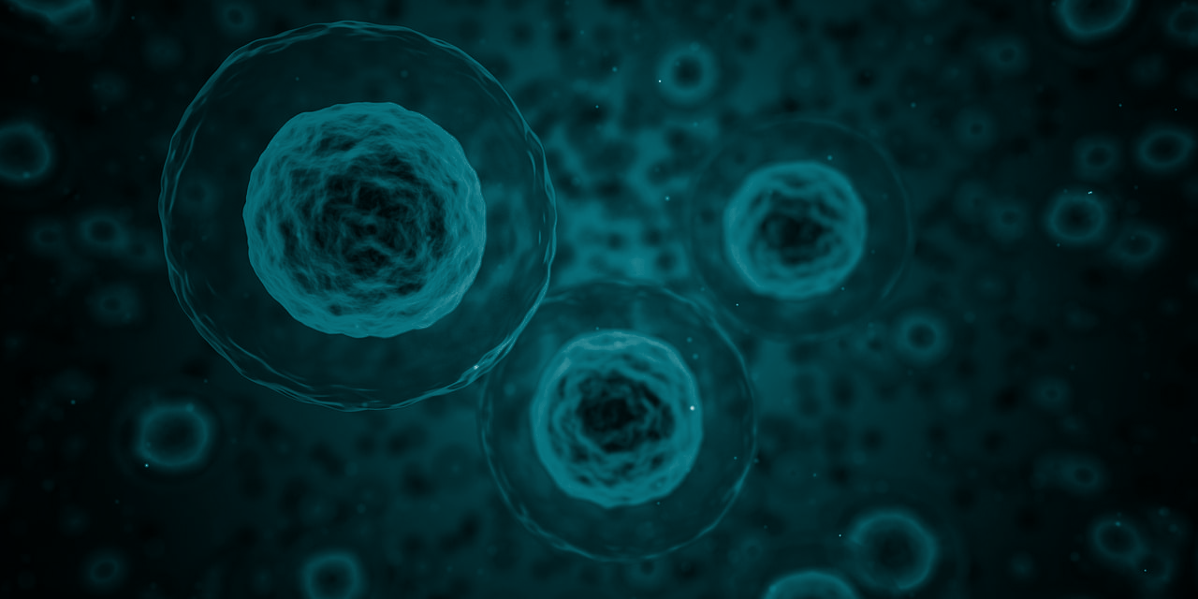

STUDENT DIGITAL NOTEBOOK
Cells in Focus
Student Name:

Slide 2

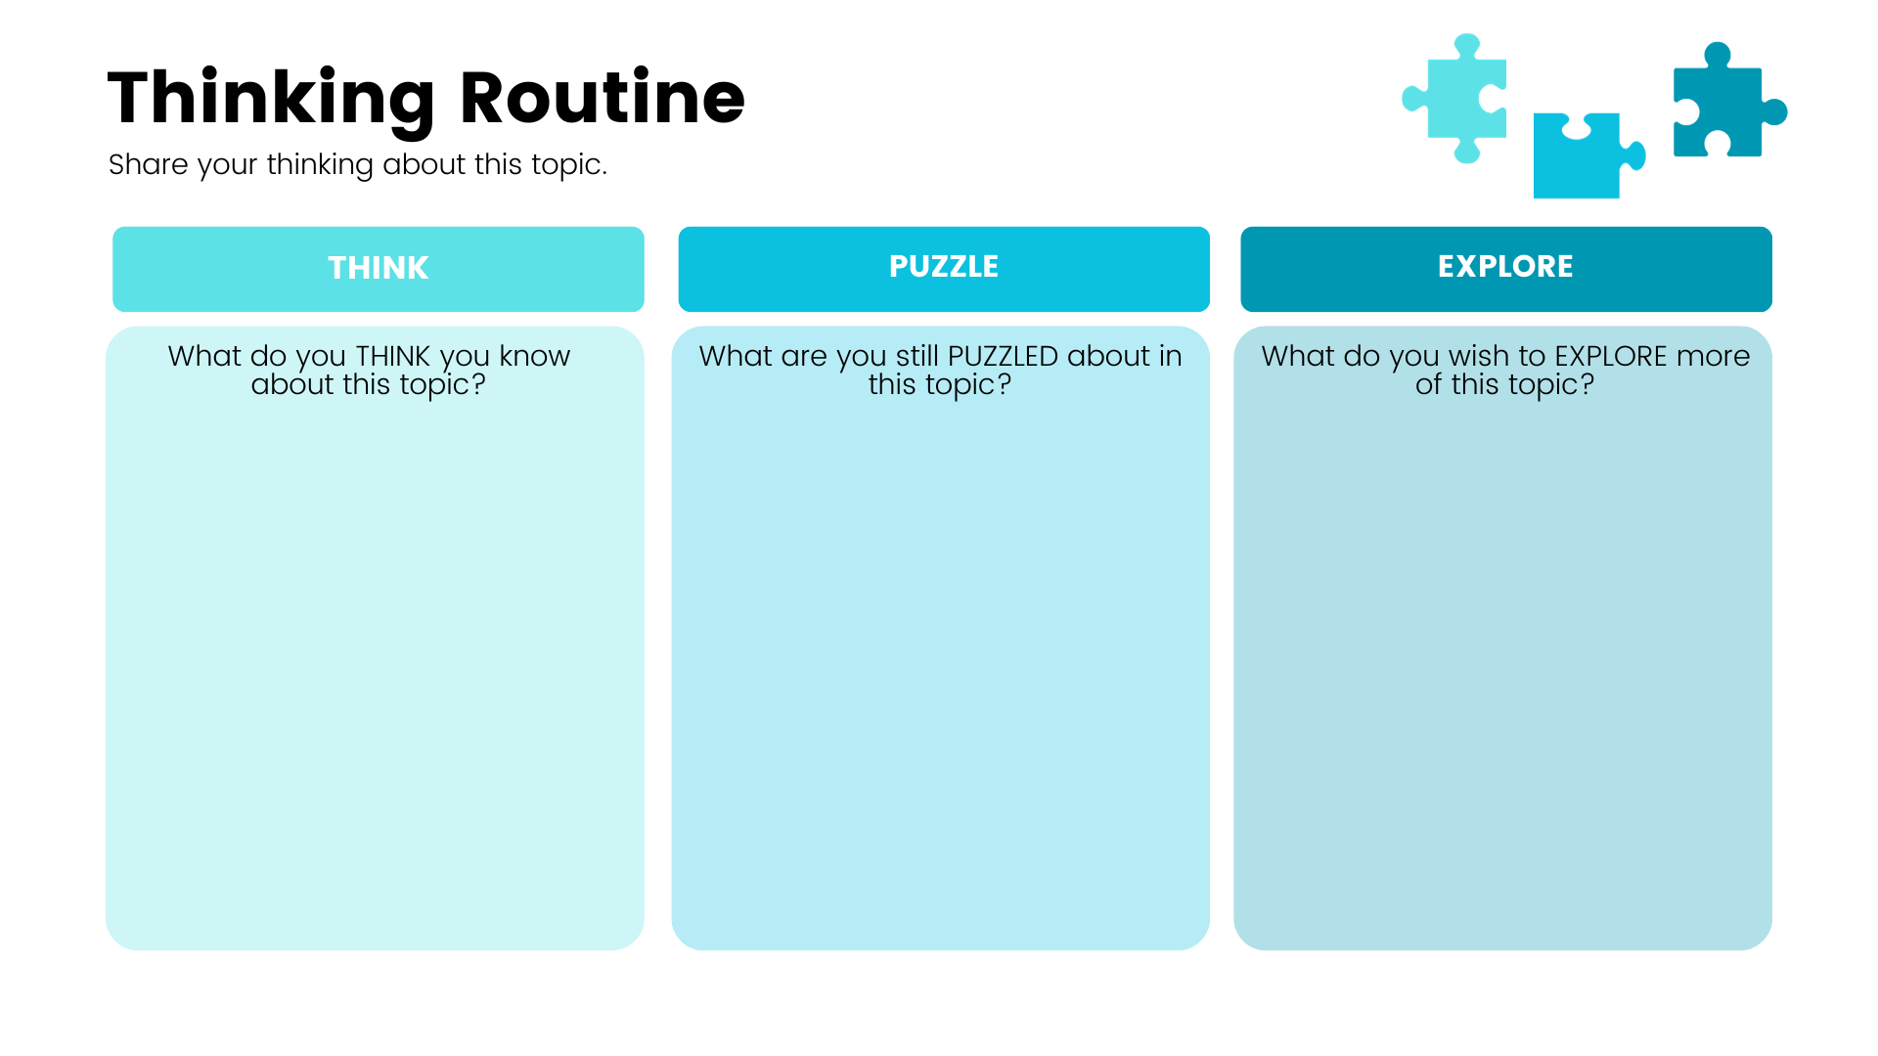
Write your answer here.
Write your answer here.
Write your answer here.

Slide 3
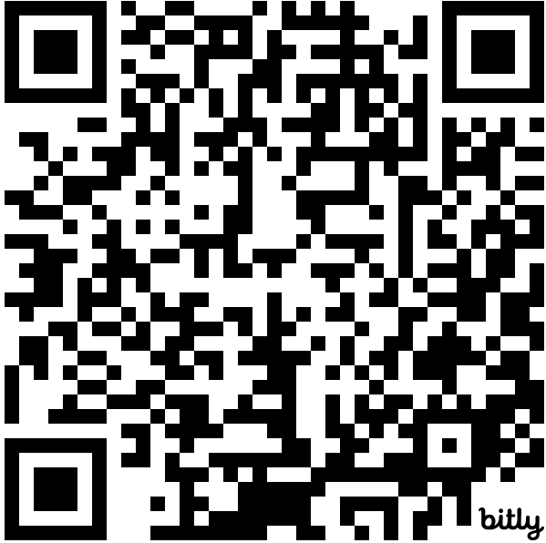
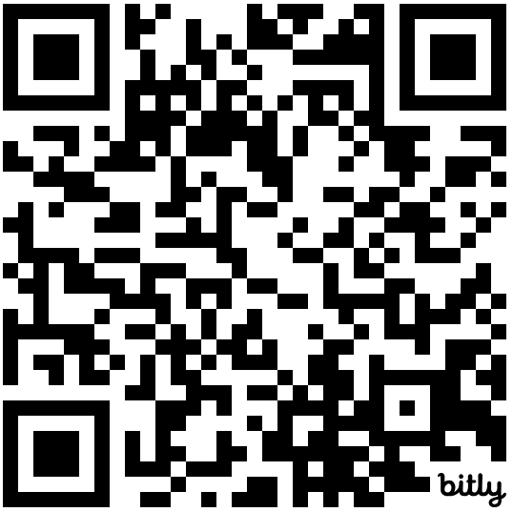
HHVR Videos
Scan the QR codes using your mobile devices.
View a Plant Cell In VR
https://bit.ly/PlantCellVR
View an Animal Cell In VR
https://bit.ly/AnimalCellVR

Slide 4
Plant and Animal Cells In VR
Task questions
Based on this activity, can you name at least three things that are the same between animal cells and plant cells?
Can you name at least one thing that’s different in a plant cell? What is its function?
Can you name at least one thing that’s different in an animal cell? What is its function?

Slide 5
Plant Cell Mind Map
Create a mind map of a plant cell’s form and function, starting with the organelle.

Slide 6
Animal Cell Mind Map
Create a mind map of a animal cell’s form and function, starting with the organelle.

Slide 7
Draw a Cell
Share a snapshot of your cell illustration here.

Slide 8
Plant and Animal Cells
What was one thing that PUZZLED you about cells that had been answered through this activity? What did you learn?

Slide 9
Quick Quiz
Answer the following questions in your digital notebooks or online form.
Which of these cell structures is present in both plant and animal cells?
  Cell wall
  Chloroplast
  Cytoplasm
  Vacuole
Which cell component controls the substances that enter and exit a cell?
  Cell membrane
  Cell wall
  Chloroplast
  Cytoplasm
In which component of a plant cell does photosynthesis occur?
  Cell membrane
  Cell wall
  Chloroplast
  Cytoplasm
4. What does the cell nucleus do?
  Provides support
  Keeps the cell firm
  Absorbs sunlight
  Controls cell activity
5. What makes raw vegetables crunchy?
  Their cytoplasm
  Their mitochondria
  Rigid cell walls
  Their chloroplasts

