Slide 1
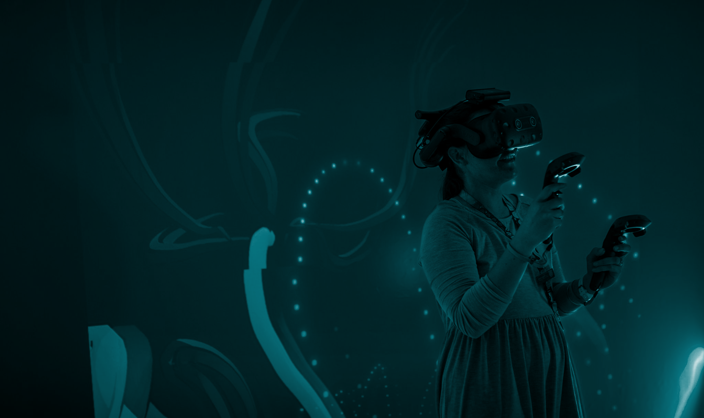

DIGITAL NOTEBOOK
Immersive Art Exploration
Student Name:

Slide 2

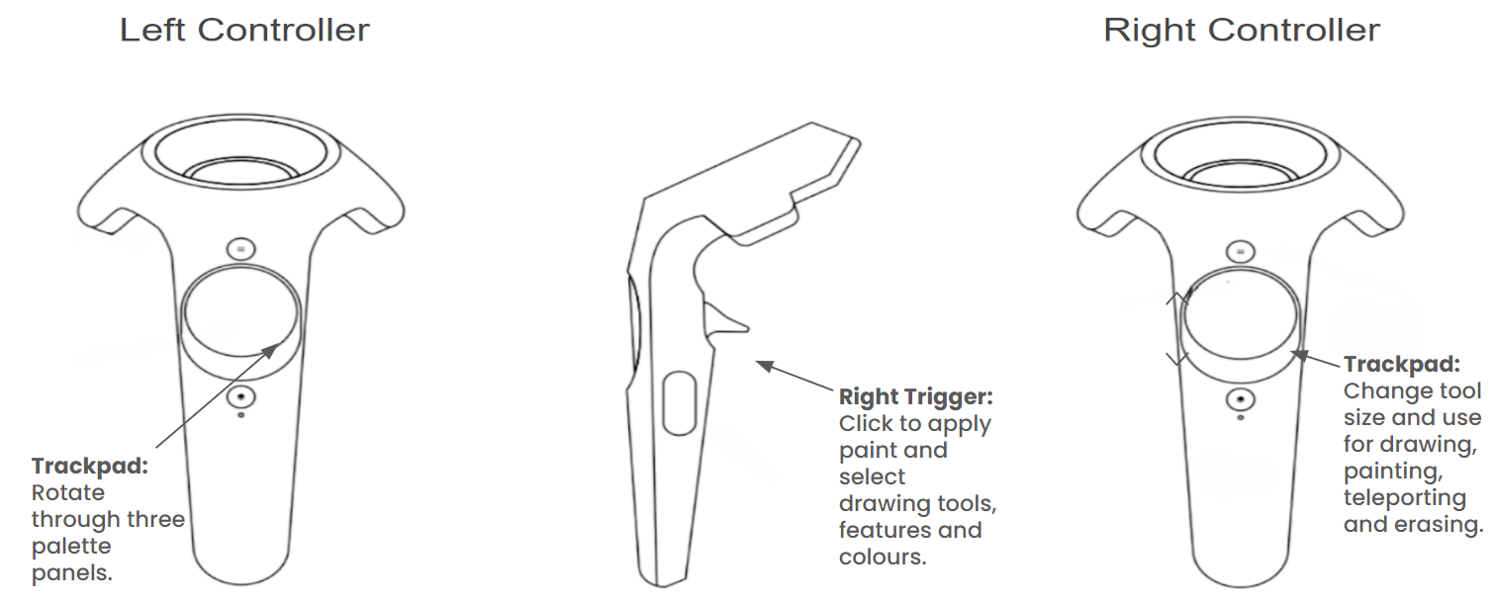
Tilt Brush - controllers

Slide 3
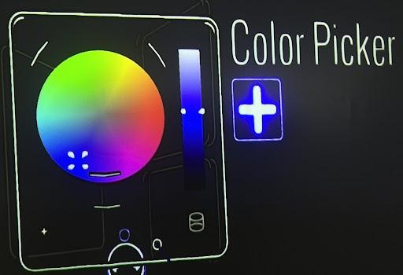
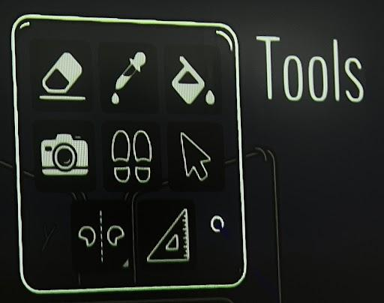
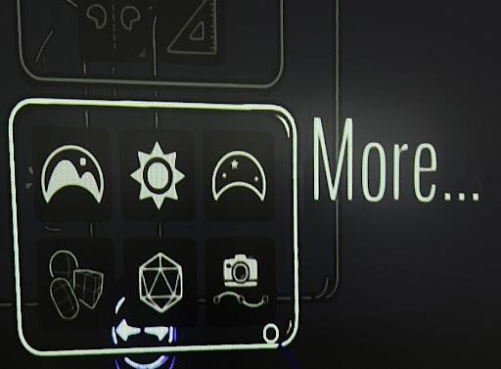
Tilt Brush- tools and options
Digital tools for immersive art
Here you can choose your colour and its different shades.
Here you can choose various tools such as eraser.
Click ‘More’ for more options such as environment.

Slide 4
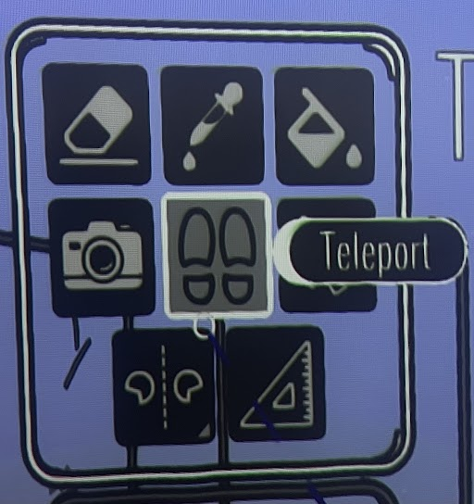
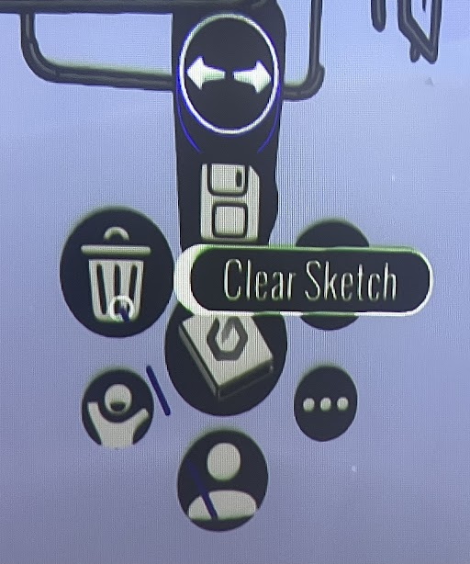
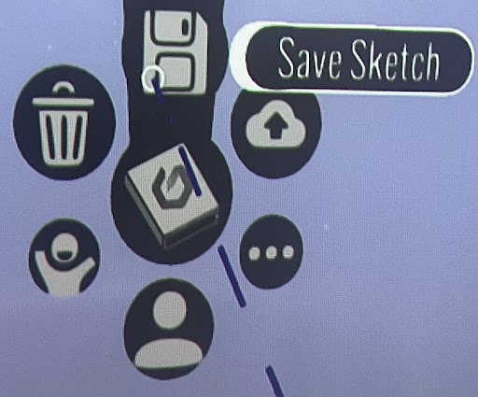
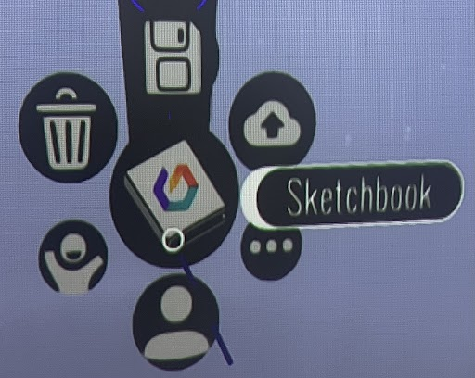
Tilt Brush - tool options
Digital tools for immersive art
Select teleport and use the trigger to move around your canvas.
Use the rubbish bin to clear your whole canvas in one go.
Use this button to save your work and continue working on it later.
Your saved designs can be found in the sketchbook later.

Slide 5
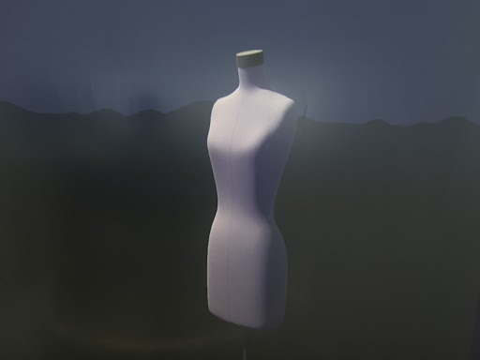
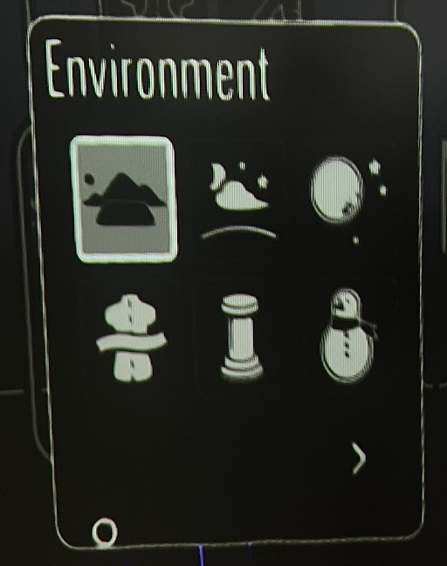
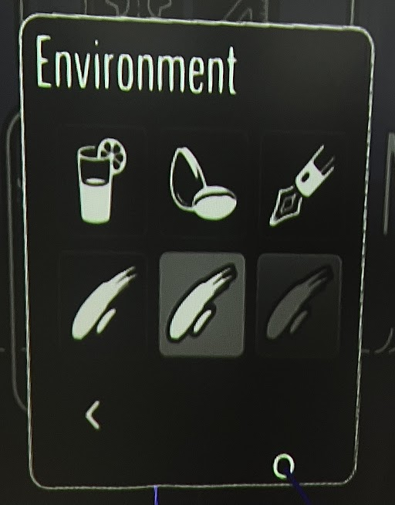
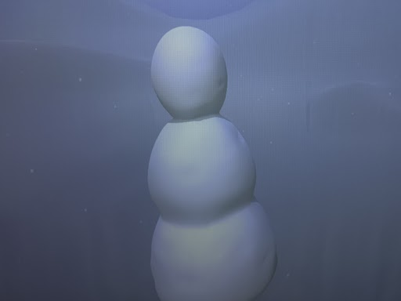
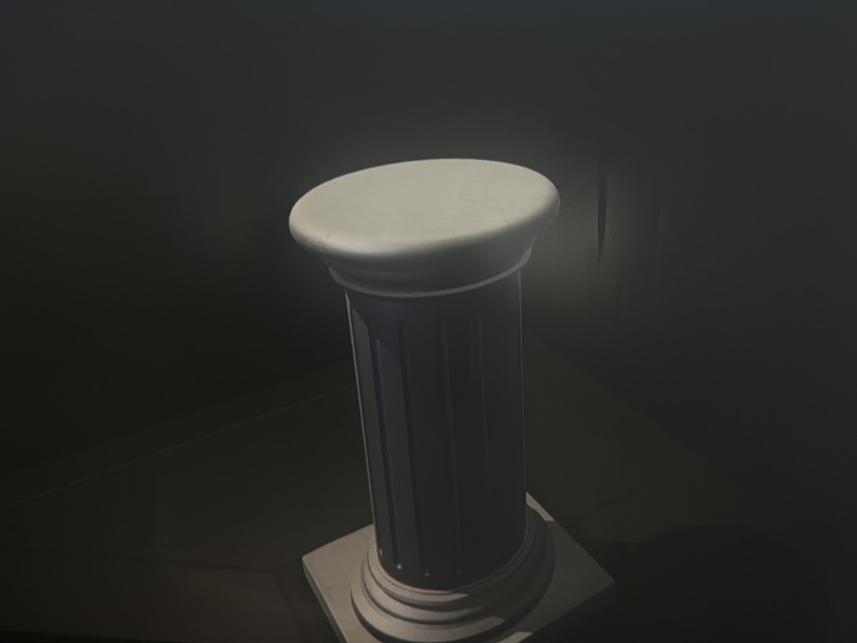
Tilt Brush - environment options
You can change your environment/canvas.
Dress Form
Snowman
Standard
Night sky
Space
Pink Lemonade
Pistachio
Illustrative
Dress Form
Pedestal
Snowman
Black
White
Blue
Pedestal

Slide 6
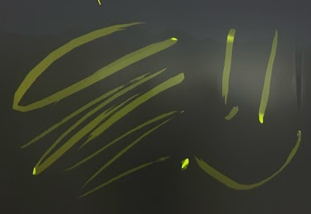
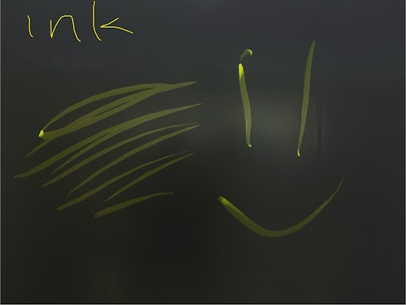
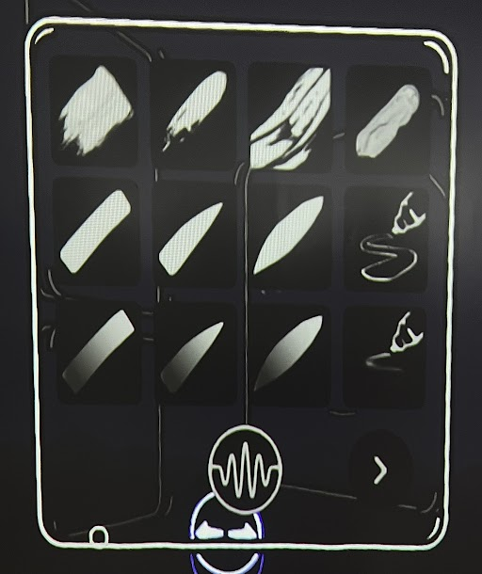
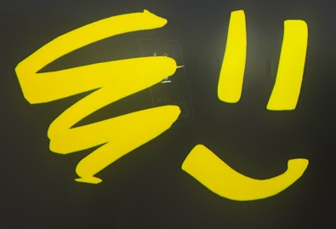
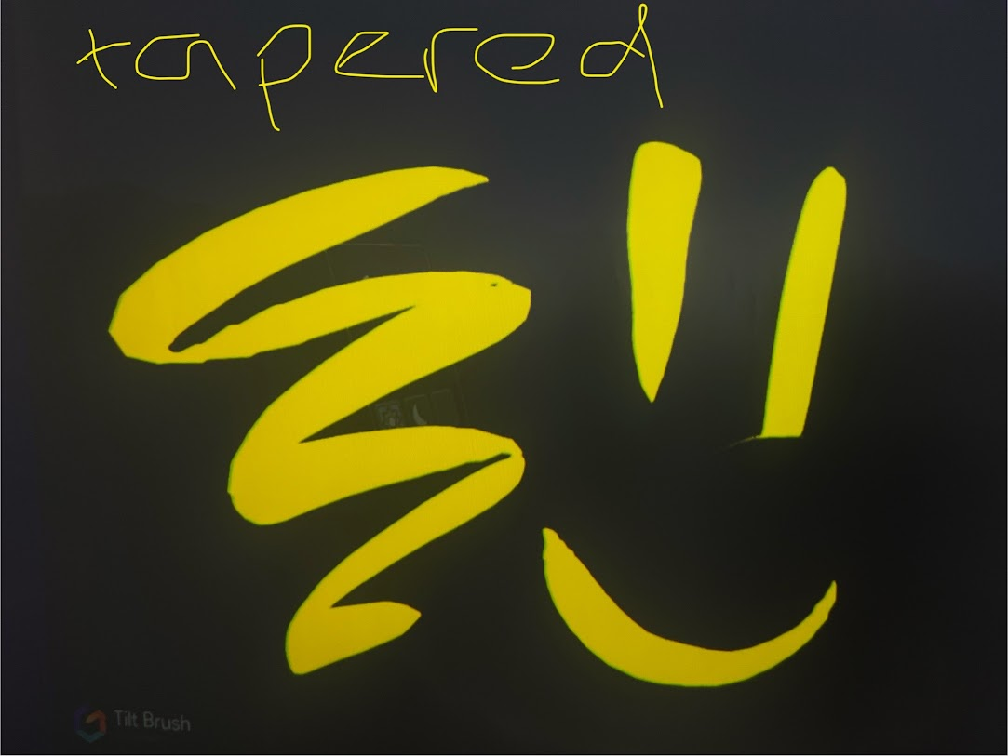
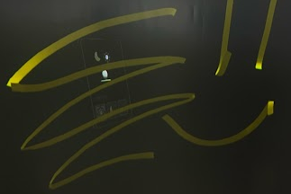
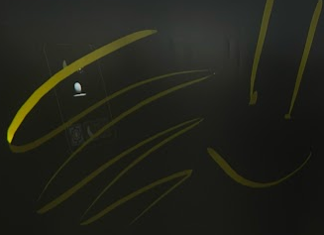
Tilt Brush - brush options
Oil paint
Ink
Tapered Marker
Marker
Tapered Flat
Flat

Slide 7
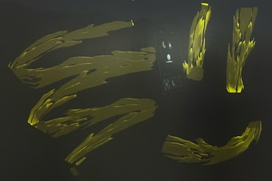
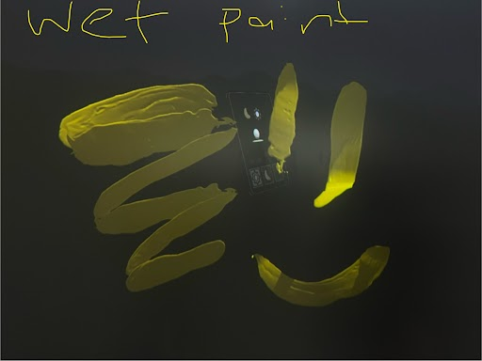
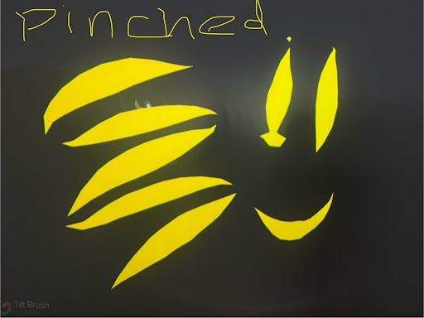
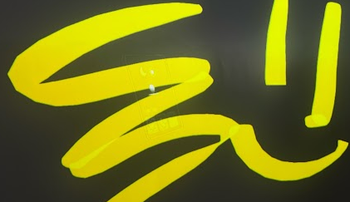
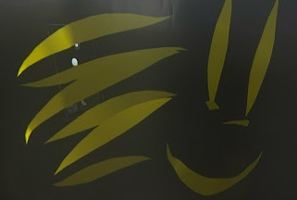
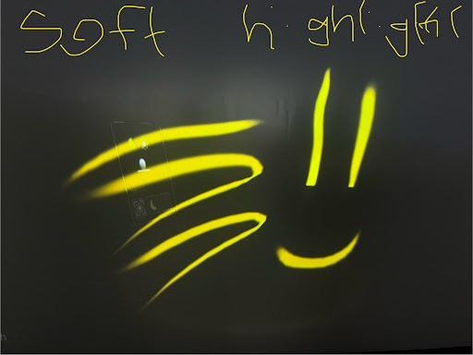
Tilt Brush - brush options
Thick Paint
Wet Paint
Pinched
Marker
Highlighter
Pinched Flat
Soft Highlight

Slide 8
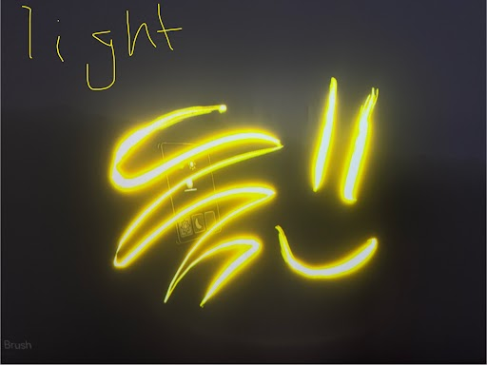
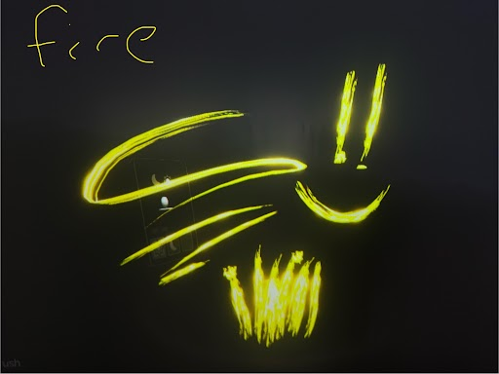
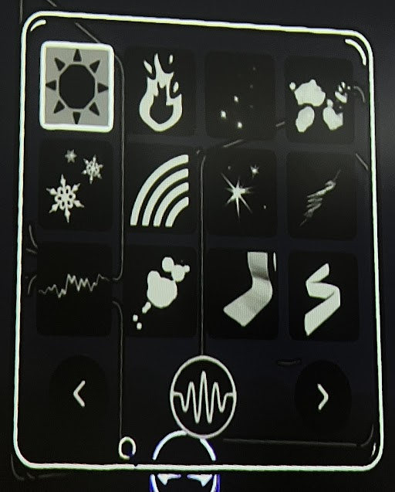
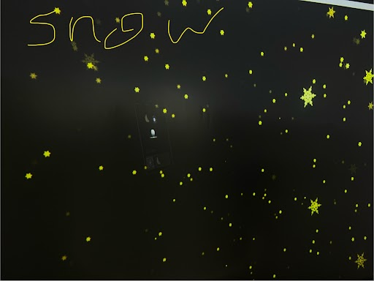
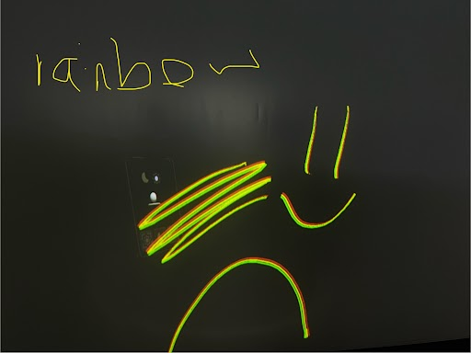
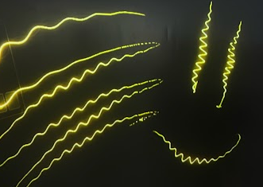
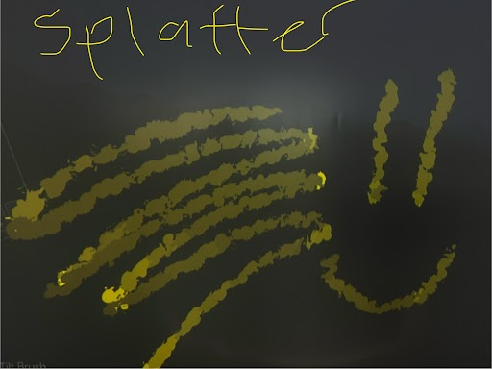
Tilt Brush - brush options
Light
Fire
Snow
Rainbow
Waveform
Splatter

Slide 9
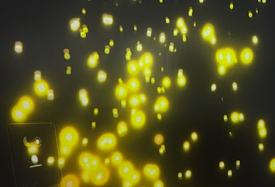
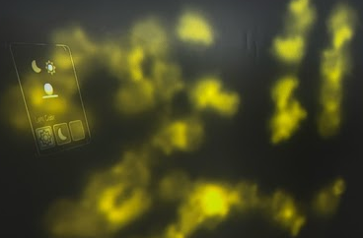
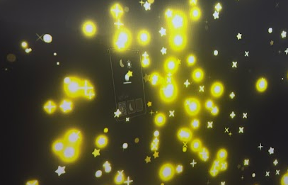
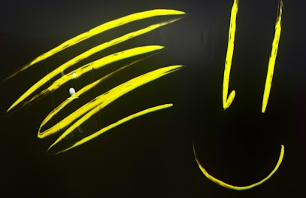
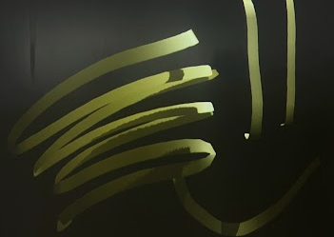
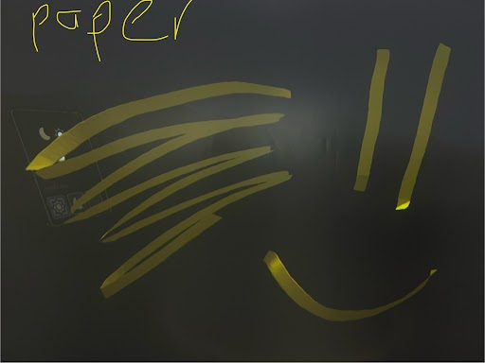
Tilt Brush - brush options
Embers
Smoke
Stars
Velvet Ink
Duct Tape
Paper

Slide 10
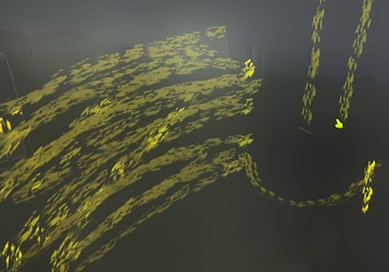
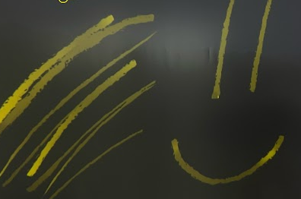
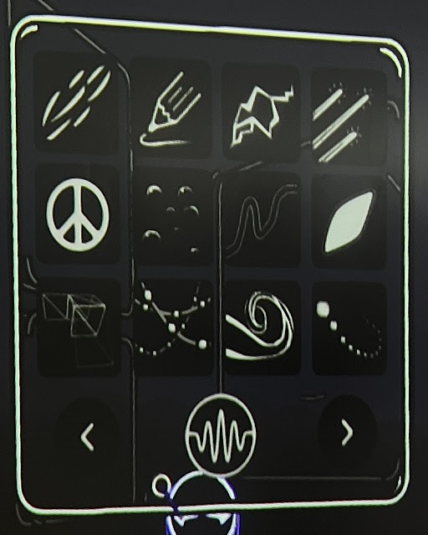
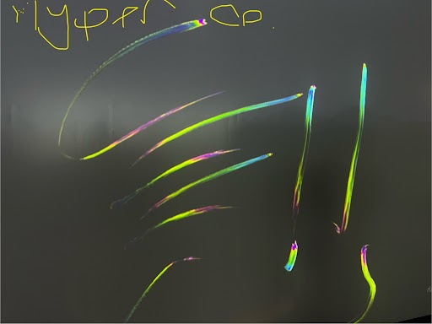
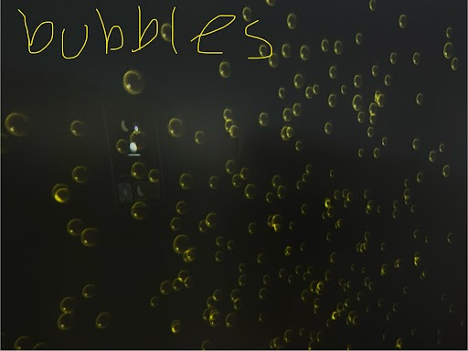
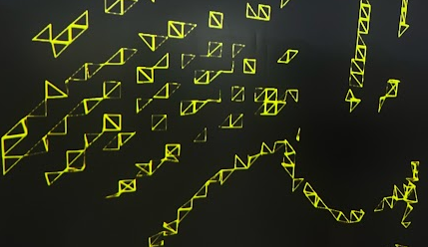
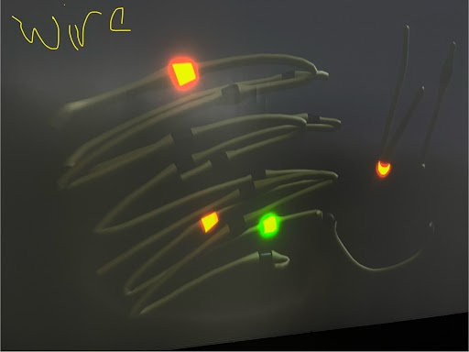
Tilt Brush - brush options
Coarse Bristles
Dr. Wigglez
Hypercolour
Bubbles
Hyper Grid
Light Wire

Slide 11
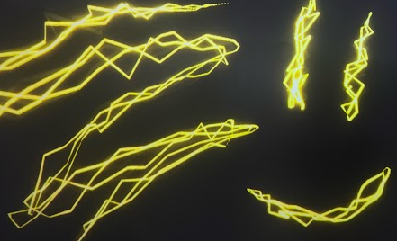
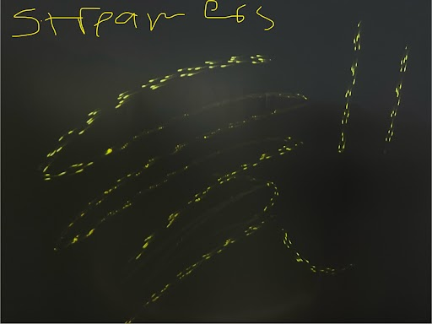
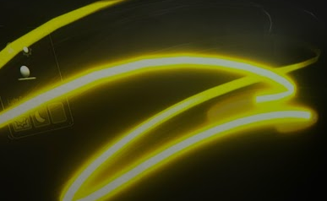



Tilt Brush - brush options
Electricity
Streamers
Neon Pulse
Cel Vinyl
Chromatic Wave
Dots

Slide 12







Tilt Brush - brush options
Dr. Wigglez
Petal
Icing
Coarse Bristles
Hypercolour
Bubbles
Spikes
Lofted
Hyper Grid
Light Wire
Shiny Hull
Matte Hull

Slide 13






Tilt Brush - brush options
Wire
Toon
Dr. Wigglez
Coarse Bristles
Hypercolour
Bubbles
Disco
Comet
Hyper Grid
Light Wire
Unlit Hull
Diamond

Slide 14
Learning stations
Working in small groups
01
IMVR station: Tilt Brush/Open Brush
Work in pairs or small groups (up to 3)
Do a warm-up in Tilt Brush/Open Brush and explore brushes and tools.
Take notes in digital notebook.
02
Viewing station: View 3D art models
Check student digital notebook.
Scan QR codes with tablet or follow the link.
View 3D art models.
Respond to questions.
03
Notes and reflection station: Student digital notebook
Complete all required notes and reflections on the digital notebook.

Slide 15
Learning stations
Working in small groups
01
IMVR station: Tilt Brush/Open Brush
Work in pairs or small groups (up to 3)
Do a warm-up in Tilt Brush/Open Brush and explore brushes and tools.
Take notes in digital notebook.
02
Viewing station: View 3D art models
Check student digital notebook.
Scan QR codes with tablet or follow the link.
View 3D art models.
Respond to questions.
03
Notes and reflection station: Student digital notebook
Complete all required notes and reflections on the digital notebook.

Slide 16
IMVR station: Art warm-up
Explore the Tilt Brush/Open Brush app
Which tools did you and your partner/s use for your art warm-up?
Which brushes did you and your partner/s use for your art warm-up?
Which colours did you and your partner/s use for your art warm-up?

Slide 17
IMVR station: Art warm-up
Explore the Tilt Brush/Open Brush app
Share photos of your / your partner/s final art warm-up piece. Make sure to label the photos.

Slide 18

Viewing station: 3D art
View 3D art created in Tilt Brush using personal devices.
Answer the following questions:
What digital artwork did you see?
How did it make you feel?
In your opinion, which tools/brushes were used? Why do you think the artist used those tools/brushes?
How could you add/built on this artwork?
Summer is over by Rein Bijlsma
https://skfb.ly/SHLD

Slide 19

Viewing station: 3D art
View 3D art created in Tilt Brush using personal devices.
Answer the following questions:
What digital artwork did you see?
How did it make you feel?
In your opinion, which tools/brushes were used? Why do you think the artist used those tools/brushes?
How could you add/built on this artwork?
Tilt Brush Orange by Gabriel Martzloff
https://skfb.ly/6snUB

Slide 20

Viewing station: 3D art
View 3D art created in Tilt Brush using personal devices.
Answer the following questions:
What digital artwork did you see?
How did it make you feel?
In your opinion, which tools/brushes were used? Why do you think the artist used those tools/brushes?
How could you add/built on this artwork?
Red Bird by Lintu
https://skfb.ly/UtPJ

Slide 21

Notes and reflection station
Watch this video and reflect.

Slide 22
Notes and reflection station
Explore the Tilt Brush/Open Brush app.
In the video that you watched, briefly explain the process that the artist went through to get his final art creation.
What did you think about this process? Did it give you any ideas about your own art-making process?
How would you like to use Tilt Brush/Open Brush in your art-making?

Slide 23
Notes and reflection station
Explore the Tilt Brush/Open Brush app.
Using any drawing app that you have in your computer, draw a 2D image of something that you would like to create in 3D. Add the 2D the image here. What drawing app and tools did you use? What did you like/not like about it?

