Slide 1
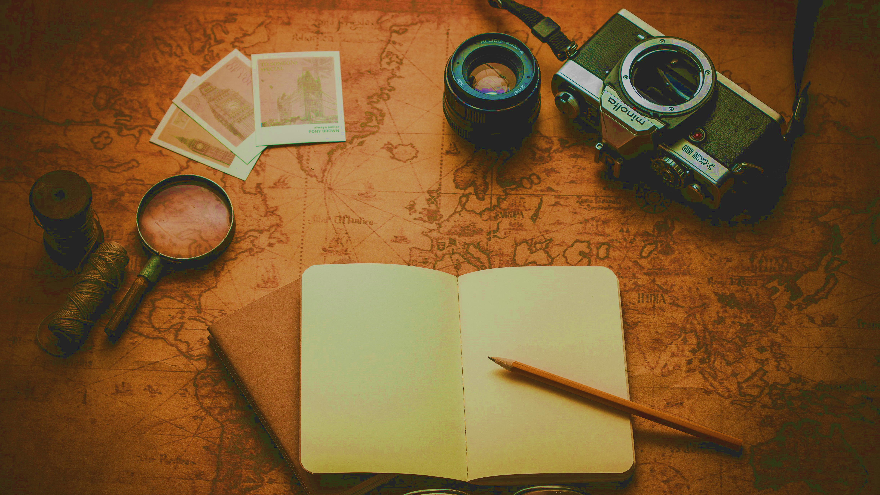

STUDENT DIGITAL NOTEBOOK
Where in the World: Europe & North America
Student Name:

Slide 2

Your Travels
Name a place you’ve been to and share a memorable experience.
Share a place you’ve visited and a memorable experience. What made the experience memorable? Is it because you liked how it looked? How it made you feel? Or how it connected with your beliefs?
Add a photo from or drawing about that experience in this section.

Slide 3
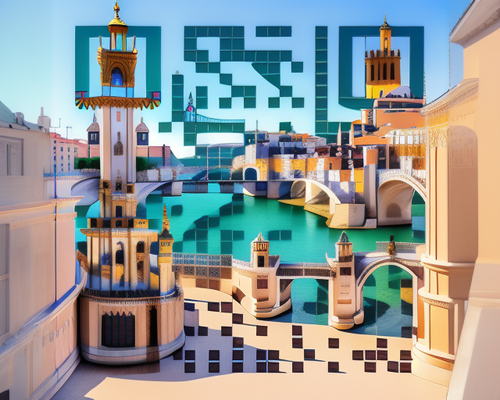
Visit Europe
Write about what you saw in the VR tour of Europe. Share what you liked or disliked about what you saw. Identify if what you like is connected to aesthetics (how it looks), emotion (how it feels), or spiritual (how it connects with your beliefs).
Write about your VR experience here.
What type of environment is it?
Natural environment
Built environment
I connected with the place because (choose all that applies):
I like how it looks (aesthetics)
I like how it made me feel (emotion)
I like how it connects me with my beliefs (spiritual)
Visit Europe https://bit.ly/4aaL1M6

Slide 4
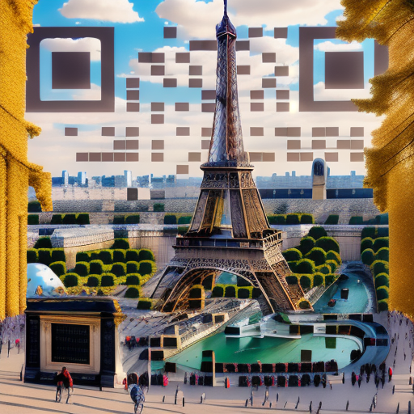
Visit Paris
Write about what you saw in the VR tour of Europe. Share what you liked or disliked about the place. Identify if it’s a natural or built environment and if what you like is connected to aesthetics (how it looks), emotion (how it feels), or spiritual (how it connects with your beliefs).
Write about one place from your VR experience here.
What type of environment is it?
Natural environment
Built environment
I connected with the place because (choose all that applies):
I like how it looks (aesthetics)
I like how it made me feel (emotion)
I like how it connects me with my beliefs (spiritual)
Escape Now To Paris
https://bit.ly/47NpEyw

Slide 5
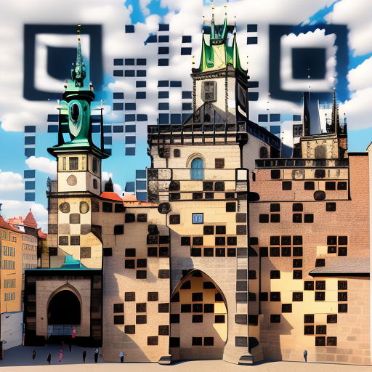
Visit Prague
Write about what you saw in the VR tour of Europe. Share what you liked or disliked about the place. Identify if it’s a natural or built environment and if what you like is connected to aesthetics (how it looks), emotion (how it feels), or spiritual (how it connects with your beliefs).
Write about one place from your VR experience here.
What type of environment is it?
Natural environment
Built environment
I connected with the place because (choose all that applies):
I like how it looks (aesthetics)
I like how it made me feel (emotion)
I like how it connects me with my beliefs (spiritual)
Visit Prague
https://bit.ly/47E1irg

Slide 6
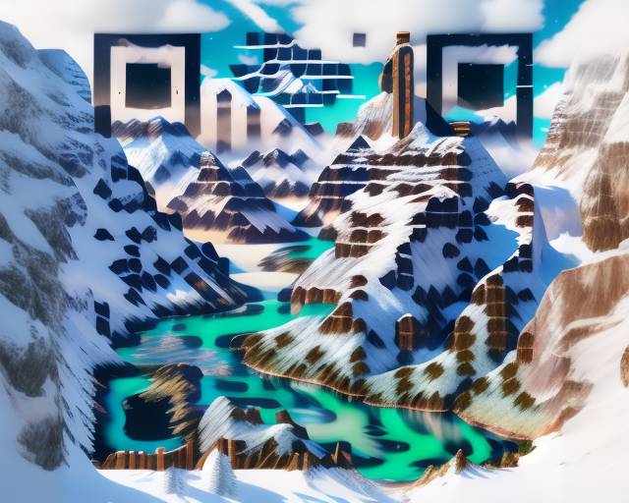
Visit North America
Write about what you saw in the VR tour of Europe. Share what you liked or disliked about the place. Identify if it’s a natural or built environment and if what you like is connected to aesthetics (how it looks), emotion (how it feels), or spiritual (how it connects with your beliefs).
Write about one place from your VR experience here.
What type of environment is it?
Natural environment
Built environment
I connected with the place because (choose all that applies):
I like how it looks (aesthetics)
I like how it made me feel (emotion)
I like how it connects me with my beliefs (spiritual)
Visit North America
https://bit.ly/47Xy5qY

Slide 7
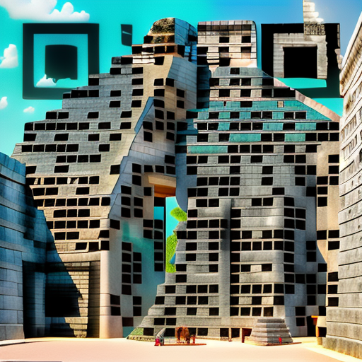
Visit Mexico
Write about what you saw in the VR tour of Europe. Share what you liked or disliked about the place. Identify if it’s a natural or built environment and if what you like is connected to aesthetics (how it looks), emotion (how it feels), or spiritual (how it connects with your beliefs).
Write about one place from your VR experience here.
What type of environment is it?
Natural environment
Built environment
I connected with the place because (choose all that applies):
I like how it looks (aesthetics)
I like how it made me feel (emotion)
I like how it connects me with my beliefs (spiritual)
Visit Mexico
https://bit.ly/47NWQps

Slide 8
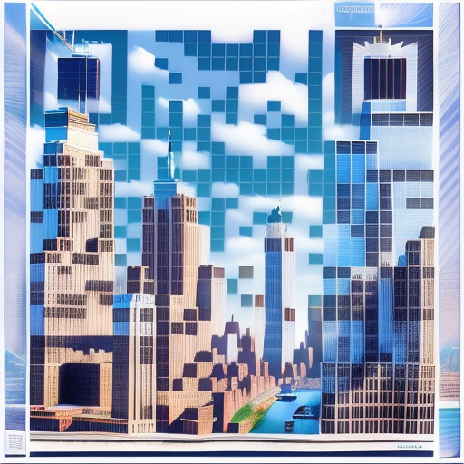
Visit New York
Write about what you saw in the VR tour of Europe. Share what you liked or disliked about the place. Identify if it’s a natural or built environment and if what you like is connected to aesthetics (how it looks), emotion (how it feels), or spiritual (how it connects with your beliefs).
Write about one place from your VR experience here.
What type of environment is it?
Natural environment
Built environment
I connected with the place because (choose all that applies):
I like how it looks (aesthetics)
I like how it made me feel (emotion)
I like how it connects me with my beliefs (spiritual)
Visit New York
https://bit.ly/3Rmy4qT

