Slide 1
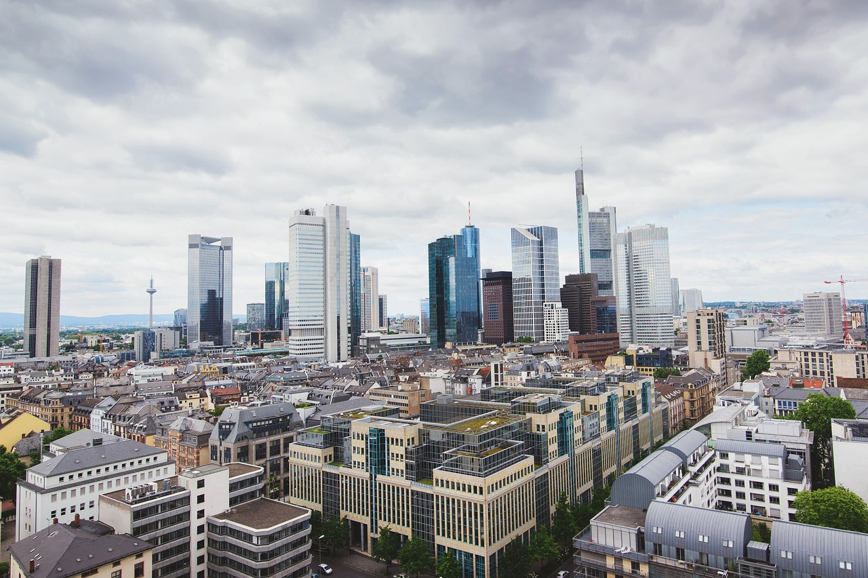


DIGITAL NOTEBOOK
Urbanisation and the Future of Cities
Student Name:

Slide 2

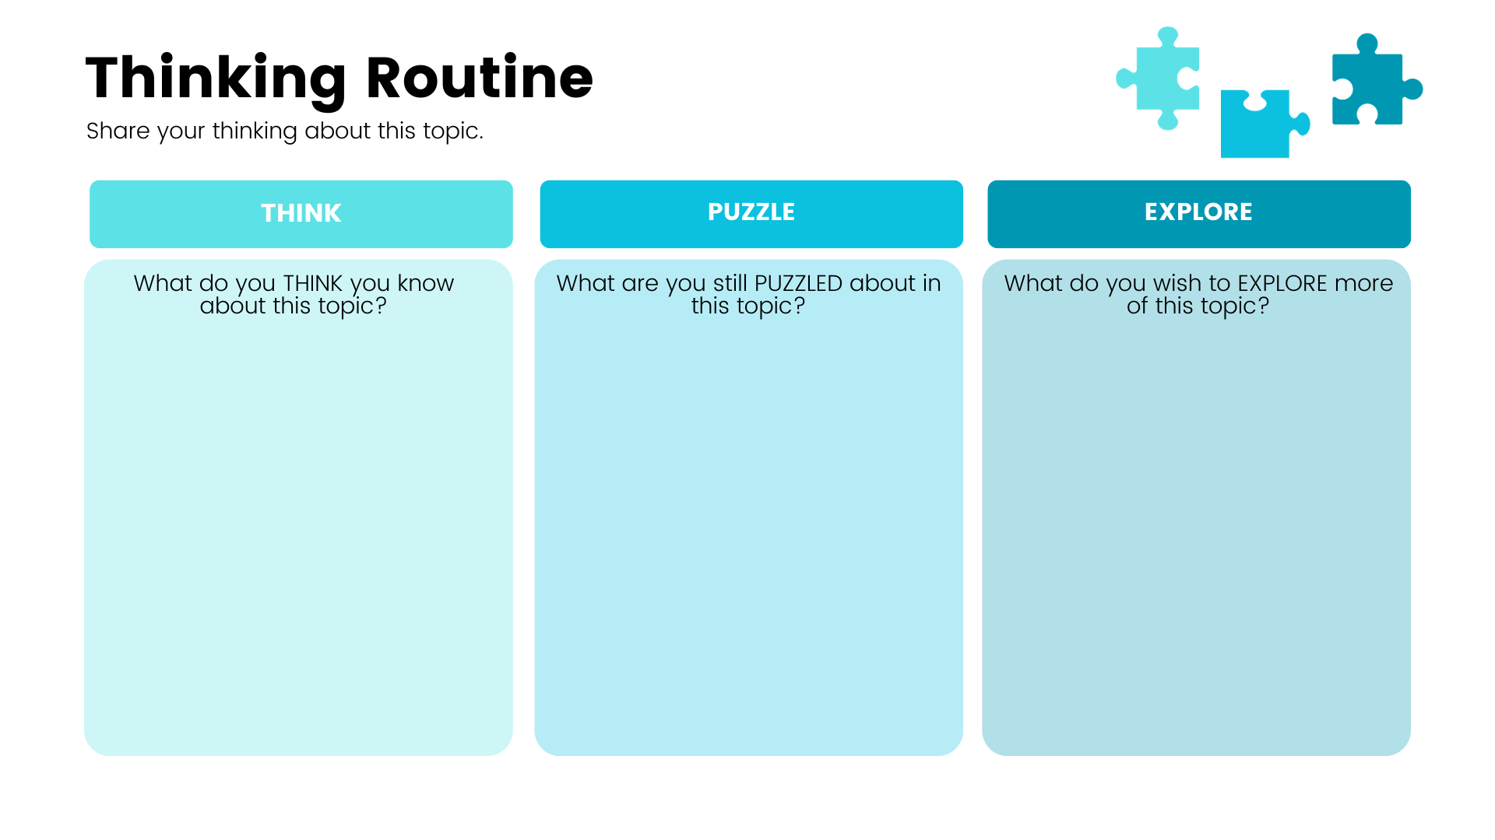
Write your answer here.
Write your answer here.
Write your answer here.

Slide 3

HHVR Video 1
View the following VR Video and and write down what you have learnt about urbanisation.
I have learnt…
How Will We Live In Tomorrow’s Cities
bit.ly/urbanisation23

Slide 4

HHVR Video 2
View the following VR Video and take notes on the positive and negative impacts urbanisation has on the human experience.
Positive Impacts | Negative Impacts
Shanghai, China
bit.ly/chinavr360

Slide 5
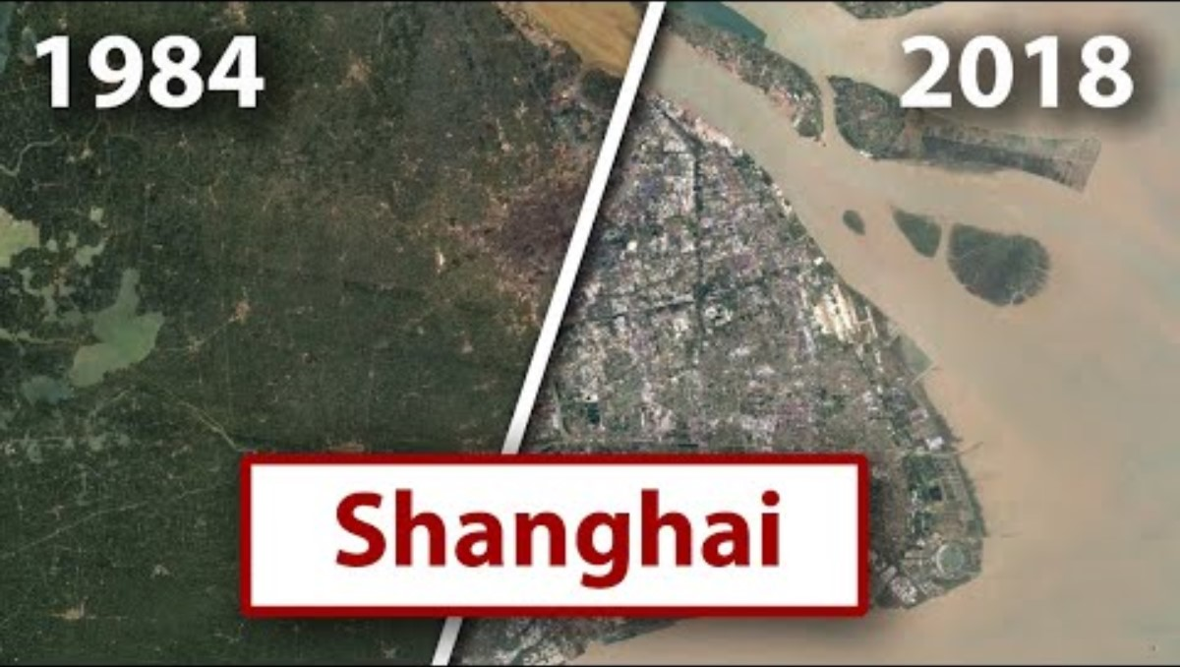
40 Years of Urbanisation
View the following video and answer the questions on the next page.

Slide 6
40 Years of Urbanisation
What changes did you notice in each city from 1984 to now?
How might these changes have impacted people over time?
Why do you think urbanisation has happened in these cities?

Slide 7
My Definition
In two sentences, write your own definition of ‘urbanisation’.
Write your definition here.

