Slide 1

TEACHING DECK
Cosmic archaeology: the age of the universe
Learn about the features and scale of the universe through research and handheld VR.

Slide 2

What do you know about the universe?
Collaboration board

Slide 3
What do you know about the universe?
Collaboration board discussion
What are some things you know about the Universe?
What would you like to find out about?

Slide 4
Learning stations
Working in small groups
01
HHVR: Archeology of Light 360°
Use: Student Digital Notebook
Take note of the most astounding fact you learn from this experience.
02
Watch: The Most Astounding Fact
Use: Student Digital Notebook
How did the most astounding fact compare with your reflection from slide 6?
03
Research and Reflection:
Research and reflect on the evidence that supports the Big Bang theory for the evolution of the universe.

Slide 5
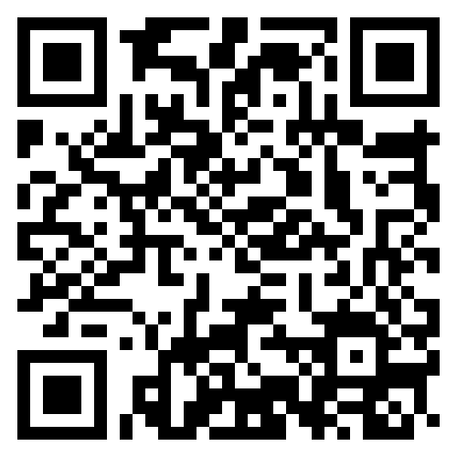
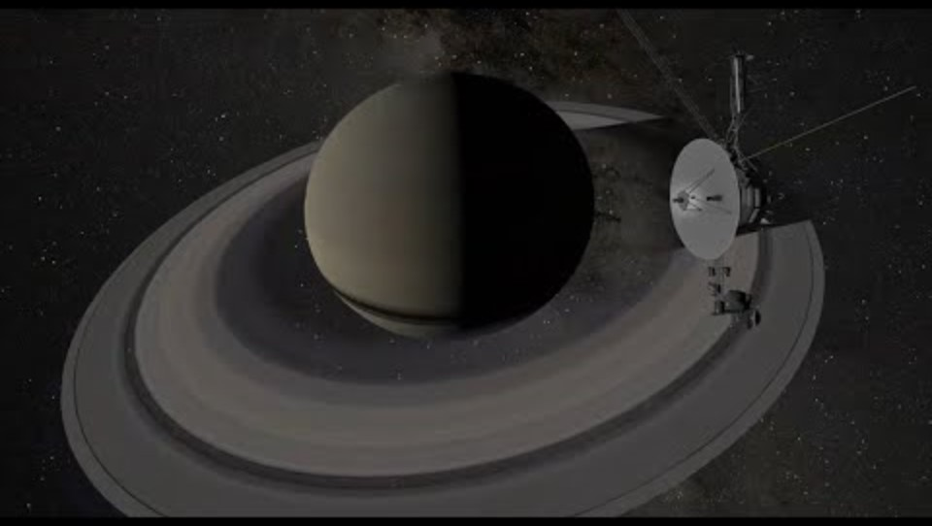
Archaeology of light 360°
Station 1 - HHVR. Watch from 5.25 - 12.38 to explore the Solar System and Milky Way Galaxy.
Archaeology of Light 360°(21:42)

Slide 6
Archaeology of light 360°
Reflection
What did you think was the most astounding fact you discovered in this experience?
How does the information presented in the video relate to our understanding of the universe and its vastness?
How do you think our understanding of the universe has evolved over time, and how might this evolution influence our approach to teaching and learning about space science?
In the video, we learn about the Big Bang Theory, which suggests the universe began as a hot, dense point and expanded over billions of years. How does this theory explain the origins of the universe, and what evidence supports it?

Slide 7
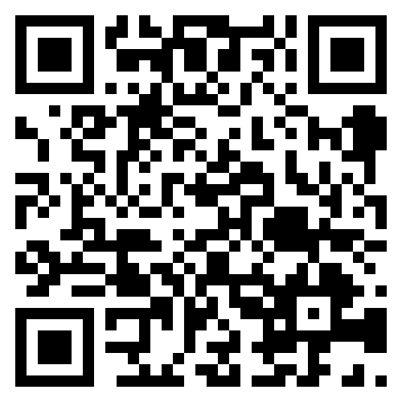
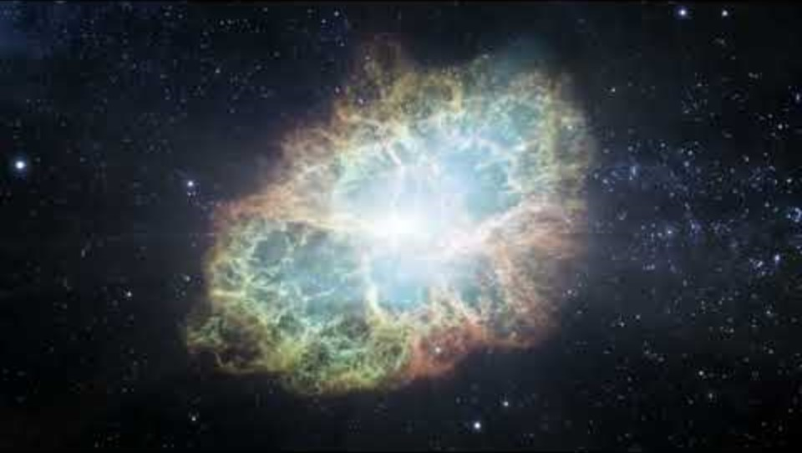
Watch
Station 2: The Most Astounding Fact - Dr Neil DeGrasse Tyson (3:55)
Watch the following video. How did his answer compare to your answers in your reflection?
The Most Astounding Fact - Dr Neil DeGrasse Tyson (3:55)

Slide 8
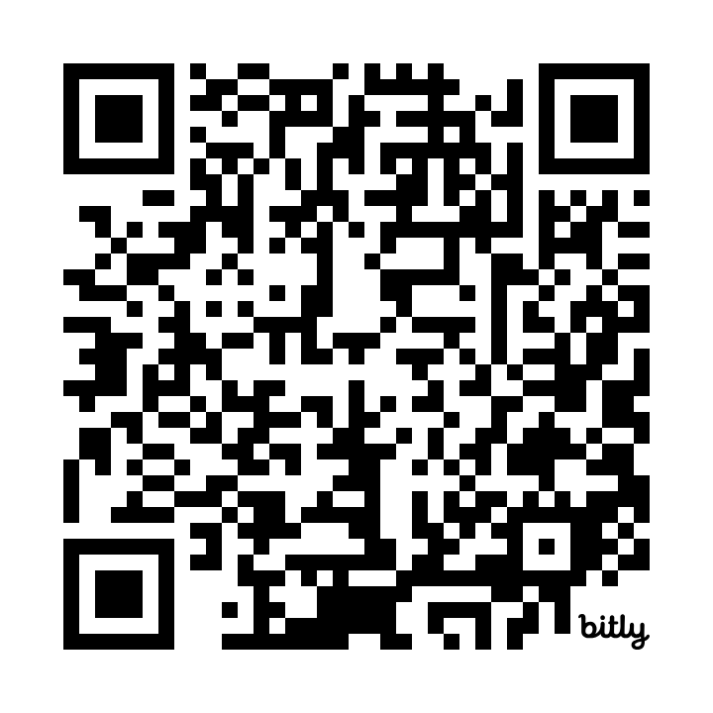
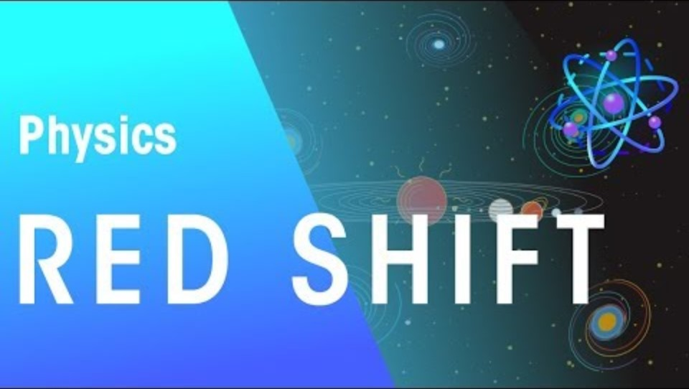
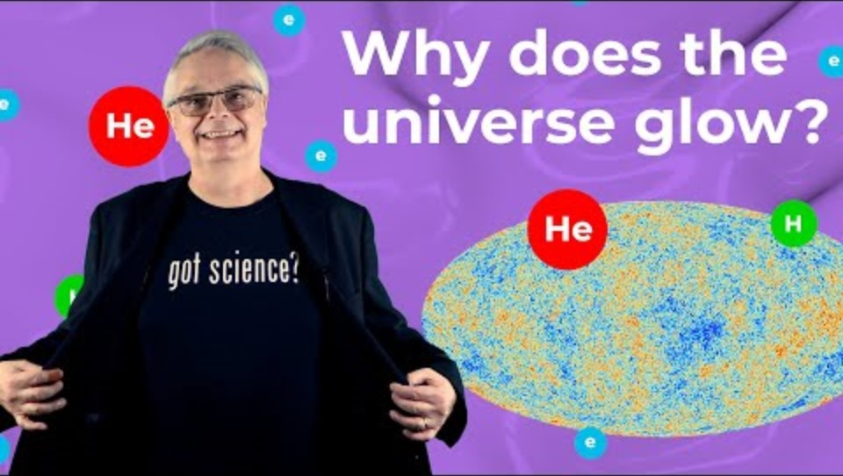
Research and reflection
Use the following videos to aid your research
Red shift | Astrophysics | Physics | FuseSchool
What is the Cosmic Microwave Background?

Slide 9
Research and reflection:
Research and reflect on the following questions in your digital notebook.
If you could rewind time like a movie and watch the universe's birth, what do you think you'd see? How does this idea of a cosmic explosion help us understand where everything came from?
When astronomers look at distant stars and galaxies, they notice they look redder than expected. Why do you think this happens? And how does this simple color change help us know the universe is getting bigger?

Slide 10
Research and Reflection:
Research and reflect on the following questions in your digital notebook.
What is Cosmic Background Microwave Radiation?
How does red shift and cosmic background microwave radiation provide evidence for the Big Bang theory?

Slide 11
Research and reflection:
Research and reflect on the following questions in your digital notebook.
How does the evidence, in your eyes, support the Big Bang theory?

